Slide 1
EMPLOYABILITY CONFERENCE 2022
Employability: expanding the narrative for a rapidly changing world – continuing the conversation
22 MARCH 2022
Follow us on Twitter:
@OUemployscholar
#OUemployconf2022
All poster presentations can be viewed on the conference website

Slide 2
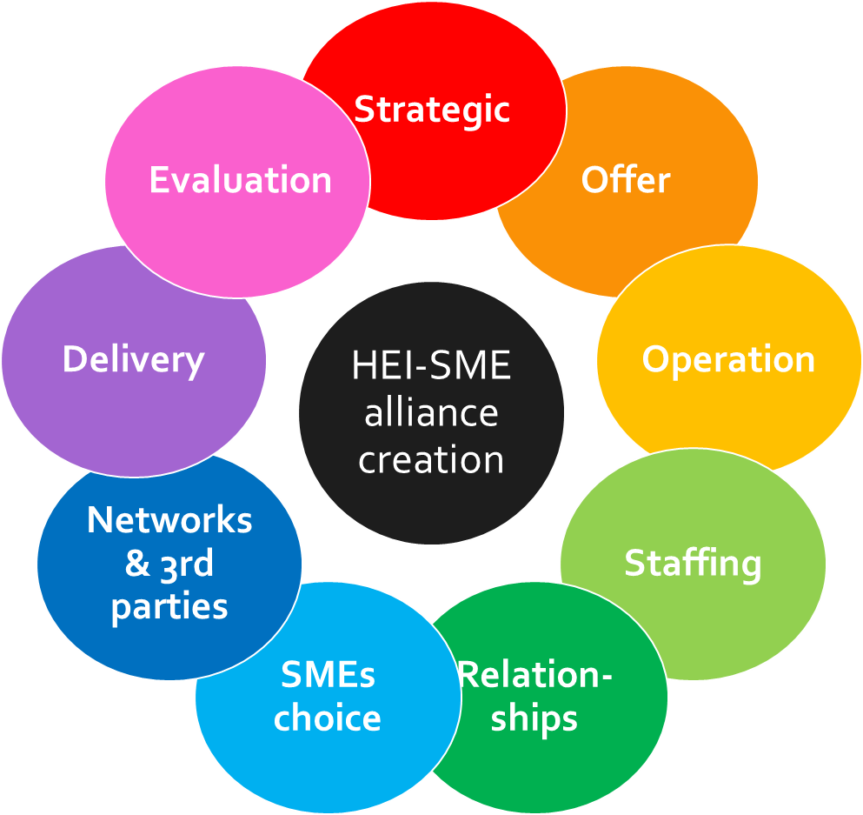
How higher education institutions (HEIs) create alliances with small & medium enterprises (SMEs) Katie McAllister: HE Manager Business & Education, and EdD doctorate researcher, University Centre Peterborough
Introduction
HEIs wishing to support graduates’ outcomes, employability opportunities, entrepreneurship and their local economy must forge links with business and, in particular, SMEs.
The current practices being introduced by individual HEIs to survive and develop in this competitive market whilst meeting state- and local-initiated requirements, are still being developed, leaving many HEIs or HEI schools grappling with how to enact this expectation.
Study purpose
To develop an effective conceptual framework of HEI-SME alliance creation for HEIs that provides theoretical and empirical basis for the future development
Main research question (RQ): What conclusions can be drawn to develop a conceptual framework regarding how HEIs create alliances with SMEs?
Theoretical framework
The literature review indicated 9 thematic elements linked to the HEI-SME alliance creation yet there is no current research considering the wider HEI-SME alliance creation elements to support those HEIs new to the creation of alliances with SMEs.
The HEI-SME phenomena is complex, linking multiple disciplines from which I have identified a pattern of representative integral elements (Mishler, 1990).
Research design
Ontology: Interpretivism; Epistemology: Subjectivism
Methodology: Case study (Yin, 2003)
Participants: The 16 Office of Students Challenge Fund recipients across England; local business networks e.g. Chamber of Commerce
Method:
Document review of HEI documents in the public domain
Questionnaires with HEI staff within employer engagement roles
Semi-structured interviews with HEI staff within employer engagement roles
Questionnaires with SMEs within the region
Ethics: approval granted
Pilot: With Further Education (FE) colleges & business representative
Figure 1: Theoretical conceptual framework (TCF) of HEI-SME alliance creation
Author: Katie McAllister. Not to be copied or shared without author’s permission.

Slide 3
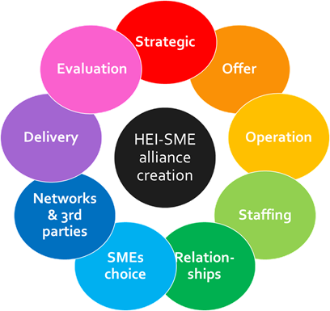
How higher education institutions (HEIs) create alliances with small & medium enterprises (SMEs) Katie McAllister: HE Manager Business & Education, and EdD doctorate researcher, University Centre Peterborough
Pilot results
Further Education colleges
Planning for SMEs is dominated by marketing mechanisms (44%), communication (44%), evaluating impact for SME (33%)
Minimal planning is considered for staffing & skill development (11%), addressing SME/FE cultural differences (11%), 3rd party networking (11%).
No targets are set for SME selection, project management, specific resourcing
Websites – limited information to engage SMEs
Interviews - Employer engagement teams work in silo, reactive rather than proactive, curriculum contention, local govt. does not promote SME alliance creation with local educators, apprenticeship policy contentions
Business representative
HEIs are not part of SME networks, SMEs are unclear of HEI offer
HEIs are not a high consideration for SMEs when looking at training/support, cannot see how HEIs can help, do not see value in engaging with HEIs beyond R&D
SMEs are unsure of how to engage, too much red tape, no funding to support engagement
Pilot recommendations
Require a checklist & guide for educational establishments covering with 9 key elements
Strategic – specific SME engagement & objectives
Offer –diverse opportunities, SME awareness of
Operation – procedures, flexible, red tape
Staffing – duties, support, training, role conflicts
Relationships – cultural differences, communication
SMEs selection – selection criteria, SME capability
Networking – brokers, agencies, intermediaries
Delivery – infrastructure, resources, procedures, tools
Evaluation – value assessment; monitoring mechanisms
Recommendations for policy
Government policy makers to address the marginalisation of SMEs within apprenticeships
LEPs to help address the fundamentally differences between educators and SMEs
Government to address the rhetoric of government (and European policy) and the real world of educators and SMEs
Figure 1: TCF of HEI-SME alliance creation
Author: Katie McAllister. Not to be copied or shared without author’s permission.
Pilot limitations
This sample set will not be representative of HEIs and SMEs.
The regional locality and FE context may have identified differing underlying characteristics.
References
Mishler, E. (1990) ‘Validation in inquiry-guided research: The role of exemplars in narrative studies’, Harvard Educational Review. Harvard Education Publishing Group, 60(4), pp. 415–443. doi: 10.17763/haer.60.4.n4405243p6635752
Yin, R. K. (2003) Case study research: Design and methods. 3rd Edition. Thousand Oaks, California: SAGE Publications

Slide 4
EMPLOYABILITY CONFERENCE 2022
Employability: expanding the narrative for a rapidly changing world – continuing the conversation
22 MARCH 2022
Follow us on Twitter:
@OUemployscholar
#OUemployconf2022
All poster presentations can be viewed on the conference website

Slide 5
The Next Chapter: understanding the career aspirations of students on the MA in Creative Writing
Almost 500 students enrolled across two MA modules. Highly regarded, successful outcomes recorded
Scholarship project investigated career ambitions, employability engagement and support
Students develop their craft through professional practice, vocational competencies, peer feedback
167 responses (35% of students surveyed) across three cohorts of MA Creative Writing parts 1 & 2
For further information about this project, please contact claire.blanchard@open.ac.uk

Slide 6
FASSTest project investigating MA Creative Writing career aspirations May ’21-March ‘22
51% have identified employability strengths
71% have not yet used the service
22% plan to use the OU Careers service
‘I’d like to write alongside teaching in HE’
‘I am doing it hoping for a career change’
The project team will develop an action plan to enhance employability for writing and broader career motivations

Slide 7
EMPLOYABILITY CONFERENCE 2022
Employability: expanding the narrative for a rapidly changing world – continuing the conversation
22 MARCH 2022
Follow us on Twitter:
@OUemployscholar
#OUemployconf2022
All poster presentations can be viewed on the conference website

Slide 8
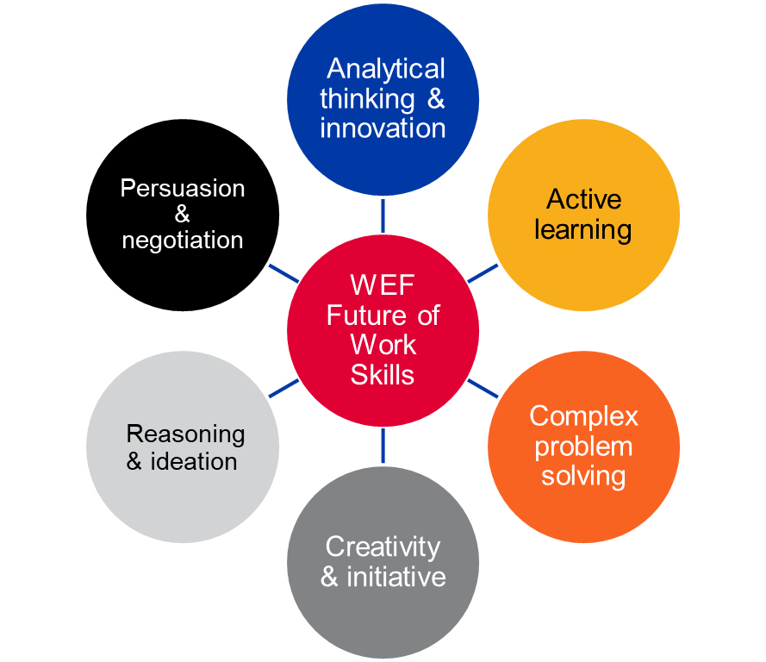
Blending Boundaries: A transdisciplinary approach to enhance future-facing employability Laura Brammar, Senior Careers Consultant, University of London Careers Service – laura.brammar@careers.lon.ac.uk
Introduction
The University of London Careers Service (ULCS) provides a global, virtual careers service to approximately 45,000 distance and flexible learning students, based in 180 different countries around the world, studying over 100 different academic programmes, UG & PG. Our students also represent a diverse range of work place experience, as illustrated by our Career Stage Framework approach (Brammar & Wilkinson 2022). Due to its significant diversity, our student cohort is by definition transdisciplinary. We were eager to capitalise on this to enhance our careers and employability education programme, and to best prepare our learners for their respective labour markets. Whilst transdisciplinary approaches originated within academia (Rosenfield, 1992), they are increasingly important within the future workplace, specifically in terms of key skills (such as those highlighted in the WEF (2020) Future of Jobs report – see Figure One), the complexity of modern professional teams and in terms of the interface with the 4IR. For this reason we launched the Blending Boundaries programme.
Blending Boundaries Programme
We launched a series of three webinars, each focused on a different topic: Wicked Problems, UN Sustainable Development Goals and a sample Business Case Study. In each webinar, the students collaborated in virtual teams in breakout rooms, examining the topic through their three different transdisciplinary lenses: their academic lens (programme of study), their lived experience lens (place/culture) and their careers stage (career starter, career developer or career changer – see Figure 2. After their discussions, the students shared their agreed priorities and reflected on the skills they had developed, including intercultural communication.

Slide 9
Blending Boundaries: A transdisciplinary approach to enhance future-facing employability Laura Brammar, Senior Careers Consultant, University of London Careers Service – laura.brammar@careers.lon.ac.uk
What did we learn?
The Blending Boundaries programme has attracted students from over 32 different study programmes, both at UG and PG level. Evaluation data has been very positive with 100% of students who participated in the sessions recommending the sessions to fellow students and 88.2% of participants reporting that the Blending Boundaries programme was either ‘Useful’ (23.5%) or ‘Very Useful’ (64.7%) to their ‘ongoing career and employability development’. Qualitative feedback on the sessions was also positive: Very useful. My fellow student changed my mind The discussion helped me understand different countries’ situations and needs I think it lets you see different angles of lives and problems I enjoyed it. Particularly different perspectives coming from different backgrounds and career stages As ULCS, we have learned that our students are eager and able to apply their academic learning, life experience and careers stage experience to explore real world issues and enhance their employability skills, such as complex problem-solving.
What next?
We now see this initial Blending Boundaries Series as a successful ‘proof of concept’ stage of the project and are looking forward to expand this transdisciplinary approach to a wider range of cohorts and settings. One approach will be to engage students from across a range of different institutions within the University of London, from medical schools to specialist art institutions, to extend the transdisciplinary approach even further. We would also like to engage with a range of employers, whom might provide case studies for future sessions, in addition to linking to the enterprise agenda.
References
Brammar, L. & Wilkinson, L. (2022) Careers Stage Framework: Meeting students where there are in their employability journey, Phoenix – AGCAS Professional Journal, February 22, Issue 164 WEF (2020) Future of Jobs Report, World Economic Forum Rosenfield PL.(1992) The potential of transdisciplinary research for sustaining and extending linkages between the health and social sciences. Social Science and Medicine. 35 (11)

Slide 10
EMPLOYABILITY CONFERENCE 2022
Employability: expanding the narrative for a rapidly changing world – continuing the conversation
22 MARCH 2022
Follow us on Twitter:
@OUemployscholar
#OUemployconf2022
All poster presentations can be viewed on the conference website

Slide 11
Practical Teaching Adjustments for Increasing Employability in Study and Assessment (part I)
Quick-ish wins for adding employability relevance to your teaching and assessment resources
Contextualise and Incentivise
Examples
Swap:
Independent and exclusive teaching / question scenarios
For:
Joining up questions within a case study / future employment context
Use real-world contexts (as is, or adapted)
Fictional contexts but with relatable scenarios / models
State a Role: Consultant, Manager, Specialist
Name a Recipient: Client, Judge, Director…
Specify their information needs
State how they want to benefit from the output
Swap:
Generic/Technical Content
For:
Specific and relatable scenarios, problems, opportunities
Swap:
Marks
For:
Money, Reward, Status, Future opportunity
Client Fee; Future Contract; Prize; Something that gives employment / work-related / motivational impetus

Slide 12
Practical Teaching Adjustments for Increasing Employability in Study and Assessment (part I)
Quick wins for adding employability relevance to your teaching and assessment resources
Practical Teaching Adjustments for Increasing Employability in Study and Assessment (part I)
Quick-ish wins for adding employability relevance to your teaching and assessment resources
It’s not what they do, but the how they do it
Examples
Swap:
Requiring only data / knowledge production
For :
Use of real-world / best practice communication of information
Require use of the outcome in accordance with role, client, context, purpose …and not just to produce it
State how to present: report / forms / other real-world / best practice formats
Model, Replicate, Repeat: how to present and communicate in the real-world – vocab, process, style
Swap:
Essays / MCQ /
Short Answers
For :
Audience-focussed content & communication
Swap:
What to do
For :
How to do it
Groups: permit depth & breadth in exploration, output & collaboration; appreciate working styles & perspectives of other stakeholders; opportunity for self-realisation
Joanne Abraham – j.m.abraham@exeter.ac.uk
Questions & Further discussion welcomed

Slide 13
EMPLOYABILITY CONFERENCE 2022
Employability: expanding the narrative for a rapidly changing world – continuing the conversation
22 MARCH 2022
Follow us on Twitter:
@OUemployscholar
#OUemployconf2022
All poster presentations can be viewed on the conference website

Slide 14
TITLE: INFLUENCES ON CONCEPTIONS, PERCEPTIONS AND EXPERIENCES OF EMPLOYABILITY
Rationale for the research:
Employability remains a priority as the HE sector is increasingly marketised and competitive (see eg Arora, 2015; Pucciarelli and Kaplan, 2016)
Government and industry drivers to hold HEIs accountable for employability (Office for Students, 2021)
However, a lack of qualitative research exploring the lived experiences of constituent groups
Research methodology and analysis: Interpretative Phenomenological Analysis (IPA) uncovered rich data. A number of themes emerged, identified below:
Super-ordinate themes | Subordinate themes
Understanding employability
The Ubiquity of Change | The purpose of a university Employability and loss of agency Fractured academic identity
Differences and divides | Subject-specific issues Two camps
One size does not fit all
Employability as a process | Additional pressures Promoting employability
The research
approach:
Qualitative, semi-structured
Interviews
Identification of views, understanding, beliefs = institutional conversations
Group 3: On the ground implementation / front line academics
Groups 1 and 2: Strategic development
Principal lecturer (PLs)
Critical subjects
Senior leaders
Career-focused subjects

Slide 15
Findings: What are the influences on perceptions and conceptions of employability?
Recommendations for HE institutions:
1. Facilitate the development of local strategies and policies
2. Bridge the gaps in perception between staff groups within HEIs
3. Avoid a top-down approach to employability policy development and implementation
4. Involve students in the development of initiatives
5. Development staff development opportunities
Perceptions and conceptions of employability
Philosophy of education
Previous experience
Subject / discipline area
The nature of the institution (employer)
The social and political context
Findings: Exploration of experiences
References
Arora, B. (2015) A Gramscian analysis of the employability agenda. British Journal of Sociology of Education, 36 (4), pp.635 – 648
Pucciarelli, F and Kaplan, A (2016) Competition and Strategy in higher education: Managing complexity and uncertainty. Business Horizons, 59 (3), pp.311 – 320
Office for Students (2021) What we do [Accessed 14 March 2022]. Available at: <https://www.officeforstudents.org.uk/about/our-strategy/>
A complex picture, experienced as part of a wider change process
Experience of employability policies as surveillance and auditing
Impact on academic identity and loss of control

Slide 16
EMPLOYABILITY CONFERENCE 2022
Employability: expanding the narrative for a rapidly changing world – continuing the conversation
22 MARCH 2022
Follow us on Twitter:
@OUemployscholar
#OUemployconf2022
All poster presentations can be viewed on the conference website

Slide 17
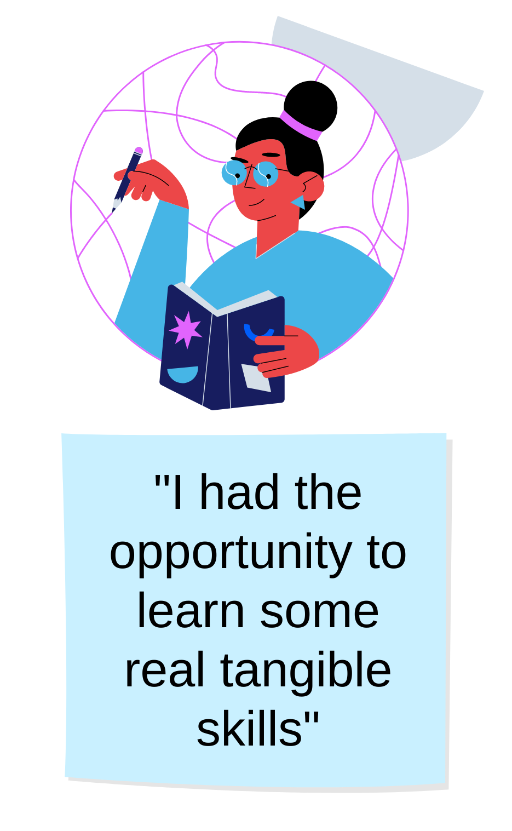
GROW & GO Wales – Employability programmes in Wales
The Open University in Wales is committed to supporting students and graduates achieve their career and personal goals, as well as supporting employers with their recruitment needs. In Wales, we have two specialist projects which offer the opportunity for students and graduates, who may face additional barriers, to undertake work experience placements with employers from a variety of sectors.

Slide 18
GROW
GO Wales
Paid, fully funded work experience placements to increase skills and confidence
Open to OU in Wales graduates who graduated during the pandemic
Unpaid work experience that can be online or in person
For students aged 25 and under
Set up in response to the pandemic and the impact on graduates
For graduates who are unemployed or under employed
Students can choose to meet a professional in a field that interests them
Develops employability skills
Graduates can access careers support to prepare for their next steps and achieve their goals
Working in partnership with OU Careers and Employability Services and employers
A work taster (up to 4 weeks) or work shadowing (up to 3 days) can be arranged
Improves chances of obtaining sustainable, long-term, graduate-level employment

Slide 19
EMPLOYABILITY CONFERENCE 2022
Employability: expanding the narrative for a rapidly changing world – continuing the conversation
22 MARCH 2022
Follow us on Twitter:
@OUemployscholar
#OUemployconf2022
All poster presentations can be viewed on the conference website

Slide 20
A student guide to Employability
In the fashion industry
HE Agenda
Graduate Outcomes
Employability in the curriculum
Co-curricular project
Students as research partners
Career opportunities in the fashion industry
Effective research model
Powerful student narrative/ teaching material
Personal development gained by engaging in the project
Self Promotion strategies
Job search and tips

Slide 21
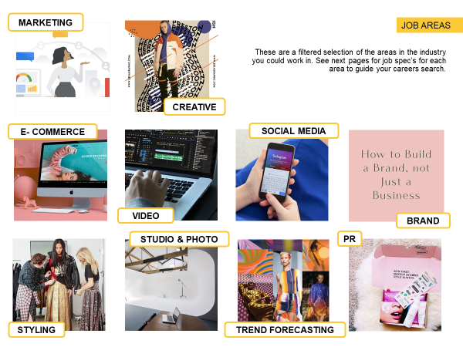
Resources
and student reflections
Creating, as well as using this guide, was pivotal to my professional development.
The value of understanding the industry as a whole and the individual areas I could pursue, gave me more options for my future than I thought existed. Not only have I re-created my CV, streamlined my graduate job search and re-visit my personal branding but I have found extra courses to complete over the summer. Posting on LinkedIn and The Dots has become a regular way to network, growing my confidence and my connections simultaneously. I advise everyone to read through the job specifications, figure out where you fit in the industry and take a deeper look at your personal brand, to put your professional face forward to a successful graduate job search.
Lisa Trencher, Senior Lecturer Fashion Business , Employability Lead

Slide 22
EMPLOYABILITY CONFERENCE 2022
Employability: expanding the narrative for a rapidly changing world – continuing the conversation
22 MARCH 2022
Follow us on Twitter:
@OUemployscholar
#OUemployconf2022
All poster presentations can be viewed on the conference website

Slide 23
Pro Bono Employability Project – Does participation in live criminal appeals work improve student employability skills?
The Open University (OU)
Our mission is to be open to people, places, methods and ideas.
Our vision is to reach more students with life-changing learning that meets their needs and enriches society.
The OU Law School offers 3 routes to the LLB, which is open to all and provides module and extra curricula activities such as Open Justice.
Open Justice Centre
Provides free legal advice and guidance to those who may struggle to access legal support.
By
Emma Curryer (emma.curryer@open.ac.uk)
Carol Edwards (carol.edwards@open.ac.uk)
The Open University Law School
Criminal Justice Clinic
Set up in 2021 to provide students with the opportunity to experience criminal practice and work on a case management system and further social justice.
Further Information
Student Blog - Journey into the unknown - Journey into the unknown | Open Justice
Themes of clinic
Social justice, professional identity, ethics and values.
What students do
Research serious criminal cases, providing advice and guidance in relation to the possibility of appeal.
Live criminal cases
Examples of recent cases include murder, manslaughter, firearm offences and serious assaults.
Develop employability skills
For example, legal writing, research, professional ethics, negotiation, workload management and collaboration.

Slide 24
Pro Bono Employability Project – Does participation in live criminal appeals work improve student employability skills?
Aims
Identify the employability skills that students perceive they have when they commence the project
Identify whether students perceive they have developed their employability skills by taking part in the project
Our Research Project
A pro bono employability project to establish employability outcomes for students participating in Open University pro bono criminal projects.
How students rated their skills
Students generally confident in the employability skills identified
Students' key concerns were based around the skills of managing and organising meetings and negotiation of workload
Initial Findings From Questionnaire 1
Key employability skills
For students the most important employability skills for a legal career are communication and teamwork
Teamwork & time management were identified as the employability skills most needed in clinic
Emerging themes
Looking forward to the experience of a clinic
Looking forward to using legal skills they acquired
Making informed career choices
Lacking confidence in their ability to take an active part in the clinic and manage workload
Method
Two questionnaires issued to students at the beginning and end of the project
Students asked to rate a pre-determined set of employability skills using set criteria allowing comparison and identification of skill development
Open and closed questions
Open questions enable thematic analysis
Where next?
Ongoing project.
Questionnaire 2 to be completed by students and a comparative analysis to take place
The findings will inform our preparation of students for future clinic projects

