Slide 1
The life story of a Greek man with learning difficulties
Dr. Godfred Boahen
School of Social Policy, Sociology and Social Research
g.boahen@kent.ac.uk
Notes:
V1.0
To change the footer on every slide:
1. On the menu go to Insert > Header and Footer…
2. Select the Footer checkbox and enter the footer text in the accompanying text box
3. Click “Apply to All”

Slide 2
Order of Presentation
Introduce Abrax
Explain why I did the research
Abrax’s life story:
Birth to nine years
Transition to adult services
Culture in Abrax’s life
Reflect on the research project

Slide 3
Introducing Abrax
Greek and British man of 19 years
Communicated through sounds and gestures
Used a wheel chair and needed his carers’ assistance
Grew up in the same area: attended one school, ‘good’ supported package, helpful school staff
Parents, grandparents, and extended family lived in area
Acceptance of his mental capacity

Slide 4
The Research Project
Find out the life story of people with learning difficulties of different culture who have not consented to research
Little research in this area
Concerns that services do not meet cultural needs of people
Possibility that cultures understand ‘mental capacity’ differently

Slide 5
Caring relationships
Communication
Creating common meanings
Importance of life story in his life
Best interests for Abrax
They know his sounds
Understand his personality
Importance of culture in his life

Slide 6
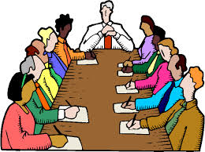
Starting research with Abrax
The Mental Capacity Act 2005
Research given ‘favourable’ opinion by Social Care Research Ethics Committee

Slide 7
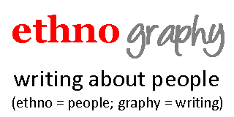
Doing research in Abrax’s home
Ethnography
Hangout Abrax to understand:
How he lived:
The way he got his carers to understand him
His culture
Weekly visits

Slide 8
Interviewed
- family,
carers
teachers
- OT and other professional
Read documents about his life story

Slide 9
What I found out about Abrax
Abrax’s culture
“Greeklish”
Spoke Greek and English
Honoured patron saints – more important than birthdays
‘Expressive’ culture: music, social relationships, food
Relational approach to mental capacity
Importance family views in decision-making

Slide 10
Becoming ‘Eric’
Name changed to more English sounding “Eric”
New (self)identify in documents and everyday interactions.
“Throughout fieldwork I have been intrigued by how Abrax came to be known as Eric. On this trip to the school I [asked] Abrax’s old class teacher Dominic…he said that he did not know… but thought that Abrax was called Eric by one of the students and he appeared to like it…as his parents did not seem to mind him being called Eric, it has now become his de facto name.” (Field notes)

Slide 11
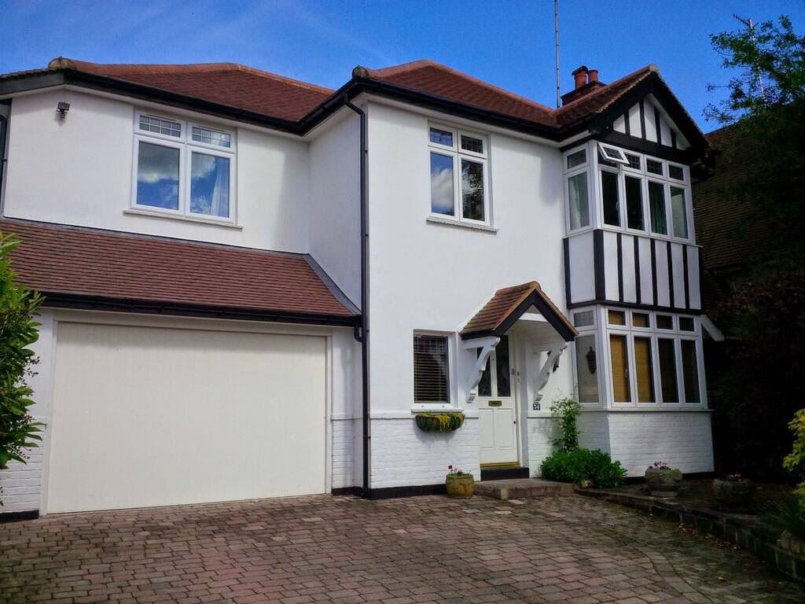
Transition to adulthood
Yarlow- supported
accommodation
More independence
Moving to Yarlow was against Abrax’s culture:
“Their relatives would not be happy with them allowing Abrax to go [to Yarlow] because their cultural tradition revolved around ‘family’ meaning that Abrax should have remained at home. I remember clearly Abrax’s father saying ‘even some of our family are not happy [with Abrax at Yarlow].’

Slide 12
Was a tenant and lived with another Greek male
Personalised care
Abrax supported by team of four males:
Morning shift was 8AM – 3PM
Afternoon shift lasted between 3PM and 10PM
Night shift ran from 10PM until 8AM.
Handover and shift changes very important.

Slide 13
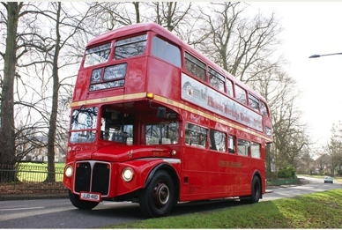
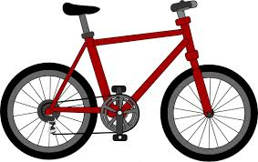
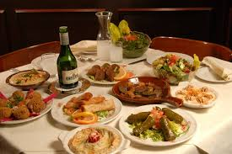
Weekly activities
Abrax chose in the morning
Visit to the day center
OT, social worker
Doing for bus rides
Cycle rides in the park
Family and friends

Slide 14
Abrax lived his culture in Yarlow
Carers recognised his culture
Presented choices
They ‘learnt’ his culture
“I’ve got to learn and understand their diet, food type, how to prepare it, you get what I mean? It’s quite different from mine, it’s quite different from where I come from, do you know what I mean? Like the preparation and everything. Because since I’ve been with Eric I’ve learnt a lot, the cooking, the cooking type, Greek cooking, the parents have helped…” (Field notes)

Slide 15
Reflections on research with Abrax
Life story shows us peoples’ strengths as opposed to what their labels mean
Not being sure about Abrax’s capacity
Who ‘owns’ the story?
Doing ‘good’ but how and when?
Who does Abrax think I am?

Slide 16
Notes:
This

