Slide 1
Caring Across the Years- a Sister’s Story of Life in the Greek Orthodox Community in Oxford
Caterina and Helena Clennett

Slide 2
Athens

Slide 3
Peter’s Christening

Slide 4
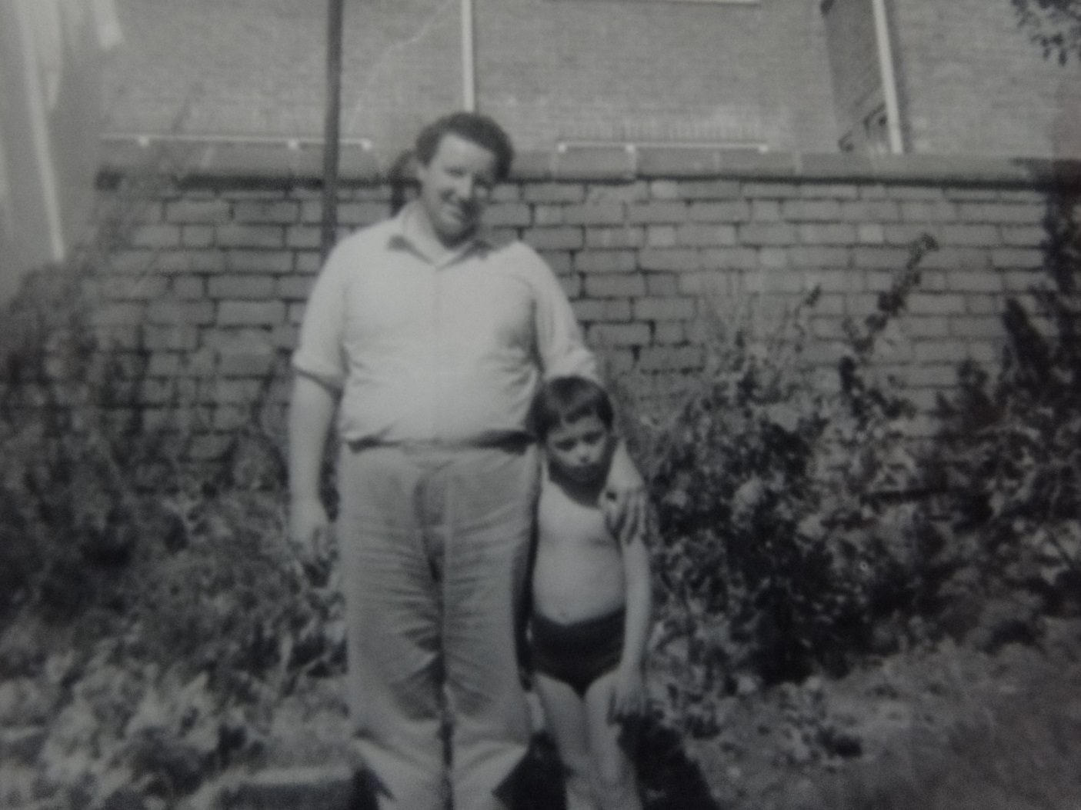
Peter with Caterina and Peter’s Father

Slide 5
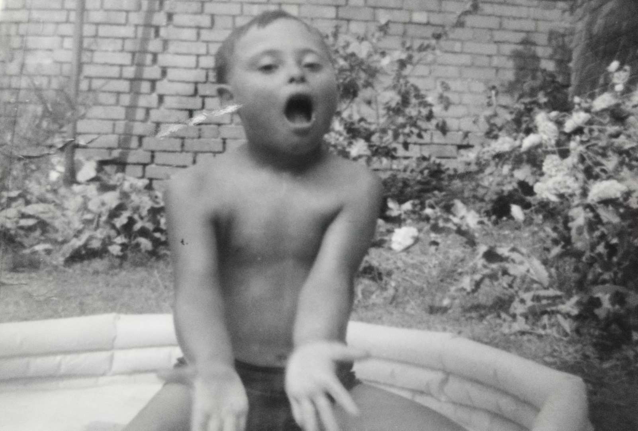
Peter in the Garden

Slide 6
With Big Sister

Slide 7
With the Family Cat

Slide 8
A Visit to Greece to see the Family

Slide 9
Peter and Helena

Slide 10
Greek Orthodox Visiting Priests from the USA

Slide 11
Greek Orthodox Church in Oxford

