Slide 1
People, Places, Events
To support Activity 11
What happened when?

Slide 2
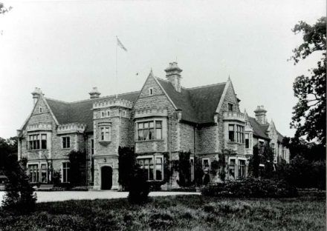
Bromham Hospital, Bedford opened 1932

Slide 3
Francis Galton (1822-1911) - wrote and campaigned about “improvement of the human stock” which he called “eugenics”.

Slide 4
1960’s-1980 hostels and day centres expansion program

Slide 5
Little Stephen Mencap Logo used 1950s to 1980s

Slide 6
Valuing People: A New Strategy for Learning Disability for the 21st Century 2001

Slide 7
Joey Deacon’s life story Tongue Tied 1977

Slide 8
Elvis Presley died 1977

Slide 9
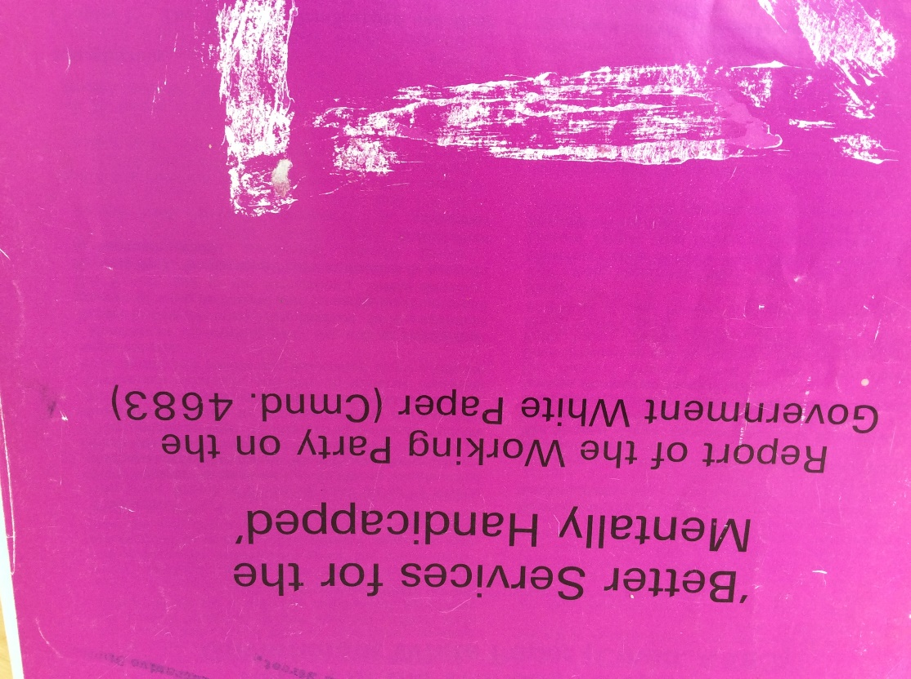
Better Services for the Mentally Handicapped 1971

Slide 10
Jay Report 1979

Slide 11
Live Aid Concert 1985

Slide 12
Margaret Thatcher Prime Minister 1979

Slide 13
Winterbourne View 2011

Slide 14
Ely Hospital Scandal 1969

Slide 15
Valuing People Now 2009

Slide 16
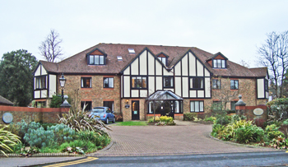
1959 Brooklands experiment showed that children did better in a small home

Slide 17
1855 Royal Earlswood Asylum opened

Slide 18
1984 People First started in London

Slide 19
Bob Marley Died 1981, age 36

Slide 20
Tony Blair elected for the first time 1997

Slide 21
Michael Jackson died June 2009

Slide 22
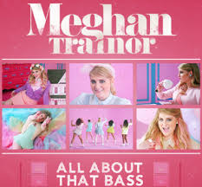
Meghan Trainor, singer and songwriter born 1993

Slide 23
Beatles’ first hit single ‘Love Me Do’ 1962

Slide 24
Martin Luther King’s I Have a Dream Speech 1963

Slide 25
London Blitz-World War 2 1940/ 1941

Slide 26
Mabel Cooper receives an honorary Open University Degree 2010

