Slide 1
Songs of Resistance The history of advocacy for people with learning difficulties
Sue Ledger
Lindy Shufflebotham
Nigel Ingham
Notes:
These slides present the findings of some research undertaken in 2004/2005 about songs composed and sung by people with learning disabilities living in long stay institutions.

Slide 2
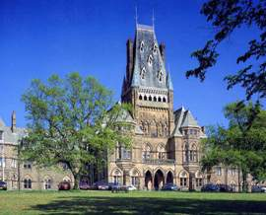
Songs from The Royal Albert Hospital,Lancaster
Notes:
The Royal Albert Hospital – A brief background
At a time when the dominant legislation (i.e. the 1845 Lunacy Act) muddied distinctions between learning disability and mental illness, the Royal Albert Asylum, Lancaster, was only one of four regional institutions in England set up specifically for the care and education of children with learning disabilities. Admitting its first patients in December 1870, the Royal Albert’s establishment owed much to the vision and energy of one Lancaster based man (twice the city’s mayor), Dr. Edward Dennis de Vitre. Dr de Vitre ensured that the hospital’s primary focus was on those young people with learning disabilities aged between six and 15 years who, ideally after seven years in the institution, would be able to leave and lead useful lives in the outside world. Taking patients from the seven English Northern Counties the institution was seen as a source of local and regional civic pride. Numbers grew and its large site, overshadowed by the imposing main building, had by 1909 become home to 662 patients.
However, the early part of the twentieth century saw dramatic changes in the ethos of the Royal Albert, and in effect set the scene for the rest of its development until its closure in 1996. Pivotal to these changes was the impact of the 1913 Mental Deficiency Act, and with it the increasing influence of the state (via the Board of Control) in the affairs of the institution. In 1916 the Royal Albert’s authorities were told, in apparent opposition to their dominant policies at the time, that no more than 10% of its patients should be under 16 and receive training, and importantly that there would be no educational grants available for those aged over 16. In addition, and much to the consternation of the institution’s authorities, the Royal Albert was now under pressure to admit patients it had previously believed were ‘helpless’. In 1923, for instance, the Central Committee of the hospital states in its report that it is pledged ‘to proceed with the erection of a custodial block for low grade cases.’ However there was now increasing acceptance by the institution’s Medical Superintendent – in line with the eugenicist spirit of the 1913 Act – that life long segregation in institutions was the most appropriate way to respond to the needs of people with learning disabilities.
By 1948, when the institution lost its voluntary status becoming part of the new NHS and renamed the Royal Albert Hospital, it had changed considerably from its early days as a voluntary institution. (Although it is worth pointing out that even in the 1940s there was still pride expressed by the Medical Superintendent in those patients who had left and were earning good wages). Of the 662 patients in 1909 85% were under 15 and 504 of its total number had been there less than 10 years. This is in stark contrast to 1948 when of its 886 patients 45% were aged over 35 with only 12% being under 15; furthermore most of those living there could be classified as long stay patients. While the earlier asylum had been designed to prepare young people for the wider world, now its primary purpose was to segregate individuals of all ages from that same environment. In line with these developments the numbers continued to rise, so much so that during the 1960s and 70s the hospital experienced serious overcrowding with the patient population exceeding 1,000.
This brief background however does not do justice to what life was actually like for patients during some of these times. During the late 1980s, in reminiscence groups based at the local Adult Education College and elsewhere, those who had experienced life as residents shared some of their memories. Their personal hospital histories went back to the Edwardian era and covered a range of topics and themes including: the daily routines, the work that patients had to do (domestic, farm, workshops, laundry), stories of resistance and - much to the surprise of those privileged enough to work in these groups – the songs and rhymes of resistance. Unfortunately many of those who were present in those groups have since died, and so gathering more information on the exact context of these particular expressions of resistance has proved difficult. Nonetheless they still provide an illuminating perspective on the Royal Albert residential experience.

Slide 3
Songs from The Royal Albert Hospital, Lancaster
During the late 1980’s reminiscence groups of ex-residents met to share and record their memories of hospital life(Ingham et al 1987-89)
The following songs composed and sung by people with learning dificulties were received from this group.

Slide 4
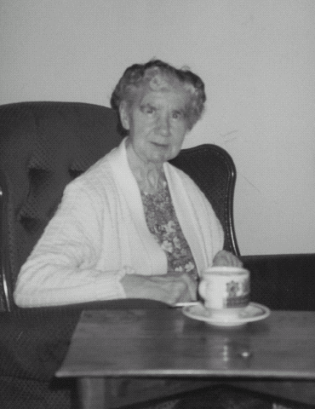
Songsters from The Royal Albert Hospital, Lancaster
Stan Byers outside his home in Morecambe in 1990 Photograph:Helen Burrow
Peggy Palmer at her home in Lancaster, after leaving the Royal Albert Hospital

Slide 5
The Cocoa Song verses 1-3
The cocoa that they gave us, they say is mighty fine.
It.s good for cuts and bruises and tastes like iodine.
So I don’t want no more of Royal Albert life.
Gee, Ma, I want to go home.
The stockings that they gave us, they say they.re mighty sheer.
We put them on the clothes line and watch them disappear.
So I don’t want no more of Royal Albert life.
Gee, Ma, I want to go home.
The bacon that they gave us, they say is mighty fine.
A leg fell off the table and killed a pal of mine.
So I don’t want no more of Royal Albert life.
Gee, Ma, I want to go home.

Slide 6
The Cocoa song verses 4-6
The bacon that they gave us, they say is mighty fine.
The staff get the bacon, the patients get the rind.
So I don.t want no more of Royal Albert life.
Gee, Ma, I want to go home.
The pullovers that they gave us, they say they.re mighty fine.
One of Betty Grable’s will fit in two of mine.
So I don’t want no more of Royal Albert life.
Gee, Ma, I want to go home.
The money that they gave us, they say is mighty fine.
They give us hundred shillings and take back ninety-nine.
So I don’t want no more of Royal Albert life.
Gee, Ma, I want to go .
Gee, Ma, I want to go .
Gee, Ma, I want to go home.

Slide 7
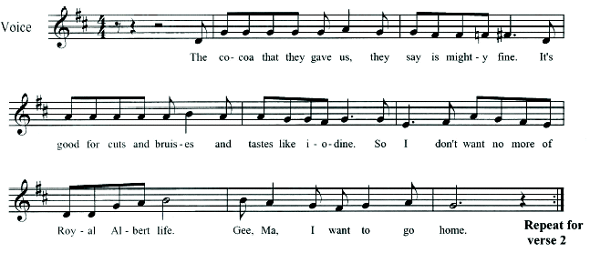
Musical Notation-The Cocoa Song

Slide 8
Hospital Song
They say the Royal Albert’s a wonderful place,
But the goings on there are a shocking disgrace.
The matrons and doctors have nothing to do,
‘Cept stick their noses in the air when they’re walking past you.
They say, Don’t you worry, you’ll soon be free..
My worry is that they’ve strolled over me.
And I think it’s useless to pull up your socks,
For when you go out, you shall go in your box.

Slide 9
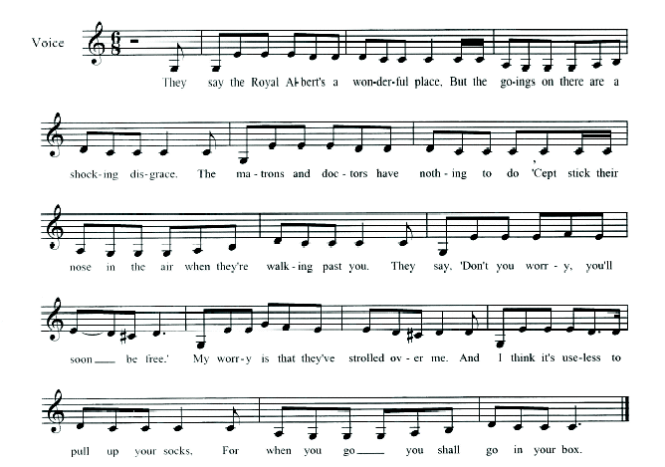
Musical Notation-Hospital Song

Slide 10
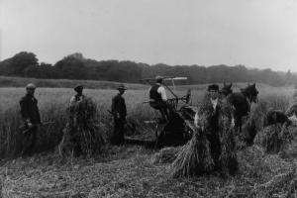
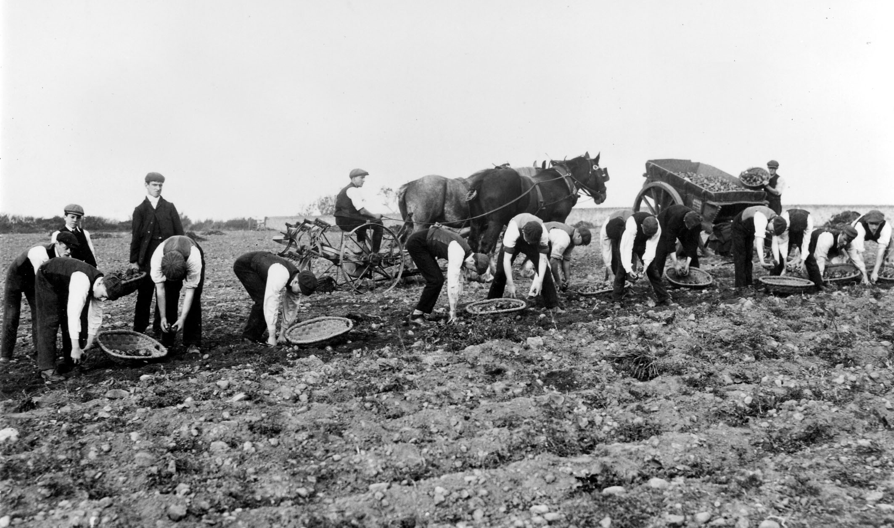
The Royal Albert Hospital,Lancaster
Farm Work at the Royal Albert
In the early part of the century.
© Lancashire County Museums Service

Slide 11
Work Rhyme
Harry Oldham, who probably entered the hospital in the 1920s, recalled the following rhyme as a response to the hard work the residents were expected to do:
God made the bees,
Bees made the honey,
The patients did the work,
While the staff get the money.

Slide 12
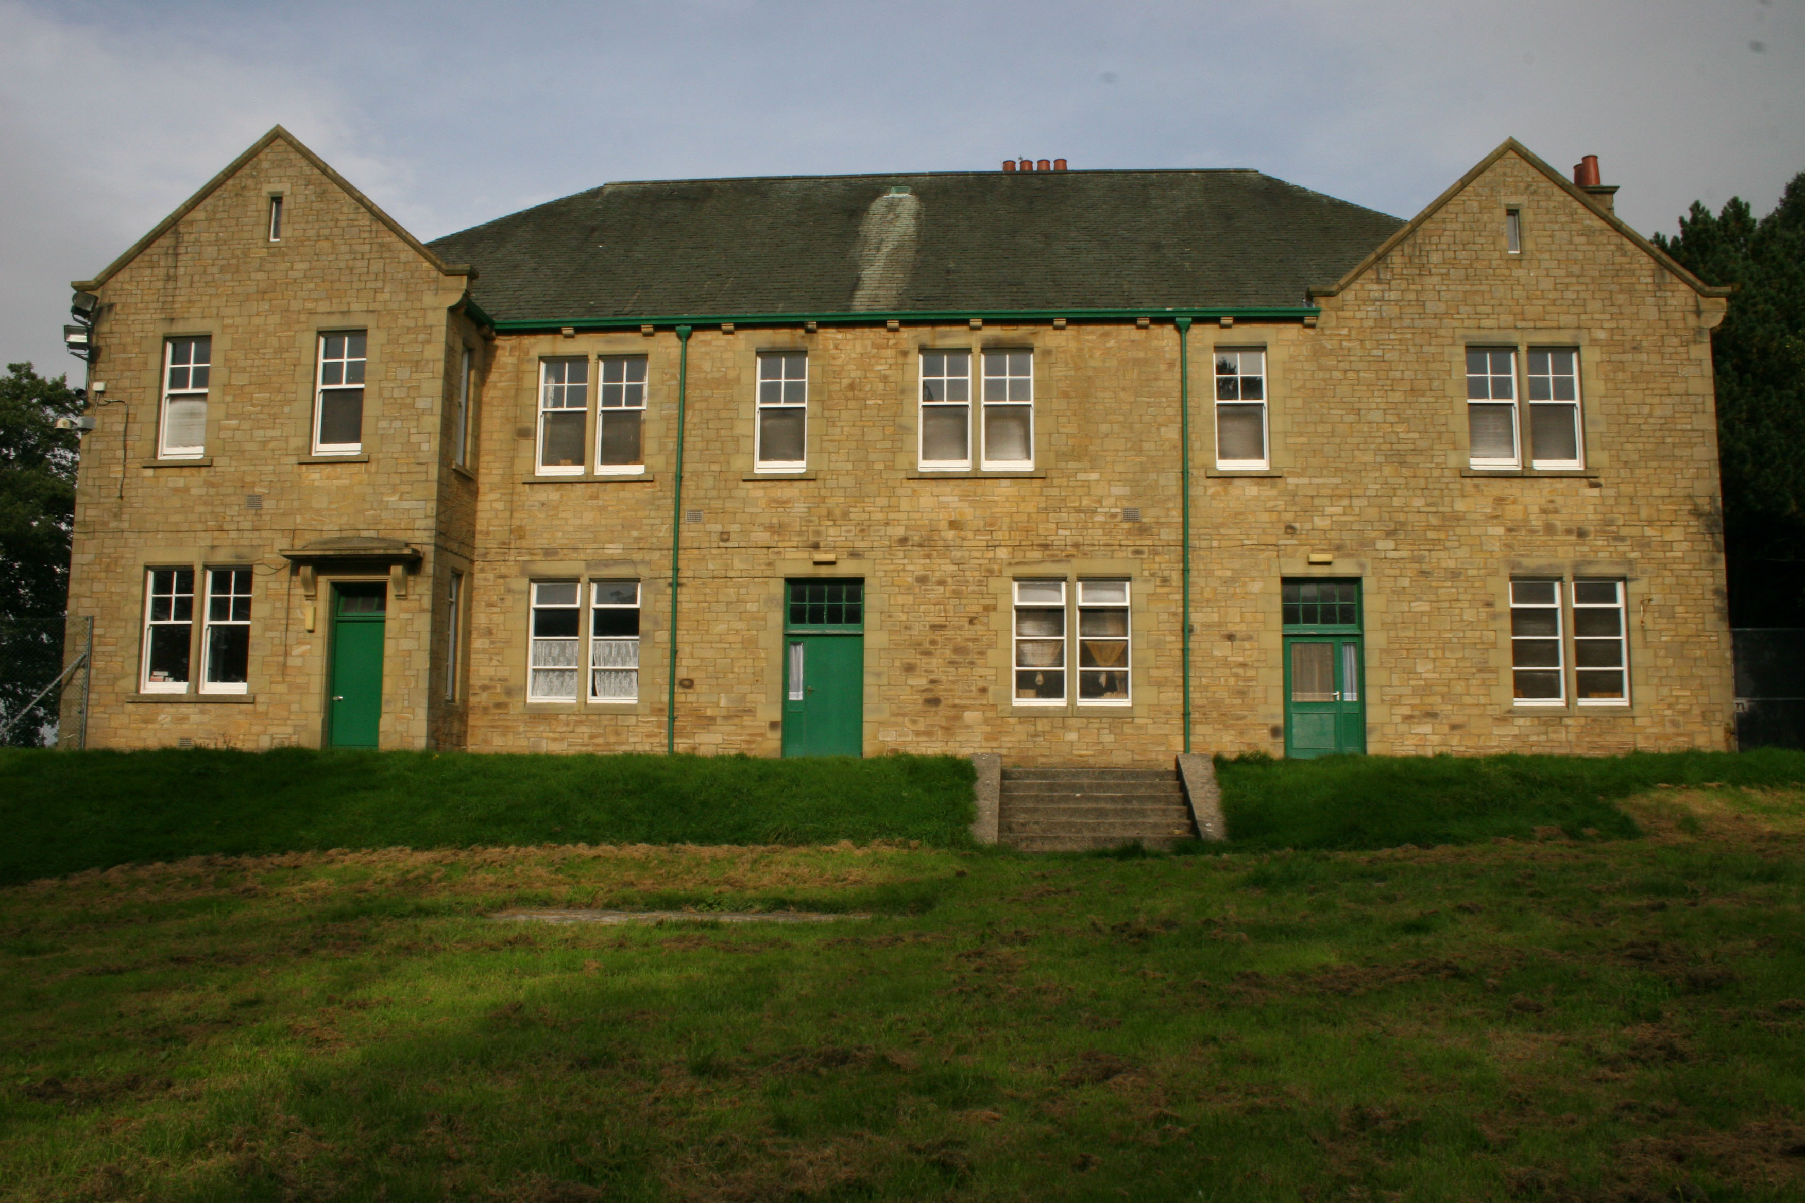
Barlow Home - A Boys’ Ward
Barlow Home 2006
Courtesy of Mandy Cody
Notes:
Opened in the early 1930s, Barlow Home was the first taste of the Royal Albert for many little boys. They would leave this ward aged around 16 years old, many of whom then stayed in the hospital for most of the remaining years of their lives.

Slide 13
Come to Barlow Song
Come to Barlow
Come to Barlow.
We will find it very nice.
If it wasn’t for the nurses,
We would live in paradise.
Build a bonfire
Build a bonfire.
Put the nurses on the top.
Put the charge hands in the middle
And we’ll burn the bloomin’ lot.

Slide 14
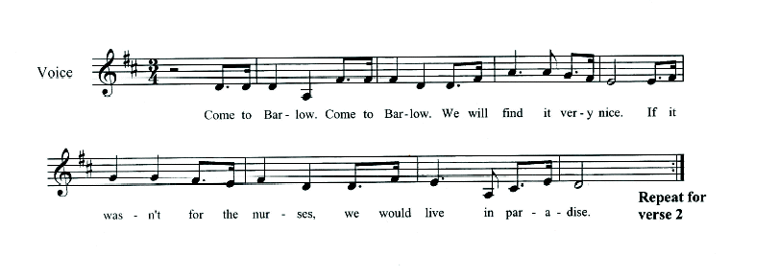
Musical Notation- Come to Barlow Song

Slide 15
Royal Albert Song
When I get my civvy clothes on
No more soldiering for me.
You can tell the sergeant major
No more soldiering for me.
No more church parades on Sunday.
No more asking for a pass.
You can tell the sergeant major
To stick his passes up his ass!

