Slide 1
Citizen Advocacy – one way to make a positive difference
Barbara Perry, citizen advocate

Slide 2
I am going to talk about….
Why human services do harm
Citizen advocacy
Our citizen advocacy partnership
How our partnership guards against abuse
An inspection
Paid advocacy and Citizen advocacy
Conclusion

Slide 3
In the past…
Brockhall Hospital,
Lancashire

Slide 4
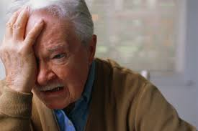
Human Services still do harm to people Why?
Social Devaluation
Services have power and control
Work practices and paperwork
Cuts in funding make it worse

Slide 5
How did Citizen Advocacy start?
Wolfensberger set up citizen advocacy in America in 1970
To help guard against devaluation
Set up in UK in 1980’s
Government funding in 2001

Slide 6
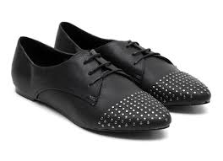
What is Citizen Advocacy?
A partnership between two people, long term
Freely given, independent of services/family
Spend time together
Get to know advocate partner well
Each partnership is different
Citizen advocate aims to meet needs of their advocate partner
instrumental needs
expressive needs

Slide 7
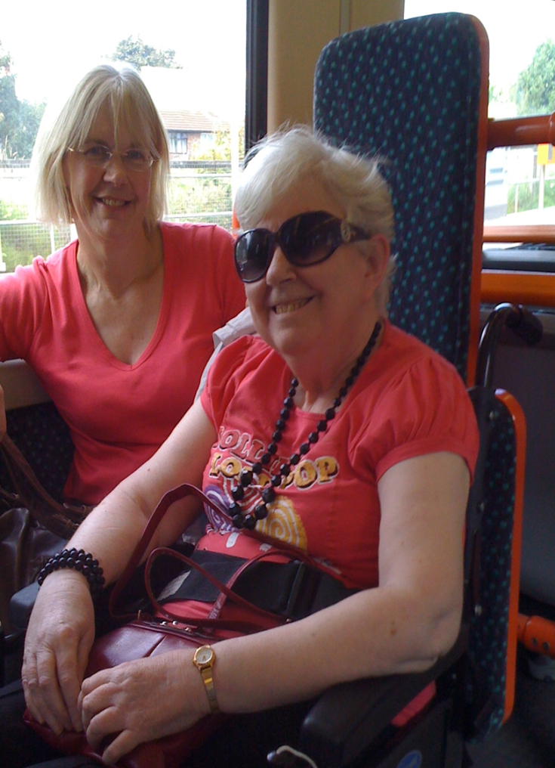
Our Citizen Advocacy partnership
Partners for over 8 years
I visit Julie at home every week
Close relationship which we both value
Supports control and choice

Slide 8
Support Julie to be heard by services

Slide 9
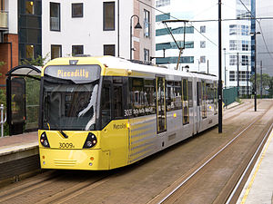
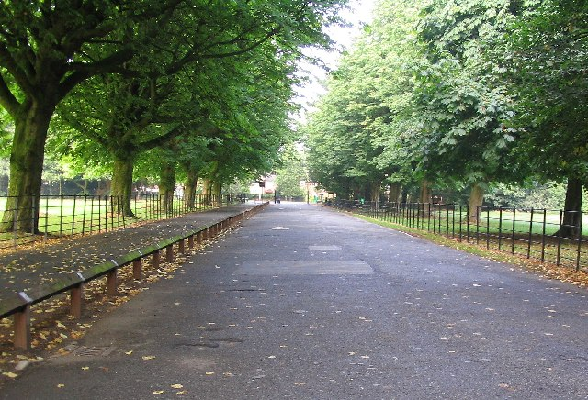
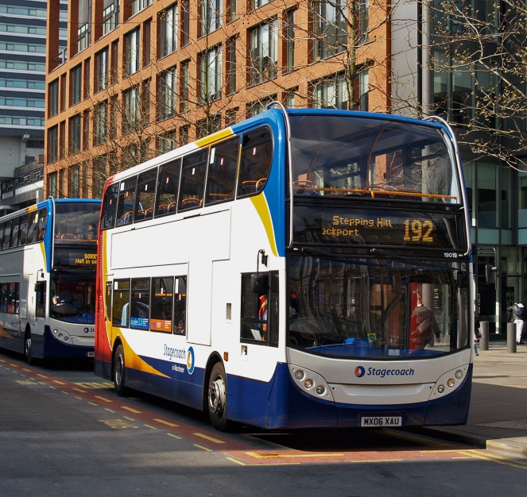
We go out every week

Slide 10
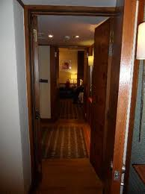
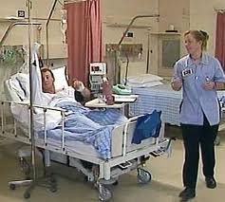
Our partnership guards against abuse and neglect
1 Institutional Abuse
Own home, work place
2 Institutional Abuse
x
4 Emotional Abuse and neglect - her support workers support her in hospital
3 Financial Abuse

Slide 11
(CQC) inspection
Inspection of Julie’s home
‘Essential standards’ checked
Safeguarding standard met but
staff only name ‘main types of abuse’
Inspector spoke to head of services

Slide 12
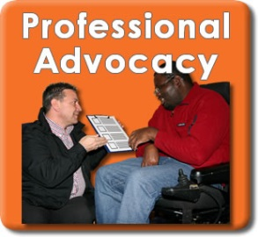
Paid Advocacy and Citizen Advocacy
More paid jobs for advocates.
Less funding, less independence
Community action policy is support for citizen advocacy?
Difficulty in measuring effectiveness of Citizen Advocacy
Public want short term volunteering (Chapman and Mitchell)
Who is the advocacy for?
Future of Citizen Advocacy?
?

Slide 13
Citizen Advocacy – one way to make a positive difference
Barbara Perry, citizen advocate

Slide 14
References
Atkinson, D. (1999) Advocacy: a review, East Sussex, Pavilion.
Cabinet Office (2010) Building the Big Society. Available from: https://www.gov.uk/government/uploads/system/uploads/attachment_data/file/78979/building-big-society_0.pdf
Care Quality Commission (CQC) http://www.cqc.org.uk/
Chapman, M. and Mitchell, D. (2011) Citizen Advocacy and Circles of Support: report for Wigan Learning Disability Partnership Advocacy Subgroup, Manchester, MLDP, MMU.
Department of Health (2001) Valuing People: a strategy for learning disability services in the 21st century, London, Department of Health.
Hildebrand, A.J. (2004) One Person At A Time: Citizen Advocacy for People with Disabilities, Newton M.A, Brookline Books
Mansell, J. (2010) Raising Our Sights: Services for Adults with Profound Intellectual and Multiple Disabilities, University of Kent, Tizard Centre. Available from: http://webarchive.nationalarchives.gov.uk/+/www.dh.gov.uk/en/publicationsandstatistics/publications/publicationspolicyandguidance/dh_114346
Rogers, C. (1967) On Becoming a Person: a therapist’s view of psychotherapy, London, Constable.
Wolfensberger, W. (1975) Citizen Advocacy for the Handicapped, Impaired and Disadvantaged: an overview, Washington, D.C., US Government Printing Office.
barbaraperry123@aol.co.uk

