Slide 1
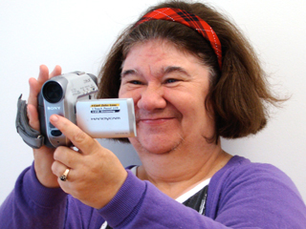
The role of computers in promoting independence: a forgotten history?
Jane Seale
Social History of Learning Disability Conference July 2014

Slide 2
1987-1993: I worked in “mental handicap” hospitals and adult training centres

Slide 3
This was a time when people with learning disabilities were moving out of big institutions into group homes in the community

Slide 4
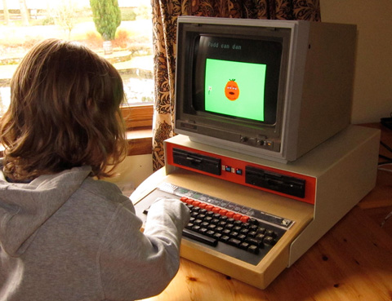
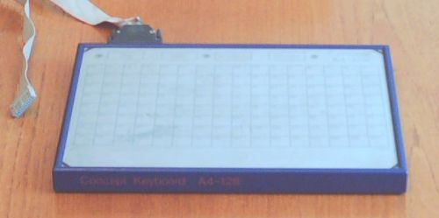
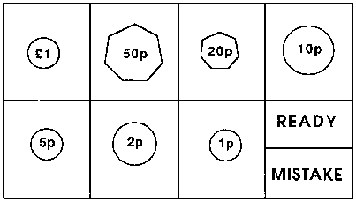
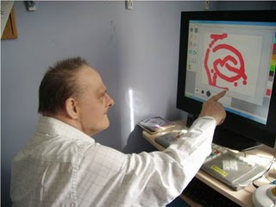
It was also a time when many people thought that computers could be really powerful tools….

Slide 5
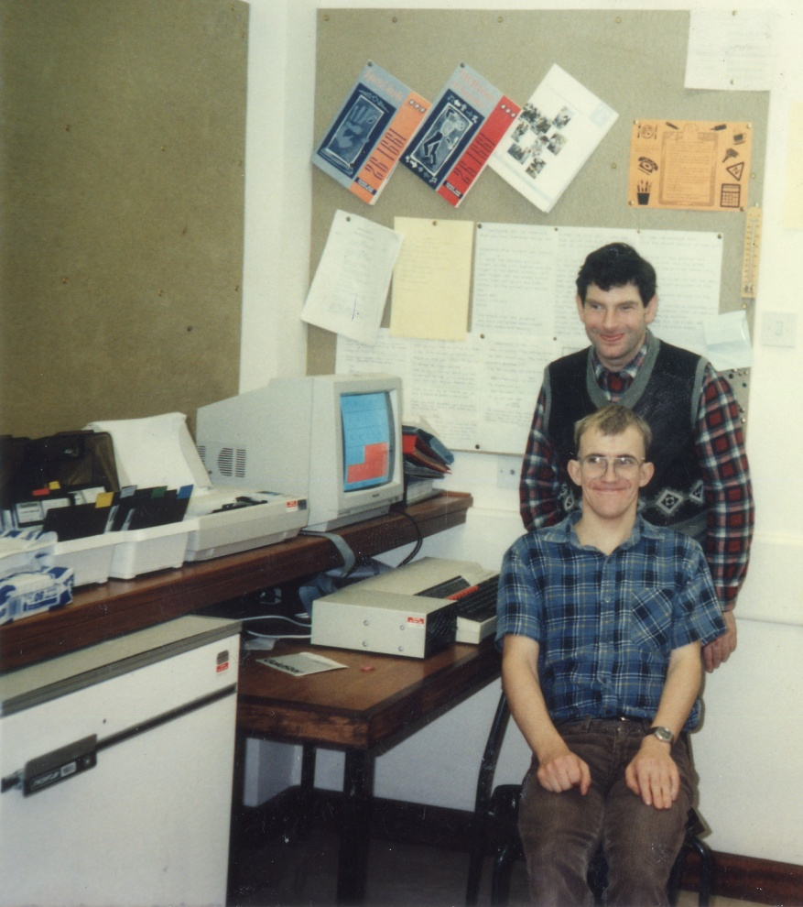
….to help people with learning disabilities improve their independence

Slide 6
Researchers and practitioners wrote lots of articles and books claiming to show how brilliant computers were

Slide 7
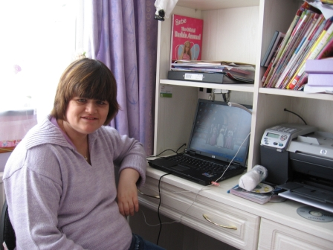
Where were the voices of people with learning disabilities talking about whether they thought computers were brilliant?

Slide 8
We have oral histories now…..

Slide 9
But they don’t mention computers…

Slide 10
A lost history = a lost future?
Were computers as helpful in the past as researchers thought they would be or did they have very little influence on the lives of people with learning disabilities?
What can we learn from the history of computer use and experiences that can help us understand and develop good practices in supporting people to use technologies today?

Slide 11
I think it is important that we try to find out about people's memories of using computers twenty or thirty years ago.

Slide 12
So we can know how people with learning disabilities might feel about us denying them access to technologies
Winterbourne:
No computers, no Internet, no mobile phones, No MP3 Players, no Ipads, no communication or assistive technology
Those who are not viewed as human, are denied access to the everyday tools of humanity

Slide 13
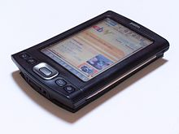
So we can know how people with learning disabilities might feel about us taking away their technologies
Aspinall (2008) reported how job coaches in a supported employment agency installed health and safety animations onto Personal Digital Assistants, which could give prompts about health and safety issues in the workplace
BUT the use of the PDA was withdrawn because:
[…] the job coaches identified that sometimes it was inappropriate for workers to get out their PDAs in the middle of a task and also this penalised those people who did not have a PDA at their disposal.

Slide 14
So we can know how people with learning disabilities might feel about us insisting that they have technologies in their homes

Slide 15
So we can understand how people with learning disabilities respond to the ‘push’ for us all to be ‘digital citizens’

