Slide 1
Using technology for communication
Marion Stanton
www.candleaac.com

Slide 3
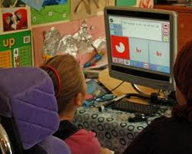
History of AAC Augmentative and Alternative Communication. Early high tech communication aid (1970’s) and recent one (2013)

Slide 4
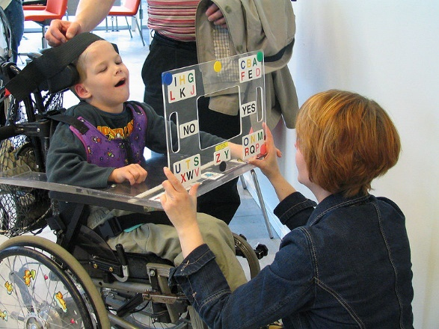
History of AAC Augmentative and Alternative Communication. Early low tech communication aid (1970’s) and recent one (2013)

Slide 5
http://en.wikipedia.org/wiki/Augmentative_and_alternative_communication The use of manual alphabets and signs was recorded in Europe from the 16th century, as was the gestural system of Hand Talk used by Native Americans to facilitate communication between different linguistic groups.

Slide 6
AAC use after the 1st World War. By 1920, Dix was associated with the Berlin Dadaists. In the summer of that year, he exhibited this painting, the War Cripples, there. Unlike many works on display, this one avoided official controversy although it clearly blamed the military for butchering a generation.

Slide 7
Accessible Text
There are many ways to make text accessible. We quite often think that enlarging it is the most important way to do this. However, for some people use of pictures and symbols is more important. Learning to read is really important if at all possible.

Slide 8
There are many ways to make text accessible. We quite often think that enlarging it is the most important way to do this. However, for some people use of pictures and symbols is more important. Learning to read is really important if at all possible.

Slide 9
There are many ways to make text accessible. We quite
often think that enlarging it is the most important way
to do this. However, for some people use of
pictures and symbols is more important. Learning to read
is really important if at all possible.

Slide 11
Accessible Text
There are many ways to make text accessible. We quite often think that enlarging it is the most important way to do this. However, for some people use of pictures and symbols is more important. Learning to read is really important if at all possible.

Slide 12
There are many ways to make text accessible. We quite often think that enlarging it is the most important way to do this. However, for some people use of pictures and symbols is more important. Learning to read is really important if at all possible.

Slide 14
For some people the real picture helps but only for very concrete concepts.
Many people
Think
Enlarge

Slide 15
Voice Output
Voice output can work in a number of ways but if you can understand language this is the most effective way of differentiating materials.
Text to speech…It speaks as I type…can have symbol support. Many AAC system do this. Tortuous on the iPad! Better on PC devices…I think!
Readers……Read books, documents, pdf’s, websites and other media. Very good on the iPad. Read Write Gold is great for making MP files out of text.
Speech to text…. Able to pick up your speech so that you don’t need to write and turns your speech into text. Dragon Dictate is an example. Pre-recorded systems…cheaper but a little restricted.

Slide 16
What is Communication?
Speaking message across listening
Hearing understanding getting people involved
Eye contact body language look at people face them
Two way respect phone text pictures objects feelings talking technology experience competence picture with cards confidence

Slide 17
What is communication?
Expressive: These are the things that we say, write or express in other ways (for example non verbally) to get our message across to other people.
Receptive: These are the things we understand when people speak to us, write to us or otherwise communicate information to us.

Slide 18
What is AAC for speech support?
Alternative and Augmentative Communication.
Alternative is instead of speech. Examples include voice output communication aids that “speak” for the communicator.
Augmentative is added on to speech. Examples include using sign and/or a verbal YES/NO in conjunction with pointing to a symbol on a board.

Slide 19
Communication Strategies
Speech may be replaced by UNAIDED SYSTEMS such as:
GESTURE/BODY LANGUAGE including choice making from a range of options or using a YES/NO response.
MANUAL SIGNING including British Sign Language, Signed English, Makaton, Signalong, Paget Gorman.

Slide 20
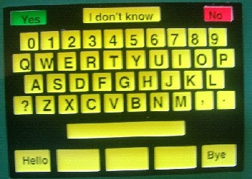
Examples of Low tech aids:
Candle wooden board with built in key guard.
Communication board to use in school.
Indexed boards that can be accessed directly or low tech scanned.
Picture Exchange Communication System (PECS)

Slide 21
Talking Mats – Decision Making Tool http://www.talkingmats.com/
Talking Mats is an interactive resource that uses three sets of picture communication symbols – topics, options and a visual scale – and a space on which to display them. This can either be a physical, textured mat, or a digital space, for example a tablet, smart board or computer screen for which we have created one of the best apps for communication disability.
Topics: whatever you want to talk about, e.g., pictures symbolising ‘what do you want to do during the day’, ‘where you want to live’, ‘who do you want to spend time with’, etc.
Options: relating specifically to each topic. For example: ‘What do you feel about going for a walk? Or living at home?’
Top Scale: this allows participants to indicate their general feelings about each topic and option. The meaning of the visual top scale can be adapted to suit the questions you are asking the person, for example, whether they are happy, unsure, or unhappy.
Once the topic is chosen e.g., ‘activities’ or ‘people’, the participant is given the options one at a time and asked to think about what they feel about each one. They can then place the symbol under the appropriate visual scale symbol to indicate what they feel.

Slide 22
Now an app of course!

Slide 23
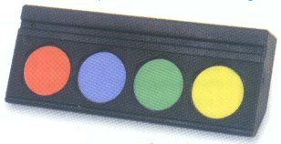
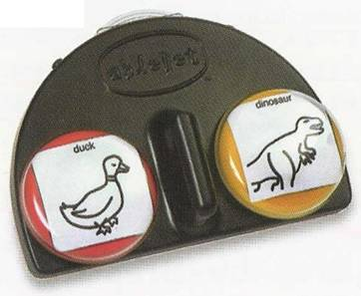
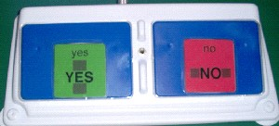
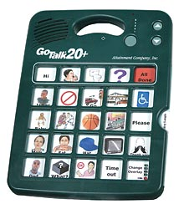
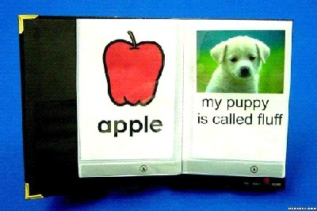
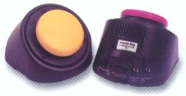
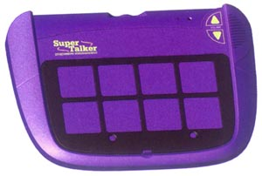
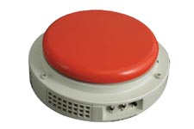
Light or Medium Tech systems
These are communication aids with voice output that have a limited application. They are usually digitised (programmed by voice recording).
EXAMPLES:
4 talk 4 – 4 levels
Lib 4Talk Inline, also 4 talk square and
Lib talk 8
1X4
Twin talker
Italk2
Lib lap top, 1,2,4,8,16. 7 levels.
Super talker, 1,2,4,8. 8 levels.
Go talk 20. Also 4 & 9.
Step communicator
Talking photo album
Single utterance

Slide 24
High Tech Communication Aids – Mainly PC based.
http://www.liberator.co.uk/ecopoint.html

Slide 25
http://www.liberator.co.uk/eco2.html
minspeak

Slide 26
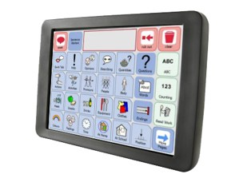
http://www.smartboxat.com/products/communication-aids/

Slide 27
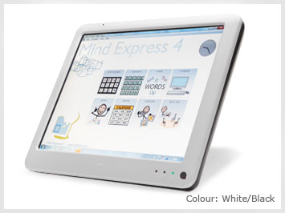
http://www.techcess.co.uk/

Slide 28
High Tech Communication aids with “associated” use
It could be argued that what some see as “associated” use are actually central to communication. A lot depends on the definition of communication. EXAMPLES:
Environmental control.
Accessing the internet and emails.
Word Processing.

Slide 29
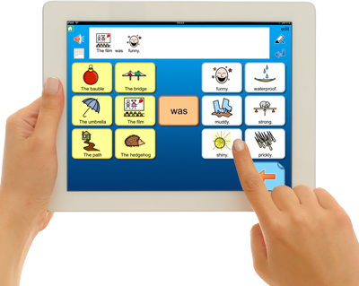
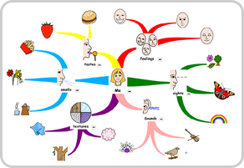
http://www.widgit.com/

Slide 30
Word prediction - http://www.spectronicsinoz.com/article/word-prediction-software-comparison-chart/

Slide 31
Text Readers
http://www.howtogeek.com/125305/the-best-text-to-speech-tts-software-programs-and-online-tools/
http://donjohnston.com/snap-read/#.U8TaS_ldVT4

Slide 32
What can the iPad offer?
Quick and cheap voice output.
Some hierarchically organised communication apps.
A number of excellent and reasonably prices schedules, social stories and routine supports.
Many learning apps.
A minefield to navigate!

Slide 33
Looking for Apps:
http://www.spectronicsinoz.com/iphoneipad-apps-for-aac/
http://www.janefarrall.com/
http://www.sc.edu/scatp/expo/expo12handouts/Apps%20for%20Communication.pdf
http://www.matchacollege.com/blog/2011/40-amazing-ipad-apps-for-the-learning-disabled/
http://www.appsforaac.net/
http://www.matchacollege.com/blog/2011/40-amazing-ipad-apps-for-the-learning-disabled/

Slide 34
For more information:
marion@candleaac.com

