Slide 1
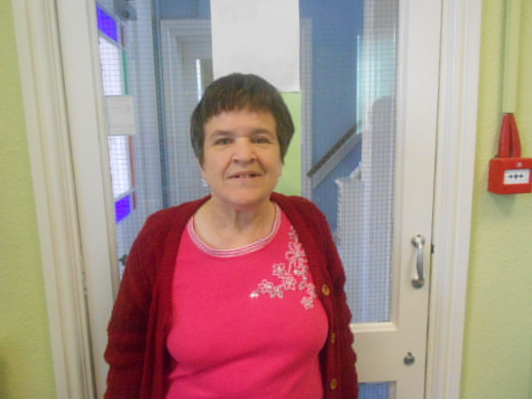
Angela Stills Presentation

Slide 2
Introduction
Hi I’m Angela Still I’m 58 and live in Kettering, Northamptonshire.
I lived on my own for 9 years without any carer/caseworker.
I do not have family that can help me. My mum has Dementia which is very difficult for me.

Slide 3
I used to feel shut off and scared and didn’t have friends that I could talk to.
My health and mobility has got worse and I couldn’t cope with the stairs to my flat and the housework.
I have spent a lot of time in hospital because of my asthma.

Slide 4
I struggled to realise the difference between a true friend and when people are just taking advantage of me.
I was financially abused by a neighbour and ended up in debt, Which mean’t I had to go to court and this was very stressful.
With the help of People First I finally now have a caseworker and carer.

Slide 5
It has been a very difficult process and has took a long time to sort out, but I now get personal help and good support including being taken shopping and help with cleaning, gardening and paying my bills.
I have recently moved home from a flat to a bungalow.

Slide 6
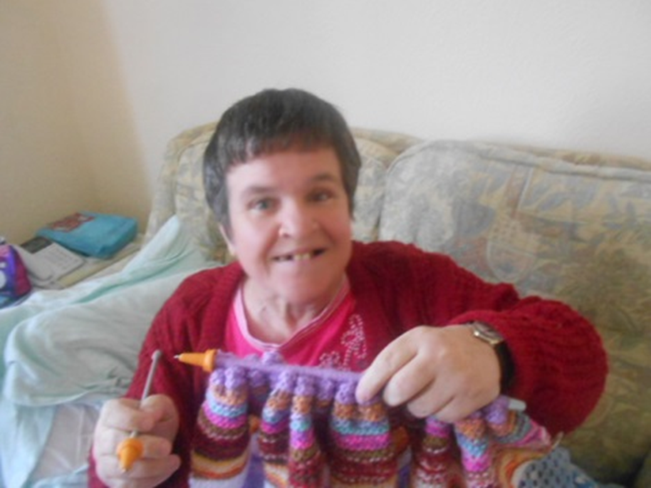
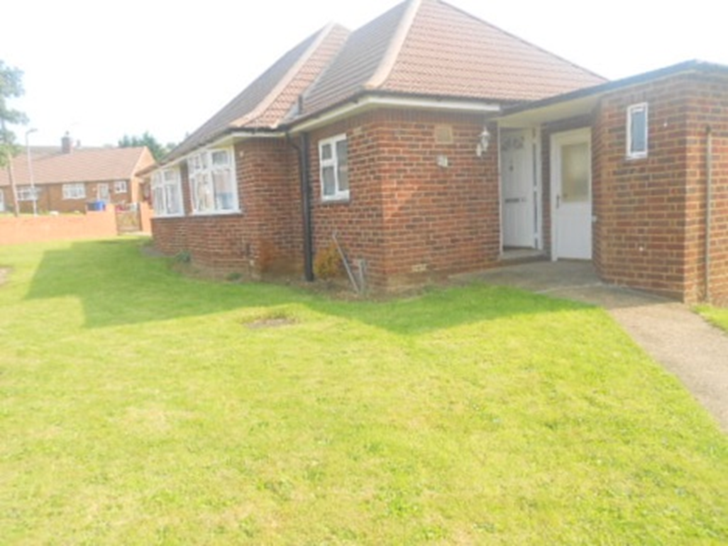
Me And My New Home

Slide 7
The Front Of My New Home

Slide 8
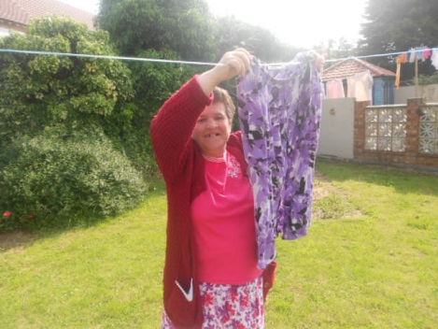
Me And My New Garden

Slide 9
I have managed to buy new furniture, carpets and decorate throughout, I also have good neighbours and I’m a member of neighbourhood watch.
I’m now waiting for my bathroom to be adapted.
I now finally feel happy, healthy, safe and secure.

Slide 10
If anyone would like to ask me any questions please feel free to

