Slide 1
Enabling Inclusion through Innovation
Theo Papaioannou
Doing Social, Conference, Judge Business School, University of Cambridge,
July 20, 2016

Slide 2
Overview
The Importance of Innovation
The Problem of Exclusion
Geography of the Problem
Addressing the Problem
Traditional Models of Innovation
Emerging Models of Innovation
Inclusive Innovations
Social Innovations
Inclusive/Social Innovations and Justice
The Scope of Inclusive/Social Innovations in the UK
Evaluation & Public Policy
Conclusion

Slide 3
The Importance of Innovation
Technology: tools we use to enhance/expand our capabilities
Innovation: processes of doing new or old things in new ways
Technological innovation: new to the firm; new to the market; new to the world.
The importance of technological innovation in human development is undeniable.
Since the 1780s, successive technological revolutions have introduced innovations with tremendous impact on well-being.
These innovations range from:
industrial textiles, railways & electricity to medicines, automobiles, ICTs and more recently,
nanotechnology, genomics and biotechnology

Slide 4
The Problem of Exclusion
Not all individuals/societies tasted the fruits of new technologies.
There are still people in the developing (e.g. in Sub-Saharan Africa) and the developed world (e.g. unemployed people in Europe) who either lack access to new products and processes or their basic needs have never been taken seriously.
Innovation has been exclusive of the poor, increasing inequalities:
1 in 7 people live on less than $1.25 per day
global income is concentrated among the top 1%;
the richest 10% earn 9.5 times more than the poorest 10%
1.6 billion people have no access to electricity;
18,000 children per day die from preventable diseases/malnutrition before reaching their 5th birthday.
In global health, almost 90% of resources are spent in problems of 10% of the world population, living in the global north.

Slide 5
Geography of the Problem
China: the rich are getting richer much faster than the poor getting better income.
India: there are huge inequalities in different regions leading to polarisation.
Africa: the fast growing economies have not helped to equalise incomes or redistribute wealth.
Latin America: one of the most unequal regions of the world.
UK: incomes & living standards have fallen since the recession (In 2014/15 10.1 million lived in relatively low income.
The consequences of inequality are devastating, leading to polarisation, bad health, low education, insecurity, etc.
Economists such as Milanovic (2011; 2016) and Piketty (2014) agree: increasing inequality undermines growth in modern capitalist societies.

Slide 6
Addressing the Problem
Unequal generation and diffusion of innovation constitutes a major problem of social justice.
Social justice is about creating a society in which people stand in relations of equality to others (Anderson, 1999)
This requires the distribution of rights, opportunities, resources, capabilities in such way that everyone’s situation and interests are taken into account.
Some neo-liberals argue inequality is inevitable consequence of technological innovation and development
However the neo-liberal orthodoxy (i.e. inequality is necessary to foster growth and prosperity) has proved to be a myth.
Data shows: although global poverty has fallen the last two decades due to innovation-led growth, a number of fast growing countries have either experienced little poverty reduction or increased inequality.
Therefore, it is clear that the shift from growth to equality is necessary for achieving inclusivity.

Slide 7
Traditional Innovation Models
Traditional innovation models (i.e. IS) have neglected inclusivity/equity, focusing on the ‘Schumpeterian motor’ of innovation i.e. role of market-driven/ profit-incentivised enterprises.
That’s the so-called innovation from above, the most crucial failure of which is: incorporation of the needs of the poor.
Unless radically revised, traditional innovation models are unable to promote the needs drive of innovation from below.
Prahalad (2005) recognised such drive, arguing:
rise in incomes at the BOP has facilitated the inclusion of some needs in the innovation of big MNCs
However, profit-making MNCs have ignored needs which cannot be expressed as ‘effective demand’.

Slide 8
Emerging Innovation Models
The BOP approach may be too optimistic or too blind to developing and developed contexts (Srinivas, 2014).
Innovation researchers have already argued that equality and fairness should be built in the innovation process itself. In this context:
the notion of ‘Below the Radar’ or ‘inclusive’ innovation (Kaplinsky et al (2009) has been introduced to explain how poor people can create low cost products to meet their basic needs.
the notion of ‘social innovation’ has re-emerged to describe how innovation as a social process can be directed at meeting human needs.
Emerging models of innovation have the potential to change radically the distributional dynamic of the global economy.

Slide 9
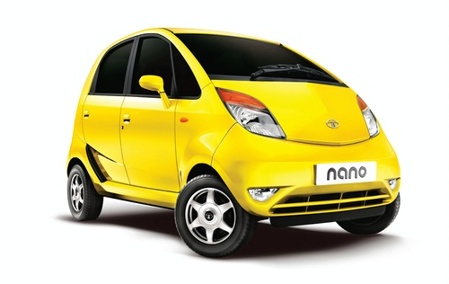
Inclusive Innovations
These innovation models incorporate the needs, interests and knowledge of BOP populations. They are recently discussed under a number of banners and using a variety of terms e.g. frugal innovation; grassroots innovation.
Inclusive innovation models are not primarily focused on totally new technology, devices or science. They are also about adapting products, services and businesses
‘Frugal’ innovations i.e. simplified versions of existing technologies; ‘Grassroots innovations i.e. low- and middle-income group generated innovations.

Slide 10
Social Innovations
In the 1960s/1970s social innovations focused democratic participation in various sectors e.g. education, universities (Moulaert, 2010).
In the 1980s/1990s social innovations focused on overcoming social exclusion within communities
In the 2000s/2010s social innovations focused on social transformations which could impact not only on exclusion, deprivation and alienation but also on lack of empowerment and well-being.
Social innovations are about improving social relations, challenging top-down economic and technological approaches.

Slide 11
Emerging Innovations & Justice
Inclusive/social innovations begin to be understood not only as emerging factors of economic and social development but also as means of social justice which can help achieve SDGs.
Inclusive/social innovations:
challenge traditional innovation hierarchies & global value chains, focusing on the needs & access abilities of low income groups.
engage poor people both as consumers & producers who actively participate in driving innovation and growth.
However, we need to explore more what inclusive/social innovation for development means in specific sectors e.g. health, education, energy, agriculture, etc.

Slide 12
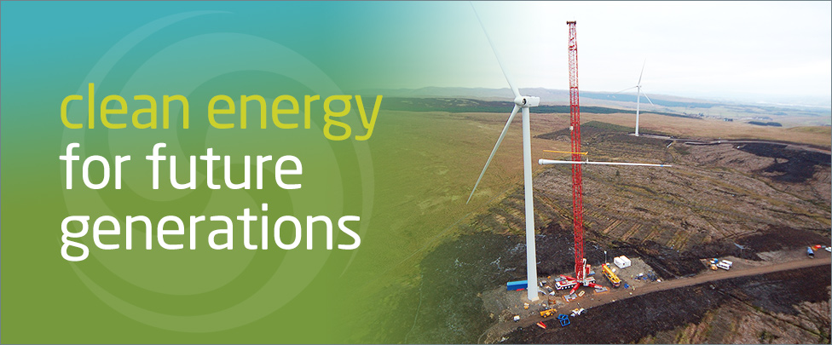
The Scope for Inclusive/Social Innovations in UK
Top-down/hierarchical/profit-incentivised technological innovation cannot meet the needs of low income populations or address 21st century challenges e.g. AMR
Inclusive/social innovations often emerge from within communities and social enterprises to become mainstream innovations, especially in the public sector
However, there seems to be no such thing as inclusive/social innovation system in the UK
There are no facilitators of inclusive/social innovations in the UK like the Honey Bee Network in India or the Social Technology Network in Brazil
NESTA and the Young Foundation are exemptions

Slide 13
Evaluation & Policy
How one can evaluate (and even measure) emerging innovations in terms of inclusiveness?
On the one hand, traditional metrics e.g. patents of the Frascati/Oslo Manuals only apply in S&T innovations.
On the other hand, evidence suggests that not all emerging innovations are necessarily equitable and/or participatory.
For example frugal innovations still come at a price that, by definition, excludes those who live below poverty lines.
Emerging innovations are able to help poor people to satisfy needs or achieve functionings but under certain conditions.
The question is what should the role of public policy be? Should public policy support inclusive innovations in some developing contexts (e.g. in communities living below $1.25 per day) and social innovations in some developed contexts (e.g. in communities living in relatively low incomes)?

Slide 14
Conclusion
It’s difficult to distinguish between inclusive and social models of innovation in globalising conditions of poverty and inequality
In any case, these emerging models of innovation have something in common: they challenge traditional, top-down and hierarchical models of S&T innovation driven by profits in neo-liberal markets
Emerging models of innovation are politically and normatively significant for transforming social relations and meeting needs
Neither inclusive nor social innovations can be evaluated by traditional S&T indicators and metrics
There is a need for alterative qualitative/quantitative evaluative frameworks drawing on what I call non-ideal principles of justice: equity; participation; and recognition.
Public policy has a role to play in supporting/scaling up those emerging innovations which meet the requirements of justice.

Slide 15
Thank you for your Attention

