Slide 1
Global health labour migration: gender, global governance, social policy
Nicola Yeates
Professor of Social Policy, Open University
Gender and Social Policy IKD seminar, Walton Hall, 30th October 2019

Slide 2
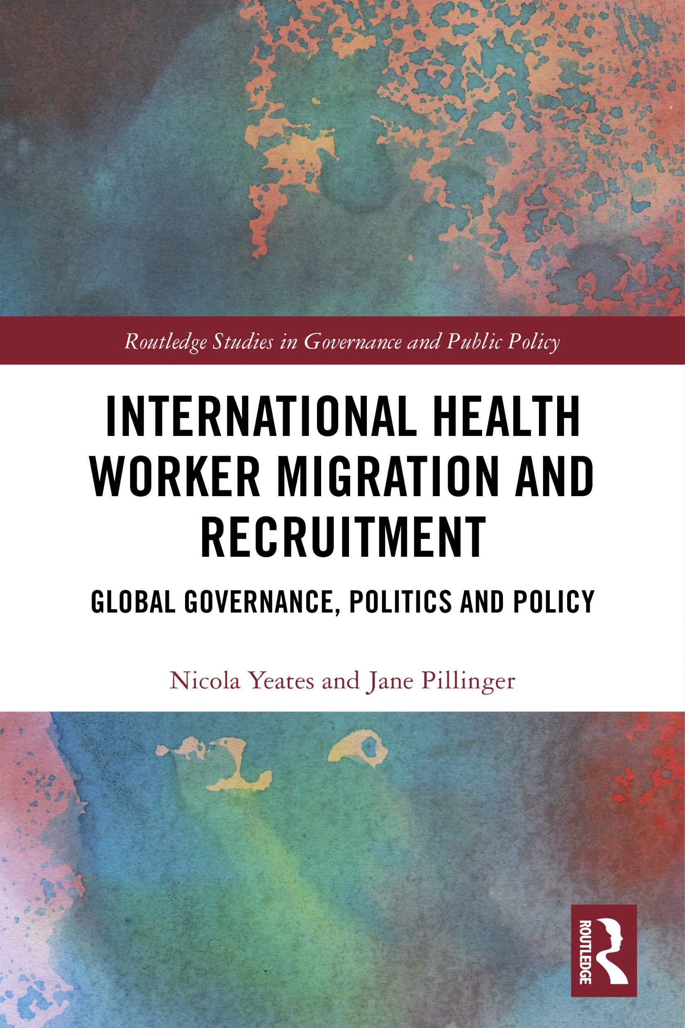

Slide 3
No health without a workforce

Slide 4
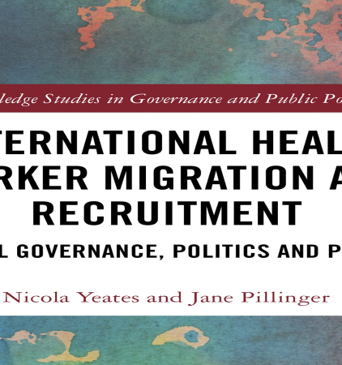
What about global social governance and policy?

Slide 5
Scope and questions of the book
Initiation and development of IHWMR as a global social policy field over 70 years (to 2018): - Global institutions, actors, norms, policies, programmes; - How IHWMR is taken up as a global policy issue and responded to, and the material, ideational, normative drivers of this; includes extended analysis of bilateral agreements; - Looking ahead: key issues and priorities for global policy viz. SDGs
How and why have cross-border spheres of governance become such important sites of action on IHWMR?
What policy approaches are evident in the field, and as instituted in global initiatives?
What are the implications of the evidence and analysis? Theoretically, in relation to welfare state and social policy change? And for creative opportunities viz. transformative action?

Slide 6
Overview of the book
Ch. 1: The global dynamics of IHWMR policy
Ch. 2 Initiating the global policy field: role of the UN
Ch. 3: Elaborating the global policy field: 1977 ILO Nursing Personnel Recommendation
Ch 4: The rise of ethical recruitment: momentum without enforcement
Ch. 5: Implementing WHO Global Code of Practice: momentum sustained?
Ch. 6: Bilateral agreements: a resurgent feature of global policy
Ch. 7: The global campaign for universal health coverage: SDGs and beyond
Ch. 8: Conclusion – towards a new world order for health

Slide 7
About the IHWMR case
Earliest case of a global social policy field of care and migration.
Development of the field is best understood through multiple global regimes - health, migration, social protection, labour, trade, equality, human rights, development – and intersections among them.
An overtly institutionalised field:
2 dedicated multilateral agreements and several flanking ones; multiple global and sub-global initiatives underway, further ones in train.
Multiple transnational actors, diverse international governmental and non-governmental organisations.
A dynamic, ‘busy’ field, viz global institutions, actors, norms, policy approaches, programmes, initiatives - and a highly contested one; critical junctures.

Slide 8
 | Key concepts | Landmark agreements
1. Initiating and defining the global policy field | Brain drain, ‘reverse’ transfers of technology, fair recruitment | ILO general labour standards from 1946 (also pre-UN during LoN era); Universal Declaration on Human Rights 1948; International Covenant on Civil and Political Rights 1966; International Covenant on Economic, Social and Cultural Rights 1966; ILO Nursing Personnel Recommendation 1977
2. The rise of ethical initiatives | health sector reforms, ethical recruitment, temporary/circular migration, decent work | General Agreement on Trade in Services 1995; MDGs 2000; Various ethical codes from 2000, leading to WHO Global Code of Practice on the Ethical Recruitment of Health Personnel 2010; (Social Protection Floor 2012)
3. Mainstreaming IHWMR into global health and development | ethical recruitment, universal health coverage, health jobs-rich growth, fair recruitment, decent work, sustainability, multistakeholderism, human rights due-diligence, temporary and circular migration | SDGs 2015/16; Global Compact on Migration 2018 [international legally binding instrument - Transnational Corporations and Other Business Enterprises re human rights. Decennial review of 2010 WHO Global Code. Global Skills Partnerships

Slide 9
Gendered health inequity:
gender inequality over the lifecourse undermines global health outcomes
Gendered workforce:
70% of the health and social care workforce are women, 25% of women in this workforce occupy senior roles
Gendered migration:
female nurses are the dominant migrant health worker group; across the migration process, vulnerability to exploitation
“Demographic changes and rising demands for health care are projected to drive the creation of 40 million jobs by 2030 in the global health and social sector. In parallel, there is an estimated shortfall of 18 million health workers, primarily in low- and middle-income countries, required to achieve the SDGs and universal health coverage. The global mismatch between health worker supply and demand is both a cause for concern and a potential opportunity… [but] gaps in health worker supply will not be closed without addressing the gender dynamics of the health and social workforce.”
(WHO 2019, Delivered by Women, Led by Men)

Slide 10
Gendering global governance, politics, policy
Early focus on ‘brain drain gives way to feminisation of the policy field in 1970s
Limited systematic appreciation of gendered HWM in global policy
E.g. gender inequalities replicated through migration process, neglected in human resources for health planning, multiple discriminations (as women, minority ethnic, migrant)
Belated impetus from SDGs: gender equality, health and well-being, decent work
Acknowledgement of gender dividend of SDGs in social and health care workforce, but discourse focuses on increasing women’s LF and educational participation in attaining UHC
Opportunities for transformative social policy to address global health and social inequalities remain to be fully seized…
…including how gender/intersectionality in health worker migration can be incorporated into global policy.

Slide 11
Strengthening global governance of International health worker migration and recruitment
Are new instruments needed or better implementation of existing ones?
What about institutional strengthening?
What approaches? From ‘aid’/’charity’ to…self-sufficiency?
And how?
Financial restitution
Inclusive multi-level, multi-stakeholder partnerships
Ending dependence on overseas health workers to staff health services
Shared responsibility rooted in the values and practices of equality, global social justice and social sustainability
Beyond health: forging lateral connections across multiple social and economic policy sectors
Dialogue with the care economy and investment in social infrastructure

