Slide 1

Exploiting industrial policy / health policy synergies for inclusive growth: research in Tanzania and Kenya
Maureen Mackintosh,
The Open University, UK
Presentation at the DEGRP – AERC Conference on
Economic Opportunities for a Better Future: Leveraging Agriculture, Innovation and Financial Inclusion
28th- 29th October 2016 Nairobi, Kenya

Slide 2
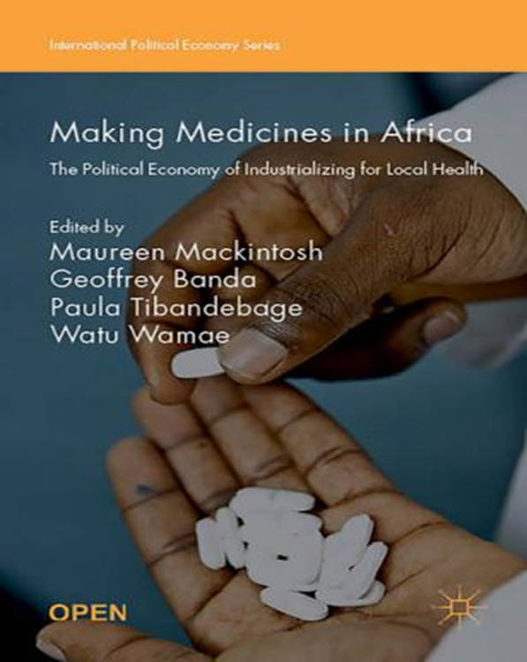
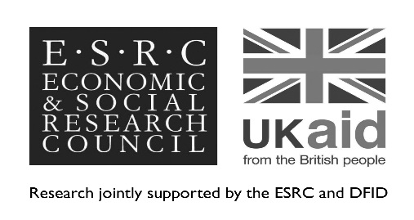
Sources and acknowledgements: DEGRP project:
Industrial productivity and health sector performance
Research collaborators:
REPOA, Tanzania
African Centre for Technology Studies (ACTS), Kenya
The Open University (OU), UK
Project website Kenya-hosted: iphsp.acts-net.org
Aim:
To identify opportunities for improved local industrial supply of pharmaceuticals and other essential health commodities to strengthen health systems performance while contributing to industrial development.
    Disclaimer: does not represent
    the view of DFID or the ESRC, UK
http://www.palgrave.com/us/book/9781137546463

Slide 3
Industrial policy : an inter-sectoral collaboration
Like innovation, industrial policy does not occur in isolation.
Local manufacturing firms are embedded in the wider economy:
Most rely on the domestic market for much of their core revenue
Includes some successful exporters as well as domestically oriented producers
All rely on capacity of suppliers and customers for inputs, services and effective purchasing.
Industrial policy-makers therefore have to work with other sectors.
Health policy forms an “implicit industrial policy” (deliberately or not) for pharmaceuticals and other health sector supplies.

Slide 4
Local manufacturers of health sector supplies in East Africa have a large, increasing but poorly exploited market opportunity
Tanzania: the medical import-export gap

Slide 5
Kenya’s medical exports are rising, but the domestic import-export gap is also increasing
Kenya: the medical import-export gap

Slide 6
Kenya and Tanzania: pharmaceutical markets 2009 and 2013: imports, exports, local production (current USD million) and market share of local manufacturers
Country and year | (1) Imports (USD m) | (2) Exports (USD m) | (3) Local production (USD m) | Local market share (%)*
Kenya
2009 | 298.6 | 67.3 | 99.9 | 30
2013 | 466.4 | 82.1 | 193.1 | 33
Tanzania
2009 | 99.4 | 7.9 | 49.2 | 35
2013 | 286.1 | 1.7 | 48.7 | 15
*Calculated as (3) / ((1) + (3) – (2))

Slide 7
Manufacturers for the health sector face some common challenges
Suppliers are technologically diverse, but all face:
Importance of quality standards for market access;
Constant upgrading to meet competitive and regulatory standards;
Price-based competition from imports, some subsidised in country of origin;
Some staff with low education, competition for skilled staff;
Problems of quality and availability of locally made inputs;
Tax/duty regime exempting final products from tax, while not all inputs are tax-free;
Public procurement regimes that are largely import-focused;
Private wholesale markets with strong import focus;
Mixed public perceptions of local product quality.

Slide 8
Industrial policy as traditionally understood can address some of these challenges
Fiscal/ tax changes: revision of taxes and duties to incentivise local production over imports, removing unintended consequences of current tax and duty regimes;
Supporting step-up in technological capabilities of local firms; donors such as German and Japanese agencies, and international public/private partnerships
Strategic investments in technical training and support for firms that train effectively; improved basic education where needed;
Support for building up the national science base, in key areas for manufacturing such as pharmacology and chemistry.

Slide 9
There is science and innovation activity requiring support.
Industrial innovation in pharmaceuticals in Africa:
Few API producers in SSA, but emerging firms e.g. LaGray in Ghana, Fine Chemicals in South Africa, artemisinin in Kenya;
Scope for growth where market predominantly African, e.g. Entecavir for HepB; key basics that are of declining interest to Indian exporters.
Other opportunities
“leap frogging” technologies such as “green chemistry”;
“reverse pharmacology” and phytomedicines: drugs using traditional medicines and skills: e.g. Nigeria synthesising and testing Niprisan^{(TM)} for sickle cell disease;
Development and use of local excipients for pharmaceuticals e.g. native “enset” and other starches in Ethiopia.

Slide 10
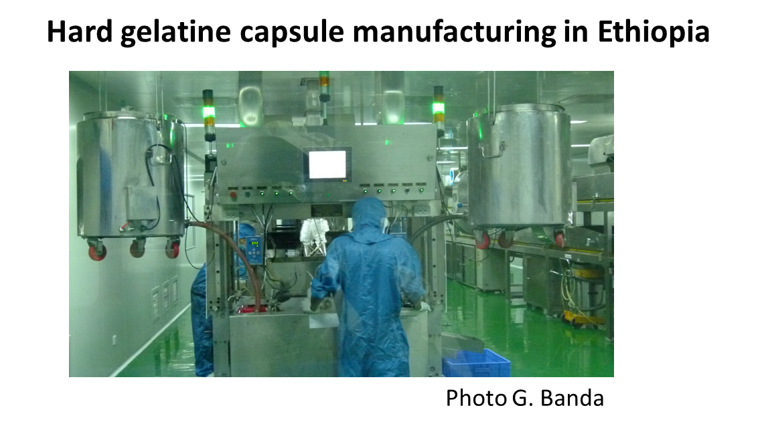
There are existing firm-level innovations that can be facilitated.
PPPs investing in introduction of new formulations (e.g. combination anti-malarials, by DNDi) for regional distribution.
Joint ventures e.g.
China/Ethiopian;
Middle East/ Ethiopian;
Japanese/Tanzanian.
Higher quality recycling
to reduce costs and face
competition.

Slide 11
A key policy arena is procurement and market access: this needs industrial/ health sector collaboration
Global health interventions have saved lives, but also “unstitched” domestic industrial/ innovation/ health system linkages in pharmaceuticals:
Donor funding has hugely increased access to HIV and TB medication in Sub-Saharan Africa, and has supported roll out of new diagnostics.
Funding forms part of huge rise in development aid for health; has had a major impact in saving lives.
Global medicines funding for international procurement from WHO-prequalified suppliers largely external, with logistics undertaken locally;
Development of vertical supply chain management for HIV/TB with some local purchasing of medicines for opportunistic conditions;
Sharp rise in barriers to entry into domestic health care markets for local pharmaceutical manufacturers.

Slide 12
Donor impact on procurement visible in supply chain data
Country of origin of essential tracer medicines, by category of medicine and country of use (% by medicine category) 2012
Country of use | Tanzania |  |  |  | Kenya
Country of origin | ACTs (ALu) | ARTs (HIV) | Chronic disease | Other | ACTs (ALu) | ARTs (HIV) | Chronic disease | Other
Tanzania |  | 10 |  | 19
Kenya |  |  | 12 | 18 | 1 | 2 | 59 | 44
India | 37 | 90 | 41 | 46 | 44 | 90 | 12 | 27
China | 8 |  |  | 8 | 4 |  | 2 | 6
HICs | 55 |  | 47 | 7 | 51 | 5 | 20 | 17
Other |  |  |  | 2 |  | 2 | 7 | 6
Total | 100 | 100 | 100 | 100 | 100 | 100 | 100 | 100

Slide 13
‘Domesticating’ procurement policy is a key element of reducing these market entry barriers
Public and NGO wholesalers buy more medicines locally than the private sector, but could do more.
 | Tanzania |  |  | Kenya
 | Wholesale source sector |  |  | Wholesale source sector
Country of origin | Public | Donation | Private | Public | FBO/NGO | Donation | Private
Medicines
Tanzania | 22 |  | 11
Kenya | 10 | 25 | 20 | 54 | 76 | 50 | 32
India | 49 | 25 | 47 | 30 | 8 | 40 | 31
China | 6 |  | 6 | 8 | 1 |  | 4
HICs | 12 | 50 | 12 | 8 | 10 | 10 | 25
Other |  |  | 4 |  | 5 |  | 8

Slide 14
Increasing local leverage over medicines procurement
Increase tax-funded procurement of medicines: share may be as low as 5% of the medicines market in both Tanzania and Kenya.
Amend public procurement rules and practices : trade credit, tender size, contract length and structure, payment reliability, accreditation of suppliers, decision rules, assessment of local value;
Improve public procurement agencies’ working relationships with local firms; increase NGO/FBO wholesaling role?
List some medicines and supplies for local tenders only so long as pricing and competition acceptable, or for local supply only (no private imports).
Influence private sector importer/wholesaler incentives and challenge business links with overseas exporters;
Challenge preferences of donors for large overseas orders, and the role of donors in setting procurement systems and fragmenting supply chains;
Involve local procurement officers and clinicians in supply chain design.

Slide 15
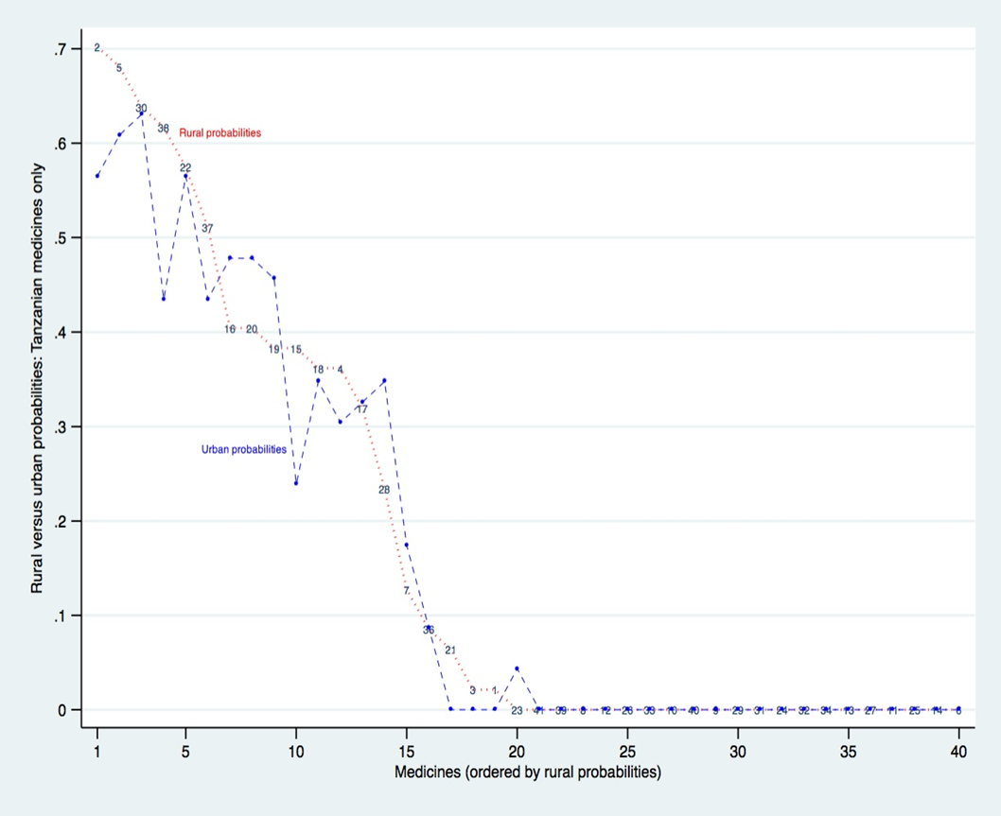
Importantly local supply can also improve health sector performance by improving supply availability
Probability of finding on the shelves a medicine made in Tanzania is roughly equal in rural and urban areas 2006

Slide 16
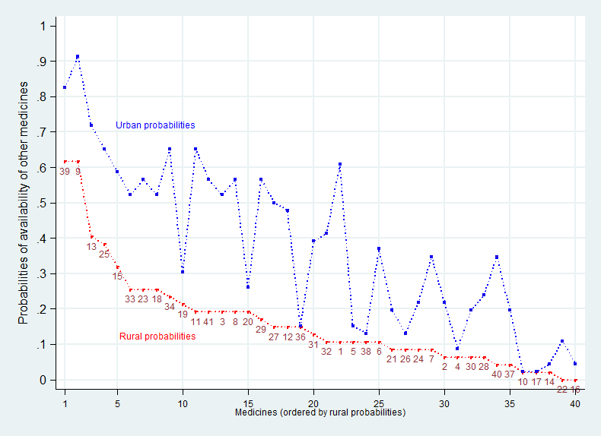
Local manufactures can reach rural areas better than imports
Probability of finding a medicine on the shelves made outside East Africa is much lower in Tanzania in rural than in urban areas (2006)

Slide 17
This in turn requires health system changes
Most SSA countries’ health systems rely too heavily on OOP, implying:
Exclusion of many people from treatment;
Lack of effective demand, reducing on-the-shelf availability;
Public sector stock-outs and heavy reliance on private shops for medicines, at higher prices than public sector;
Public facilities relying on medicines sales for petty cash;
Small scale private dispensaries and shops focus on low priced medicines sales: quality problems and chronic under-treatment;
Resistance to paying into community insurance schemes because money remains needed for medicines unavailable in the public sector.

Slide 18
Better health system quality and coverage is in the industrial interest
A much lower proportion of essential medicines access should go through private shops;
More medicines access should be free or at very low cost, implying more public and NGO/FBO procurement and supply;
Access should be increasingly associated with proper diagnosis and dispensing;
The private sector should move / be located more up-market, displaced by competition from low cost non-profit/public provision;
More and more reliable public as well as donor funding for the whole range of essential medicines and supplies, including antibiotics and chronic disease medicines, gloves and test kits.
Formalisation of the health care system, and expanding coverage, is the basis for better local industrial market access.

Slide 19
Policy ambition?
Bringing industrial and health policy together to help transform both sectors:
Industrial, technological and scientific improvement;
Better access by local manufacturers to domestic markets;
Better employment: more jobs, more skilled, decent conditions;
Moves towards universal health coverage: socialisation and formalisation of the health sector.
In the process, creating lobbies in each sector with mutual interests in sustaining domestic linkages.
But note that shaping this “health-industrial complex” in Brazil took three decades – it needs to be built institutionally, it can’t be willed into existence.

