Slide 1
Inclusive Innovations for International Development
Belinda Wu
07/12/2016
SRA IDII & DPP

Slide 3
Inclusive Innovations
Infrastructure based innovations
Technology based innovations
Research method innovations

Slide 4
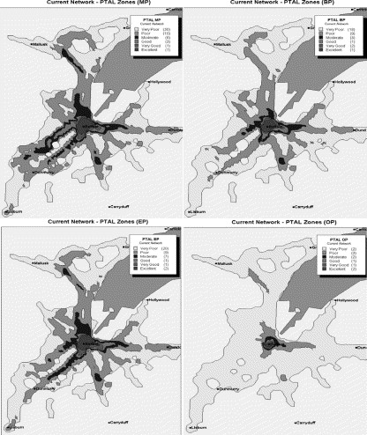

Slide 5
E-Social Science

Slide 6
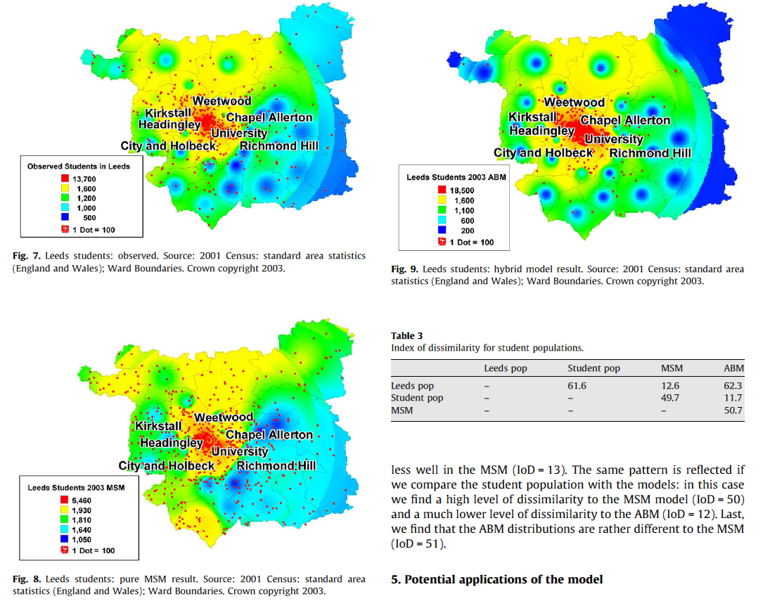
Housing

Slide 7
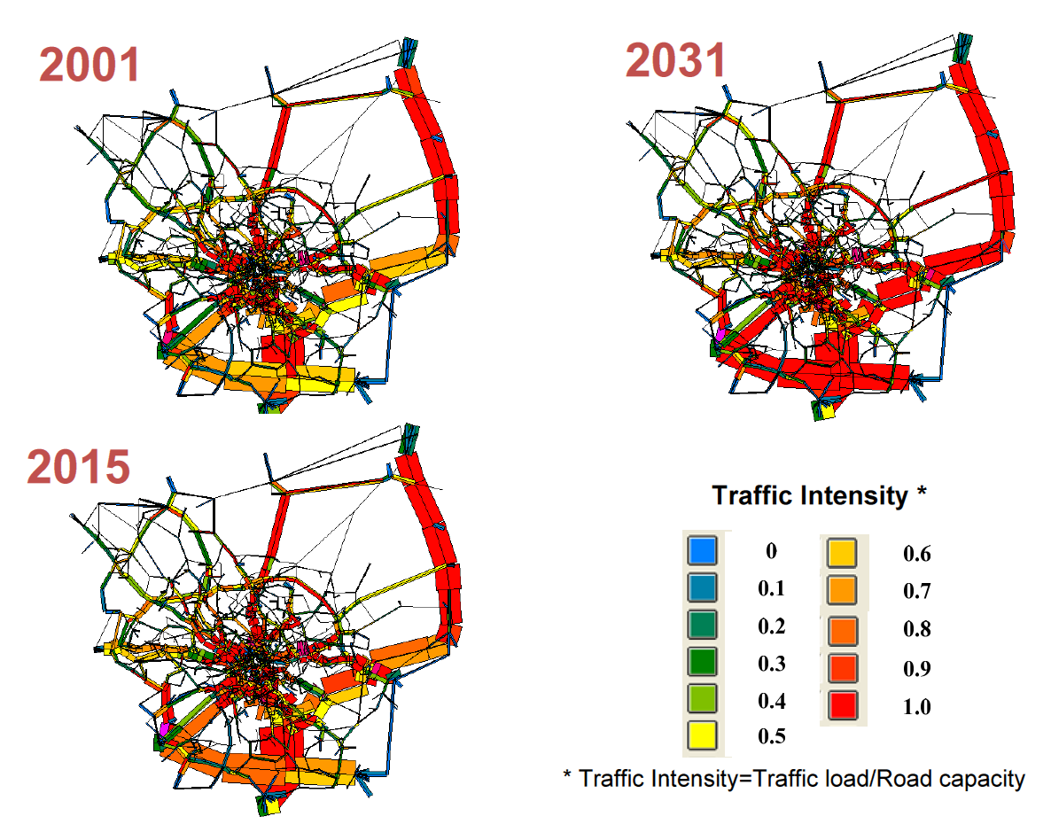
Transport

Slide 8
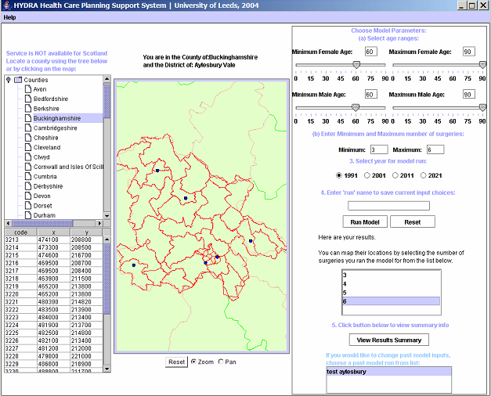
Health

Slide 9
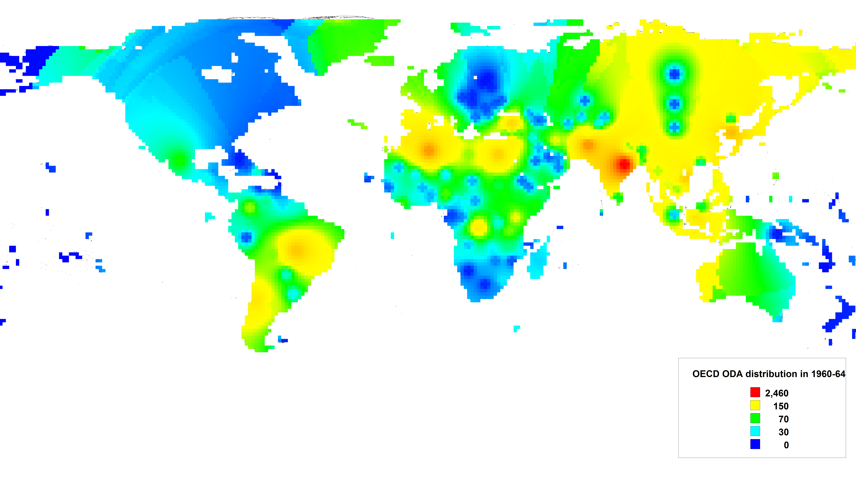

Slide 12
How big is Bangladesh?

Slide 13
How far away is Finland from North Korea?

Slide 14
Geography matters
Ultimately, people have to live in a local area and they are affected by local environment
Spatial central tendency and Dispersion
Shape and Pattern
Relationships
A surrogate
A bridge
A vehicle

Slide 15
Complexity Science
complex
self-adapting
system
self-organising agents interact
designs and strategies evolve
Emergence from micro behaviours

Slide 16
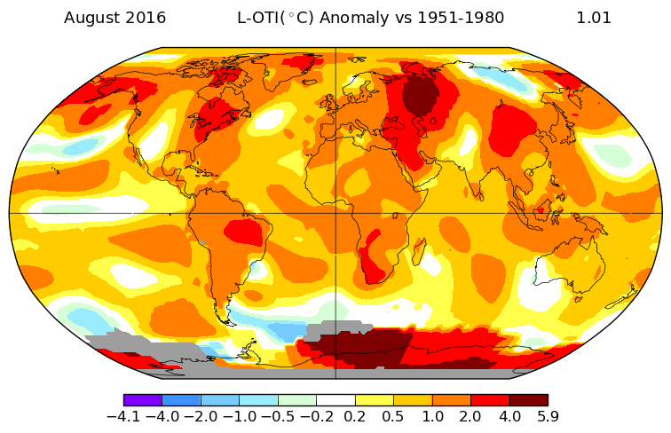
The impact of climate changes on sustainable development
The impact of climate change on sustainable development

Slide 17
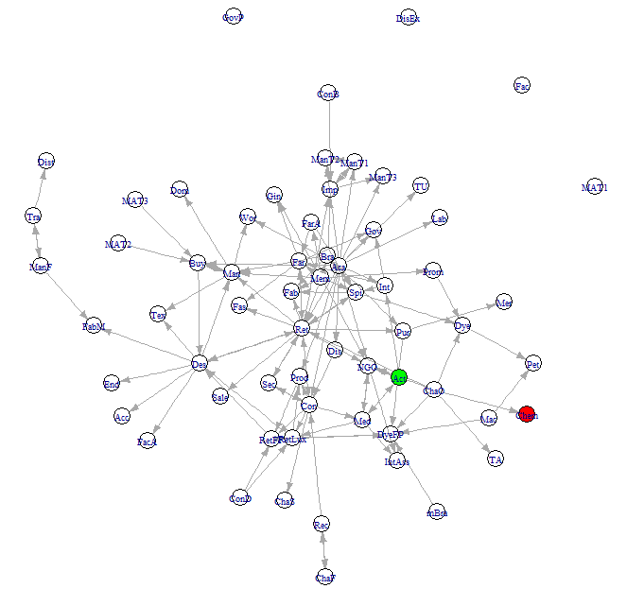
Stakeholder mapping in sustainable fashion

Slide 18
Big Data

Slide 19
‘We cannot solve problems by using the same kind of thinking
we used when we created them.’
ALBERT EINSTEIN
Notes:
19

Slide 20
Thank you!
Belinda.Wu@open.ac.uk
http://dpp.open.ac.uk/

