Slide 1
Dimensions of the Awarding Gap
Insights from a mixed-methods study with Black students and diverse educators at the OU
Key staff associated with the project: Miriam Fernandez (KMi), Martin Hlosta (KMi), Fidele Mutwarasibo (FBL), Tracie Farrell (KMi), and Vaclav Bayer (KMi)

Slide 2
OUTLINE
I
Measuring the Awarding Gap
Using learning analytics disaggregated by broad ethnic groups
II
Understanding the Awarding Gap
Interviews and focus groups with Black students and diverse educators
III
The 6 Features
Six features identified by our participants as being critical to understanding the awarding gap
IV
Recommendations
What the University would need to do next
Notes:
This presentation covers only some of the work that we conducted for this project. There’s a lot of technical work behind this that is the work for Martin, Vasek, Miri – which will be in our final report on this project. In this presentation, I will be focusing more on parts 2 and 3, with a little bit of part IV, but I think this research best communicates how important it is to continue researching this subject empirically and qualitatively to understand its features better.

Slide 3
Using Learning Analytics to understand the Awarding Gap
RQ 1: Are learning analytics biased?
RQ2: Can learning analytics help understand or mitigate the awarding gap?
Understand where exactly the gaps are
Track the impact of predictions on students of different ethnicities
Take predictions from OUAnalyse and disaggregate them by ethnicity
Check error rates for Black, Asian and White students
RQ3: How do Black students and diverse educators view our findings?
What explanations are given?
Is this a useful approach?

Slide 4
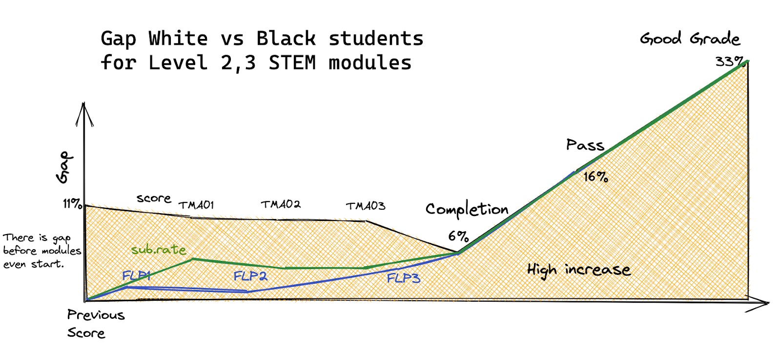
Using Learning Analytics to understand the Awarding Gap
2017B -> 2020D presentations
Largest gaps are in passing and getting a good grade

Slide 5
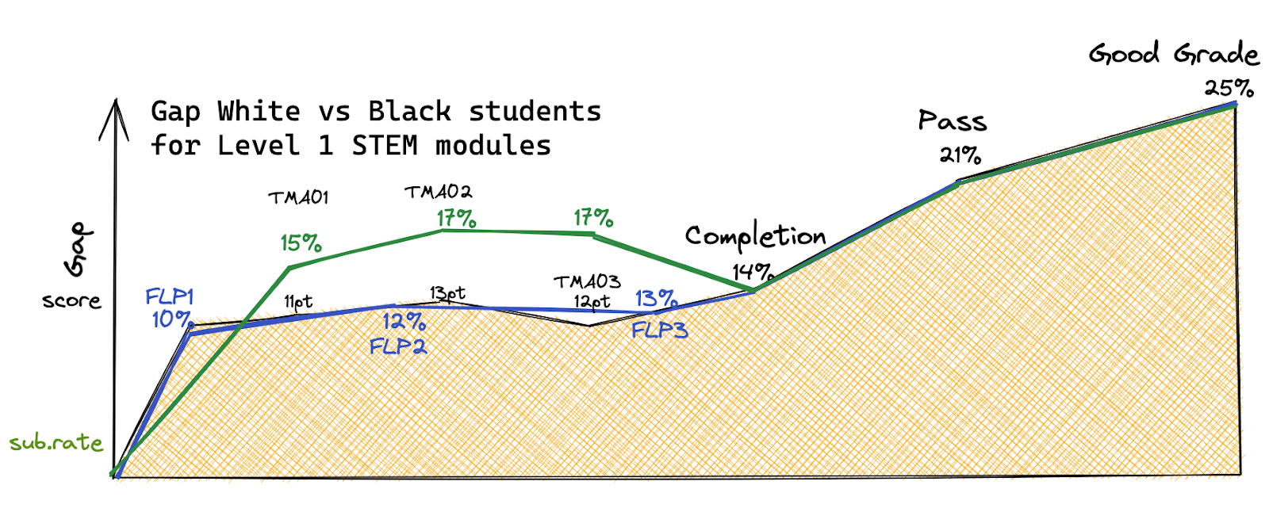
Using Learning Analytics to understand the Awarding Gap
2017B -> 2020D presentations
More Black students withdrawing
More Black students repeating the module
Starts with the first TMA. At the STEM faculty, the difference of average scores between Black and White students is 11 points. This gap prevails even after accounting factors like previous education or IMD.

Slide 6
Qualitative Interviews
Participants:
6 Educators and 6 students
Setting:
1.5 -2 hour Focus Group on Teams (x 3 focus groups)
1 hour Interviews with participants that could not join focus groups
Stimulii:
Outputs from OUAnalyse
Summaries of other student analysis
Analysis:
Thematic Analysis of emerging categories
Participant checking and amendment
Findings
Black students are not a monolith, there were 6 major features named as impacting the awarding gap in an intersectional way,:
Cultural Capital – your own cultural background, values, and how this interacts with the educational environment of the UK
Family Matters – the level of support you have from your family and the level of support you are providing to your family (can be impacted by immigration status)
Immigration Status – whether or not you were born and educated in the UK, the security of your status and how this interacts with the education system
Socioeconomic Factors – what resources are available to you and which not
Racism and Discrimination – on top of all other features that Black students may share, experiences within the milieu
University Relations – what you expect from the University and what it expects from you
Features can be resources if the University is aware and responds appropriately.

Slide 7
Cultural Capital
For West Indian families, generally, there is this thing that education will get you where you need to be. Still, at the same time, it is a) can you get into the educational system?, b) have you got the tools to survive in the educational system?, and c) have you got the guidance that someone can help you pursue the education and maximise what you are doing? (Student 2).
What participants discussed:
The importance of cultural values and expectations around education
How cultural values can drive students into certain fields, encourage them to keep going, set their goals for the future
How values impact students’ abilities to navigate the UK education system and what they expect from it
“And one thing that I also notice is that raised black people, we value education a lot, because I remember back home or my parents used to tell me study study study, it’s only when I came here, I got, I understood, I understood that you can do other things than studying, you can do apprenticeship, for example, for example. But in all my life, I have been taught that you need to finish university, it may be because your parents did not study, that push you more because you want to complete it. So that as well I can contribute the fact that black people, if they are financially settled, it is incorporated in them that they need to study.” [Student 6]
"And if you don’t know what you are aiming for, and you don’t know what the impact is of the grading you get, you are just not plodding along, you are just kind of sucking it up, just getting along with it and just to pass. If you think that getting 60 is normal for you and no one told you any difference, you are going to just continue at the same rate, so I wonder if that feeds into it." [Educator 4]

Slide 8
Family Matters
I don't know, but I think maybe there is a relative that can help you with a weekend of childcare; I think that can make a big difference, but for most immigrants, it is 24/7; I have been told that. If you have people other than the child-minders who will take care of other things, maybe it reduces (Student 3).
What participants discussed:
The impact of your responsibility to your family
The impact of family support on education (childcare, financial, other support)
you couldn't come when you were younger because you didn't have the means to go to university, so you wait until you start working, and then you start, you try to study maybe, you might find it harder to juggle family life and studies and things like that. Yes, whereas if you come in younger because you can afford it, maybe your family can afford it, perhaps it might be in a better mindset to study. (Student 2).
Our system is totally different. As Africans, our system is totally different. As a Black person, you take care of your mom; you take care of your dad, take care of your siblings, take care of so many people. So when you're in a different country, even though you're working, most of your resources goes back home to take care of some of those people. So that tends to affect even your ability to increase or advance in your academics. (Student 4).
Those 20-something-year-olds who didn't care in the world attended OU for convenience, because they couldn't cope with the traditional ways of learning. So she didn't have kids; she didn't have anything. (Student 5)

Slide 9
Immigration Status
So, working twice as much because you're an immigrant who is not entitled to a student loan, you have to work to pay for them. So I think that might impact (Student 5).
What participants discussed:
Intersections with other features
Impact on prior knowledge
Impact on how knowledge is verified (English competency)
Impact of generational experiences, racism and xenophobia
most of the Windrush generation, of which my dad would be presumed to be one, came to do more of the jobs that British people didn't want to do, so it was things like the admin jobs, the nursing jobs, bus driver jobs, those kinds of things…so I think it has taken a while for in effect that trying to put it, the group of people to realise we are part of Britain truly and but that we should set expectations amongst our kids, we should be no different to the white ones (Student 1).
We have students from all over the world, so is there a difference between the Black students based in the UK and black students based in Black-majority countries that study with us? (Educator 2)
[science-based module] was easier for me to do that module because I didn't have to write a lot in English. Because I know English is my third language is not even my second language. So it's quite difficult for me to speak. And you can, you can understand right and will be more difficult (Student 6).

Slide 10
Socioeconomics
What participants discussed:
Historical settlement of Black communities
Disproportionate access to resources
Access to generational wealth
Compounded problems
if you have more things to worry about in your environment, so if you come from a poor background, a poorer background, you might have more problems interfering with your studies or leading you to withdraw from your studies, and that might be higher in minority students if you want … for someone who really doesn't want to carry on because ok I haven't got enough money I really can't afford it, that's it the end of the story (Student 2).
certain people don't have the financial support you know if your support is just the student loan or your work supporting you then you don't have grandad or mum or dad to support you from if you are a certain social demographic you don't have that, certain people do have that you know (Educator 1)
You get a lot of people withdrawing for financial reasons, either they’ve lost their job, or…you also get people who are in unstable home environments where they are about to be made homeless and so on … students withdrawing for mental health reasons (Educator 2)

Slide 11
Racism and discrimination
students who are black, particularly, are always carrying stuff. Still, it's become part of our experience that we are carrying stuff in the society … an additional burden to bear. If you already feel that you don't belong in the organisation, if you feel like you have no one to speak to … this is really heavy, and that really throws your concentration, that can throw your motivation if you are in a predominantly white environment, it can make you feel you are even less likely belong. So I think within the mind, this is the most challenging year, and then life stuff bleeds into it (Educator 4)
What participants discussed:
Racism in the milieu and impact on motivation
Impact of key events on students’ progress
University response to racism
I'm already at a disadvantage because I am Black so to speak, but then my degree doesn't get me through the door as well (Educator 1)
I think the White person knows that regardless of whether they're educated or not. They can get a job anywhere. But black people, without this, we can't get into the, you know, the kind of jobs we want to get. So you can, you know, in the professional sector, you see white people with little or no education managing Black people with a lot of educational qualification. (Student 5).

Slide 12
University Relations
What participants discussed:
Flexibility as a key reason for choosing the OU (linked to socioeconomic and family matters)
Preferring less interaction with tutors
Needing more interaction with other learners
Representation
why I had to pick OU was because of the flexibility. I at the point I was travelling a lot. So, I felt is only the OU programme that can allow me, you know, travel and yet still, you know, do the programme with such flexibility. And basically, that was my main reason for choosing OU. (Student 4)
I wanted someone who lives in [City] and, and who I can go sometimes away to the library and study with, because I have never been used to the idea of studying on my own at home is a bit difficult is a change for me. And on the comments section, they were only white people responding. And they were all saying that they were fine sitting at home. (Student 6)
No, no, I’ve got good relationships with my tutors. I don’t really interact with them very much or very often. (Student 2)
It is not about a student that wasn’t capable of doing the degree these are all capable students coming through the door, but when they come through the door something happens and they can’t get the degree that their skills and quality suggest that they should. (Educator 1)

Slide 13
What can the OU do immediately?
Learn more about different Black communities at the OU
Collect more nuanced data about student circumstances
Provide more targeted support for Black students, especially those with immigration background
Utilize knowledgeable staff (and compensate them for their work)

Slide 14
What are Open Research Questions?
What are the impacts of distance learning on our Black students?
Is an OU degree is valuable for Black students?
What measures impact the awarding gap most?

Slide 15
Thank you for listening If you want to know more about the qualitative study, or contribute your point of view, please get in touch with Tracie.Farrell@open.ac.uk or Fidele.Mutwarasibo@open.ac.uk If you want to know more about OUAnalyse or the predictions discussed in this presentation, please contact Vaclav.Bayer@open.ac.uk

