Slide 1
Embedding research into teaching:
Practices, motivations and impacts
Sarah Davies, Philip Holden, Kadmiel Maseyk,
Cat Cowie and Lorraine Hudson
Environment, Earth and Ecosystem Sciences
20th April 2023

Slide 2
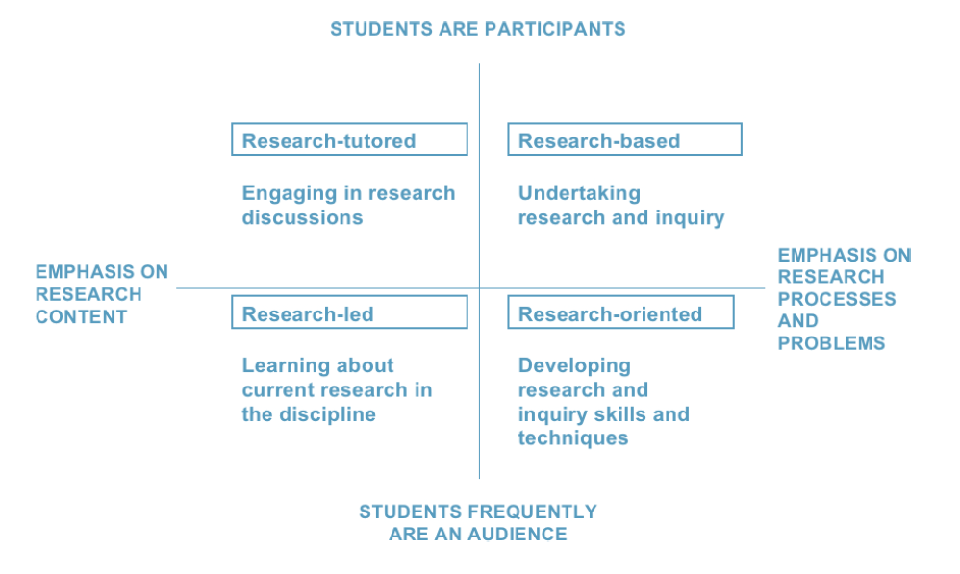
Project background
Linking research and teaching
Benefits to academics and students
However, strength of links are contested
Many struggle to find effective and efficient ways to integrate their teaching and research
A framework for engaging undergraduates with research and inquiry (Healey and Jenkins, 2009).
Healey, M. and Jenkins, A. (2009). Developing Undergraduate Research and Inquiry. Higher Education Academy. https://www.advance-he.ac.uk/knowledge-hub/developing-undergraduate-research-and-inquiry
Notes:
The view that research and teaching in universities should be linked is widespread with suggestions that this is of benefit to both academics and students
But the strength and focus of this is contested. Many institutions grapple with the most effective and efficient ways to integrate their teaching and research
research productivity only shows a weak positive correlation with overall teaching effectiveness
This project takes as one of its starting points the Healey and Jenkins (2009) framework of the nature of undergraduate research and inquiry which places learning activities within a space defined by level of participation (from student as audience to student as participant) and by type of learning (from content knowledge to research processes); this gives a frame for activities ranging from students learning about current research to students undertaking research themselves.
Healey lists seven different methods of linking research and teaching
Bringing data and findings from staff research into the curriculum
Developing students’ appreciation of research in the discipline
Developing students’ research skills (explicitly, in addition to other disciplinary and generic skills)
Using assignments that involve elements of research processes (e.g. literature reviews, bidding for grants, drafting bids or project outlines, analysing existing project data, presenting at a ‘conference’)
Using teaching and learning processes that simulate research processes (e.g. project-based modules, dissertation modules, problem-based learning)
Giving students the opportunity to work on research projects alongside staff (e.g. as a research assistant)
Giving students first-hand experience of commercial consultancy (e.g. as an ‘intern’, as work based learning, as a consultant assistant or as a supervised consultant)

Slide 3
The lightbulb research icon
S397 ‘Terrestrial ecosystems’ SDT306 ‘Environment: responding to change’
“Connections between OU research and teaching materials serve to enrich your learning experience”,
“you are now very close to research” ,
“inspiring for your own futures as scientists”
(S397 and SDT306 module guides)
However, students’ perceptions of these research-teaching links and the impact on their learning has not been investigated

Slide 4
Embedding research into teaching
Aims
To explore the practices of embedding OU research into environmental science teaching
To investigate the experiences of students and academics
To develop recommendations and illustrative case studies as guidance for embedding research into teaching for future module material
Approach
Review core environmental science modules for research-teaching links (U116, S111, S112, S/XF206, S397, SDT306, SXE390)
Student survey
Focus groups with tutors (ALs) and with module content creators
Case studies
Modelling
Data
Knowledge from research
Notes:
3061 students, and received 85 complete responses, giving a response rate of 2.8%.

Slide 5
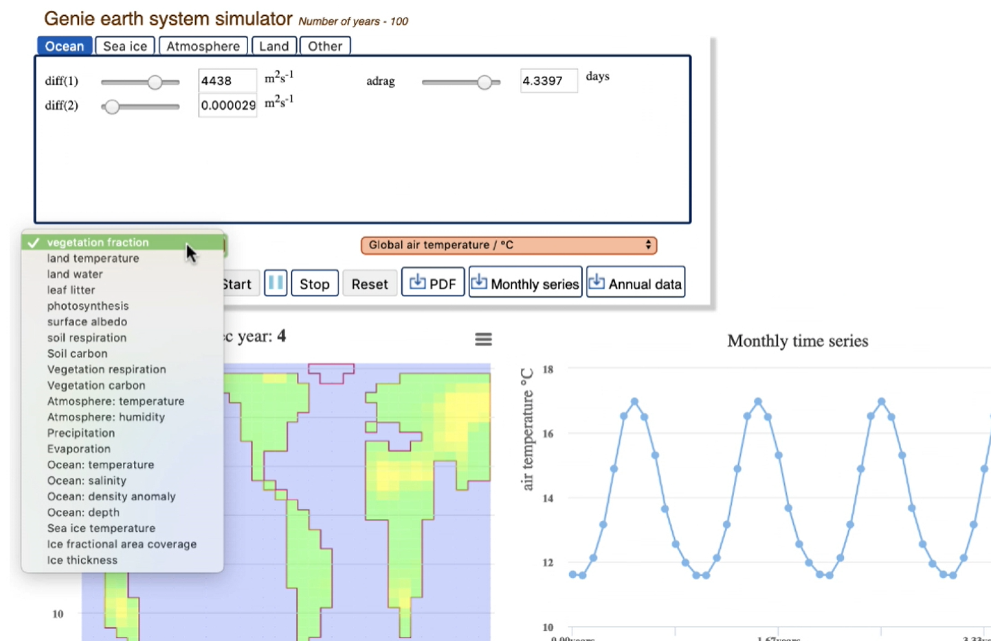
GENIE: Research-grade software
An Earth System Model of Intermediate Complexity
Students:
Apply historical CO₂ emissions to explore the effects of human emission to date on the Earth system
Investigate how uncertainties in vegetation model parameters drive uncertainties in the climate and carbon cycle
Tune the model and make projections of climate change over the next century
Notes:
S397 Terrestrial Ecosystems

Slide 6
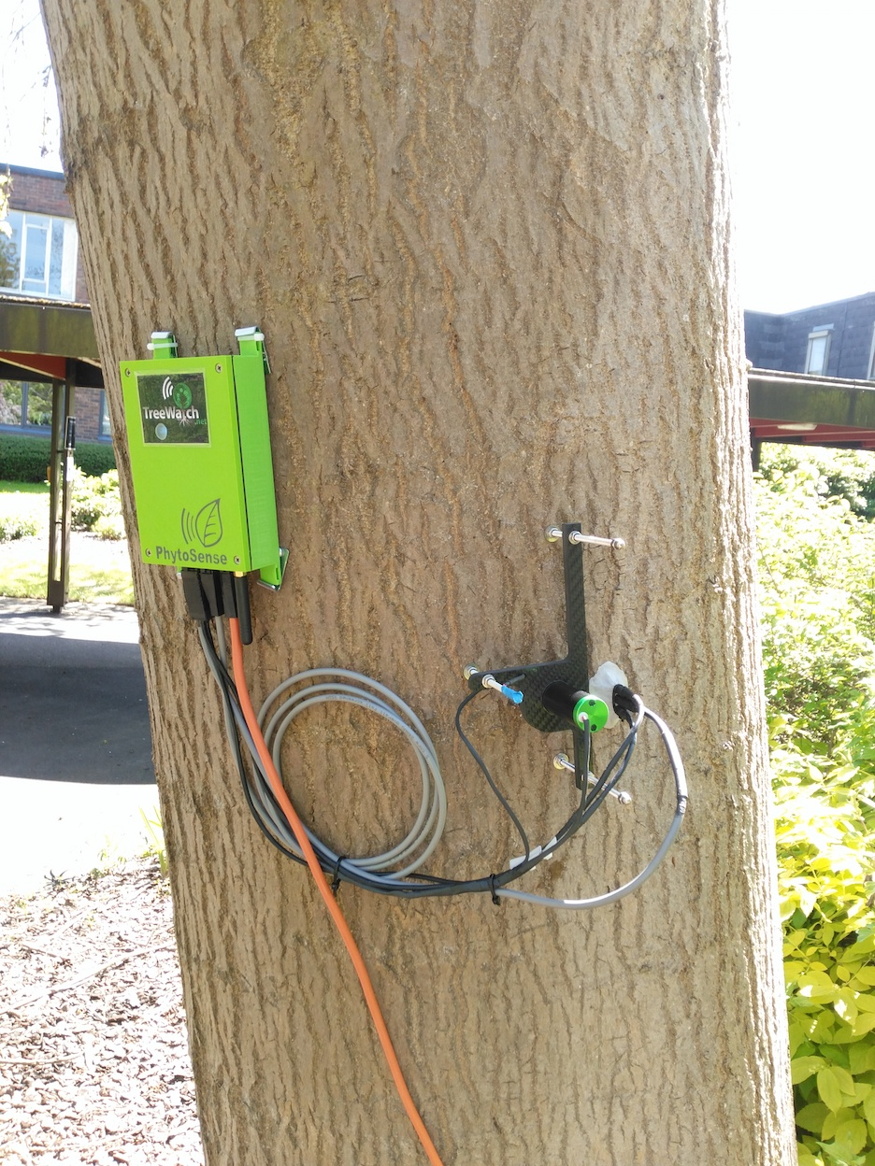
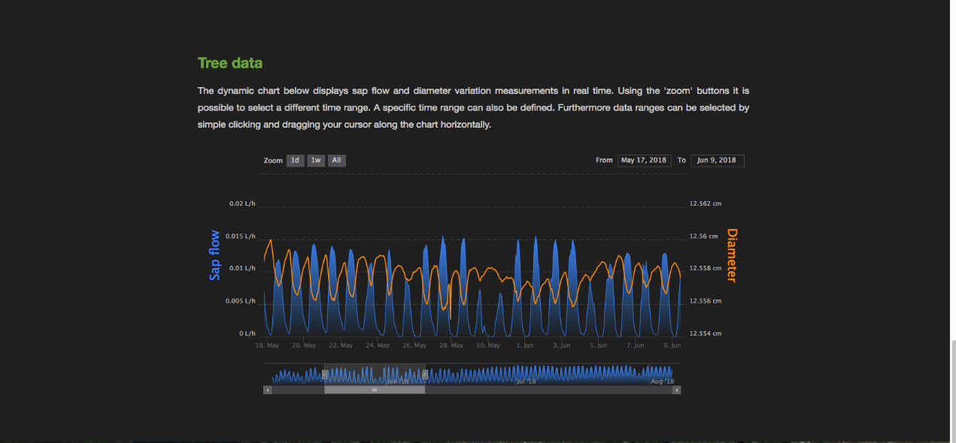
Data: real-time remote data collection
Cutting-edge analytical methods, web-based interface

Slide 7
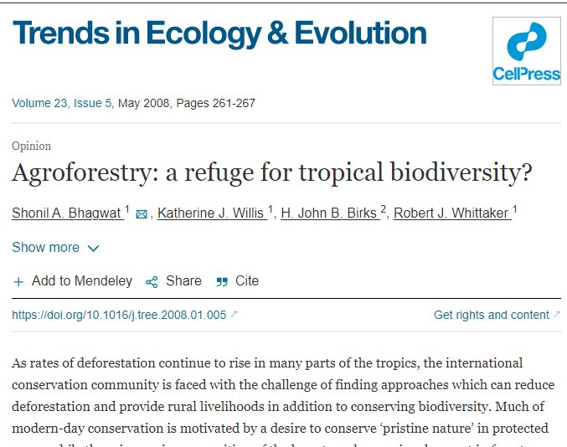
Knowledge from research: module-team authored papers
SDT306 ‘Environment: responding to change’
Shonil Bhagwat et al (2008) “Agroforestry: a refuge for tropical biodiversity?” Trends in Ecology & Evolution
food security and biodiversity can be synergistic
Araya, Yoseph N.; Silvertown, Jonathan; Gowing, David J.; McConway, Kevin J.; Linder, H. Peter and Midgley, Guy (2011). A fundamental, eco-hydrological basis for niche segregation in plant communities. New Phytologist, 189(1) pp. 253–258.
niche segregation in plant communities

Slide 8
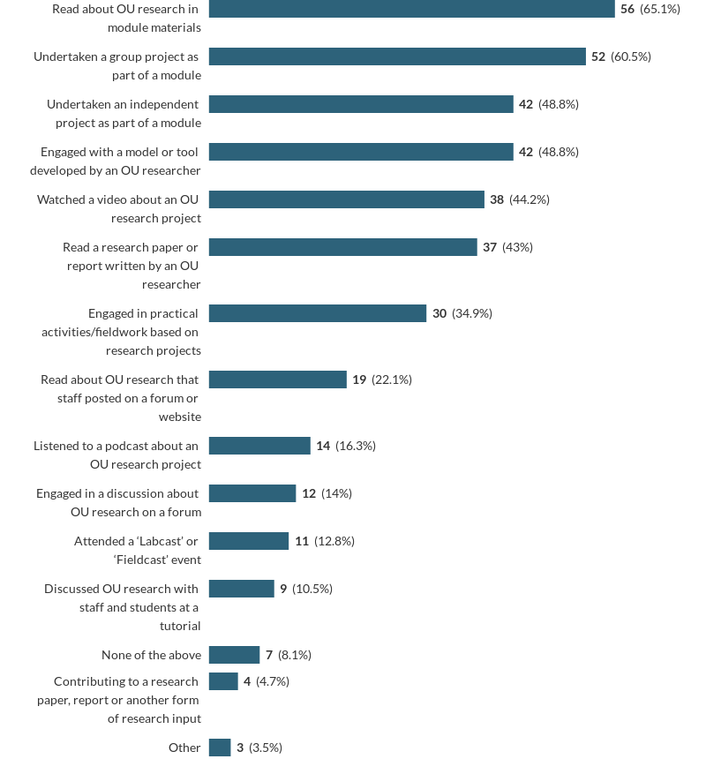
Results
Student survey
How have you engaged with research?
Notes:
Figure 1: Number and percentage of student respondents who had taken part in each of the listed activities. Those responding ‘other’ had attended a School of Social Sciences and Global Studies Teaching-Research Day (1 respondent) or reported reading research papers written outside the OU (2 respondents).

Slide 9
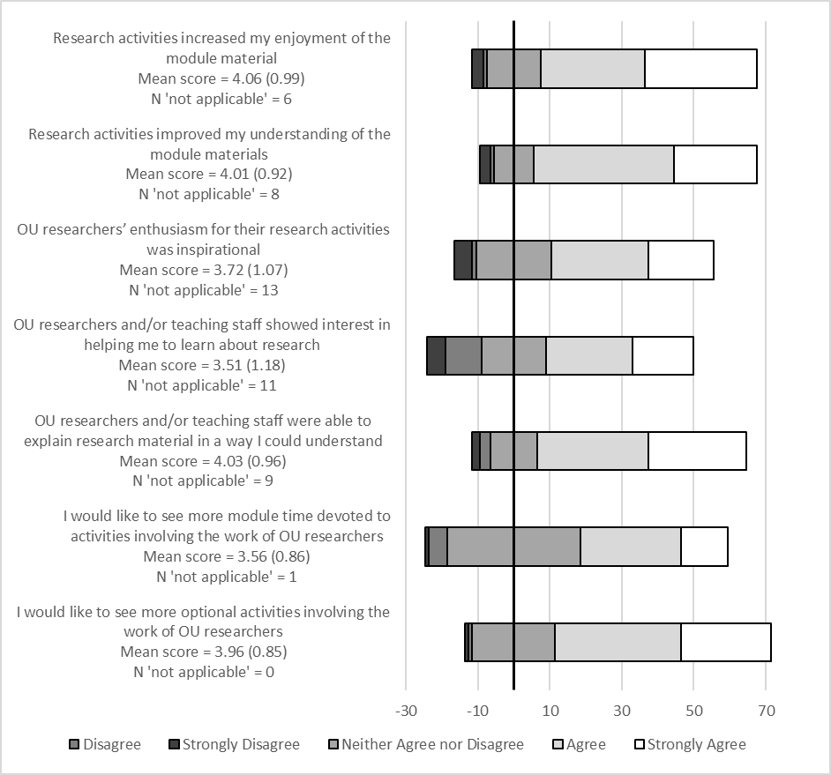
Results
Student experiences of research (across modules)
Number of responses to statements about experiences of research in teaching
shown in each category of the Likert scale, centred on the midpoint of the ‘neither agree nor disagree’ responses.
1=strongly disagree, 2= disagree,
3= neither agree nor disagree,
4=agree and 5=strongly agree
The mean (±SD) score and the number of respondents who selected ‘not applicable’ is shown after each statement.

Slide 10
Results
Awareness of OU research and the lightbulb icon
S397 Terrestrial Ecosystems
SDT306 Environment: Responding to Change

Slide 11
Results
Student free text comments
“very motivating to have a sense of knowledge frontiers”.
Enthusiasm for research content
Timing of engagement with research across degree
Balance between learning about research content and research processes
Practical considerations
“[Studying] an introductory module, I wasn’t expecting too much engagement with research, but [I] would very much like to see this aspect strongly in place in higher level modules”.
“participation is more important the further into your degree you get”
“The world has moved on at a great pace since this material was written”
“Collaborative research within the module was very difficult due to having to wait for others to respond”.
Notes:
Cronbach’s α show internal consistency for each respondent’s answers to the different statements. All between 0.7 and 0.86, i.e. respectable to very good)
Cronbachs alpha - a value of 0.60-0.65 is undesirable, 0.65-0.70 is minimally acceptable, 0.70-0.80 is respectable and 0.80-0.90 is very good

Slide 12
Results
Staff focus group comments
“[research content] makes it much more relevant and credible for [students]” (AL)
“developing skills in how to deal with all that variability and uncertainty in data which [they] don’t always expect to see” (MT)
Benefits for students
Student exposure to research made them feel part of the OU community
Personal and university level motivations for embedding research
Meeting student expectations of research content from the OU (esp. BBC links)
Would like students to think “this is my university, they are doing research that actually matters and are contributing” (AL)
“feels like a way of giving back” (MT)
“Every time you watch an interesting programme about science (or other disciplines), it says ‘if you are interested in this, follow the links to the Open University’. …
If the university doesn’t capitalise on that and we as ALs don’t learn how to utilise it, then I think we are missing a trick” (AL)
Notes:
Cronbach’s α show internal consistency for each respondent’s answers to the different statements. All between 0.7 and 0.86, i.e. respectable to very good)
Cronbachs alpha - a value of 0.60-0.65 is undesirable, 0.65-0.70 is minimally acceptable, 0.70-0.80 is respectable and 0.80-0.90 is very good

Slide 13
Findings and next steps:
Disconnects
Research icon
Students did not indicate high levels of awareness about the lightbulb research icon and ALs thought that they didn’t use or highlight it sufficiently. But module teams thought it worked well.
ALs and the research conducted in their schools
ALs have contact with students and deliver the majority of module materials, but themselves report feeling cut off from the research being conducted. There was support for addressing this - deserves further exploration
Measures that would benefit both students and the OU community
improving the highlighting of OU research in materials
linking ALs more closely to the research conducted in the schools
development of guidance for module content creators and tutors on linking research and teaching
Notes:
Benefits gained and lessons learned
Ngoasong, M., Beadle, H. and Kodwani, D. (2018) ‘Promoting the integration of research-teaching-external engagement linkages into the Open University Business School curriculum development: Exploratory research’ Report on Scholarship Exchange.
Ngoasong, Beadle and Kodwani (2018) looking at the research-teaching-engagement links on the OU MBA Programme and perceptions and facilitation of such links. They found that the OU’s approach to module design and presentation meant that the handling of the research-teaching nexus is likely to require different approaches to those deployed in other universities and highlighted the strong drive to align with student needs. They were cognisant of the difference between module materials benefiting from the research output of academics and those materials being seen largely as a research dissemination activity. They also found that the OU’s collegial approach to developing module materials could have positive ramifications for an academic's research work as well as for teaching. The role of the module chair was frequently cited by interview participants and in particular the role they play in arbitrating between those contributing to module materials. Some participants highlighted the role of Associate Lecturers (ALs), who bring teaching materials to life drawing upon their own experiences, and that there was an opportunity to incorporate research into the AL’s teaching role.

Slide 14
Slide Title 30
Thank you

