Slide 1
A timed, marked mock exam to enhance student success
Cath Brown and Sue Pawley
School of Mathematics and Statistics
April 2024

Slide 2
Why are we doing this?
Students can struggle to prepare adequately for remote exams, and in particular timing can prove an issue.
Whilst students have access to the SEP (and solution) and past papers, many do not prioritise practising timing or test conditions, and may be generous in their marking of their work.
A timed, marked mock exam was intended to address this by
Making those taking it aware of time constraints
Encouraging earlier revision
Giving a realistic picture of their current position to help them focus their efforts appropriately
Notes:
Sue

Slide 3
How it worked
Available early May – time-limited once opened but a period of a week within which to do it, we factored in any additional time allowances required.
Results back within 10 days of cut-off
Worked solutions and recordings going through questions available
Drop ins for students to ask questions about it
The time-limited nature was achieved by students receiving a code to unlock the paper and this creating a time-stamp, with which their submission time could be compared.
Notes:
Sue

Slide 4
How it worked - staffing
Used TRA for a very experienced AL to set a new paper and write the mark scheme
Used some tutorial hours for ALs to mark scripts
Videos produced and drop-ins staffed by project co-lead.
Notes:
Sue

Slide 5
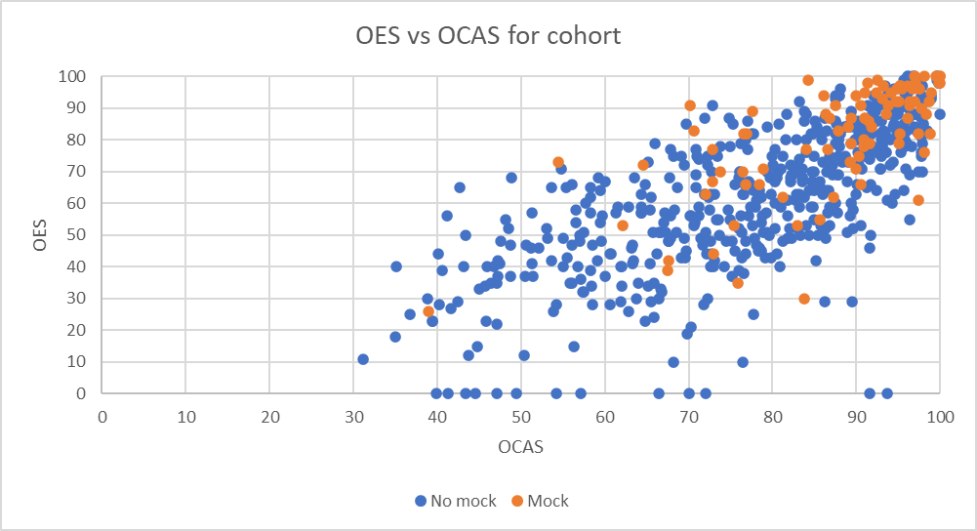
Comparing exam and OCAS performance
Of students who took the mock, 75% obtained a grade as good or better in the exam as their OCAS mean
Of students who did not take the mock, 45% obtained a grade as good or better in the exam as their OCAS mean
Notes:
Cath

Slide 6
OES vs OCAS regression lines
Almost constant uplift across the range
Notes:
Cath

Slide 7
Exam scores vs Mock scores
Notes:
Cath

Slide 8
Mock scores profile
Notes:
Cath

Slide 9
Results of student questionnaire
Notes:
Cath

Slide 10
Results of student questionnaire
Notes:
Cath

Slide 11
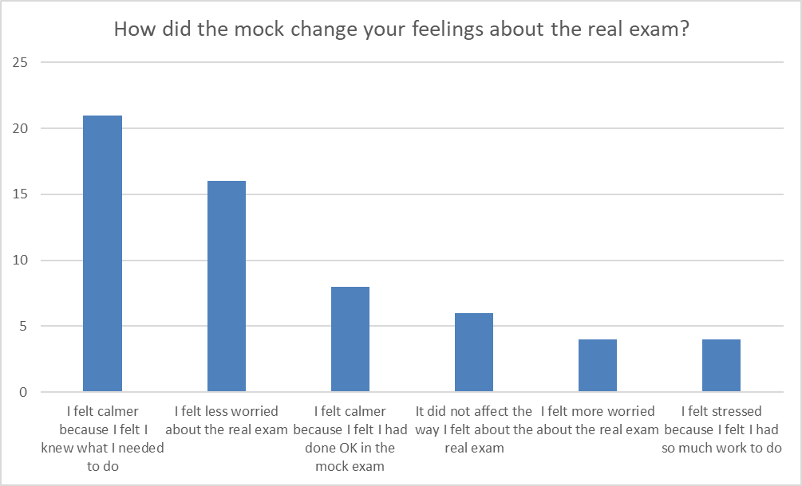
How did the mock change feelings about exam
Notes:
Cath

Slide 12
How much did the mock help?
Notes:
Cath

Slide 13
What are we doing differently in 2024?
Using the iCMA system so the technology is similar to the real thing
Moving the slot for the mock slightly later to enable students to do more revision in advance
Additional resource produced: hand-written version of the solutions showing what a good exam script, as opposed to a TMA looks like
This is in response to significant numbers of student scripts in the actual exam which were very “polished” but clearly ran out of time
Notes:
Cath

Slide 14
QUESTIONS?
Cath.Brown@open.ac.uk Susan.Pawley@open.ac.uk
Notes:
Cath

