Slide 1
Intro Slide Title 3
Tutor recruitment & retention on M269
Teaching Innovation Talk
Phil Hackett
Computing & Communications
10th April 2024
Notes:
I was not entirely convinced that this topic fits the brief since it related to tutors, but it will hopefully have a positive impact on student experience in an indirect manner.

Slide 2
Slide Title 8
Background
M269 – Algorithms, Data Structures & Computability
Perception that M269 is a difficult module – knowledge, skills and understanding
M269 has seen student numbers increase steadily and significantly over the past few years…
Notes:
I’ll just give some background information on M269..
Perception among Tutors, Staff Tutors & Students that M269 is difficult. “If you can tutor M269, you can tutor anything!”
It requires significant amount programming skills, mathematical understanding (Big-O notation) and knowledge of computational theory (P vs NP) – tractable and intractable problems.
The first presentation of M269 was in 2013
Between 2015 – 2018 (inclusive) the average number of student registrations was 746
Recently, there has been a steady increase in student numbers (more than the Covid bubble?)

Slide 3
Slide Title 8
Problem
Recruitment & Tutor Retention Issues
Prior to 20J presentation of M269, tutor numbers were quite stable however…
AL Contract - ALVS
21J – first presentation of module rewrite (2/3 of module completed). New approach to marking (Jupyter Notebooks)
Moved from 2 TMAs and an Exam to 3 TMAs
Further updates in 22J – last 1/3 of module re-write completed
Notes:
Historically, tutor numbers appeared to be quite stable – there didn’t seem to be an obvious issue although I do not have the figures prior to 2020.
There were a number of changes on the horizon…
AL Contract
Module re-write over a 2 year period, so the materials and approach to tutoring was in flux.

Slide 4
Slide Title 8
Problem
Recruitment & Tutor Retention Issues
As well as recruiting additional tutors for the increase in student numbers, we also needed to replace tutors who had reduced workload, resigned or retired…
Prior to start of 21J we lost 9 tutor groups
Prior to start of 22J we lost 16 tutor groups
Prior to start of 23J we lost 13 tutor groups
In early 2023, an opportunity arose to address the tutor recruitment & retention issue
Notes:
As previously mentioned, the number of students increased, however we also had a number of workload reductions, resignations and retirements.
Some of these were tutors who had double or triple groups – we were told that we are not allowed triple groups under the new contract.
I proposed a project to address the retention (and recruitment) issue – develop a package of CPD to support M269 tutors.

Slide 5
Slide Title 8
Opportunity
Developing a Package of CPD
Other successful C&C initiatives - recruiting tutors to specialist (cyber) modules
Opportunity to do something similar, however…there was no existing CPD material
This led to the production of a bespoke, tutor created package of CPD including…
11 hours of video covering each weekly topic
Bank of iCMA quiz questions
Production of materials involved 7 existing M269 tutors
Notes:
A previous C&C initiative provided vendor specific courseware to tutors prior to them applying to tutor on TM256 and TM359.
I was presented with an opportunity to develop the pool of potential M269 tutors as well as support existing tutors in a similar way, however there was no existing vendor specific materials other than the module itself.
The videos, created by 7 different M269 tutors, are 30-60 minute videos summarising each topic in enough detail to become reasonably familiar.
The iCMAs are practice questions to give real examples of the theory.

Slide 6
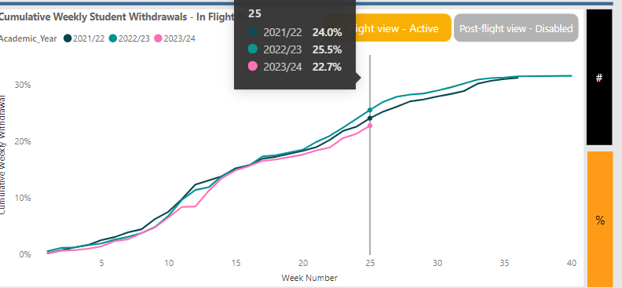
Slide Title 8
Opportunity
Developing a Package of CPD
Initially, the CPD has been offered to newly appointed M269 tutors to develop confidence and to ensure familiarisation with materials
The impact of this project will be assessed with a tutor survey and analysis of tutor (and student) retention at end of the module.
Notes:
At the moment, only 8 newly appointed tutors have accessed the M269 CPD.
The student retention numbers are better this year – not necessarily anything to do just with this project. This is only one of multiple initiatives to improve retention on M269.
Tutor retention is good, up to now – only had 2 resignations so far, but I expect more before the start of 24J.

Slide 7
Slide Title 8
Summary
Tutor CPD
The ‘teaching innovation’ is…
Tutor developed CPD materials to increase tutor confidence and familiarity with materials; increase the pool of potential tutors that could be recruited (prevent module caps).
The philosophy behind this…
Happy Tutors == Happy Students
Notes:
The teaching innovation is…
In the new world of the AL Contract where tutors can move between modules, this model (innovation) may offer a solution to making it better for tutors and students.

Slide 8
Slide Title 30
Thank you
Notes:
Going forward, the CPD will sit alongside other CPD offers for tutors including:
Cisco; Certified Ethical Hacker; other bespoke CPD.

Slide 9
Slide Title 31

