Slide 1
Getting Started with Scholarship
Trevor Collins and Mark Jones
Tuesday, 2nd February 2021
esteem@open.ac.uk
www.open.ac.uk/esteem
@OU_eSTEeM

Slide 2
Getting Started with Scholarship
Definitions of Scholarship (of Teaching and Learning)
Interrelationships with teaching and research
Stages of Scholarship of Teaching and Learning (SoTL)
Thinking about your own project
Further information: SoTL books and websites

Slide 3
Activity 1: Defining Scholarship
How would define scholarship?
Are there any other terms you would associate with scholarship?

Slide 4
Definitions of Scholarship
Scholarship (of Teaching and Learning)
is focused on improving and supporting learning through teaching practices
includes reflection on our teaching and the learning of our students, … and the implementation of improvements
requires knowledge of the discipline-specific area that is being taught, and about learning and teaching
involves dissemination of teaching practices for public/peer scrutiny
Scholarship at the OU
Scholarship is a term used to cover activities that lead to evidence-informed development of our learning and teaching
Other terms associated with Scholarship
Action Research
Educational Inquiry
Pedagogic Research

Slide 5
Definitions of Scholarship
Teaching
Scholarly Teaching
Scholarship of Teaching and Learning
Research
Evidence-informed teaching
Evidence-informed teaching made public and open to critique

Slide 6
Activity 2: What is SoTL for?
What is your impetus for being interested in SoTL?
What does SoTL offer?

Slide 7
What is SoTL for?
What SoTL can do
Offers space to understand issues around teaching and learning
Provide evidence to identify and address issues in module design and delivery
Provide a basis for determining whether an intervention or change in practice is successful
What SoTL can’t do
Provide a silver bullet to overcome issues of retention and attainment
Provide absolute evidence of cause and effect

Slide 8
Stages of Research
Starting from what you know…
Thinking about your own discipline areas, what are the stages of research?
How might they compare to the stages for pedagogic research?

Slide 9
Stages in SoTL
7 Steps to Pedagogic Research (PedRIO)
5 Stages of SoTL (University of Glasgow)
Identify a research question
Consider theoretical underpinnings
Formulate a research methodology
Obtain ethical approval
Analyse data appropriately
Disseminate your findings
Collaborate
Clear goals
Adequate preparation
Methods and evidence
Dissemination
Reflection

Slide 10
Which stage are you at?
1. Identifying an issue
Clear goals: A clear articulation of purpose
Adequate preparation: Grounded in the literature
Appropriate methods: Aligned with goals
2. Changing practice
Making changes to resolve the issue identified
Based on issues identified
3. Evaluating change
Significant results: Evidence to address goals
Effective presentation: Open to peer review and to influence others
Reflective critique: Implications for future practice

Slide 11
Stages in a scholarship project
1. Identifying an issue
Initial question
2. Changing practice
Further question
3. Evaluating change
Further question
Plan
Act
Observe
Reflect
Plan
Act
Observe
Reflect
Plan
Act
Observe
Reflect
Identify current practice
What does the literature say?
Introduce change
Improvement?

Slide 12
Activity 3: Goals and preparation
Think about a potential project you are interested in…
What are the goals of your project?
What initiated your interest in this project?
What is already known about the topic
From existing evidence
From shared practice
From the research literature
What would be your question(s) at this stage of the research?

Slide 13
Other factors to consider
What are the intended outcomes of the project?
To inform module development
For dissemination amongst colleagues
For external publication
How many people will be involved?
How much time do you have?

Slide 14
Identifying the issue
Now that you have a research question and clear goals…
What data already exists?
What do you still need to know?
What methods might be appropriate?

Slide 15
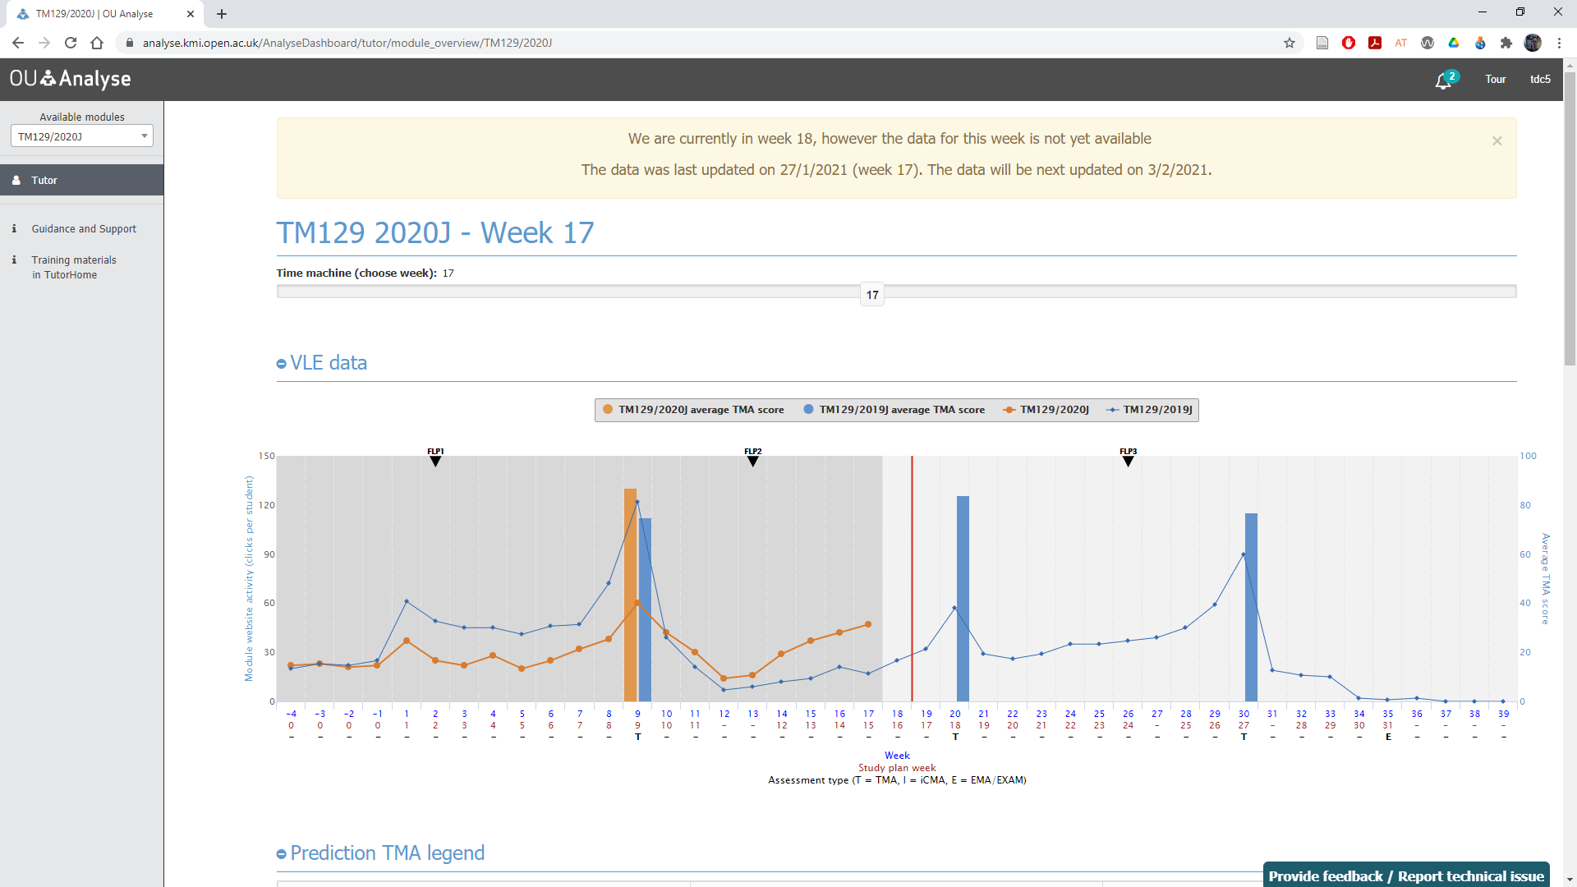
Finding Institutional Data
OU student data
https://openuniv.sharepoint.com/sites/mi/data-and-student-analytics
E.g. Student Profile Dashboard Training
Learning Analytics
Analytics 4 Action
A4A Home
OU Analyse
OU Analyse website
OU Analyse Dashboard

Slide 16
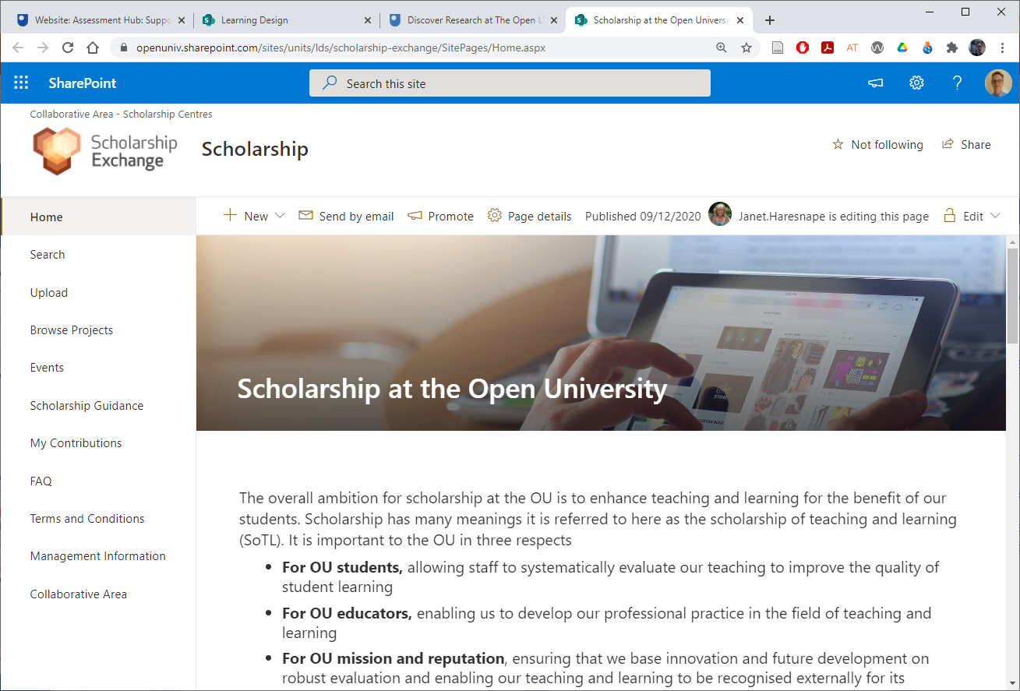
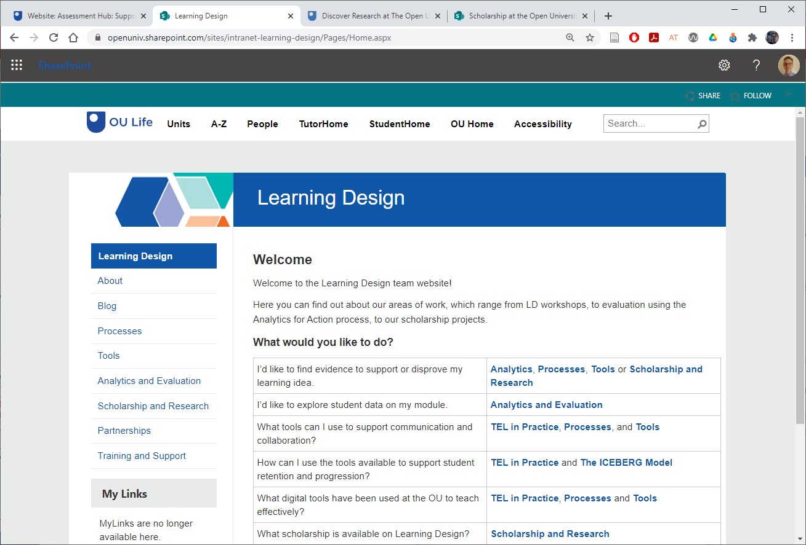
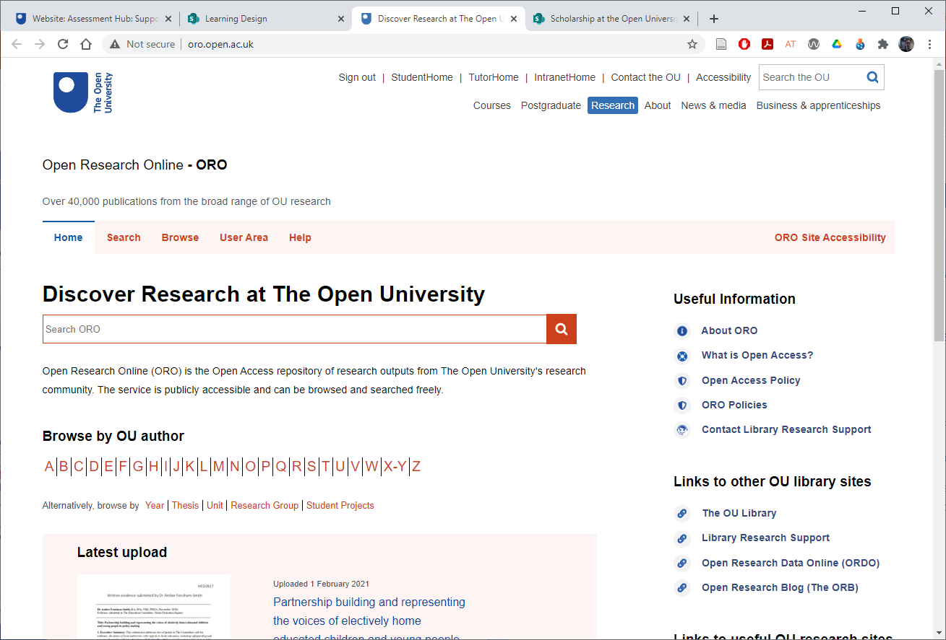
Finding OU Knowledge
OU Intranet – A to Z…
Assessment Hub
Learning Design
Open Research Online
Scholarship Exchange

Slide 17
HE Research, Policy and Practice
HE funding councils/regulators
https://officeforstudents.org.uk
http://sfc.ac.uk
https://www.hefcw.ac.uk
https://www.economy-ni.gov.uk/ topics/higher-education
Quality Assurance Agency for Higher Education (QAA)
http://www.qaa.ac.uk
Higher Education Statistics Agency
https://www.hesa.ac.uk
Advance HE
https://www.advance-he.ac.uk
Jisc
https://www.jisc.ac.uk

Slide 18
Choosing Research Methods
Depends on the purpose of the stage of the research….
…and on the scope and scale of the research
To identify the issue
To evaluate change
Needs to be manageable by one person or team of people
Must be appropriate to the timeframe you have available

Slide 19
Choosing Research Methods
What the methods can be used for and when…
Questionnaires: Useful for getting snapshots in time, getting quantifiable data, identifying the situation before and after a change. Not so good for identifying feelings and attitudes
Observations (face to face and online): Useful for understanding what students actually do (rather than what they say they do in activities)
Interviews/focus groups: Useful for gathering in-depth data, including feelings and attitudes. Can be used at any point in the research cycle. Generates a lot of data to analyse

Slide 20
Choosing Research Methods
What the methods can be used for and when…
Documentary evidence: Useful for identifying the current state of play and whether any changes have occurred after making changes (e.g., teaching and assessment materials, student assignments, policy documents)
Learning analytics: Provides data on student activity, can be used at any time in research cycle
Research diaries by students: Useful for gathering data over time and gives some control to the student
Research diaries by researcher: Useful for gathering data over time and provides a basis for analytical notes

Slide 21
Practical considerations and approvals
Ethics
The OU’s Human Research Ethics Committee website has an ethics checklist and guidance (see HREC website)
Access to Students
The Student Research Project Panel oversees the involvement of students in research (e.g. max 4 times per year) see SRPP website for application form and guidance
Data Protection
Freedom of Information and GDPR compliance – Information Governance Liaison Officers (IGLOs) record OU datasets in the Information Asset Register (IAR)
Staff Survey Project Panel
Approval required for surveys with more than 30 staff (see SSPP website for guidelines and application form)

Slide 22
Activity 4: Identifying the issue
For your chosen area of interest
What data already exists?
What do you still need to know?
What methods might be appropriate?
Needs analysis
What knowledge and skills do you already have in relation to:
Planning your scholarship project;
Identifying and reviewing the literature; and
Selecting appropriate methods.
What skills do you need to acquire or develop?

Slide 23
Next steps: After identifying the issue…
Changing practice
Evaluating change

Slide 24
Dissemination
OU events
School or faculty seminars
e-Learning events
eSTEeM conference talks and workshops
External events
Advance HE STEM Conference (January)
Horizons in STEM Conference (June)
Publications

Slide 25
Further information – Books on SoTL
Nitty-gritty guides
Bishop-Clark, C. and Dietz-Uhler, B. (2012), Engaging in the Scholarship of Teaching and Learning: A Guide to the Process, and How to Develop a Project from Start to Finish. Sterling, VA, Stylus Publishing.
Cleaver, E., Lintern, M. and McLinden, M. (2014), Teaching and Learning in Higher Education. London, Sage.
Cousin, G. (2009), Researching Learning in Higher Education: An Introduction to Contemporary Methods and Approaches. London & New York, Routledge.
Norton, L. (2009), Action research in teaching and learning: A Practical Guide to Conducting Pedagogical Research in Universities. London & New York, Routledge.

Slide 26
Books on SoTL
Nature and relevance of SoTL
Dewar, J., Fisher, M.A. and Bennett, C. (2018), The Scholarship of Teaching and Learning: A Guide for Scientists, Engineers and Mathematicians. Oxford, Oxford University Press.
McInney, K. (2013), The Scholarship of Teaching and Learning In and Across the Disciplines. Bloomington and Indianapolis, Indiana University Press.
Murray, R. (2008), The Scholarship of Teaching and Learning in Higher Education (Helping Students Learn). Maidenhead & New York, Open University Press.

Slide 27
External websites on SoTL
Getting Started in Pedagogic Research within the STEM Disciplines
https://www.heacademy.ac.uk/system/files/pedagogic_research_guide_final_version_0.pdf
University of Edinburgh SoTL
https://www.ed.ac.uk/institute-academic-development/learning-teaching/staff/sotl
University of Glasgow 5 Stages of SoTL
https://www.gla.ac.uk/myglasgow/leads/staff/sotl/fivestagestoengagewithsotl/
Plymouth University Pedagogic Research
https://www.plymouth.ac.uk/research/pedagogic-research
SoTL Canada
https://sotlcanada.stlhe.ca/sotl-resources/
University of Central Florida SoTL and DBER
https://fctl.ucf.edu/sotl-and-dber/
Vanderbilt University Guide to SoTL
https://my.vanderbilt.edu/sotl/

Slide 28
Example Teaching and Learning Journals
Assessment and Evaluation in Higher Education
Distance Education
Higher Education Quarterly
Innovations in Education and Teaching International
International Journal for the Scholarship of Teaching and Learning
International Journal of Teaching and Learning in Higher Education
Journal of Further and Higher Education
Open Learning: The Journal of Open, Distance and e-Learning
Practice and Evidence of Scholarship of Teaching and Learning in Higher Education
Studies in Higher Education
Teaching in Higher Education
Also… Subject teaching and learning journals

Slide 29
Getting Started with Scholarship
Definitions of Scholarship (of Teaching and Learning)
Interrelationships with teaching and research
Stages of Scholarship of Teaching and Learning (SoTL)
Thinking about your own project
Further information: SoTL books and websites

Slide 30
Getting Started with Scholarship
Trevor Collins and Mark Jones
Tuesday, 2nd February 2021
esteem@open.ac.uk
www.open.ac.uk/esteem
@OU_eSTEeM

