Slide 1
A STEM scholarly response to the OU Awarding Gap
Diane Butler, Associate Dean (Academic Excellence) with Trevor Collins and Mark Jones, eSTEeM Directors
Thursday, 25th March 2021
esteem@open.ac.uk
www.open.ac.uk/esteem
@OU_eSTEeM
Notes:
A STEM scholarly response to the OU Awarding Gap
Diane Butler, Associate Dean (Academic Excellence) with Trevor Collins and Mark Jones, eSTEeM Directors
Thursday 25th March, 14.00-15.00 via MS Teams followed by Putting Talk into Action online discussion, Thursday 1st April, 19.30-20.30 via MS Teams
Abstract
Widening access to, and enhancing success in higher education, is at the heart of the OU’s mission. The Access, Participation and Success Strategy details the University's strategic approach to supporting students from underrepresented and disadvantaged backgrounds to access HE and achieve equitable outcomes. However, there are significant differences in the proportion of OU students gaining a good module pass (1:1 and 2:1) when grouped by ethnicity, levels of higher education participation, indices of multiple deprivation or disability. The Access and Participation Plan (APP) sets out specific targets to reduce these awarding gaps by 2024/25.
This seminar will consider how the Scholarship of Teaching and Learning (SoTL) can be applied to inform the implementation of the OU’s Access, Participation and Success Strategy and enable the University to meet the aims and objectives of the APP. Within the STEM Faculty, a range of APP initiatives are being undertaken, from scholarship projects (supported through eSTEeM) to a curriculum review and audit. This seminar will focus on what we know about the OU’s awarding gaps, what we need to find out to develop evidence-informed interventions, what work is currently being done, and what further actions are needed.

Slide 2
Overview
Welcome and introductions
Access and Participation Plan(s)
OU Awarding Gap(s)
What (we think) we know
Learning from previous projects
Learning from the seminars
What we are finding out
Overview of latest projects
What further actions are needed
Ideas/opportunities for scholarship
Notes:
Trevor to welcome and start

Slide 3
Access and Participation Plan(s)
Access and Participation Plan is a condition of registration with the Office for Students aligned with funding for students
OU guidance set under the Access and Participation Strategy
Reduce the gap in the award of module good passes for Black and Asian students compared to white students (Black students to be a particular focus)
Reduce the gap in the award of module passes for disabled students (faculties to check if awarding gap is larger for students with mental health disabilities)
Reduce the gap in the award of module good passes for students in lowest and highest quintile of deprivation (e.g., Index of Multiple Deprivation ‘IMD’)
Key issues for STEM compared to the OU overall are good pass rates for black students and module passes for disabled students, particularly those with mental health disabilities

Slide 4
OU Awarding Gap(s) – Ethnicity (STEM)
Reduce the gap in the award of module good passes* for Black and Asian students compared to White students
Student Group | Total pass | Good pass | % good pass to pass | Awarding Gap | OU Awarding gap
Black | 431 | 137 | 31.8% | 32.8% | 31.1%
Asian | 784 | 419 | 53.4% | 11.1% | 12.7%
White | 16,708 | 10,791 | 64.6%
Key: | STEM lower than OU
 | Gap to OU >1%
 | Gap to OU > 3%
 | Gap to OU >5%
Data Source: Data and Student Analytics Student Profile data from 2019/20 (Feb 2021)
* Good pass = G1 or G2 first time pass at level 2 or 3

Slide 5
OU Awarding Gap(s) – Disability (STEM)
Reduce the gap in the award of module passes for disabled students
Faculties to check if awarding gap is larger for students with mental health disabilities compared to overall disabilities
Student Group | Total Students | Total | Pass Rate | Awarding Gap | OU Awarding gap
Disability | 12,253 | 7,385 | 60.3% | 11.4% | 9.20%
No Disability | 43,568 | 31,220 | 71.7%
Student Group | Total Students | Total | Pass Rate | Awarding Gap | OU Awarding gap
Disability - Mental Health | 4,924 | 2,776 | 56.4% | 15.3% | 12.50%
No Disability | 43,568 | 31,220 | 71.7%
Key: | STEM lower than OU
 | Gap to OU >1%
 | Gap to OU > 3%
 | Gap to OU >5%

Slide 6
OU Awarding Gap(s) – Deprivation (STEM)
Reduce the gap in the award of module good passes for students in lowest and highest quintile of deprivation (IMD)
Ethnicity | Total pass | Good pass | % good pass to pass | Awarding Gap | OU Awarding gap
Q1 | 2,749 | 1,547 | 56.3% | 10.0% | 13.0%
Key: | STEM lower than OU
 | Gap to OU >1%
 | Gap to OU > 3%
 | Gap to OU >5%

Slide 7
OU Awarding Gap(s) – Boards of Studies
Note only statistically significant results shown (Chi-squared, p < 0.05)
Module Good Pass – Ethnicity | C&C | E&I | EEES | LHCS | M&S | SPS
Black | 37% | 28% |  | 31% | 37%
Asian | 17% |  |  | 13%
Other | 26%
Module Good Pass – IMD | C&C | E&I | EEES | LHCS | M&S | SPS
Q1 (highest) | 37% | 28% |  | 31% | 37%
Q2 | 17% |  |  | 13%
Module Pass – Disability | C&C | E&I | EEES | LHCS | M&S | SPS
Disability (all) | 12% | 13% | 7% | 11% | 12% | 12%
Mental | 13% | 21% | 10% | 15% | 15% | 18%
Physical | 18% | 8% |  | 10% | 14% | 13%
Learning | 7% |  |  |  | 12%
Other | 6% | 13% | 12% | 6%
Key: | STEM lower than OU
 | Gap to OU >1%
 | Gap to OU > 3%
 | Gap to OU >5%

Slide 8
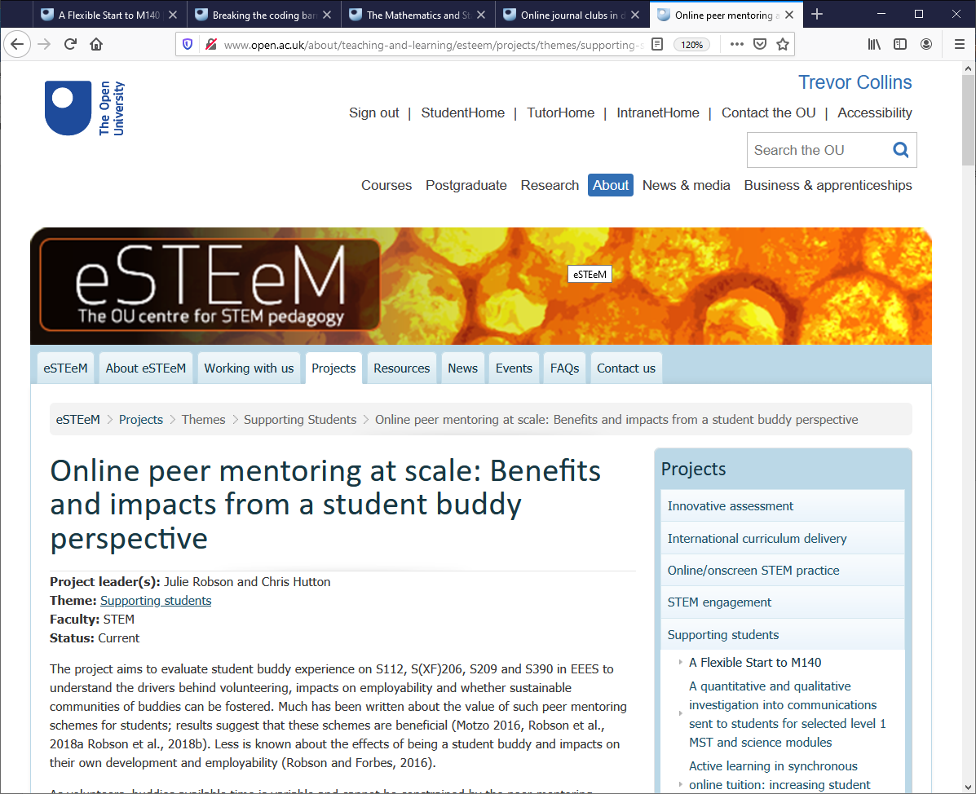
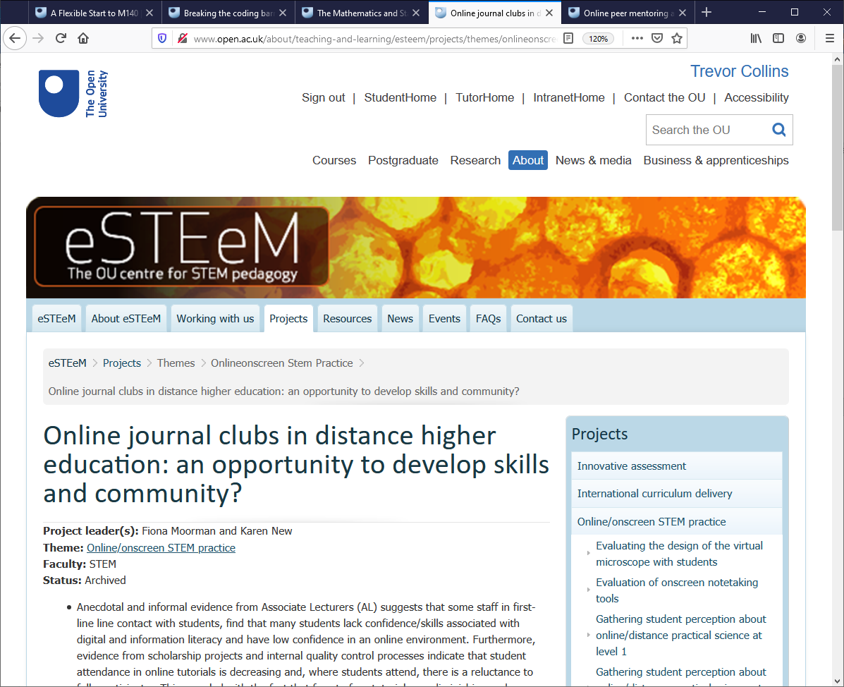
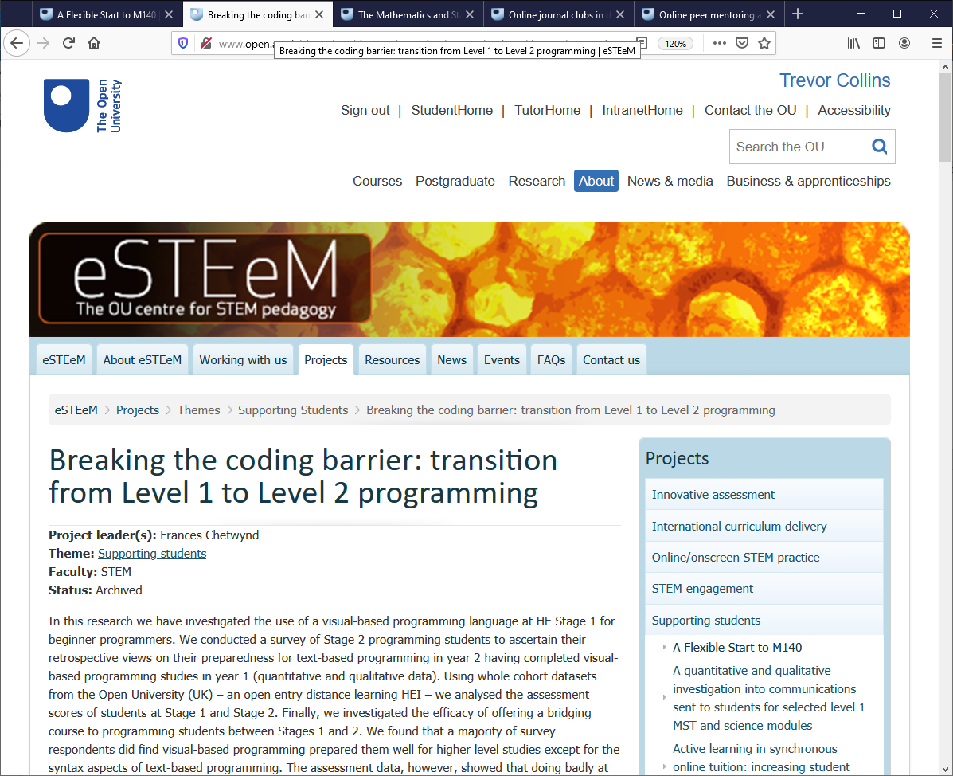
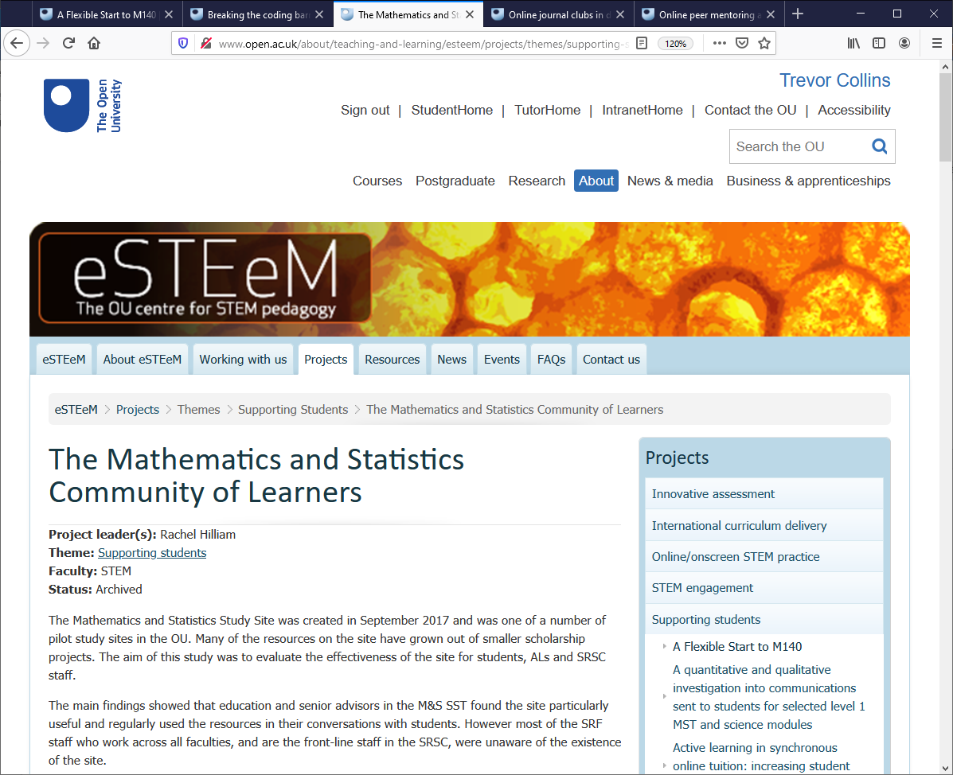
Learning from previous projects
Scholarship targeting a specific context (i.e. module, issue, group) and across contexts
A selection of projects that have had impact…
Early Starts
Bridging Courses
Subject Study Sites
Online Journal Clubs
Student Buddy Scheme
Notes:
Trevor handover to Diane for learning from scholarship
Advertisement: Heineken 'Refreshes the parts that other beers cannot reach’

Slide 9
Learning from previous projects
…but do only the students that engage benefit?
Who is missing from our data?
Non-response bias: The evidence shows a benefit to students that participate, but what about those that don’t participate (or don’t respond to research invitations)?
Statistical biases: By comparing the averages or looking at frequent experiences are we at risk of missing different students’ experiences?
Selection biases: How could we better engage with and understand the experiences of different groups of students?

Slide 10
Learning from seminars
John Butcher and Darren Gray (APS) Lessons from a recent sector seminar: Reducing inequitable outcomes for BAME students
Jenny Douglas (WELS) Decolonising the ‘STEM’ curriculum
Nicola Swann (Kingston University) Inclusivity in Pre-Assessment Academic Support
Les Levidow (FASS) Decolonising the Science Curriculum: Reflections from 1980s anti-racist science teaching
Emerging themes…
Student involvement in the curriculum
Work with and listen to students more
Embed student perspectives into the curriculum
Engender sense of belonging
Importance of support
Enable more personalised teaching/support
Understand students’ needs and experiences
Increased training, resources, more time with students

Slide 11
Overview of latest projects (17th call)
Computing and Communications (1 Tech)
Modern Container-based Learning Interface and Delivery Infrastructure (MCLIDI)
Engineering and Innovation (4 EDI)
Barriers and enablers to higher education: the experiences of disabled students from minority cultural backgrounds
Associate Lecturer Disability Champion scheme at the Open University (E&I-STEM)
Understanding the mental health attainment gap in Design modules
Understanding factors influencing BAME students’ achievements within Engineering and Innovation
Knowledge Media Institute (1 EDI)
Understanding the BAME attainment gap at the OU by means of quantitative and qualitative data analytics
Life, Health and Chemical Sciences (1 Online; 1 EDI)
Online Summer Schools
Black student experience and attainment on S112: improving a level 1 STEM module (with EEES)
Notes:
Diane handover to Mark for current projects

Slide 12
Overview of latest projects (17th call)
Maths and Statistics (2 SS; 3 EDI)
Welsh-medium tuition in Level 1 Mathematics
Using knowledge from Associate Lecturers in a Bayesian model to predict the probability of students’ results
Evaluating the increase in student wellbeing brought about by informal online sessions and computer-generated worked examples on a level 3 pure maths module
Exploring the extent of maths anxiety within the STEM Faculty at The Open University
Effective support for reflective writing: learning from improvers
School of Physical Sciences (1 E; 1 EDI)
Using Learning Logs in SXPS288 – Effectiveness in helping students to reach Learning Outcomes, to enhance and document their employability skills, and raise awareness of opportunities in the space sector
Investigating the impact of ethnicity on student experience in stage 1 and 2 Physical Sciences (PS)-oriented modules
Area | STEM School (Project Leads)
 | C&C | EEES | E&I | KMi | LHCS | M&S | SPS
EDI (APP) |  | 1 | 4 | 1 | 1 | 3 | 1
Tech for Learning | 1
Online/Onscreen |  |  |  |  | 1
Student Support |  |  |  |  |  | 2
Employability |  |  |  |  |  |  | 1

Slide 13
Ideas/opportunities for scholarship
Relationship Building
Student induction (and beyond)
Getting to know all our students
Risks of making assumptions in the absence of information
Better data access and support
Power BI (EDI) dashboards
Analytics4Action going to use the Power BI datasets
OU Analyse (EDI focus e.g. BAME)
eSTEeM Project Officer - Jonathan Evans (jonathan.evans@open.ac.uk)
Personal Learning Advisors
Proactive targeted support
Peer support
Mentoring (alumni and students)
Study and career advice
Internships and placements
Disciplinary differences
Why are the Awarding Gaps larger in some areas than others
Who is participating / not participating (and why)?
Notes:
Mark to handover to Trevor to lead with Mark and Diane to chip-in and discuss ideas and opportunities for future APP scholarship…

Slide 14
Ideas/opportunities for scholarship
A STEM scholarly response to the OU Awarding Gaps (so what)…
A need for more meaningful conversations
Enabling more talking and engagement with students
Conversations to help us understand what we don’t know
OU brand (national treasure / middle class guardian readers)
Are we delivering on the mission (open to people, places, methods and ideas)?
What are we doing to dispel the myths about the OU (expanding our brand)?
Risks of generic student personas – using shortcuts for a lack of knowledge
Neoliberal reforms in higher education
Outcomes oriented approach by university regulators (can we all be above average?)
Vocational and career orientated higher education (impact on interdisciplinary teaching)
Is selective/elitist higher education narrowing (rather than widening) participation
Reclaiming excellence of opportunity and supported open learning
Notes:
Each of us could take the lead on one of these (and the others could chip-in/discuss)?...
- Diane: A need for more meaningful conversations
- Mark: OU brand (national treasure / middle class guardian readers)
- Trevor: Neoliberal reforms in higher education

Slide 15
Overview
Welcome and introductions
Access and Participation Plan(s)
OU Awarding Gap(s)
What (we think) we know
Learning from previous projects
Learning from the seminars
What we are finding out
Overview of latest projects
What further actions are needed
Ideas/opportunities for scholarship
Notes:
Trevor to welcome and start

Slide 16
A STEM scholarly response to the OU Awarding Gap
Diane Butler, Associate Dean (Academic Excellence) with Trevor Collins and Mark Jones, eSTEeM Directors
Thursday, 25th March 2021
esteem@open.ac.uk
www.open.ac.uk/esteem
@OU_eSTEeM
Notes:
A STEM scholarly response to the OU Awarding Gap
Diane Butler, Associate Dean (Academic Excellence) with Trevor Collins and Mark Jones, eSTEeM Directors
Thursday 25th March, 14.00-15.00 via MS Teams followed by Putting Talk into Action online discussion, Thursday 1st April, 19.30-20.30 via MS Teams
Abstract
Widening access to, and enhancing success in higher education, is at the heart of the OU’s mission. The Access, Participation and Success Strategy details the University's strategic approach to supporting students from underrepresented and disadvantaged backgrounds to access HE and achieve equitable outcomes. However, there are significant differences in the proportion of OU students gaining a good module pass (1:1 and 2:1) when grouped by ethnicity, levels of higher education participation, indices of multiple deprivation or disability. The Access and Participation Plan (APP) sets out specific targets to reduce these awarding gaps by 2024/25.
This seminar will consider how the Scholarship of Teaching and Learning (SoTL) can be applied to inform the implementation of the OU’s Access, Participation and Success Strategy and enable the University to meet the aims and objectives of the APP. Within the STEM Faculty, a range of APP initiatives are being undertaken, from scholarship projects (supported through eSTEeM) to a curriculum review and audit. This seminar will focus on what we know about the OU’s awarding gaps, what we need to find out to develop evidence-informed interventions, what work is currently being done, and what further actions are needed.

