Slide 1
Front Cover Title 1
Can we reduce anxiety of students sitting online exams? Sharing best practice between SPS and LHCS.
Fiona Moorman, Gemma Warriner and Becca Whitehead
This Photo by Unknown Author is licensed under CC BY-SA-NC

Slide 2
May 2020
LHCS – school wide & module specific remote exam prep
May 2021
LHCS – school wide & module specific remote exam prep
SPS – module specific remote exam prep
Mar and May 2022
LHCS & SPS
– school wide remote exam prep
- joined by ACQ, SST and IT colleagues
Mar and May 2023
LHCS & SPS
- school wide remote exam prep
- joined by ACQ, SST and IT colleagues
Mar and May 2024
SPS – school wide remote exam prep sessions planned
Timeline
19J
- Start of all
remote exams
due to Covid
- 24 hour exams
- eTMA system
20J
- Exams written to be remote
- 4.5 & 24 hour exams
- iCME system
21J
- More
expertise writing remote exams
- 4 & 4.5 hour exams
- iCME system
22J
- SEPs on all modules
- 4 & 4.5 hour exams
- iCME system
23J
- SEPs on all modules
- 4 & 4.5 hour exams
- iCME system
June 2022
JISC Survey
349 responses
Feb 2023
JISC based interview
18 responses
April 2023
Focus group run in AC
5 participants
Notes:
The move to online exams was a big change for OU students. Although some students had previously sat a remote exam with the OU, there were still a large number of students who had never had this experience.
There were concerns as to whether students had adequately prepared themselves for their remote exam – did they have the technical skills required to prepare and submit their script via the new exam submission system? Did they know how to revise appropriately for a remote exam - whether or how to use module materials/ internet during the exam? And most importantly how to cope should a problem arise during the exam?
There were reports of student anxiety about the experience of sitting a remote exam, in communications with the SST, via student forums on module websites, and in end of presentation survey SEAM feedback
We looked in the literature to see what other institutions were experiencing, and it seemed to be a mixed picture – there were some reports that online tests could reduce anxiety for those suffering from high anxiety in a traditional exam hall setting, but plenty of other studies that found online examinations to be associated with higher levels of student anxiety than face-to-face exams. One thing was certain - high levels of exam anxiety is negatively correlated with academic performance in those exams, so we wanted to try and do something to help our students

Slide 3
Theme 1
Preparedness

Slide 4
Page Title 10
Exam preparation sessions
Number of Attendees
104 attended in March with 625 views. 187 attended in May with 380 views
These were provided to SPS and LHCS students to de-mystify the remote exams processes, to facilitate students to take ownership of problem solving, and to attempt to increase their self-efficacy concerning their upcoming remote exam.
We noted that there were very anxious students at the first sessions
What we covered
Exam format, iCME system, creating & uploading pdf/word files, revision, exam day planning, advanced troubleshooting, plagiarism
What students asked about
Discretionary postponement special circumstances, access to websites, plagiarism, timing of the exam and the timer
Notes:
self-efficacy - ‘a person’s belief in their ability to succeed in a particular situation’

Slide 5
Survey : perceived usefulness of our sessions
Statement | Very useful/ useful | Undecided/ neutral | Not very useful/ not useful at all
Supporting my revision | 144 (53.7%) | 73 (27.2%) | 51 (19.1%)
Preparing for my remote exam (overall) | 170 (62.9%) | 71 (26.3%) | 29 (10.7%)
Using the iCME system | 157 (58.8%) | 71 (26.6%) | 39 (14.6%)
Knowing who to contact if I had an IT issue | 155 (57.8%) | 68 (25.4%) | 45 (16.8%)
Knowing who to contact if could not complete my exam | 148 (55%) | 65 (24.2%) | 56 (20.8%)
Removing uncertainty about sitting my remote exam | 150 (56.2%) | 71 (26.6%) | 46 (17.2%)
Improving my general anxiety about my remote exam | 123 (45.8%) | 77 (28.6%) | 69 (25.7%)
Between 267 and 270 individuals responded to these statements.
Notes:
Overall, feedback about our exam preparation sessions was positive, with the majority of students reporting that these sessions were beneficial for overall exam preparation and in removing uncertainty (62.9% and 56.2% respectively). However, it must be acknowledged that despite these positive aspects, 25.7% of students felt their anxiety had not been improved. This may be due to subject specific anxiety, or alternatively may indicate that students may benefit from additional support to improve their exam preparation and alleviate their anxiety.

Slide 6
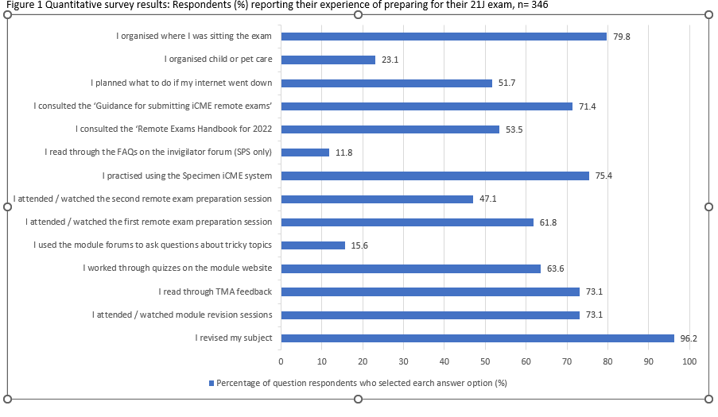
Survey: How did students prepare?
Notes:
The top five activities in preparation for the exam were revision, sorting out a space to work, practising using the iCME system, reading through TMA feedback and module revision sessions. These activities were all recommended in our exam preparation sessions

Slide 7
Questionnaire and focus group
“Practice tests and past papers are useful as they encourage filling in of knowledge gaps and provide reinforcement of ability. Mock exam similar to above and helps with the time management”
“The exam preparation was helpful and there was available support with tips on revision and how to go about tackling a remote exam”
“The only support I feel I need is good tuition. If I have a good tutor who presents one or two good tutorials before the exam I'm happy with that”
“I put in as many hours as I can manage of revision regardless of remote or not”

Slide 8
Survey: What did you wish you had known?
Theme | Number of responses
How little time I’d have / how fast it would go | 37
That an open book exam would be harder/ take longer | 4
That I’d have IT issues | 33
That the support/ preparation would not have been adequate | 11
That I would be confused about other aspects of the exam/ processes | 21
That it would be ok / positive | 21
Miscellaneous (timer / distractions / OU admin / anxiety) | 13
Notes:
As can be seen IT issues and time management are the largest factor here. It is pleasing that 21 students wish they had realised that the exam would be alright, hopefully this will feed into their next remote exam experience.

Slide 9
Survey: What did you wish you had known?
I answered as much as I could but typing an exam was very difficult especially with equations etc and then having to add in scanned drawings etc was time consuming so wasn't able to complete the exam fully.
That I would have been better off with using 2 screens as the constant shift from tab to tab to writing the exam to looking at the research paper was horrendous
Exam set as open book, but insufficient time to consult books
That the exam would be harder than normal because it would be open book.
I wish I had test-submitted the SEP...that's my fault, but I think the issues I had would have been resolved if I had done that
I didn't feel completely sure about the timing. We were told 3 hours for the exam and 1.5 hours for scanning/uploading but I was worried.....that I would be penalised for submitting after the 3 hours.
I think when these exams are being planned someone should be timed doing it on a computer
Even though I’d revised for the exam I still struggled to finish within the time allowed without getting penalised.
We had a lot of free text responses! Strong feelings.
Notes:
In hindsight Q

Slide 10
Questionnaire and focus group
“I’d spent years working towards doing these exams, and everything that comes with that, and I felt reassured that I would be at home in a known and cosy environment, and I had everything set up, I thought, but I could not have prepared myself as the sheer panic when …the digital timer that you have on the screen was ticking down
It really did panic for me and it definitely did affect my performance on the day, so in future I would have to prepare for that element of it”

Slide 11
Theme 2
Lack of time?

Slide 12
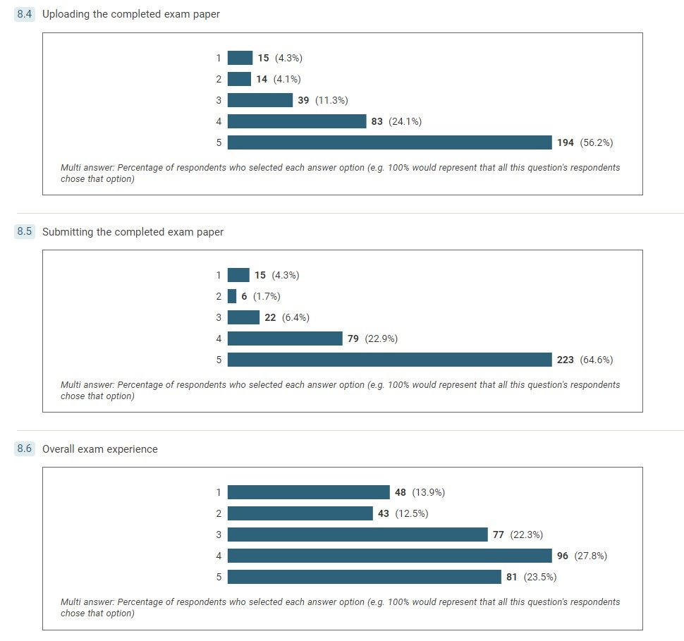
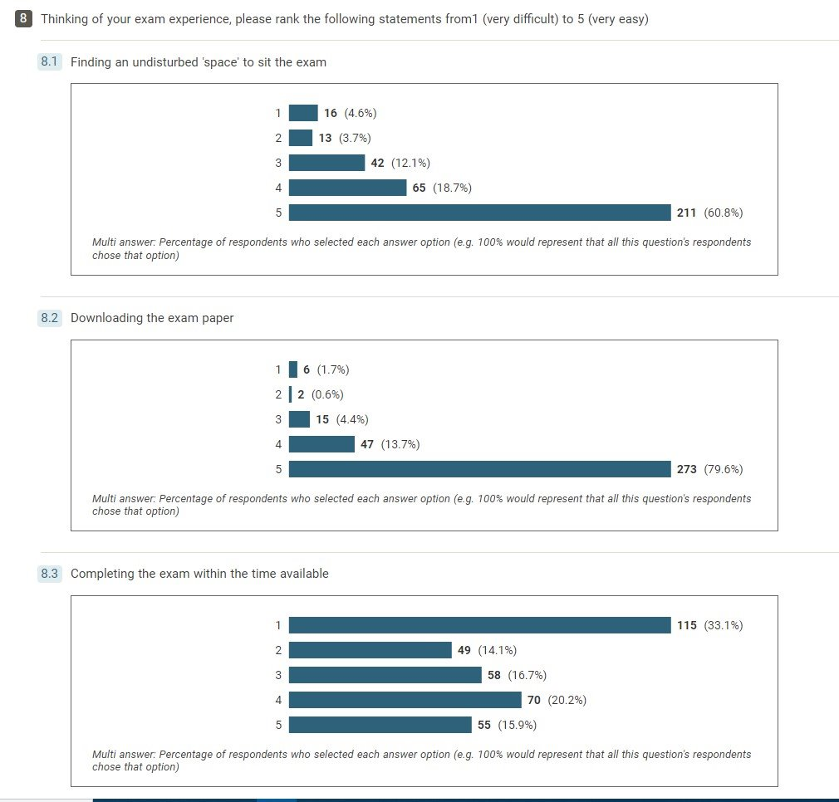
Survey : Exam experience overall
The word cloud for free the free text answers indicated that lack of time was a large factor
38 students who responded to the question ‘Were you able to complete your remote exam’, indicated that they were unable to complete their exam (38; 11.2%), with 20 citing time related issues specifically
Notes:
A little over 10% of the 340 students who responded to the question ‘Were you able to complete your remote exam’, indicated that they were unable to complete their exam (38; 11.2%).

Slide 13
Survey : Reasons for exam non completion
The word cloud for free the free text answers indicated that lack of time was a large factor
38 students who responded to the question ‘Were you able to complete your remote exam’, indicated that they were unable to complete their exam (38; 11.2%), with 20 citing time related issues specifically
Notes:
A little over 10% of the 340 students who responded to the question ‘Were you able to complete your remote exam’, indicated that they were unable to complete their exam (38; 11.2%).

Slide 14
Survey : exam non-completion
It being open book was more of a hinder than a help - too tempting to refer to books which caused time to run out.’
‘Exam set as open book, but insufficient time to consult books’
‘Time frame allowed to complete the questions was not long enough. Felt like I was under a lot of pressure from the start’
‘I am not a novice where exams are concerned and have never failed to finish before. The time constraints meant there was no time for thought or planning and everything was rushed’
‘I physically completed it but I was not able to use my Audio software eg read aloud which meant I have a high chance of missing marks for details.’
‘I submitted the exam but wasn't able to complete all questions due to the time taken to resolve technical issues and the slow speed of my laptop due to extreme heat.’
‘I am unable to type quickly and this is a real disadvantage in this situation.’
‘Time allowed - using a computer is actually slower than an exam in a room to complete.’‘
Notes:
Multi faceted reasons

Slide 15
Questionnaire and focus group
“Finally, I found the exam questions required a lot more time than that allocated. Disappointingly, I run out of time while I was working on a question for which I knew the answer”
“You don’t actually know the notes that well and that’s – it starts absorbing time, and once you get into the notes you start reading the notes again and that’s not what you are meant to be doing”
“I actually found it more stressful having access to my books and the internet than in a conventional exam setting! It was too much of a temptation to look up something you didn’t know”

Slide 16
Theme 3
IT issues and digital inequality

Slide 17
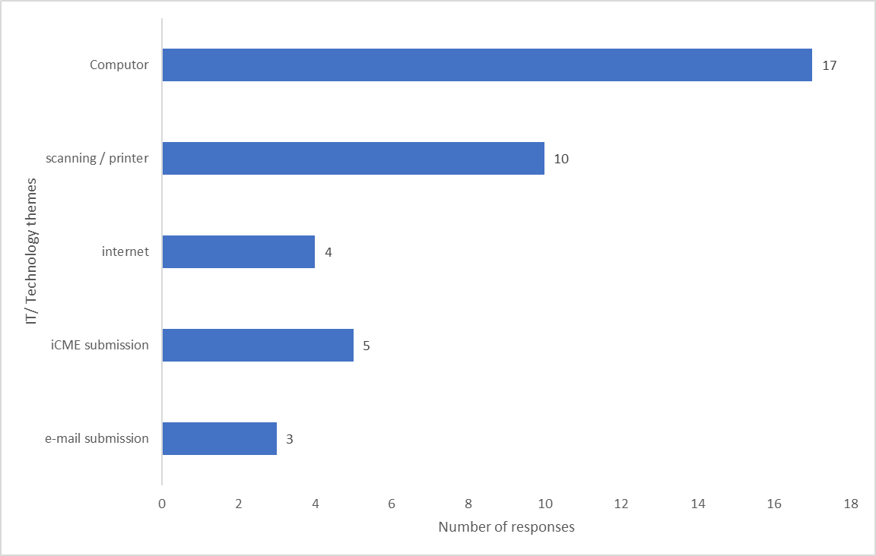
Survey : technical issues experienced
The top two causes of technical issues are the student’s own equipment
Their computer and scanner/printer
Notes:
Computer issues were the biggest issues followed by the scanning /printer.

Slide 18
Survey : technical issues experienced
‘…Slow internet speed.’ ‘Internet went down for 5 minutes it just caused anxiety but it all went back to normal soon‘.
‘The tab for the iCME froze on my computer. The clock was still counting down but I could not move to the next question using next button on question status box.’
‘My tablet had an error when I was trying to send my document to my email before submitting. It took much longer to fix than it should have so lost some time and ended up entering the "penalty period" and am very frustrated about this.’
‘I managed to get the computer working by closing the laptop for a few minutes (around 3 or 4) but I lost some time doing this.’
‘My keyboard stopped working so I couldn't type anything!‘
‘I inadvertently pressed the submit button before uploading my answers on the system.’
‘I went to submit one of my exams and the refresh rate on the page took my exam time to roughly 30 seconds after exam time was up.’
Notes:
When asked whether their IT/ technical issues had been resolved, 33 students said yes, but 14 students (29.8%) said that they had not been resolved.
These results indicate that not all students are seeking the correct help for technical issues, the SST are not able to help with IT. Contacting the helpdesk is a better idea and it was good to see that students were filling in the special circumstances form.

Slide 19
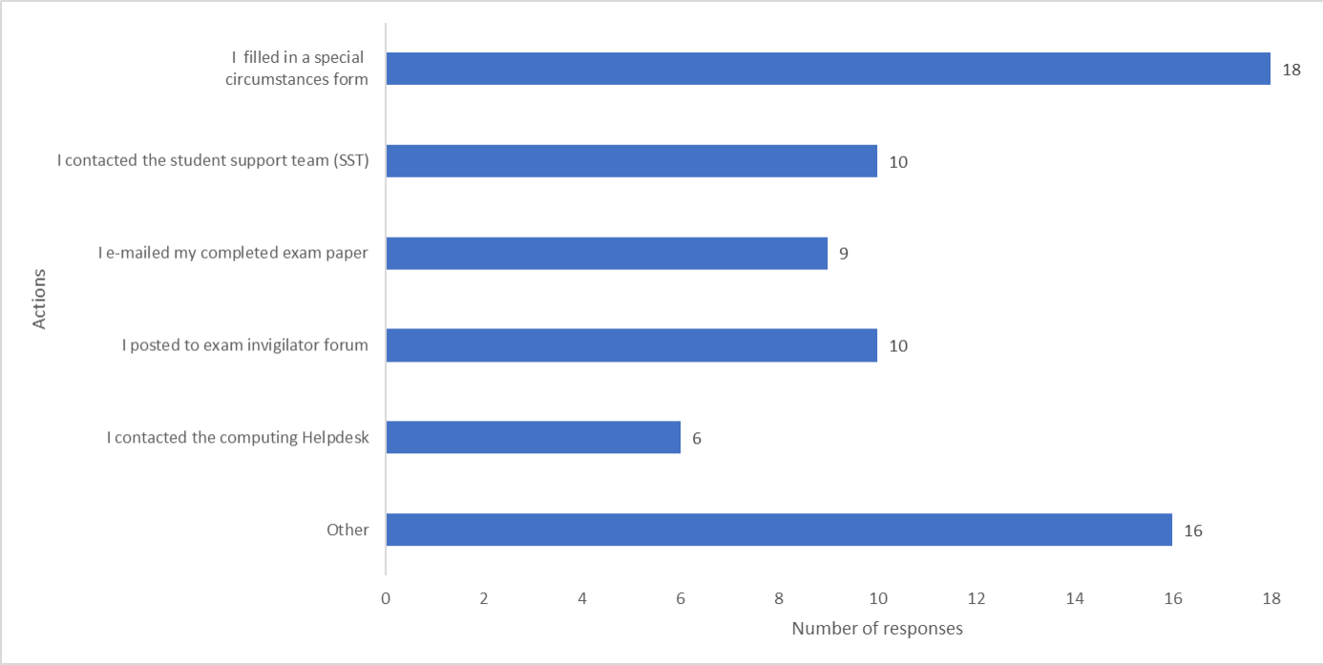
Survey : response to technical issues

Slide 20
Interviews and focus group
“In respect to the scanning, you end up with about 20 pages to scan in and even with the best equipment in the world things go wrong and suddenly it scans 16 pages and then it stops and you have to start again …I found that quite difficult because I’d give myself lots of time to scan it in, and I was literally down to the last minute or two before the cut-off to get it in”
“I'm fortunate to have a dedicated desk space plus dual screens. I think if people were having to work from a laptop screen it would have been a challenge.”
“The IT equipment was fine - although I had a worrying moment at one point when my internet connection went down”
Theme 1 – Physical Setting
Theme 2 – Time/Anxiety
Theme 3 – Preparation for exams

Slide 21
Conclusions
Recommendations
And Impact

Slide 22
Conclusions and recommendations
Preparing students for their exam via the online sessions did reduce the anxiety of many. This work should be continued and extended We should remember the fact that even with all this support in place, some students will find exams very stressful.
Inequality of students’ own equipment will be a factor in remote exams as will the nature of the student’s' home setting. There was anxiety around the use of the iCME systems and we technical support on the day is vital to allay these concerns.
It is important to emphasise to students that searching for internet-based resources is not needed.
We recommend that module teams consider how much they expect students to consult module materials when writing exams and plan the amount of content accordingly. Clarity around timings and the timer itself would address the concerns of many students.

Slide 23
Impact
The exam preparation sessions directly contributed to a better examination experience for the 21J cohort who sat their exams in June 22, as measured by fewer reports of issues on forums and fewer phone calls to the SST. ACQ showed a 5.5% increase in exam completion in June 2022 (93.7%) for SPS modules, compared to the previous year (88.2%).
The need to practise producing a document was emphasised and students were encouraged to decide whether to type or handwrite based upon their own skills, and the type of questions that they would face. Practise on using the iCME system was advertised more widely to students
Findings from our survey were disaggregated by module and shared with Module teams who used these findings to inform setting exam papers and planning student support measures. highlighting the issue of lack of time fed into discussion about the number of questions to have and to factor in time spent looking at module materials.
We contributed to discussions resulting in changes to AQC guidance given to students on the Help Centre concerning the term “open book”

