Slide 1
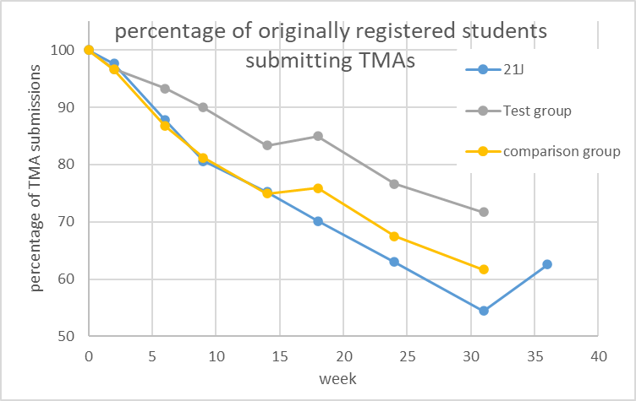
Evaluating community-focussed Workshop Sessions as improvement to the tuition strategy on a core Level 2 Physics module Adam Freeman, Anne-Katrin Klehe
The intervention (tuition strategy)
Situation
Retention is a problem on S217. Between 30-40% of students typically defer or cancel their enrolment.
Poor sense of community [1]
Previous eSTEeM project [2] running weekly meetings with tutorial groups showed promising results
Informal study time can be a valuable practice.
Aims :
improve student retention by an increased sense of community and maintain excitement of learning
Plan
Wider roll-out being planned for 23J
Work within constraints of tuition budget
The evaluation (this eSTEeM project)
Does a more community-orientated tuition strategy improve student retention?
student participation in study sessions and their sense of community.
the effect of these sessions on different demographic groups
Method:
Qualitative analysis:
perception of community, two surveys of all S217 students.
student-led focus groups: how did students feel about the sessions.
Quantitative data: Student retention and TMA submissions
Outcome: Provide recommendation for best practice of tutorial strategy for 24J (and for S217’s successor module).
References:
[1] Discoveruni (2022) NSS 2022 results for The Open University Physics courses: R51 https://discoveruni.gov.uk/course-details/10007773/R51/Part-time/ and Q77 https://discoveruni.gov.uk/course-details/10007773/Q77/Part-time/
[2] Klehe (2022) eSTEeM project: Building a sense of community in a core 2nd level Physics module(S217) and investigating qualitatively its effect on retention.

