Slide 1
Intro Slide Title 1
Evaluation and improvement of print pack use for Environmental Science students.
Fiona Aiken and Chris Hutton
Senior Lecturers in Environmental Science
Jane Kendall-Nicholas and Caroline Langdon
ALs and EEES print pack champions
STEMinar 10th June 2025
Notes:
Introduce ourselves

Slide 2
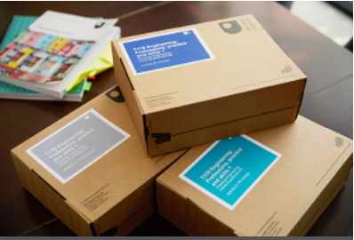
Plan for this workshop
Overview of the project
Background
Objectives
Methods
Results and Discussion
Quantitative data
Focus group data
Student questionnaire data
Student Voice
Conclusions and Recommendations
Questions.
Acknowledgements
References

Slide 3
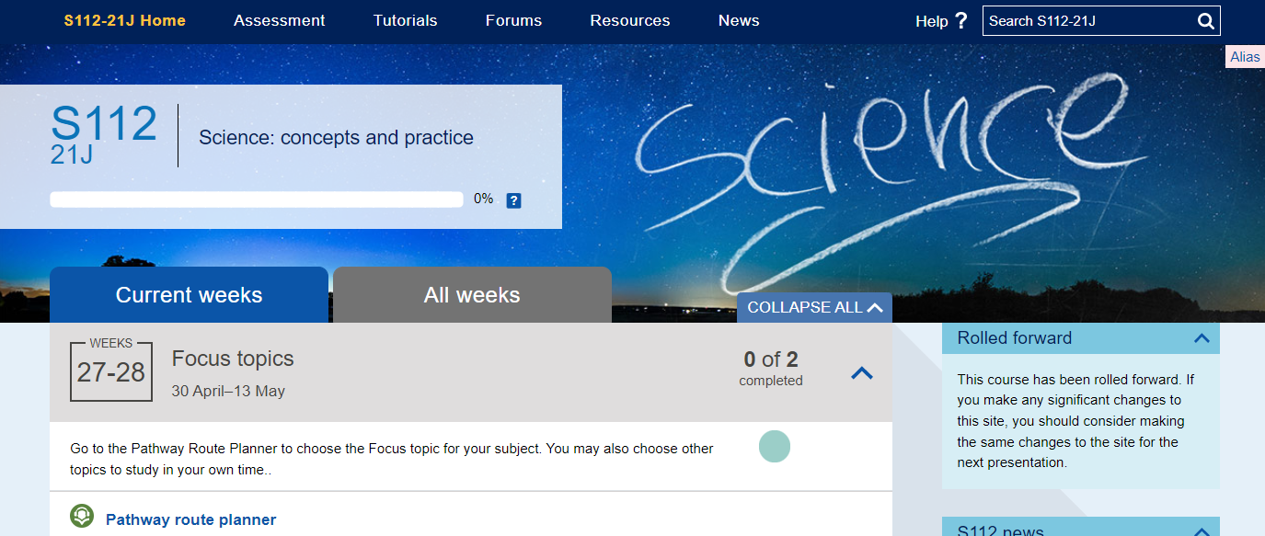
Introduction
Background
Teaching materials for Environmental and Earth science are delivered online
No textbooks
Online materials may present accessibility barriers
Additional requirements
Secure Environments
Limited / poor internet access
In these cases, a printed version of the online materials is provided (demo opening of a print pack)
FA &CL
Notes:
Open University materials for Environmental Science modules are delivered wholly online/onscreen through a Moodle virtual learning environment.
They include interactive components, videos, activities to complete and text.
No textbooks are provided.
Demo the opening of a print pack box. Caroline.
Online materials may present barriers to students with disabilities e.g. visual impairment or autism, who are in a secure environment e.g. a prison or who have poor or limited internet access.
As an adjustment to these additional requirements students can request and are provided with a printed version of the module materials.
These are posted out to students at regular intervals throughout a module.

Slide 4
Introduction
Our project
Objectives…
Evaluated the current use and efficacy of print packs for students and their Associate Lecturers (ALs)
Designed an intervention and train AL champions to improve print pack use
Re-evaluated use and efficacy of print packs post-intervention
Note on literature…
Strong focus on disability
Very little on print as an accessible alternative to online materials
FA
Notes:
The objectives of our project are :-
1.To evaluate the use in academic year 21/22 and efficacy of print packs for Env Science students and for their Associate lecturers/tutors.
The associate lecturers support groups of around 20 students on a module , they run tutorials answer student queries by email and phone and they mark their continuous assessment assignments.
2. Design an intervention to help improve the use of print packs for the academic year 22/23 and to train Associate lecturer champions to increase the effectiveness of their use.
3 . To re-evaluate the use and efficacy of the print packs following the intervention 23/24.
We will summarise the findings from the work we have carried out so far on objectives 1 and 2.

Slide 5
Methods
Research instruments used to evaluate print pack use and efficiency
Associate Lecturer Focus Group
(SiSE theme)
Student Support Team Focus Group
(Non-SiSE theme)
Quantitative Data
(OU data)
Student survey
(Non-SiSE)
FA
Literature review
FA
All University ethical approvals obtained prior to starting.
SiSE = Students in Secure Environments
Notes:
The research instruments we used to address our objectives were as follows:
Evaluate the current use and efficacy of print packs for students and their Associate Lecturers (ALs)
We have run focus groups with Associate lecturers and with student support advisors
We have carried out some quantitate analysis of Open University data and have carried out a student survey of students who have used print packs in the academic year 21/22.
We have carried out 2 student surveys, one at the end of the academic year 21/22 and a second one at the end of the academic year 22/23.

Slide 6
Results and Discussion
Quantitative data - baseline
S112 - Science: concepts and practice
Comparison of previous two years data
Focus on first assignment submission and score
Least affected by pandemic
SiSE perform better than whole cohort
Print pack users lower than whole cohort
Many have complex additional needs
CH
 | SiSE | Print pack | All
2019-20 | 11 | 35 | 1536
2020-21 | 14 | 21 | 1731

Slide 7
Results and Discussion
Focus Groups
Both
- Late delivery
- Poor organisation
SST (Print pack users)
- Blended use
- Few complaints
- Viable work-arounds
ALs (SiSE)
- Blended use often impossible
- Poor interactivity
- Lack of AL info and support
AL = Associate Lecturer
SST = Student Support Team
SiSE = Students in Secure Environments
CH

Slide 8
Results and Discussion
Student questionnaire – initial highlights
Sample of eligible print-pack users (not SiSE)
Response rate of 30 % (n = 13)
Most rely heavily on print packs as an adjustment for disability
Most blend with online resources
Interactive content
Media
Tutorials
Main advantage: improving accessibility (e.g. visually impaired, difficulty sitting at desk)
Improvements: timely delivery, better organisation / format
CH
Notes:
The results of the first phase survey (n=13, response rate of 30%) found that 60% of students spent over 75% of their time using print packs and that that 75% of them hadn’t received advice on best use of the print packs.

Slide 9
…ensuring they arrive slightly earlier than the study weeks they cover (rather than later!)…
Student Voice
Quotes from the student questionnaire
Cannot use a screen for reading large amounts of text so would be unable to sufficiently complete the modules without the printed materials
Being disabled I struggle to sit at a desk for long periods due to chronic pain so I use the printed packs to study whilst lying down
CH

Slide 10
Findings in a pan-University context
A University-wide survey of students using print packs has recently been conducted (n = 86) by Brian Foster.
This study has considerable overlap with our project.
Though the two are not directly comparable, the study’s conclusions triangulate with our principal findings:
Timely delivery of print packs must be improved
Organisation of print packs requires improvement
Most non-SiSE students use print packs in a blended context
Those who blend print packs with online content find print packs very valuable
CH
Notes:
Stela team, student experience and learning adjustments team

Slide 11
Conclusions and recommendations
Positives
Very valuable in blended context
Enable study when no online access
Improvements /
Recommendations
Timely delivery / better organisation
More support for students & ALs
Better interactive adaptations
Outcomes
ALs worked as champions in 22J on S112 and S206. Scaled up to all of EEES UG curriculum 23J. In 24J school funded 2 print pack champions for EEES quals and level 1 Science.
CH
Notes:
Tutorhome News item on April 9th 2025 outlined how ALs can support students using printpacks and gave them access to the printspacks library.

Slide 12
AL Print Pack Champions’ findings…
Students who have access to module website are better supported by print packs than SiSE who rely entirely on print packs.
Sticky threads on tutor forums used to engage tutors at module start – some initial activity, then quiet
Tutors found access to print pack resources on SharePoint helpful on S112
Physical copies of print pack delivered to champions for evaluation – better organisation and introduction recommended (e.g. covering letter with advice on which documents to prioritise; explanatory titles and cross-links between resources)
Some ALs produce additional materials for SiSE and print pack students, when these are already provided for them but the ALs do not know where to locate them. Many do not know what print packs look like, despite their availability in electronic format to all ALs.
CL

Slide 13
Phase 2 of the project results.
Our second student survey returned similar results
We had a year’s extension to our project…
Print pack 2.0 is coming (StELA).
Two Print Pack Champions working across all EEES modules for 23J – testing scaled-up model extended to 24J and funded by the school.
Two sessions of AL-led staff development.
Focus group with ALs to capture recommendations.
Developed a community of SiSE ALs on S112.
Print pack champions mentored ALs new to supporting SiSE students.
FA
Notes:
StELA, student engagement and learning adjustments team.

Slide 14
Over to you….
How could you improve print pack use on your modules and qualifications?
FA

Slide 15
Slide Title 30
Thank you
Questions?
Fiona.Aiken@open.ac.uk
Christopher.Hutton@open.ac.uk

Slide 16
Acknowledgements
Dr Jane Kendall-Nicholas and Dr Kim Vickers – AL print pack champions 22J
Dr Jane Kendall-Nicholas and Dr Caroline Langdon – AL print pack champions 23J
Dr Jenny Duckworth – literature searching / review
Brian Foster – Production Manager, Learner Discovery Services
Associate Lecturers and Student Support Team colleagues participating in focus groups
Student reviewers for questionnaire design
eSTEeM – The OU Centre For STEM Pedagogy – for funding

Slide 17
References
Aiken F.J., Hutton C., (2024) Evaluation and improvement of print pack use for Earth & environmental Science students eSTEeM final report. https://www5.open.ac.uk/scholarship-and-innovation/esteem/projects/themes/access-participation-and-success/evaluation-and-improvement-print-packs-use
Collins, A., Azmat, F. & Rentschler, R. (2019). ‘Bringing everyone on the same journey’: revisiting inclusion in higher education. Studies in Higher Education, 44(8), 1475-1487. https://doi.org/10.1080/03075079.2018.1450852
Moriña, A. (2017). Inclusive education in higher education: challenges and opportunities. European Journal of Special Needs Education, 32(1), 3-17. https://doi.org/10.1080/08856257.2016.1254964
Seale, J.K. (2014) E-Learning and Disability in Higher Education: Accessibility Research and Practice (2nd Edn), Abingdon, SRoutledge.
Slater, R., Pearson, V.K, Warren, J. P. and Forbes, T. (2015). Institutional change for improving accessibility in the design and delivery of distance learning – the role of faculty accessibility specialists at The Open University. Open Learning, 30(1), 6-20. https://doi.org/10.1080/02680513.2015.1013528
Terras, K., Leggio, J. & Phillips, A. (2015). Disability accommodations in online courses: The graduate student experience. Journal of Postsecondary Education & Disability, 28(3), 329-340.
The Open University (2021a). Facts and Figures. https://www.open.ac.uk/about/main/strategy-and-policies/facts-and-figures
The Open University (2021b). Accessibility statement for the Open University. https://www.open.ac.uk/about/main/strategy-and-policies/policies-and-statements/website-accessibility-open-university

Slide 18
Slide Title 31

