Slide 1
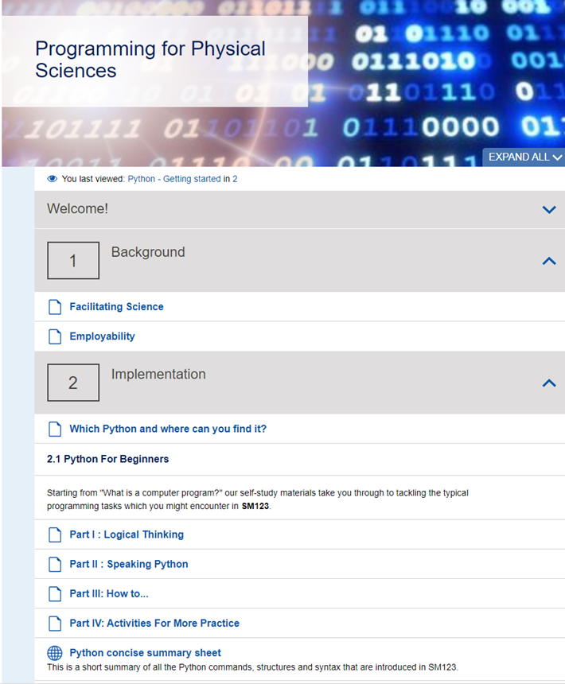
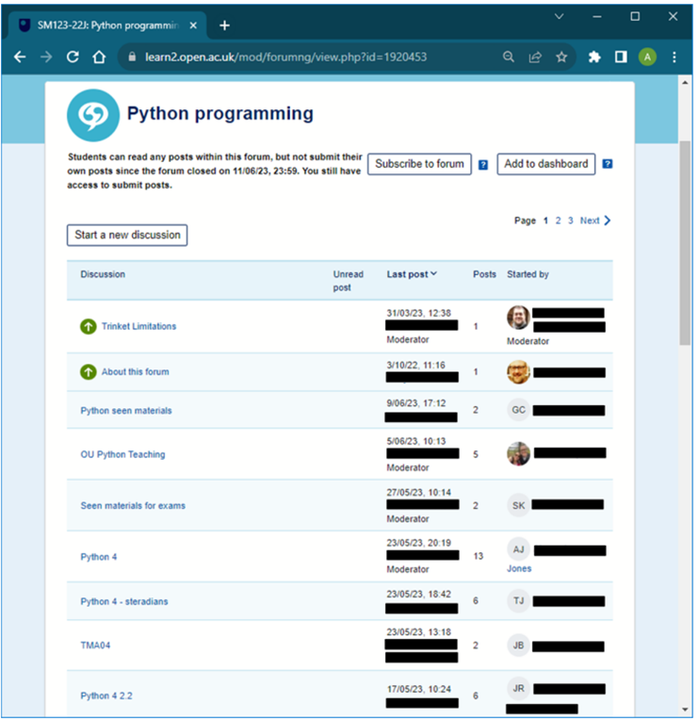
Page Title 6
Evaluating the Programming for Physical Sciences website and forums on SM123 Physics and Space
Andy Diament, Gemma Warriner & Stella Bradbury
Evaluating the website
We will be analysing logs to understand the patterns of access over time and the students using the website.
A survey will help us understand how we can further it develop.
Outcomes
Inform development of website
Usage information across several modules will drive website promotion
Inform future use of forums – scholarship of private forums
Evaluating the Python forum
We will investigate the themes, issues, timings of programming forum, to learn the patterns of use and if students are deterred from using the forums.
We will analyse the logs and content of one presentation’s forum (22J).
Intervention – private forum
We will use a private forum which hopefully will have a lower threshold for use for less strong students.
We will compare its use to the concurrent module wide forum (23J) and the previous year’s forum (22J).

