Slide 1
Notetaking and on-screen learning
Correlation does not imply causation.
John Baxter
May 2019

Slide 2
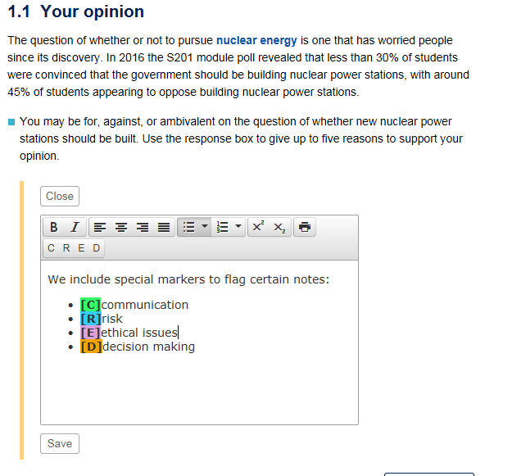
S201 Science and society A simple note-taking tool
Students take notes on the page they are studying
Notes are stored on our servers.
We provide two types of notes boxes:
“Study notes” boxes at the bottom of every page
“Response boxes” for embedded questions

Slide 3
Integration with assessment
Students are told in week 1, for example:
In order to enable you to take appropriately focused notes as you study the module, you should be aware that Part two (of the EMA) will ask you to discuss:
Examples drawn from the S201 Topics in which, in your opinion:
decision-making was influenced by science.
decision-making was not sufficiently influenced by science

Slide 4
Previously reported …
Weekly mean: 46% of students use the boxes, mean entries = 14
BUT the tail says lots of students are not using it to any great extent

Slide 5
Previously reported …
 | Correlation between intensity of note-taking tool use and module outcome |  | Correlation between intensity of note-taking tool use and final essay mark
 | Whole cohort r | Intense users r | Whole cohort r | Intense users r
2017 | 0.202 (n=97) | 0.459 (n=26) | 0.124 (n=97) | 0.488 (n=26)
2018 | 0.292 (n=99) | 0.468 (n=28) | 0.238 (n=99) | 0.518 (n=28)
Intensive tool users (>10 entries/week), show a relatively strong correlation between the number of entries and achievement in end of module outcomes(r ≈ 0.5)

Slide 6
Further analysis
Mean note box use over entire module
On average younger students make less use of our notetaking boxes than older students.

Slide 7
The survey
A survey was undertaken of 17J S201 students who completed the module asking them about their notetaking habits (return rate 46%).
The remaining slides give some highlights of the ongoing analysis of the survey data
Survey did not include students who did not submit the EMA
Students seemed to underestimate how much they use the tool: 9% of those surveyed felt they used the boxes 10 times or more a week (it was ~30%). This is likely to indicate a difference of interpretation as to what notes are!

Slide 8
Survey
93% of students surveyed felt they regularly took notes

Slide 9
Survey:
Effect of prior onscreen-only study

Slide 10
Survey results:
Intensive notetaking techniques associated with success

Slide 11
Survey results:
Intensive notetaking associated with lower marks?

Slide 12
Survey results:
Profile Key:
For each notetaking technique students were asked to estimate of their usage using the following scale
Score | How often did you use note-boxes?
0 | Not at all
1 | 1 or 2 times in a Topic (4/5 weeks study)
2 | 1 or 2 times in a week of study
3 | 3 to 9 times in a week of study
4 | >10 times in a week of study

Slide 13
Profile 1 (F, age 40-45, essay 85%)

Slide 14
Profile 2 (M, age 21-24, essay 86%)

Slide 15
Profile 3 (M, age 35-40, essay 65%)

Slide 16
Profile 4 (F, age 30-34, essay 78%)

Slide 17
Profile 5 (F, age 30-34, essay 33% )

Slide 18
Profile 6 (F, age 40-44, essay 60%)

Slide 19
Profile 7 (F, age 30-34, essay 85%)

Slide 20
Profile 8 (F, age 30-34, essay 73%)

Slide 21
Profile 9 (M, age 40-44, essay 52%)

Slide 22
Profile 10 (M, 30-34yrs, essay 42%)

Slide 23
Survey: conclusions
The results of the survey, particular the open text questions, confirm that it is unlikely that the correlation seen between notetaking techniques and outcomes are causative.
Far more likely is that the note taking technique adopted is a reflection of other factors including:
Devices/technology available
Prior experience of study
Pressures (or otherwise) of time
Level of study skills
Level of digital skills

Slide 24
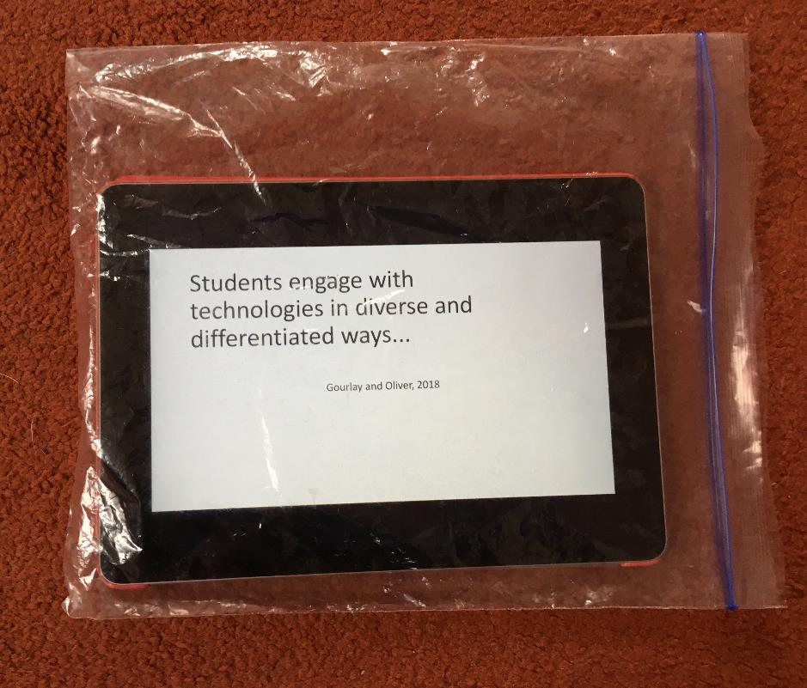
The end…
j.s.baxter@open.ac.uk

