Slide 1
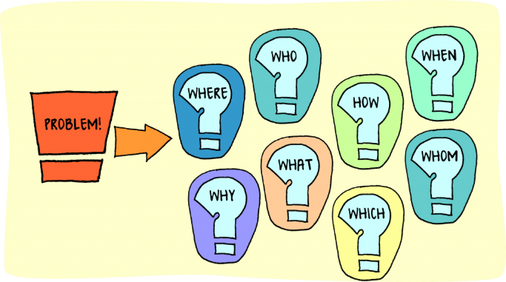
Improving student use of feedback on marked TMAs Carol Calvert (staff tutor), Clare Morris (AL) Problem: Inefficient use of correspondence teaching time Symptom: up to 10% of marked etmas are not collected (prior work undertaken outside eSTEeM on scholarship exchange https://openuniv.sharepoint.com/sites/units/lds/scholarship-exchange/documents/Student%20%20use%20of%20TMA%20feedback.pdf#search=calvert) Solution (eSTEeM project): - increase awareness of tutors of which students are and are not picking up and why - build and disseminate materials for students to help them understand, use and value written feedback on TMAs - build and disseminate materials for tutors to help them develop ways to get students to want to engage with feedback
This Photo by Unknown Author is licensed under CC BY

