Slide 1
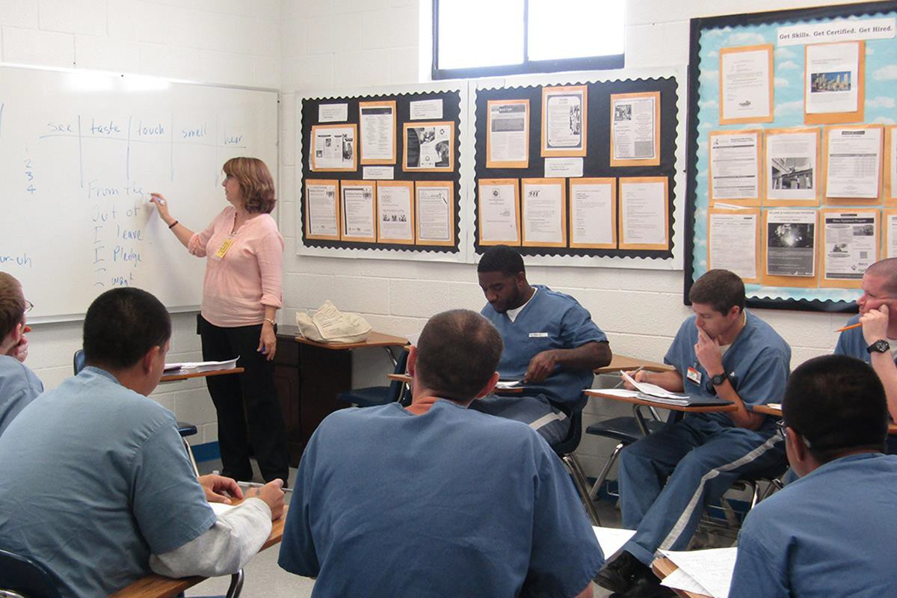
Investigation into Running Module Specific Taster Tutorials Within Prisons for Non-OU Students
Colin Blundell & SiSE Team North
Scope
When I visit prisons to run tutorials more often than not there are a large number of prisoners in the same classroom doing non-OU study who show an interest in what is being covered. This project aims to try to capture these students by running joint AL/SiSE team visits which include taster tutorials on level one STEM modules and the administration/requirements for OU study. This is also to be done in prisons where the OU currently do not have a presence and in particular opening the net for female prisoners.
Project Aims
To generate relationships between the OU and education departments of prisons which currently have none and to enhance these relationships where we have them.
Set up and run joint SiSE team and AL visits within prisons for wide
group taster sessions for non-OU students covering the how to study and the what to study.
Evaluate the effectiveness of the sessions.
10% decrease in re-offending rate for prison learners
Phases
Literature research and current situation in North prisons analysis.
Contact prison education departments and discuss feasibility of visits. 3 Target specific prisons based on Equality, Diversity and Inclusion.
4 Evaluate project using recorded data and interviews/surveys.
78000 adults in prison education-12% drop from last year

