Slide 1
Developing responsive approaches to enhance personalized learning in S315
Nick Chatterton, Eleanor Crabb and Kate Bradshaw

Slide 2
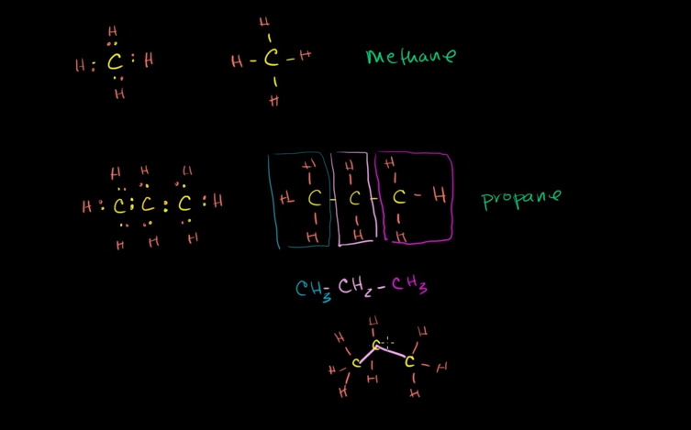
562,000 subscribers
4 million subscribers

Slide 3
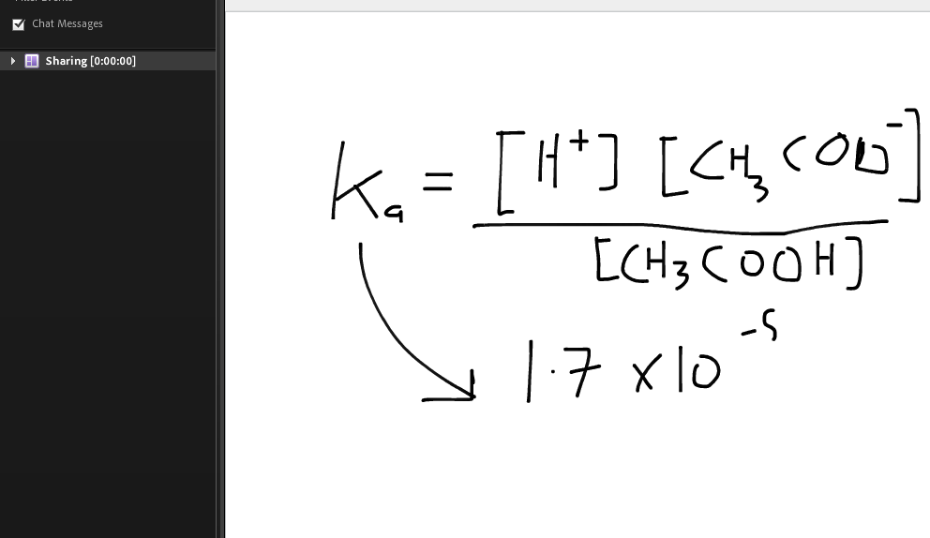
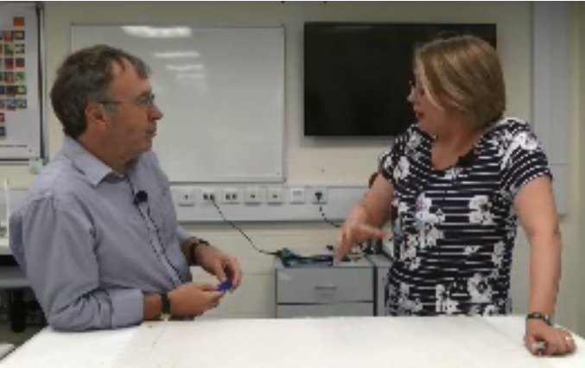
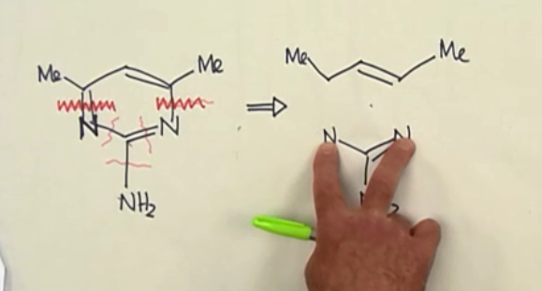

Slide 4
Aims:
To develop responsive “chalk and talk” teaching resources for S315 i.e. in response to specific forum queries.
To produce recorded “chalk and talk” sessions on topics that are known to be problematic for students
Scope affordable hard and software solutions that allow for the production of these resources that might of use to the university more widely
To compare effectiveness of different approaches

