Slide 1
Improving students' engagement with Python
Gemma Warriner and Andy Diament
School of Physical Sciences
Notes:
Looking for a better word than consequences…..

Slide 2
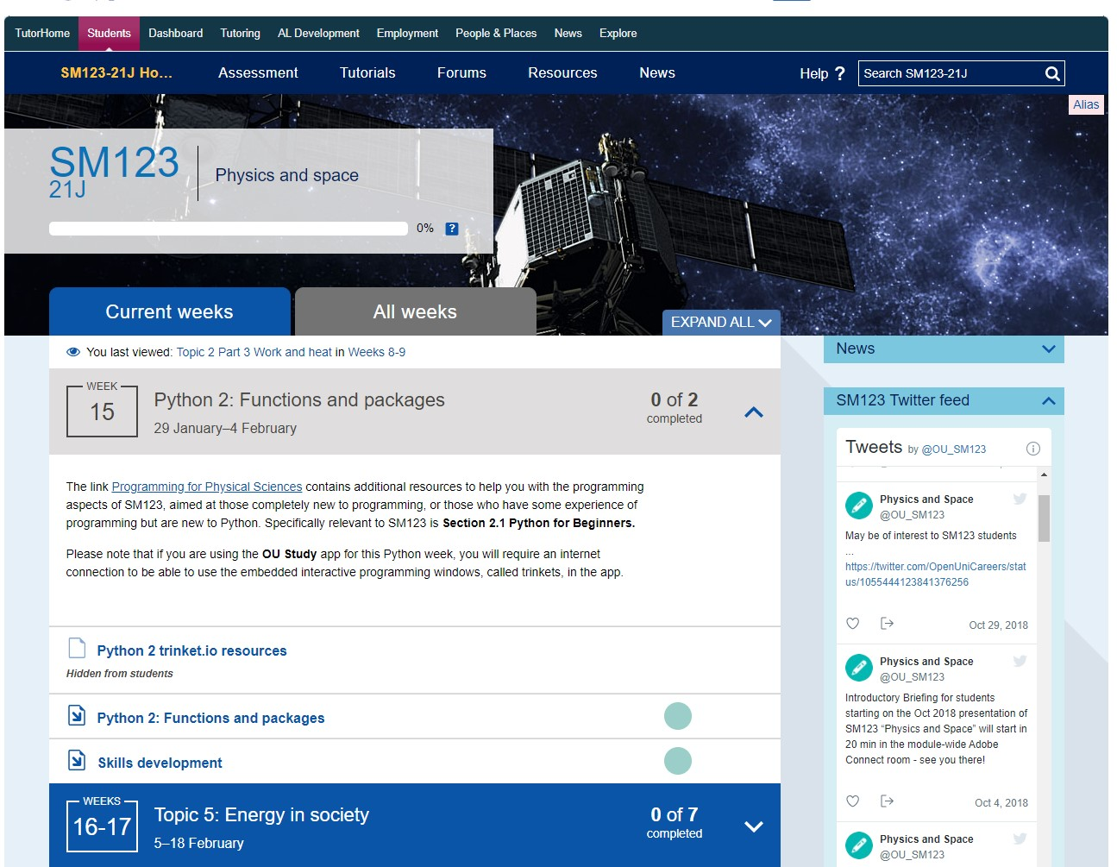
Notes:
Little context here for non-experts, new slide

Slide 3
Context
Programming, using the Python programming language, is an essential skill for employability in Physics and Space Sciences.
Programming is introduced in SM123 Physics and Space
It is delivered in 4 separate weeks, Python 1, Python 2 etc
It is used more extensively in SXPS288 Remote Experiments in Physics and Space
It will be used in level 3 modules
Most SM123 students are new to programming
Not all engage successfully with this skill
Notes:
Little context here for non-experts, new slide

Slide 4
Questionnaires
We ran two questionnaires that ran in the first and third weeks of Python study.
55 students took part in the first survey (13%)
87 took part in the second survey (21%)
We used the JISC Online Questionnaire Tool
  Yes/No answers
  Multiple choice answers
  Likert scales for confidence, time taken etc
  Free text responses
Notes:
Changed the numbers here

Slide 5
Questionnaires
Broadly we asked them about:
How they were finding SM123 as a whole
Any preparation they did
What resources they used to help them with Python during the module, OU and external.
What they felt about Python. For those that felt quite negatively we tried to find out where and why this happened
We asked about specific activities within the Python weeks of study

Slide 6
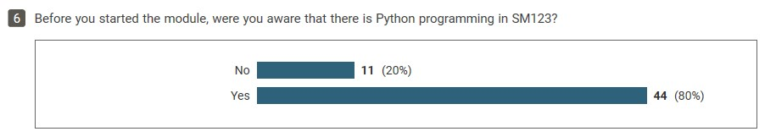
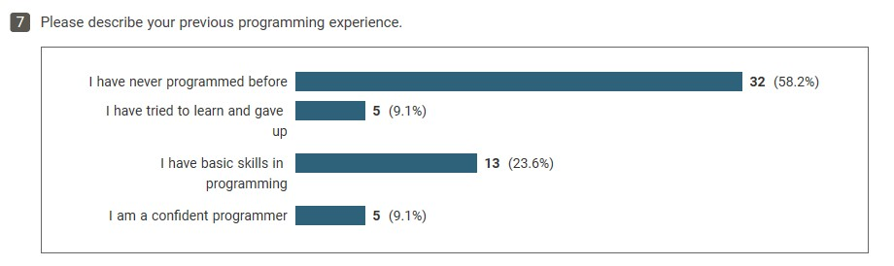
Preparation for SM123
We looked at how these 11 students responded to later questions (on next slide), they all reported that they didn’t know Python was part of SM123 until they saw it on the website. It is apparent from Q7 that the majority of these students are new to programming

Slide 7
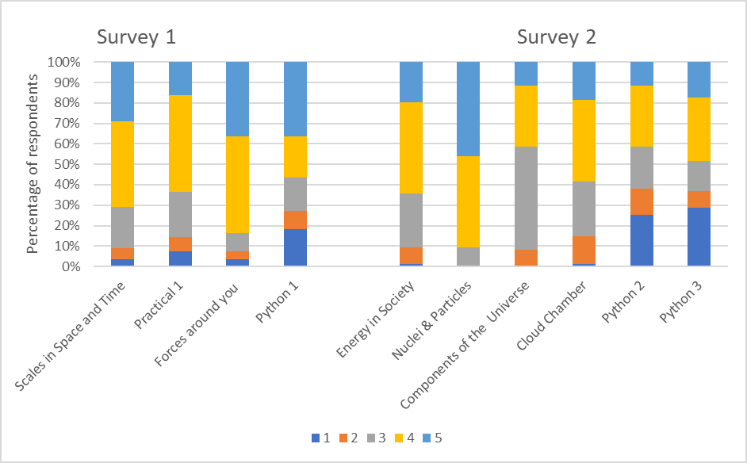
SM123 Overall Enjoyment
Students rating their enjoyment from 1 (low ) to 5 (high) for different parts of SM123
Notes:
Used graphs from final report, they may not fit on one slide

Slide 8
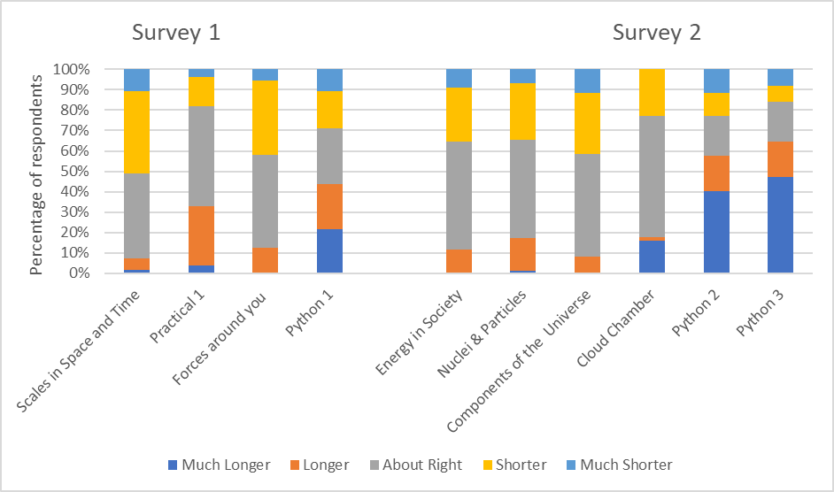
SM123 Time Spent
Time spent on study weeks in SM123 in Survey 1 and Survey 2, compared to suggested time on study planner

Slide 9
Python Resources Accessed
Resources accessed by students whilst studying SM123

Slide 10
Python 1 specific activities
Students rating their confidence after activities in Python 1
Notes:
I’ve hidden this one as it is very specific to activities and we’ve already got confidence in figure 5. If we want to include it, we need to include the post Python 3, then I think we are getting close to death by bar chart. If anyone has a question about programming specifics we can mention it.

Slide 11
Python 2 specific Activities
Students rating their confidence after activities in Python 2
Notes:
I’ve hidden this one as it is very specific to activities and we’ve already got confidence in figure 5. If we want to include it, we need to include the post Python 3, then I think we are getting close to death by bar chart. If anyone has a question about programming specifics we can mention it.

Slide 12
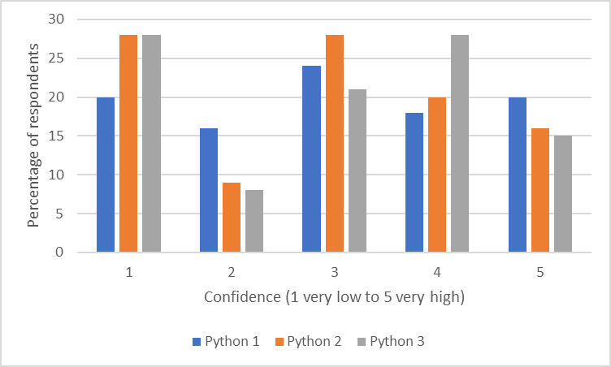
Confidence after Python weeks
Students rating their confidence after Python weeks 1, 2 and 3

Slide 13
Summary of findings
A summary of our findings:
Our surveys confirmed that a lot of students struggle with Python in SM123. It takes them longer, they enjoy it less and many rate themselves as having low confidence after each week.
The majority of students are novice programmers and some were unaware that Python was within the module before starting the module.
Students are spending a lot of time looking at non OU resources to help them, not always sucvessfully.
Certain activities seem to be a stumbling block for students in each Python week. This causes a proportion of the students to give up

Slide 14
Outputs
Based on the evidence collected, a case was made to update the Python for Physical Sciences website in time for 21J, to better support SM123 students before and during the module.
The updated content was written by two ALs addressing the issues that students found particularly difficult as identified by my eSTEeM project.
The site now has a new section aimed at SM123 students, with embedded pdfs. The expanded website has been retitled as “Programming for Physical Sciences”.
News about the updates were disseminated to colleagues and links were put on the SM123 website within the Python week information on the Study planner.
An email was sent to all prospective 21J students highlighting the Python content. Links were given to the “Are You Ready For” (AYRF) activity and the updated “Programming for Physical Sciences” website outlined in section 5.9.

Slide 15
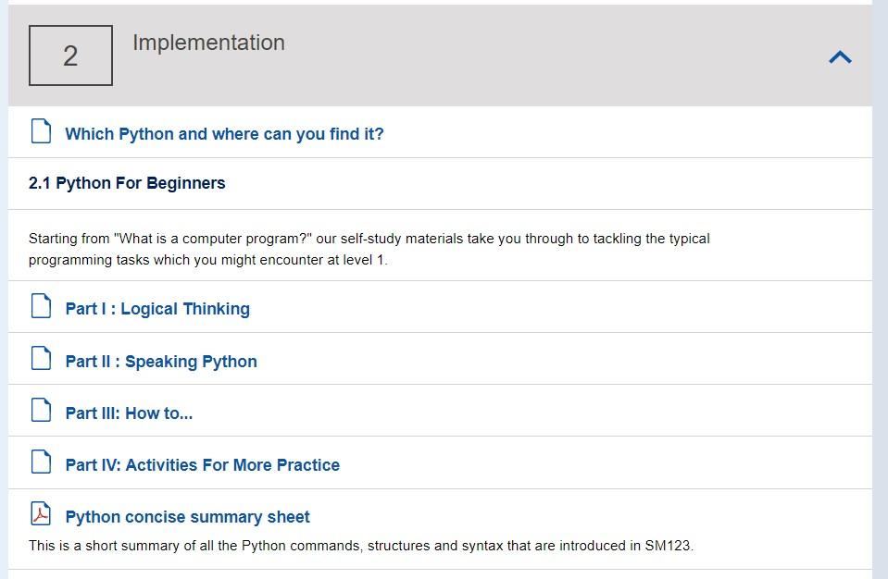
Outputs
Website: Programming for Physical Sciences (open.ac.uk)
https://learn1.open.ac.uk/course/view.php?id=100219

Slide 16
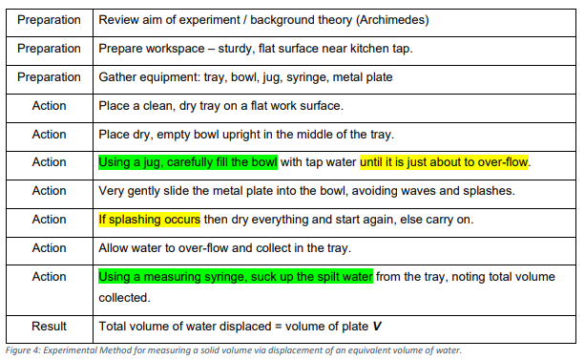
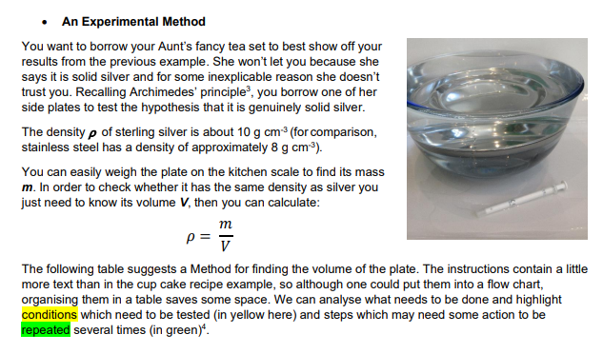
Outputs – Logical Thinking – problem solving/algorithms

Slide 17
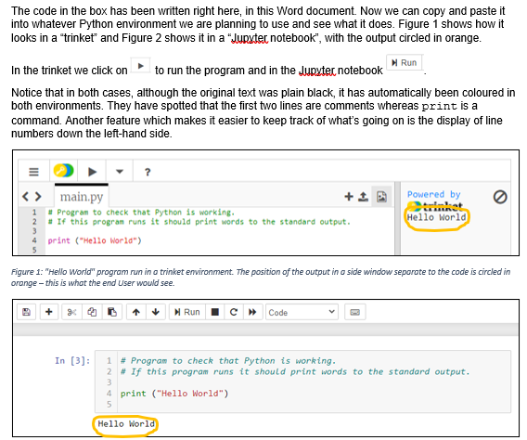
Outputs – Speaking Python – Syntax in Depth

Slide 18
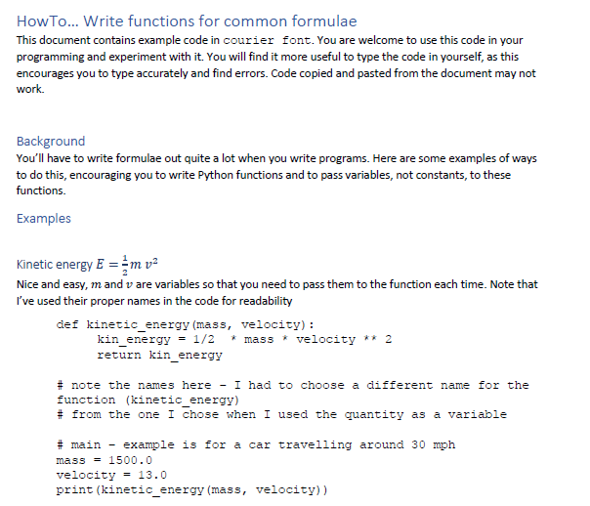
Outputs- HowTo Guides

Slide 19
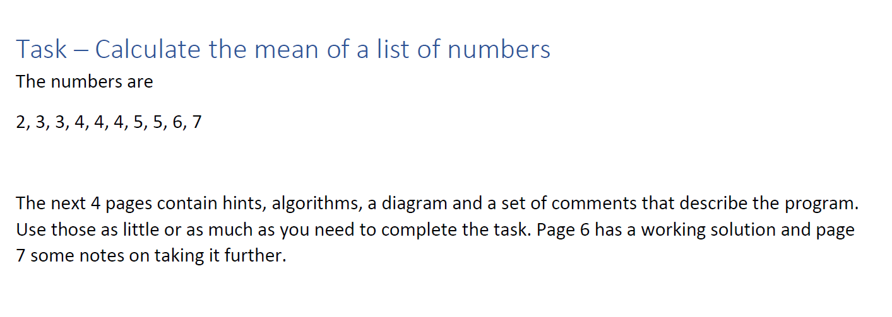
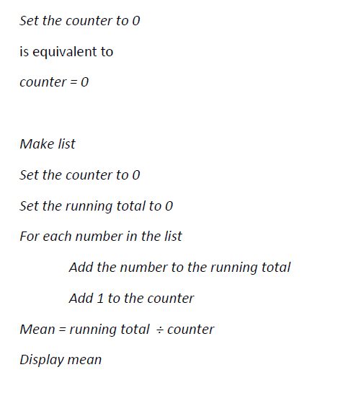
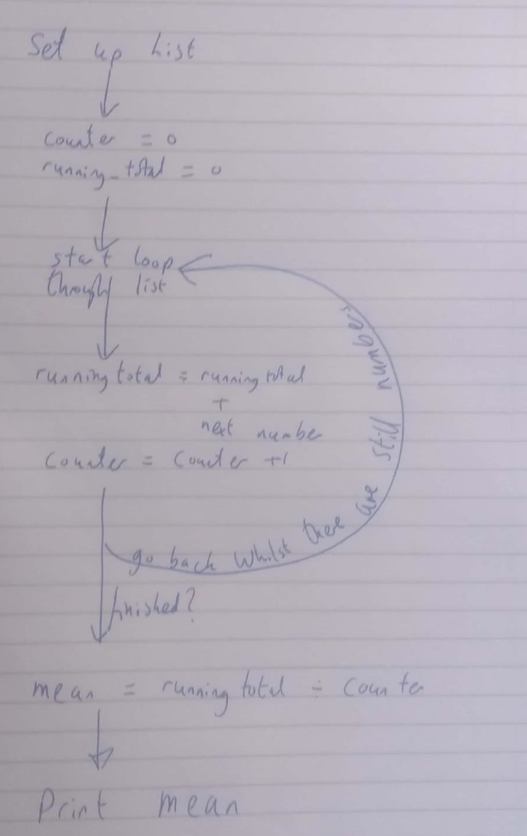
Activities for More Practice
Scaffolded tasks variously including hints, algorithms, rough flowcharts, solutions

Slide 20
THANK YOU
Next steps
Evaluation of new website
Further resources

