Slide 1
Implementing a one-to-one online English for Academic Purposes (EAP) support service across the University curriculum
Dr Jo Fayram and Dr Lina Adinolfi, School of Languages and Applied Linguistics

Slide 2
Existing EAP provision at the OU
Two dedicated credit-bearing EAP modules currently exist within LAL - one general EAP, one business-related EAP – both embracing students with English as either a first or additional language
Yet to date there has been:
- no systematic cross-university focus on EAP

Slide 3
The OU-wide one-to-one online EAP support service
was prompted by concern from some tutors in FBL that they could not provide their students with EAP support via the ISSF, themselves
was organised by a cross-faculty team
drew on the ISSF to provide dedicated subject-specific one-to-one EAP sessions using a team of specialist EAP tutors
is offered to students across all OU Faculties at Access, undergraduate and taught postgraduate levels
is operationalised by three advisors based in the Manchester SST.

Slide 4
EAP sessions broken down by Faculty or programme, student numbers and total session count (01.02.19 - 11.10.21)
Faculty or programme | Number of students | Number of sessions
Access | 37 | 49
Faculty of Arts and Social Sciences (FASS) | 177 | 212
Faculty of Business and Law (FBL) | 71 | 85
Faculty of Science, Technology, Engineering and Mathematics (STEM) | 103 | 126
Faculty of Wellbeing, Education and Language Studies (WELS) | 237 | 286
TOTAL | 625 | 758
TOTAL COST | £52,677
^{[1}

Slide 5
The operationalisation of the one-to-one online EAP support service
OU-wide one-to-one online EAP support
Strategic alignment and buy-in
Robust communications
Electronic systems and dedicated webspaces
EAP specialist tutors
Project evaluation (ongoing)

Slide 6
Strategic alignment -Access Participation and Success Strategy: the project is seen as particularly valuable to students with low prior educational qualifications (PEQs) -The project is of clear relevance to supporting international students with English as an additional language Buy-in -Academic Services: agreement to use a portion of the ISSF for the scheme -Faculties: agreement needed for tutors to refer their students to the project.
Strategic alignment and buy-in

Slide 7
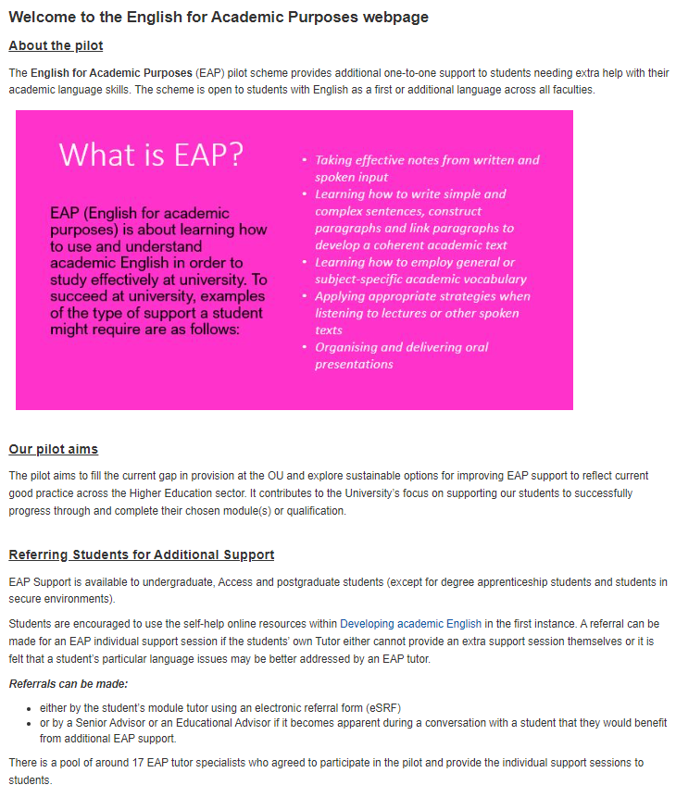
Robust communications
Staff Tutors: briefing materials sent via email
Tutors: separate briefing forwarded by staff tutors via email
Student Services: presentations, Q & A sessions, briefing notes
All of the above supported by an intranet page and tutor newsletter.

Slide 8
The EAP specialist tutors
16 tutors originally recruited from the two existing EAP modules
Criteria for recruitment included a broad range of subject-specific EAP experience (e.g. Law, Chemistry)
EAP tutors briefed via a dedicated forum with follow-up Q & A sessions
Ongoing EAP tutor support provided via the forum and by email.

Slide 9
Online systems and dedicated webspaces
A dedicated forum, materials’ repository and online room was created on an existing website to foster an online Community of Practice where EAP tutors can share experiences, support one another and upload additional resources
A VLE website was set up to host the Adobe Connect tutorial sessions
An intranet page was created as a source of information for others about the project
A Student Services SharePoint site contained project-related statistics and feedback forms.

Slide 10
Research questions
What is the impact of the one-to-one online EAP support service on student success, as measured by standard OU indicators of completion and first time pass rates?
What is the value attributed to the one-to-one online EAP support service from the perspectives of the participating students and specialist tutors?

Slide 11
Methodology (mixed methods)
Instruments and datasets | Data analysis | RQ
a. Module completion & first-time pass rates of 326 EAP student participants (intervention group) compared to those of 326 non-participating students from the same module presentations (control group), matched with the EAP participants | Quantitative analysis: propensity score matching | RQ1
b. Ratings of the usefulness of EAP support sessions, based on 150 student & 229 EAP tutor feedback forms | Quantitative analysis: descriptive statistics | RQ2
c. Open comments from the above feedback forms | Qualitative analysis: thematic analysis of open comments | RQ2
d. Transcripts from 9 semi-structured student interviews who had received an EAP support session | Qualitative analysis: thematic analysis of student interviews | RQ2

Slide 12
Findings

Slide 13
Module completion and first-time pass rates
Comparison of intervention group and matched control group against outcome measures (RQ1)
Outcome measure | Intervention | Control
Module completion rate | 83% | 72%
Module first-time pass rate | 70% | 69%

Slide 14
Value attributed to students’ academic progress from their own and the specialist EAP tutors’ perspectives (RQ2)
Student evaluation data

Slide 15
Value attributed to students’ academic progress from their own and the specialist EAP tutors’ perspectives (RQ2)
Specialist EAP tutor evaluation data

Slide 16
Value attributed to students’ academic progress from their own and the specialist EAP tutors’ perspectives (RQ2) Themes and sub-themes derived from student and tutor open survey comments and student interviews
Academic impact
Progress
‘My writing level was so bad, so poor. For me, oh my God, I saw that my level was better and I just, like, I was like climbing the Everest- you know that huge mountain and I say at least I know where I am at the moment and what I have to do.’ (Student interview comment)
TMA scores
‘[Student] contacted me this morning to tell me that he had received a mark of 58% for TMA02, whereas his mark for TMA01 was 0%.’ (Tutor survey comment)
Retention
‘I was on the verge of deferring or stopping studying altogether. It was amazing. It was really good.’ (Student interview comment)

Slide 17
Factors contributing to academic impact
Student confidence & self-belief
‘‘As soon as I spoke to [the tutor], I knew I could do this. I really needed this support. A lifeline.’ (Student interview comment)
EAP tutor-student relationship
‘[Tutor] was a lovely, genuine professional, caring, attentive and a great listener, empathiser and excellent, understanding communicator. I consider myself fortunate to have been given the opportunity to pick his brains. It was a genuine pleasure to “meet” with him online via Adobe Connect.’ (Student survey comment)
Personalised one-one support
‘She found 1 to 1 really helpful.’ (Tutor survey comment)

Slide 18
Factors contributing to academic impact
Language awareness
‘[Student] seemed to have a better understanding of the need to plan and structure ideas, and how to do that. She now has a “template” she might use to plan her writing.’ (Tutor survey comment)
Meeting an EAP support need
‘This scheme is incredible, in my opinion it would be wonderful for it to become a permanent fixture, as the knowledge I gained has enabled me to move forward with my studies. For students like myself who have not studied for a long time this scheme was outstanding and I cannot praise the tutor enough for giving up his time to help me..’ (Student survey respondent)
‘I would have liked to have more. They did add a lot of value.’ (Student interview comment)

Slide 19
Key takeaways
EAP sessions showed a statistically significant positive impact on student retention, as measured by module completion rates.
Impacts on student first-time pass rates were not statistically significant.
Encouraging quantitative outcomes were reinforced by consistently positive feedback from students and tutors about the quality and value of the sessions.
EAP support attracted a relatively high proportions of students from widening participation groups, in particular Black, Asian and Minority Ethnic (BAME) students. Approximately half of the EAP participants were EAL students.

Slide 20
Conclusion
Benefits
Increased awareness of EAP support needs across Faculties
Clear indication of an ongoing need for EAP provision, with potential to scale up and test additional modes of EAP support
Challenges
Cost/complications of expanding the 1:1 service within the new climate of the AL contract
Challenge of introducing longer-term EAP courses when many students cannot fit in additional credits int their study programme
Challenge of integrating EAP across the curriculum in a period of cost-cutting and economic decline.

Slide 21
Thank you
Jo.Fayram@openac.uk Lina.Adinolfi@open.ac.uk

