Slide 1
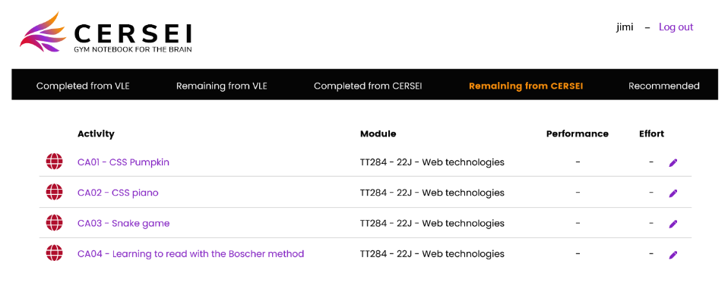
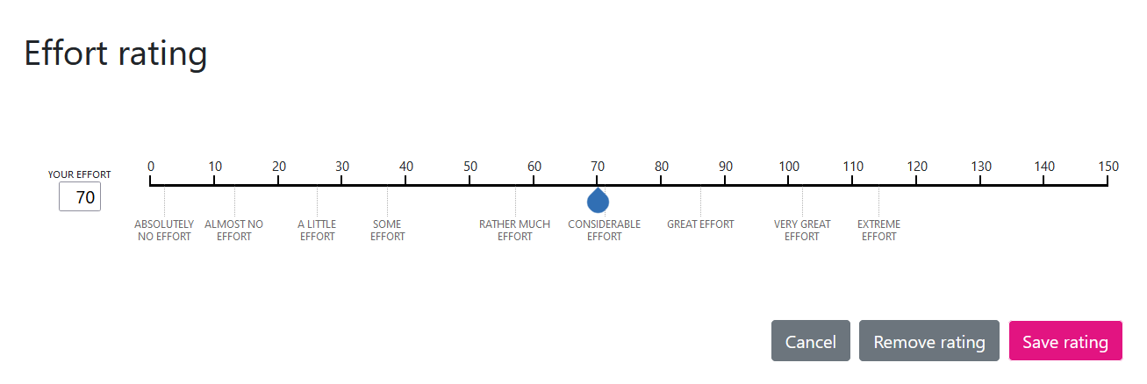
Study of the potential for digital educational tools to provide more inclusive learnings Miriam Fernandez, Geoffray Bonnin
KEY RESEARCH QUESTIONS
Is effort different for different categories of students?
How do different categories of students exert effort while learning?
How do recommendations impact different categories of students?
PREREQUISITE: DEVELOPMENT OF A NEW PLATFORM
Allows students to track their cognitive effort
Provides engaging activity recommendations
Contains a local Moodle with additional learning activities
WORK PLAN
Currently preparing a usability and design pre-study
The actual large-scale study will start in October 2023 (next presentation of TT284)

