Slide 1
How do STEM students use digital and non digital learning resources?
A study focusing on S217, MST224 and M269 students
Laura Alexander, Alexis Lansbury and Sharon Dawes

Slide 2
eSTEeM project
Laura Alexander and Alexis Lansbury
If students meet modules which rely on different media for learning resources part way through their studies, what is the impact of this?
Does it affect student progression and retention and could there be ways to mitigate this impact?

Slide 3
Students have very different experiences at level 1 and at level 2
Focus on S217, MST224 and M269 students.
Science (Physics) | Mathematics | Computing
Level 1, Previously S104, MST124, (book based and online) From 2016 entirely online (S111 and S112) Or Online and book based (S111 and MST124) | Level 1 Mostly book based study resources (eg MU123, MST124, MST125, M140) | Level 1 TM111, TM112, TM129, MU123 or MST124
Level 2 - S217 Entirely online | Level 2 - MST224 purpose-written text-books | Level 2 - M269 blend of digital resources, texts in the public domain and texts specifically developed for the module

Slide 4
Aims and Objectives
Identify similarities and differences between the different approaches that schools in STEM take
Identify the similarities and differences between students’ learning strategies in the different schools
Identify how the use that students make of different types of learning resource evolves over time
Investigate whether students’ preferences for specific types of resource have any correlation with factors such as age, gender, first language/mother tongue
Use individual interviews to investigate whether any correlation has an underlying causality.

Slide 5
Data Collection
Sent a questionnaire to students on Oct 2017 presentations of S217, MST224 and M269 in January 2018, and repeated this for October 2018 presentation in Jan 2019
Mix of quantitative and qualitative questions
200 students on each module.
17-18% response rate, including at least 30 students on each module in each year

Slide 6
What did we ask them?
What was your first level 1 module?
What methods did you use to study it? (select from list plus text box)
What proportion of your time was spent using each method?
Did you change how you studied for subsequent level 1 modules? (Why?)
Considering current level 2 module, What methods did you use to study it? (select from list plus text box)
For your current level 2 module, did you need to change how you studied? (Why?)
Did this cause you any issues? (What issues?)
Would you be willing to take part in follow up interviews?

Slide 7
What resources did students use?
Green – digital, Orange – paper based

Slide 8
How do you study
Online quizzes and iCMAs and Doing module exercises and activities on paper were two most popular ways of studying for both initial level 1 and current level 2 modules.
Fairly even split between using digital and non-digital resources at level 1 and level 2.
 | Computing | Maths | Physics
First Level 1 Module, methods of study
Digital | 58% | 46% | 51%
Non-digital | 42% | 54% | 49%
Current Level 2 Module, methods of study
Digital | 61% | 47% | 48%
Non-digital | 39% | 53% | 52%

Slide 9
How do you study, digital vs non digital
Students seem to stick to the approach they developed on their first level 1 module
Max 3% shift in digital/non digital study approach from first level 1 to first level 2
But 47% of all students surveyed felt they had to change their approach to study as they moved to level 2 study!
Indicates students find an alternative method which still falls into the same category?
For example, S217 students, (whose S217 module material was entirely online), appear to have changed from annotating module textbooks at level 1 to annotating printed pdfs when studying S217, rather than developing ways to annotate information online or making notes electronically.

Slide 10
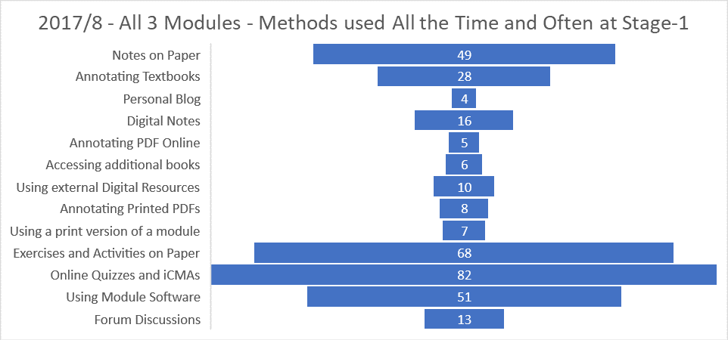
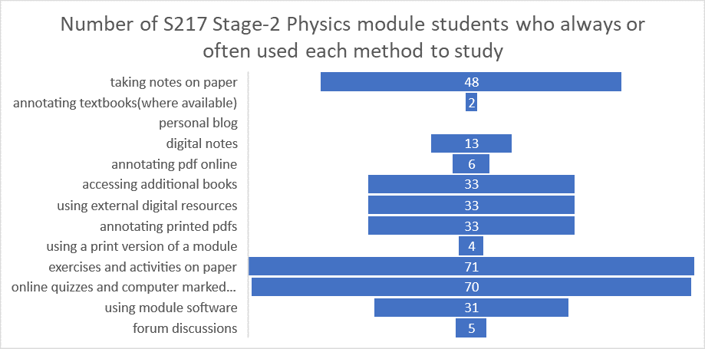
Entirely online module?

Slide 11
Did you have to change how you studied?
Note most S217 Physics students in 17J had studied S104 as their first OU module
Students currently studying module | Approach changed between first level 1 module and subsequent level 1 modules | Approach changed when studying first level 2 module
Computing | 5 (14%) | 17 (49%)
Maths | 5 (15%) | 9 (27%)
Physics | 9 (20%) | 27 (60%)
Total | 19 (17%) | 53 (47%)

Slide 12
Studying at level 2 – did changing approach cause issues?
Module | Changing approach caused issues (percentage of those who had to change approach)
Computing | 9 (53%)
Maths | 3 (33.%)
Physics | 23 (85%)
Total | 35 (66%)

Slide 13
Does first module studied set preferred study methods?
Data from respondents from 17J and 18J cohorts combined
Module(total number of respondents) | Total number | Percentage responding who felt they had to change approach when starting their level 2 module | Percentage changing approach for whom this change caused issues
S217(88)
First module S111 | 23 | 41% | 44%
First module S104 | 31 | 83% | 84%
First module level 1 maths | 22 | 63% | 67%
MST224(81)
First module S111 | 6 | 33% | 50%
First module S104 | 18 | 29% | 0%
First module level 1 maths | 47 | 18% | 50%
M269(66)
First module level 1 maths | 13 | 50% | 40%
First module TU100 | 40 | 58% | 43%

Slide 14
Focusing on S217 in the context of these results
We now know what students perceive causes them problems
Does this actually affect how they perform on the module?
S217 provides a perfect chance to investigate this.

Slide 15
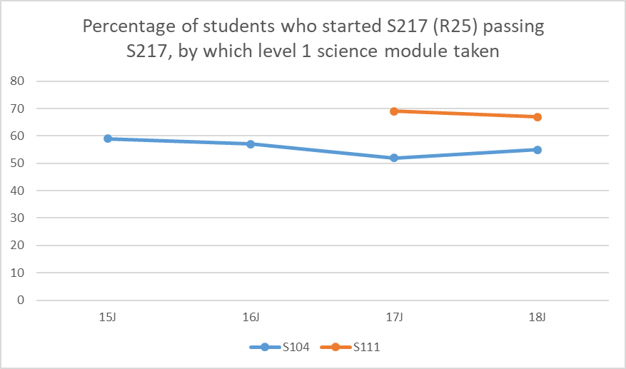
Looking at S217 results
Having studied an online module at level 1 was a better predictor of success for the onscreen only S217 than having studied more maths or more physics

Slide 16
Grade of pass on S217
Students studying at full time rate – S111 students half as likely to fail S217, and 30% more likely to get a grade 1 or 2 pass

Slide 17
Conclusions in an OU context
Also checked for age, educational background etc
Having completed an entirely online Stage 1 module is a better predictor of success on the entirely onscreen Stage 2 S217 Physics module than having completed a module which contains more physics and more opportunities to apply maths to solve physics problems.
The perception of students that they perform less well when they suddenly meet a module where all the material is supplied onscreen appears to be correct.
Consideration needs to be given to likely pathways through qualifications to avoid this happening later in a student’s studies.
Onscreen study skills can be learnt, it is important to give all students the opportunity to gain these skills at Stage-1 if they are going to meet entirely onscreen modules later in their studies.
Note-taking for onscreen material is a key skill.

Slide 18
Analysis of free text comments 17J cohort

Slide 19
Secondary concerns more revealing
Highlighted other preferences including:-
Desire for more non-textual online content
Desire for offline access to digital resources
Enjoy the combination of books and online

Slide 20
Further analysis of free text comments 17J cohort

Slide 21
In depth interviews
We completed approx 12 in depth interviews
'I find it easier to learn from a book than I do from looking at a screen. I look at a screen all day long at work'
'I’m less likely to take notes when I’m reading it digitally’
‘What do you think would make a well-integrated package of learning resources for a module?’
Every student wanted books plus visual and interactive online resources, particularly more practice iCMAs with detailed answers, and more recorded screencasts.
Several students referred to MST124 or S104 as their ideal combination of digital and book based
Online note taking only seemed to be at all effective for those with the newer iPad Pro and an Apple pencil. Even these students said annotating paper copies was better.
Many students said that they remembered content studied on paper better, they could visualise it on the page. Ties in with other research
Internet access issues meant they wanted digital resources that were available offline – several references to DVDs.

Slide 22
Do younger students prefer online?

Slide 23
STEM students
Want the best of both worlds, they:-
Use a mix of digital and paper-based study methods, regardless of whether a module is presented entirely digitally, or has a mix of paper and digital resources.
Prefer to have a combination of book based and digital resources.
Particularly value screencasts and online quizzes
Find two devices with large screens are required to study entirely digital material
Find books better for studying while travelling, both for ease of use and because of poor internet connectivity while travelling
Want to be able to access digital module material offline
Want to be able to access a digital version of any paper module books.

