Slide 1
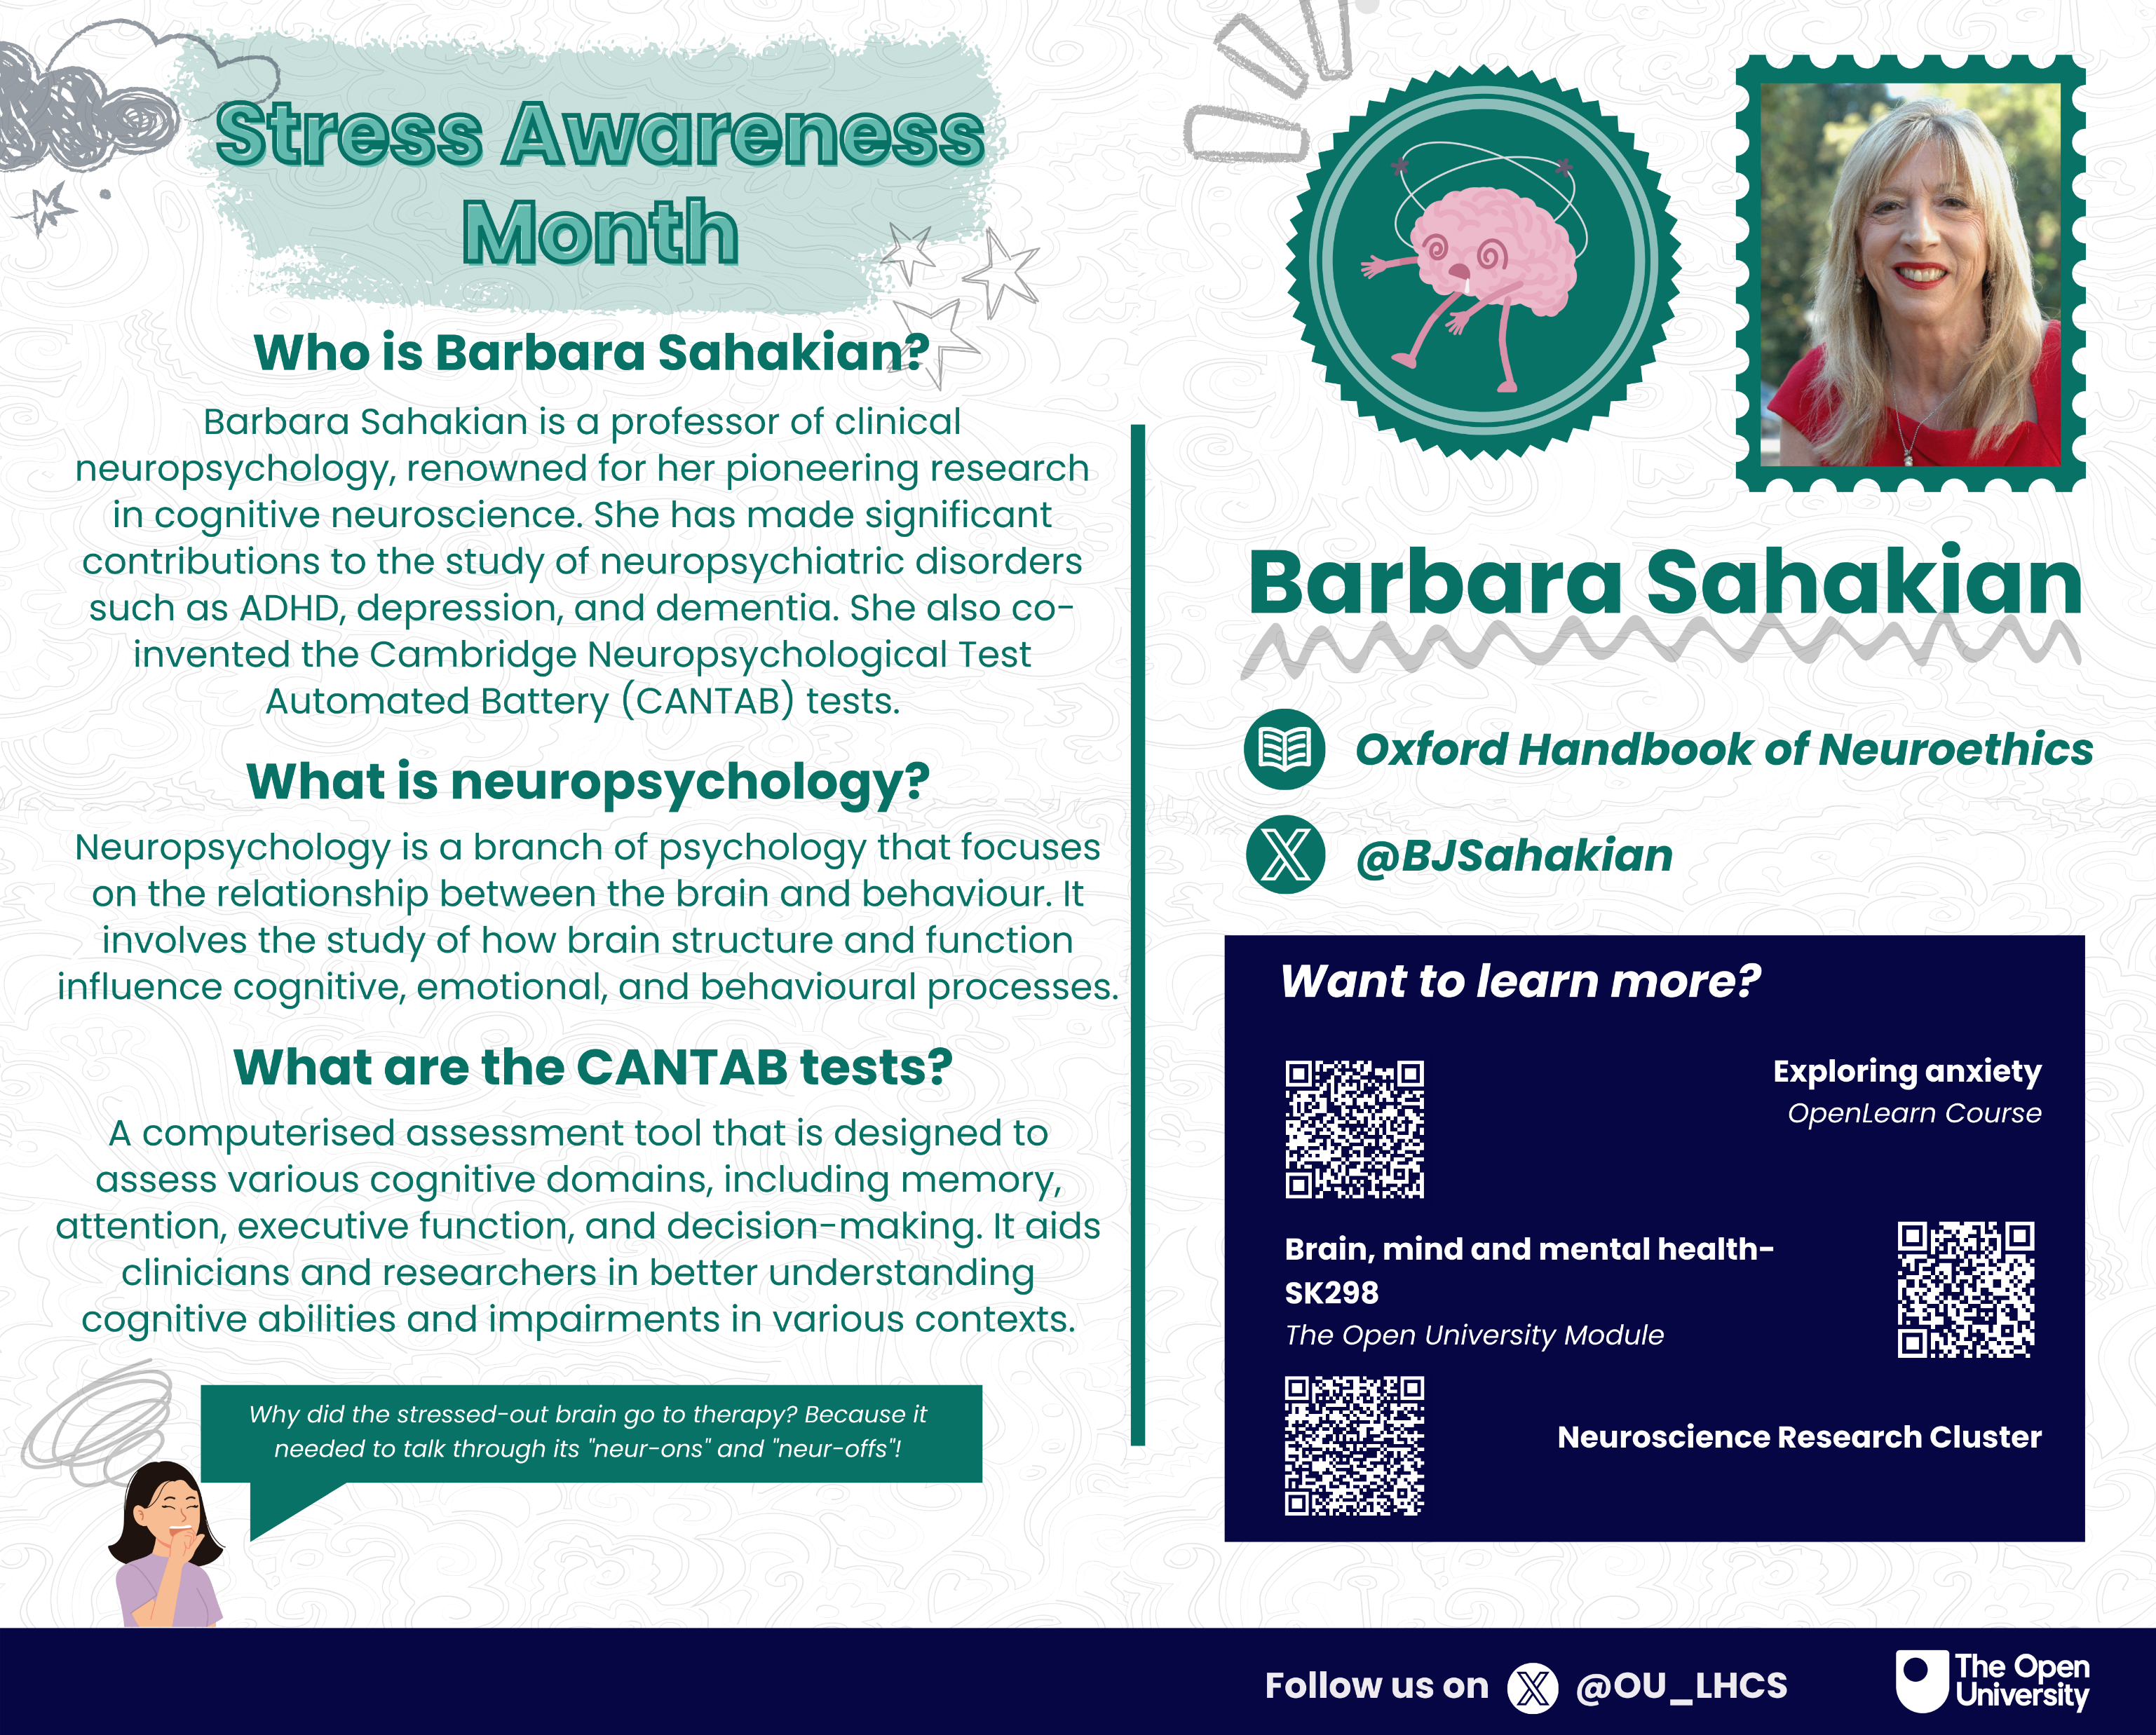
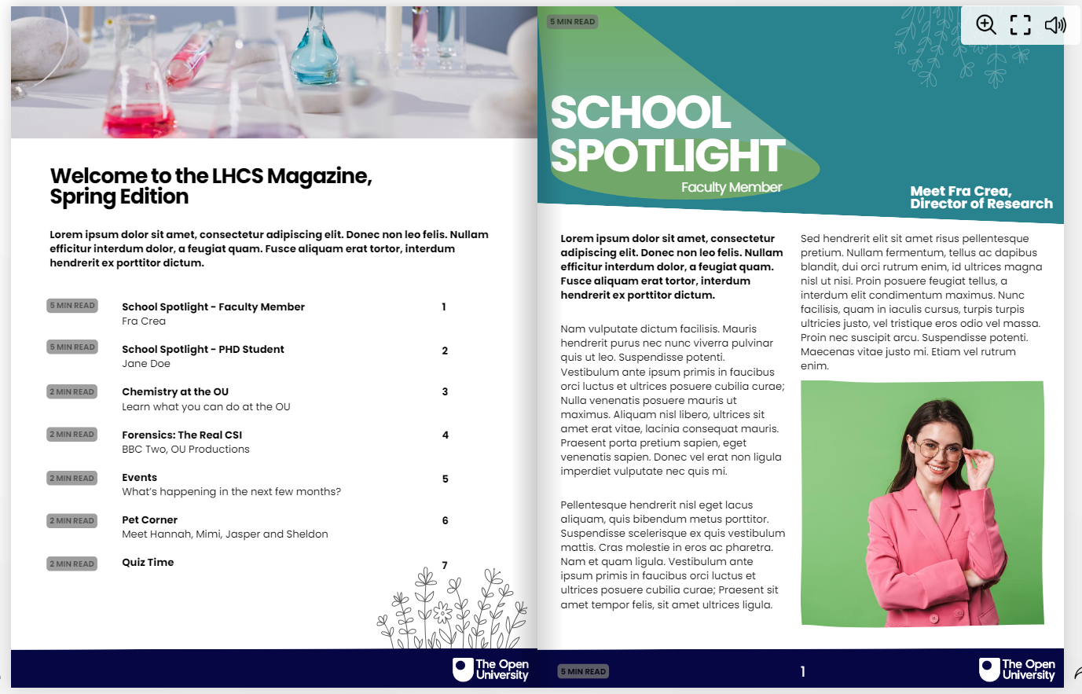
Evaluation of Digital Assets to support LHCS Students’ Sense of Belonging
Janette Wallace and Zoë Chapman, Faculty of STEM, School of Life, Health and Chemical Sciences
Background
Dissemination
Sense of belonging has been linked to improved student retention, attainment and satisfaction (Zumbrunn et al., 2014; Thomas, 2021; Crawford et al., 2024), particularly within a campus based HE setting as well as in online environments (Thomas et al., 2014; Peacock and Cowan, 2019).
The LHCS APS team have several initiatives to increase retention and improve attainment, some of which are focussed upon building a sense of belonging which has been linked to STEM student success in previous studies (Rainey et al., 2018).
Postcards and magazine will be hosted on the Science Study Site and a CAMEL email sent to all LHCS students with link to access.
Links for postcards to be sent out on 1st of the month starting October 2024.
Links for magazines to be send out 1st of each quarter starting January 2025.
Methods
Mixed methods approach using a blend of qualitative and quantitative data methods:
Quantitative data can be captured via web traffic to the Science Study Site, as well as data on click rates from emails.
Qualitative data can be captured via RTSF questions.
Further, a JISC survey hopes to obtain students opinions and attitudes using a mixed of fixed and open answer questions.
The survey will take place in 2025 once the postcards and magazine have been disseminated.
Project Assets
In January 2024, LHCS hired an APP intern to support a sense of belonging initiative by creating a series of digital assets in the form of 12 x digital postcards and 4 x editions of a digital magazine.
Each postcard celebrates a particular month or day, and showcases a scientist linked to LHCS in terms of their topic/research interest.
Each magazine has similar features but with differing thematic content.
References
Janette.Wallace@open.ac.uk
Zoe.chapman@open.ac.uk
Contact:
Crawford, J., Allen, K. A., Sanders, T., Baumeister, R., Parker, P., Saunders, C., and Tice, D. (2024). Sense of belonging in higher education students: an Australian longitudinal study from 2013 to 2019. Studies in higher education, 49, pp. 1–15.
Peacock, S., and Cowan, J. (2019). Promoting a Sense of Belonging in Online Learning Communities of Inquiry. Online Learning, 23 (2).
Rainey, K., Dancy, M., Mickelson, R., Stearns, E., and Moller, S. (2018). Race and gender differences in how sense of belonging influences decisions to major in STEM. International journal of STEM education, 5 (1), pp. 10–14.
Thomas, L. (2021). #Ibelong: Towards a sense of belonging in an inclusive learning environment. Widening Participation and Lifelong Learning, 23 (3), pp. 68–79.
Thomas, L., Herbert, J., and Teras, M. (2014). A sense of belonging to enhance participation, success and retention in online programs. The International Journal of the First Year in Higher Education, 5 (2), pp. 69–80.
Zumbrunn, S., McKim, C., Buhs, E., and Hawley, L. R. (2014). Support, belonging, motivation, and engagement in the college classroom: a mixed method study. Instructional Science, 42, pp. 661–684.

