Slide 1
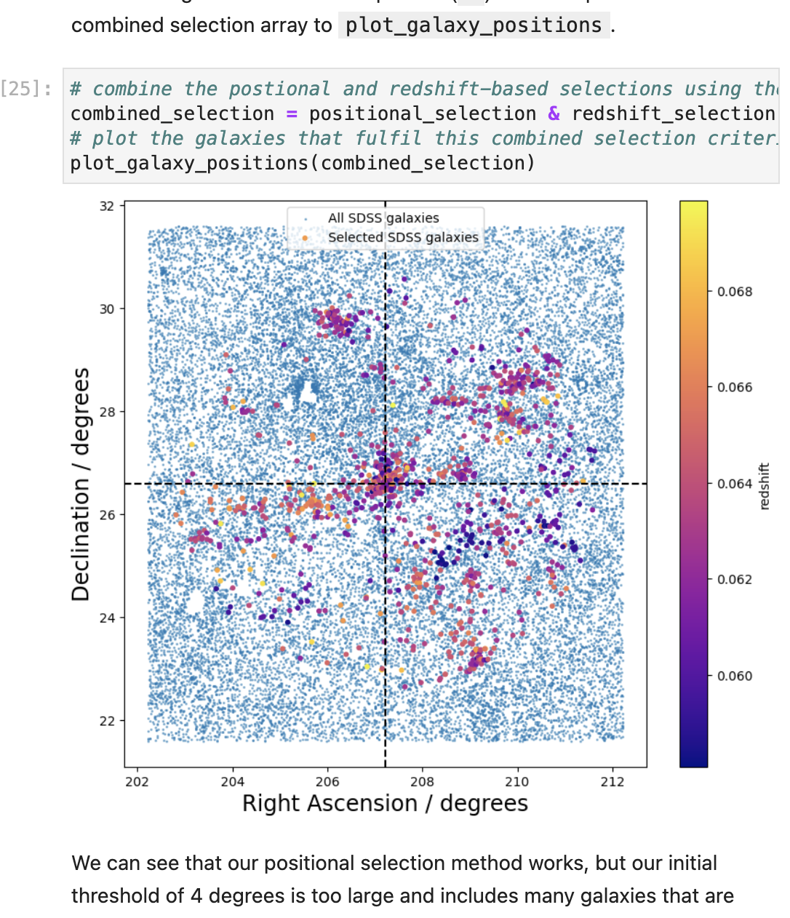
Evaluating outcomes of embedding coding activities in an advanced (astro)physics module Judith Croston, Kate Gibson, Jonathan Nylk, Gemma Warriner
Open Computing Lab activities in S385
Introductory practice and demos
Exercise and example solutions
Five extended week-long activities
Questions for the eSTEeM project
Do the activities improve conceptual understanding & module performance?
What impact is there on coding confidence and skills development?
How do benefits and challenges differ for different demographic groups?
Methodologies
Student reflections at three stages of the module (thematic analysis)
Overall module performance & performance on three question types:
Conceptual
Physics problem-solving
Applying Python tools
Demographic comparisons

