Slide 1
Use of augmented reality in a second level human biology module:
Benefits and Challenges
Karen New
Staff tutor LHCS
Staff tutor SK299
AL SK299/SK277

Slide 2
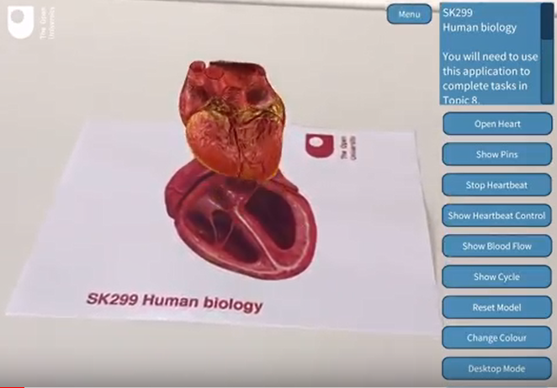
Student experiences and perceptions relating to potential benefits and challenges associated with this app
Usability
Engagement and motivation
Understanding
Age or gender difference in the use/perception of augmented reality
Experiences of students from a variety of ethnic backgrounds / AR
The findings can be used to inform practice for future SK299 presentations, and, since analysis covers all SK299 variants, may inform support for replacement nursing-strand human biology module

Slide 3
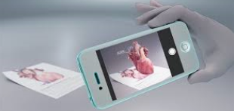
Proposed methodologies
Surveys (~1100 students/200 on nursing programmes)
17J cohort
18J cohort (within website and separate survey)
Real-time investigations - Use LTI user lab
Members from SK299 cohort
Non-SK299 students
Case-study
Individual interviews with LTI users

