Slide 1
L-markers
An evaluation of use and impact of zero grades in assessment Are we being consistent, fair, and transparent?
Fi Moorman and Karen New
LHCS
May 2025

Slide 2
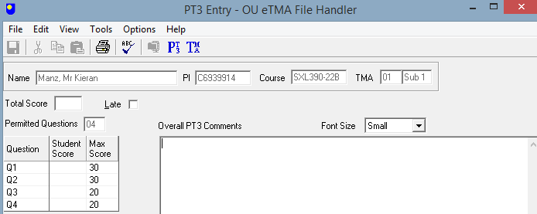
What is an L marker?
Set by the AL on completing the PT3

Slide 3
Who are our students?
70% of directly-registered OU students work full or part-time during their studies
26% of OU UK undergraduates live in the 25% most deprived areas
34% of new OU undergraduates are under 25
77% of OU undergraduates had no previous HE qualifications on entry
We are the largest provider of higher education for people with disabilities:
36,400 students declaring a disability studied with us in 2020/21.
34% of students had one A level or a lower qualification at entry
Given this context, somewhat inevitably, there are times when a student requires more time to complete a TMA and there is the potential for some flexibility in submission after the original deadline

Slide 4
What did we do?
Numbers of assignments which had L-markers applied for all modules within the School of Life, Health and Chemical Sciences (LHCS) over the time-period 2018-2021.
Stage 1 | Stage 2 | Stage 3 | Post-graduate
SDK100 (J and B) | SXHL288, S295, S290, S215, S248, S294, SK299, SDK228, SK298, S285 | S315, SD329, S317, SK320, SXLNM390 | S826, S807, S827, SXH810, SD816, SXM810
We considered key demographics:
sex, age, disability flag, ethnicity, WP flag, caring responsibilities
Manually interrogated VOICE for ‘next steps’

Slide 5
What did we do?
An anonymous mixed-format JISC questionnaire
Open- and closed-ended questions (qualitative and quantitative information)
Distributed via email to a randomly-generated list of ~1000 ALs across the University (103 respondents)
The survey collected information relating to AL length of service, faculty, and study-stage along with questions related to awareness, usage and perceptions of L-markers.
Quantitative responses were analysed using thematic analysis, performed by two independent ALs as well as the project leads.

Slide 6
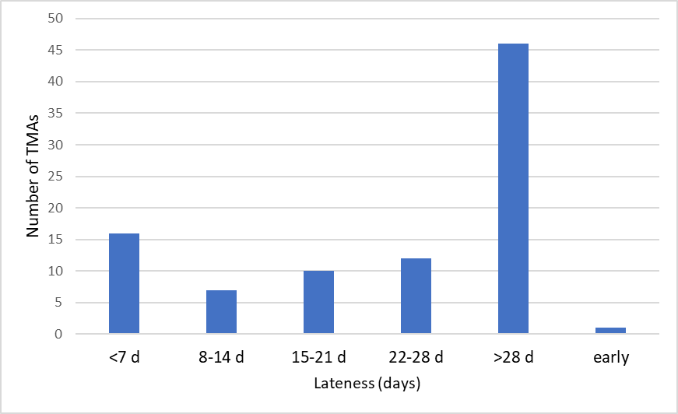
How late is late?

Slide 7
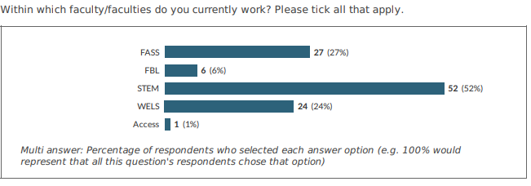
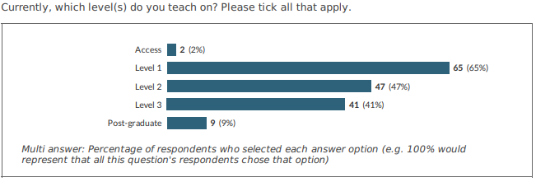
Results from AL survey: who are our ALs

Slide 8
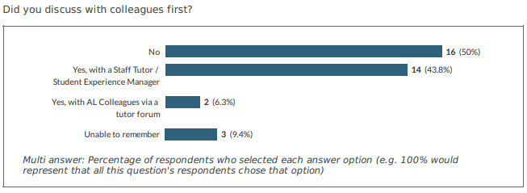
Results from AL survey: communication

Slide 9
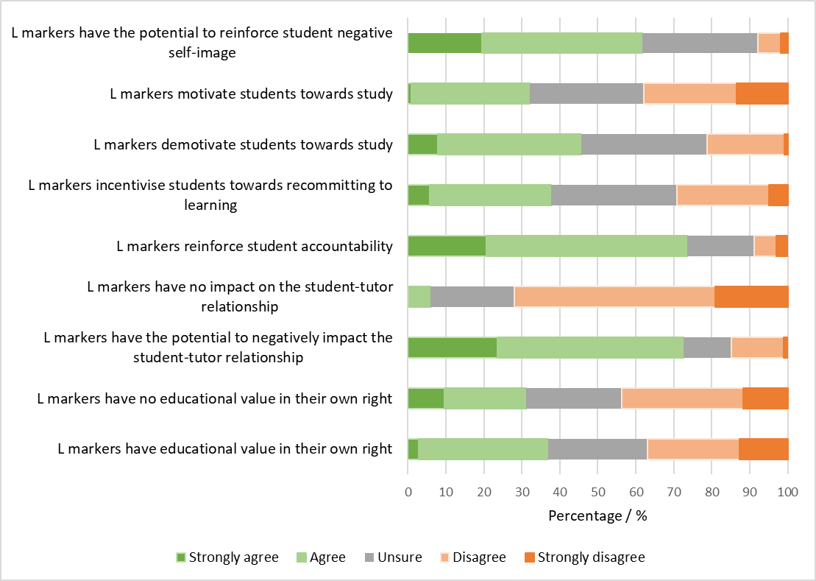
Results from AL survey

Slide 10
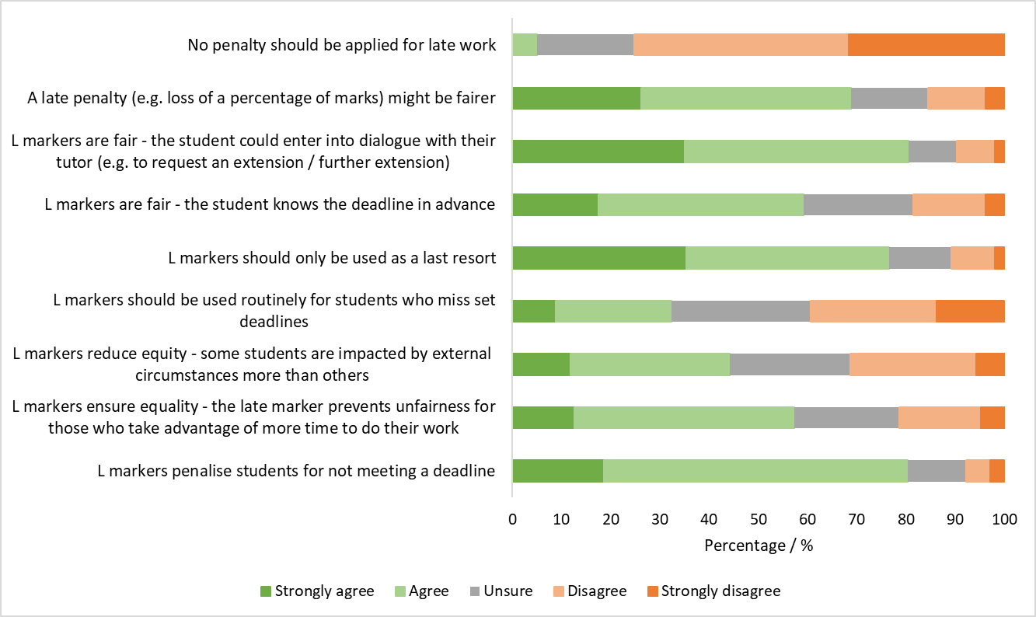
Results from AL survey

Slide 11
What happened to students next?

Slide 12
Recommendations from the project
A review of the University late submission policy
Alternative mechanisms to deal with late submissions are available, which might include, for example:
Fixed percentage deduction (in line with 10% penalties applied to late EMA submissions)
Sliding scale deduction of marks, depending on ‘lateness’
Capped score
No penalty
Clear and transparent guidance is made available for students, associate lecturers, staff tutors and module teams.
Staff development events should include opportunities to share best practice.

Slide 13
Thank you

Slide 14
Final Slide

