Slide 1
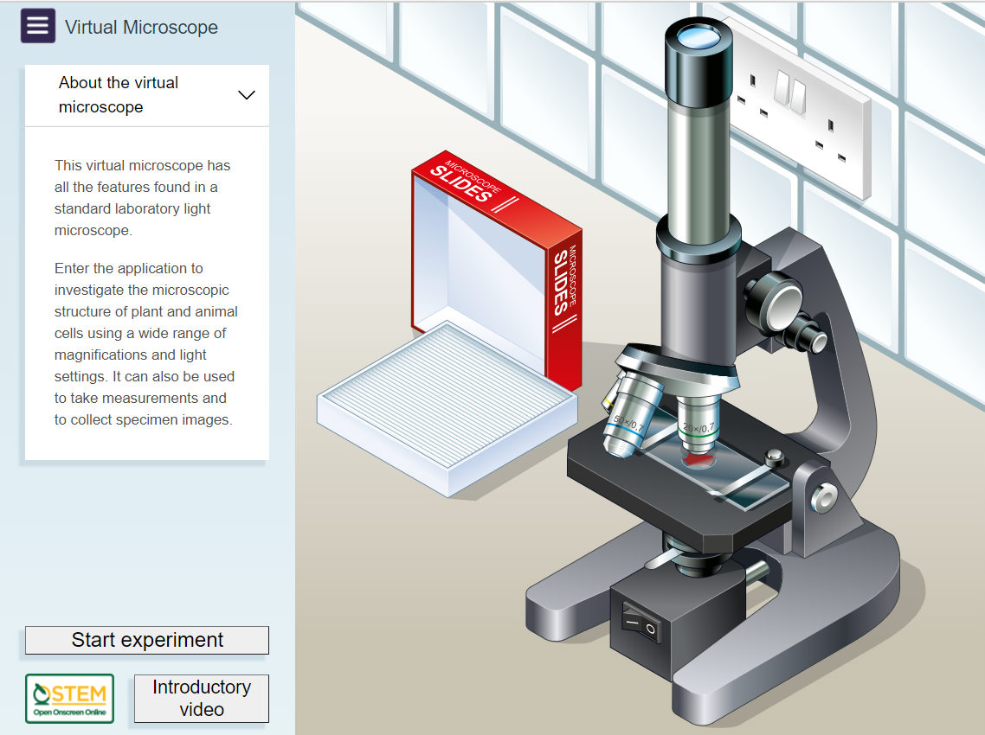
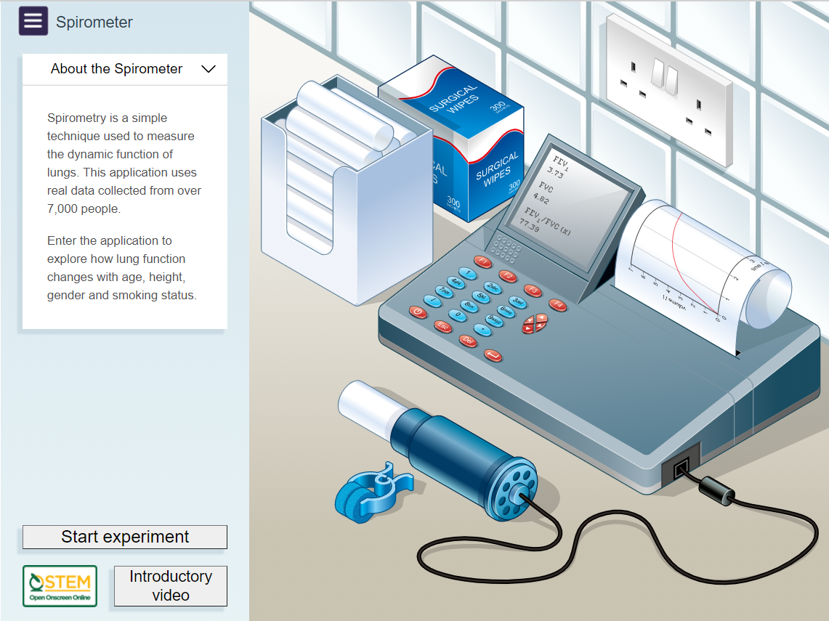
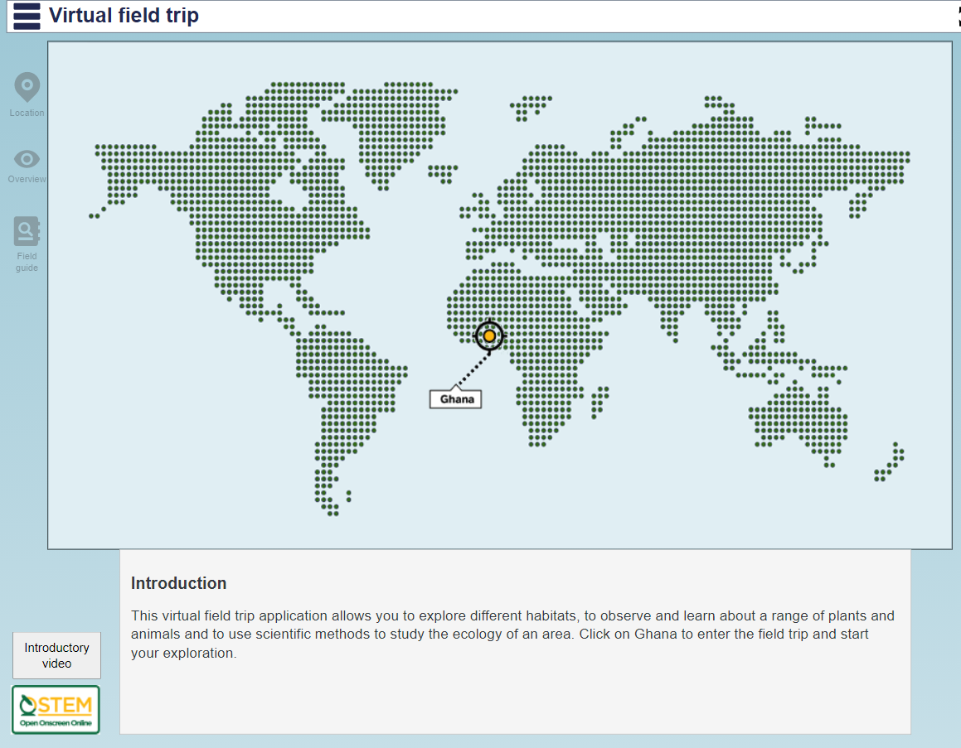
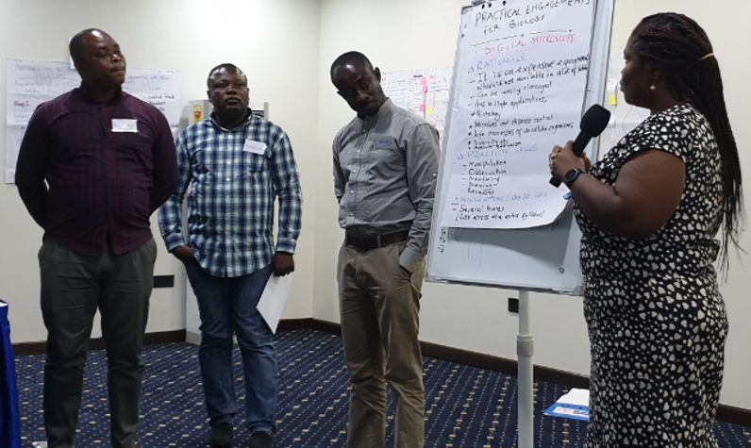
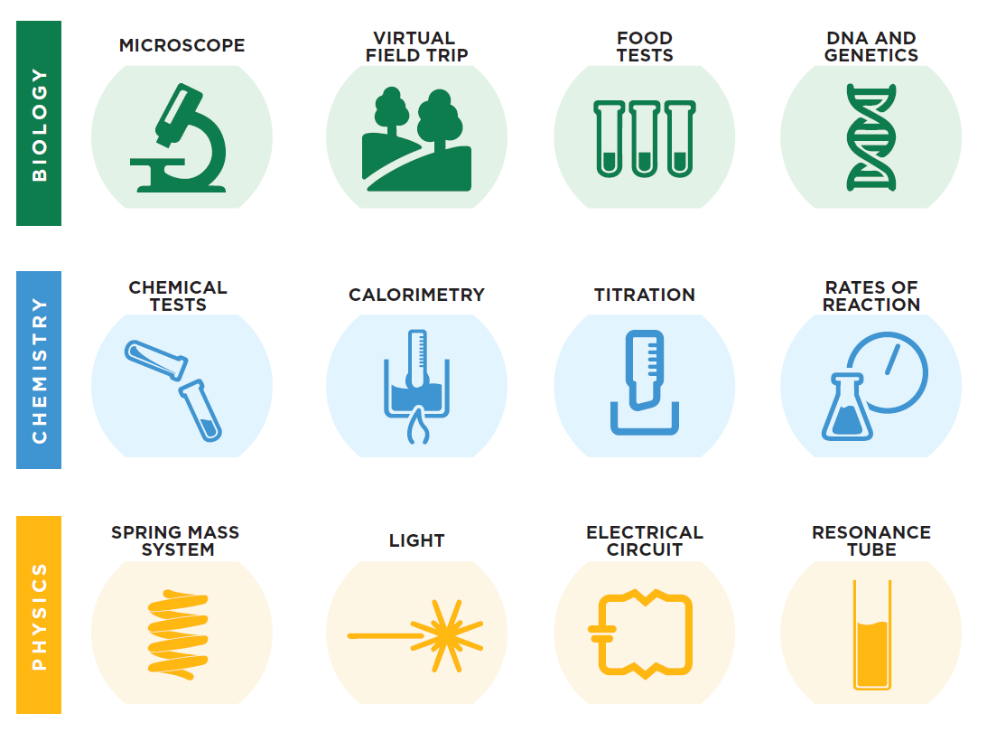
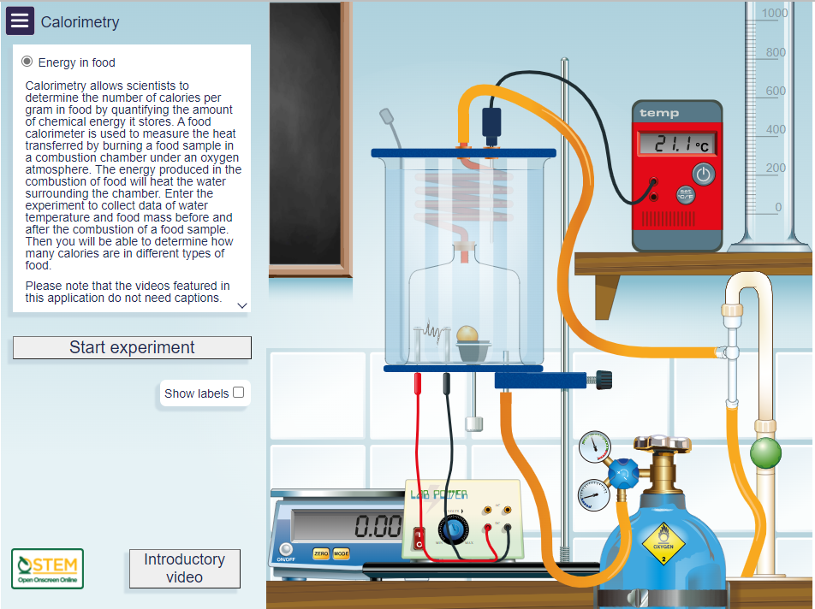
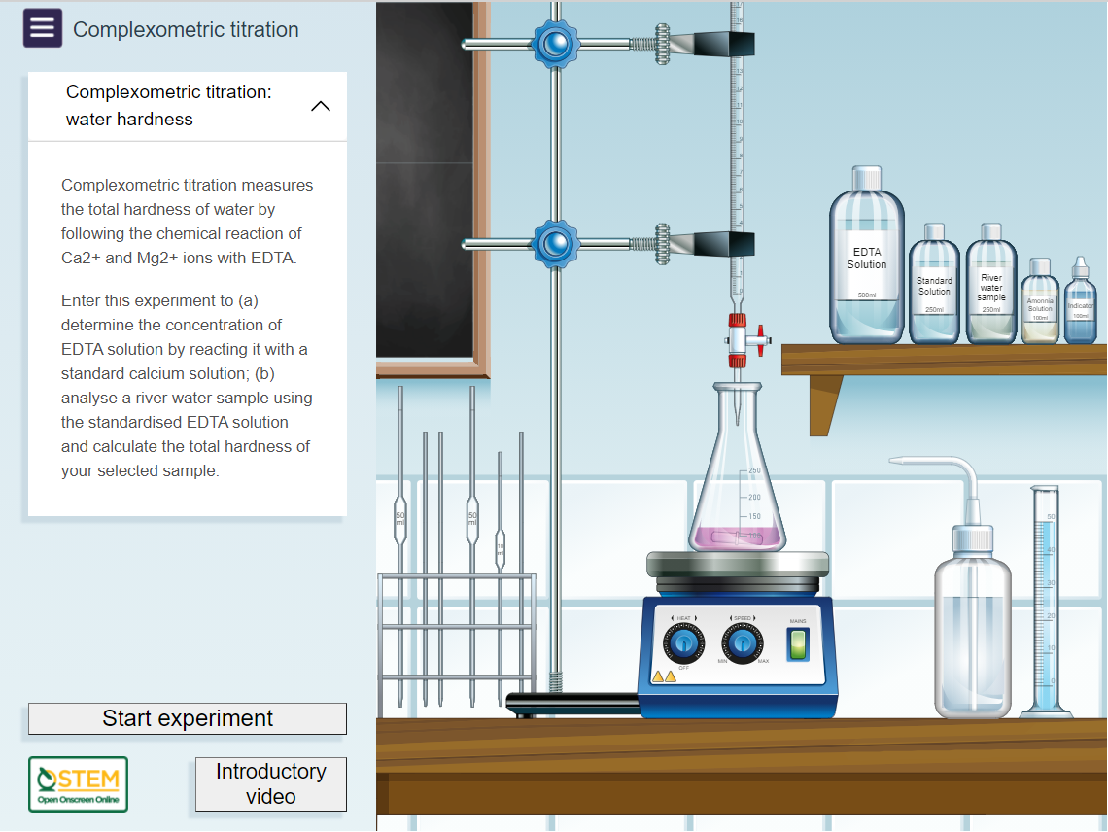
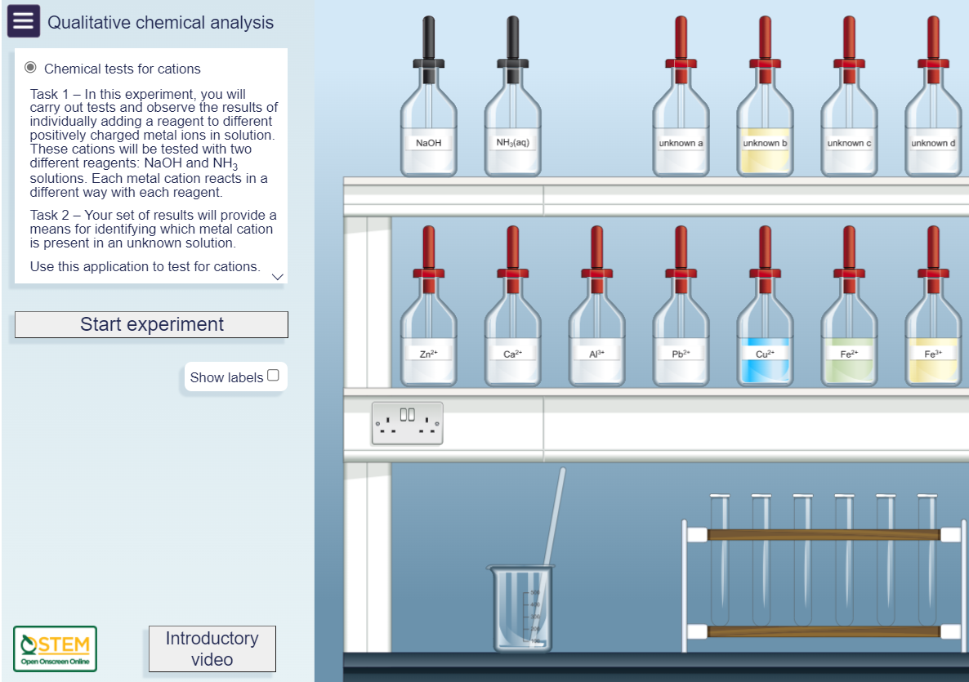
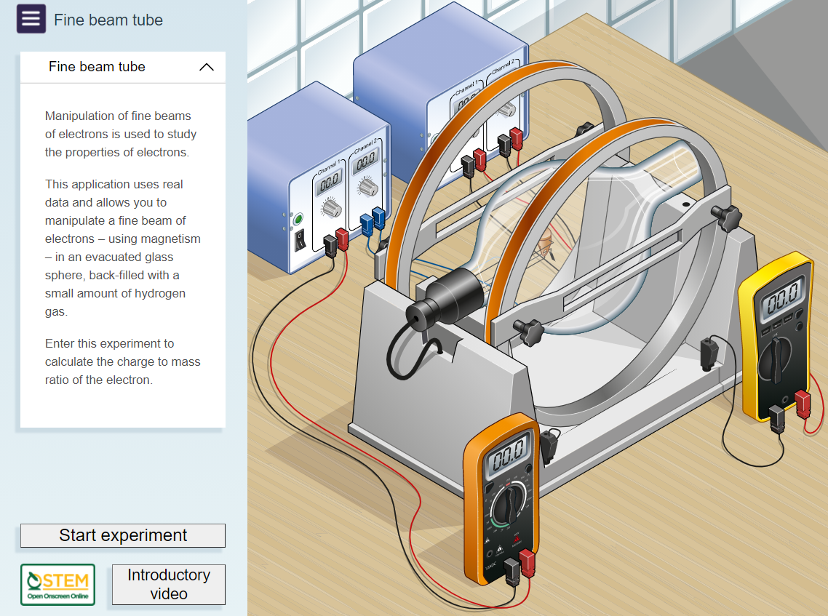
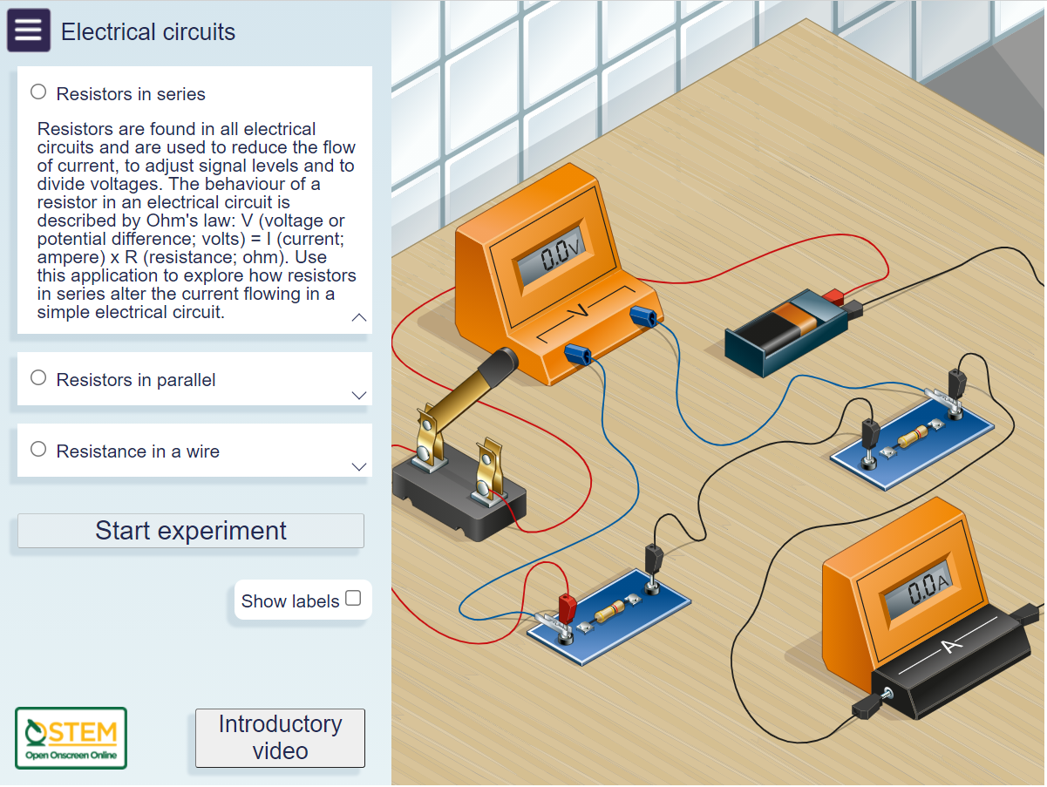
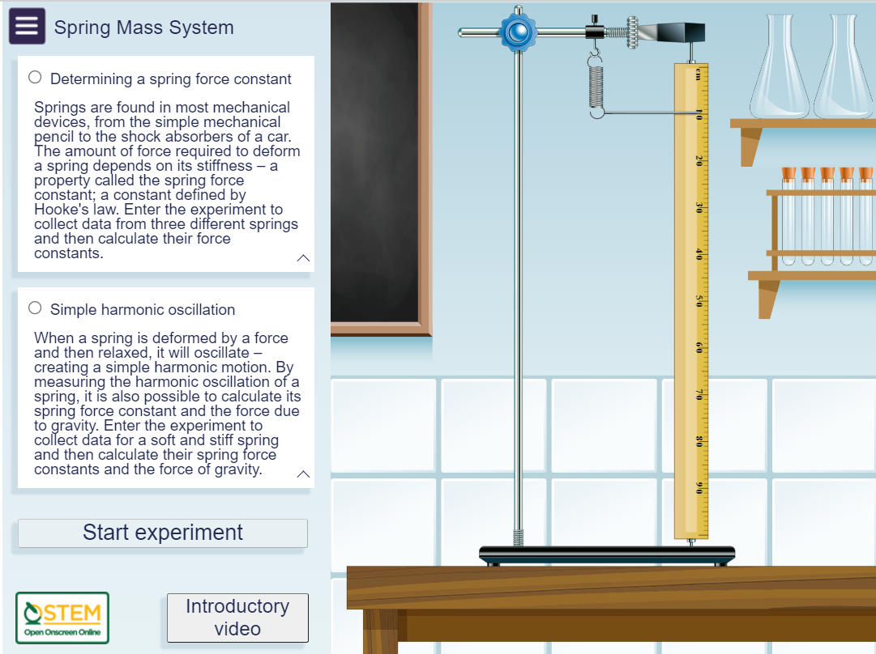
OpenSTEM Africa: Ghana – Test & Learn with UCC
Kerry Murphy, Maria Velasco & Sarah Davies
Background
OpenSTEM Africa (OSA): Improving access to STEM education is viewed globally as a route to economic empowerment. OpenSTEM Africa is a collaboration between The Open University & government partners in Ghana to co-create virtual instruments, onscreen immersive laboratory experiences & virtual worlds to support the teaching & learning of the practical sciences (Figure 1).
eSTEeM project primary aim
To research the effectiveness of the OSA virtual laboratory (Figure 2) & CPD materials to support the teaching & learning of practical science in both the training of undergraduate science teachers & relevance for the Senior High School science curriculum.
How and outputs
The Science Education Dept of the University of Cape Coast (UCC) will embed the OSA virtual laboratory & CPD materials into the next semester for undergraduate Senior High School trainee teachers.
In addition to commencement & washup workshops, virtual questionaries & interviews will be used prior to & on completion of the semester to capture the views & thoughts of both academic staff & students. We will also gather analytics from the UCC severs.
This work will be carried out alongside a similar project, funded by Education Futures (WELS), working with science undergraduates & academics at the University of Ghana.
The findings of both studies will be used to formulate a policy document for the Ministry of Education in Ghana together with conference contributions & a peer-reviewed journal paper.
Figure 1 Left: Senior High School biology teachers share their thoughts on how a virtual microscope will enhance access to learning. Right: Twelve curriculum areas where practical teaching could be enhanced by the use of onscreen applications.
Figure 2 Homepages for some of the applications in the OSA virtual laboratory.

