Slide 1
Time to think bigger?
Can qualification f2f events succeed where module tutorials fail?
Nicole Lotz, Georgy Holden
School of Engineering and Innovation, STEM, OU, UK
9th May 2019

Slide 2
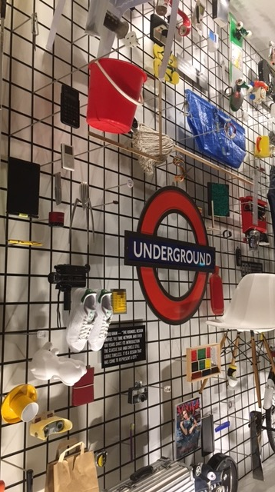
Motivation
Listening to tutors and students
Trying something different
With support from E&I eSTEeM and MSQ
Events and feedback
Numbers and impressions
Discussion
How we overcome the pay barrier to inclusion

Slide 3
Motivation
Listening to tutors and students

Slide 4
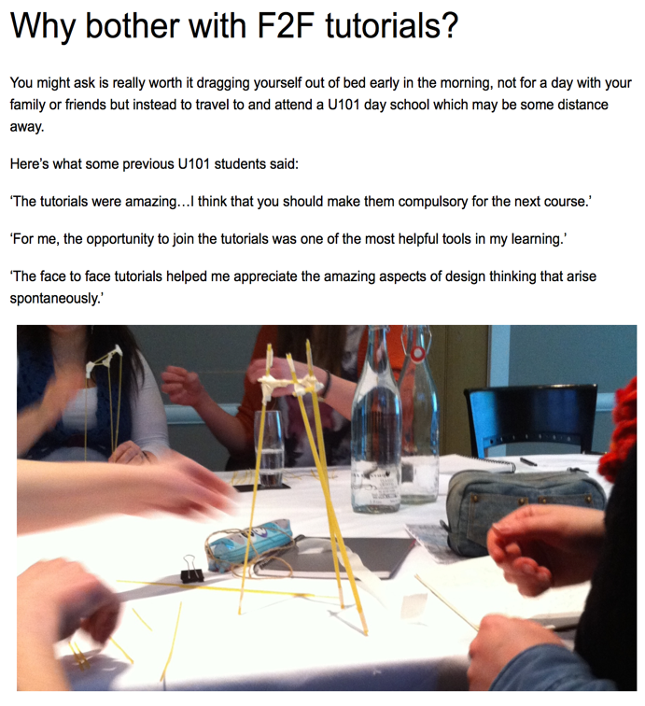
Tuition is broken
What is ‘support’ in supported open learning?
Shift in higher education culture to customer culture
GTP
Decreasing trust in tutor, breaking t-s relationship
Attendance drop in face to face tutorials
Demotivation for tutors and students
Qualification thinking
Introduction of Study site
Sense of what it means to be / become a designer

Slide 5
Trying something different
With support from E&I, eSTEeM and MSQ

Slide 6
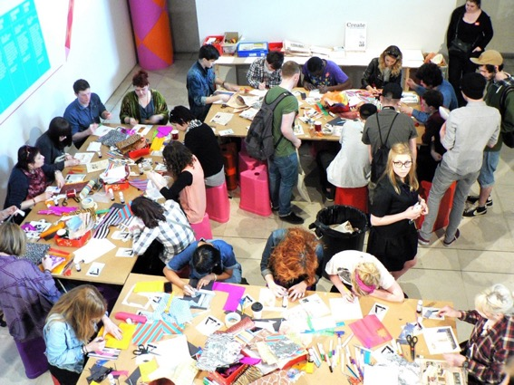
eSTEeM + E&I 2017-2018
Developing a sense of community through cross-level engagement in Q61
Developing a Sense of Community has been shown to increase retention and progression
Pilot four innovative programme level blended engagement events
Evaluate how an emergent Community of Inquiry at Q-level facilitates retention and progression.
Initial pilots were funded by the School of Engineering and Innovation and will run across the 17J and 18B presentations of U101, T217, T218 and T317
Evaluation funded by eSTEeM
Pilot 1: Cross-level Design Fair at OU campus.
Pilot 2: Cross-level Design Field Trip to Design Museum in London
Pilot 3: Cross-level Design workshop at Imperial War Museum, Manchester
Pilot 4: Cross-level Talks: Designers Talking
Pilot 5: Exhibition of student work

Slide 7
MSQ2018-2019
Re-run successful and Pilot other events
Action research, design, pilot, evaluate improve and re-run or change
Events designed and piloted by and with tutors and central staff
Evaluated with tutors and students (qualitative and quantitative)
Students loved Museum visit and exhibition of students work
Suggested events in regions for 2018/2019

Slide 8
Events and feedback
Numbers and impressions

Slide 9
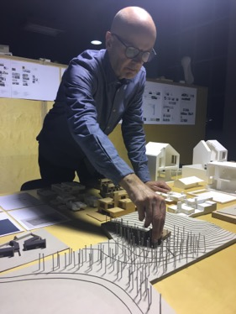
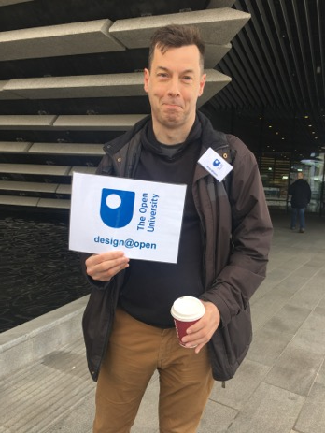
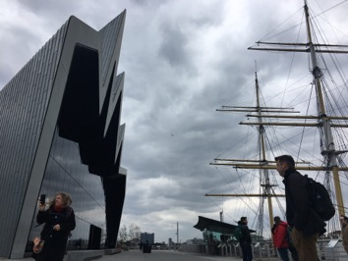
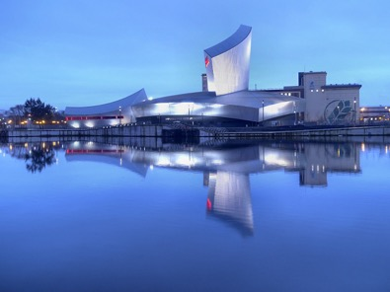
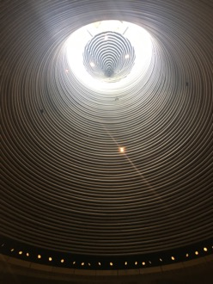
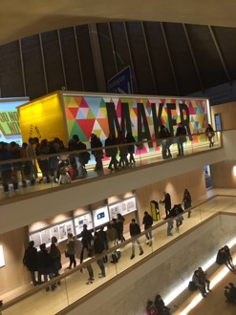
Events so far

Slide 10
Engagement
Venue | Place | F-t-F Students / Fam+Friends / Staff | Online FB / YouTube / Blog | Additional Output
Design Museum | London | 25 / 7 / 5 | X / x / 9
Design Museum | London | 17 / 5 / 4 | 36 / 13 / 41
Campus | Milton Keynes | 9 / 3 / 6 | X / x / 23 | Module material
Imperial War Museum | Manchester | 3 / 1 / 3 | X / x / 47
Annual Show | Milton Keynes | 45 / 6 (35) | X / x / 1458 | Video, Online Exhibition
Design Week | Belfast | 3 / x / 3 | 36 / 13 / 20
V&A | Dundee | 3 / 1 / 5 | 34 / 1 / 33 | Case study
Riverside | Glasgow | 5 / 2 / 4 | 34 / 11 / 33
Senedd | Cardiff | 3 / 2 / 3 | 29 / x / x

Slide 11
Quantitative feedback
1 strongly disagree --- 5 strongly agree
Question | DM1 | DM2 | MK | MCR | BF | DU | GL | AV
I understood the purpose of the event. | 4.8 | 4.9 | 4 | 5 | 4 | 5 | 5.0 | 4.7
I was appropriately challenged by the event. | 4.8 | 4.4 | 4 | 5 | 4 | 4.5 | 3.7 | 4.3
I was inspired by the event activities and discussions. | 4.7 | 5.0 | 4.8 | 5 | 4.5 | 5 | 5.0 | 4.9
I will be able to apply what I learned. | 4.5 | 4.7 | 4.6 | 5 | 5 | 4.5 | 4.3 | 4.7
My learning was enhanced by the knowledge of the facilitator(s). | 4.4 | 4.7 | 4.75 | 5 | 5 | 5 | 4.7 | 4.8
I found the facilitator(s) approachable and welcoming. | 4.8 | 5.0 | 4.8 | 5 | 5 | 5 | 5.0 | 4.9
It was easy for me to get actively involved during the session | 4.7 | 4.9 | 4.8 | 5 | 4.5 | 5 | 5.0 | 4.8
I was comfortable with the duration of the session | 4.7 | 5.0 | 4.75 | 5 | 4.5 | 3.5 | 5.0 | 4.6
I was well engaged during the event. | 4.7 | 4.9 | 4.8 | 5 | 4.5 | 4.5 | 5.0 | 4.8
I was given ample opportunity to get answers to my questions. | 4.9 | 5.0 | 4.2 | 5 | 5 | 3.5 | 5.0 | 4.7
I was given ample opportunity to network with others. | 4.8 | 5.0 | 4.6 | 4.75 | 4.5 | 4.5 | 5.0 | 4.7
I was given ample opportunity to demonstrate my skills. | 4.0 | 4.3 | 4.2 | 4.75 | 3.5 | 4 | 5.0 | 4.2
I was pleased with the venue. | 5.0 | 5.0 | 4.6 | 5 | 4.5 | 4.5 | 5.0 | 4.8

Slide 12
Qualitative feedback
Confidence
Without the event to encourage me, I doubt I would have come to visit the museum, and that would have been such a shame. Thank you for organising!
Motivation
Thank you and everyone that made it happen. Getting to meet you all and getting to share a bit of the OU experience with my peers was wonderful and highly motivating.
Meeting the module/design innovation team 'for real' was marvellous. Talking with other OU students inspired me. I feel motivated after this group event. Will attend in future. Thank you too.
Informality and networking
Interesting event, but I found the talk a little long. It was interesting, but I found it a pity that I didn’t get to see more of the museum.
Annotated form: 'Massivly agree' to 'opportunity to network with others’
Beyond students
I found event on Eventbrite. Hope the plastic fantastic will be a driving force for OU, and gain traction with students, and public (eventually)

Slide 13
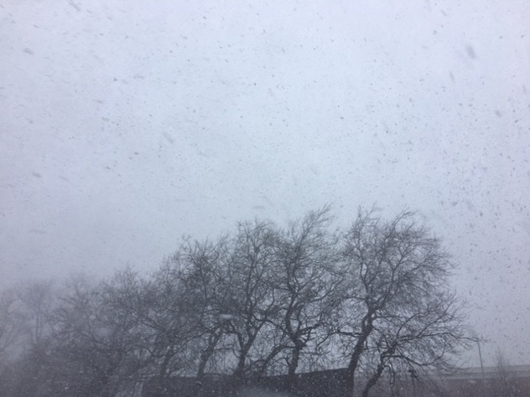
Challenges and Opportunities
Learning from every event
Low attendance due to circumstances
Snow storm, traffic gridlock, short notice, communication channels – FB live, Youtube video impressions, create blended events
Large catchment, expensive to travel to, other commitments – funding for low income and families
Expensive to run – Video for Q promotion, student success case, recording for module material
Organising events logistics – workarounds, getting better, missing support on Q level
Online activities and contents – where to put what: integration of multiple sites for multiple audiences (study site, module sites, FB, Twitter, Design@Open blog)
Month | JAN18 | FEB18 | MAR18 | APR18 | MAY18 | JUN18 | Average | After summer 2018
Design Study home | 166 | 315 | 321 | 271 | 292 | 317 | 280 | 2 (staff)

Slide 14
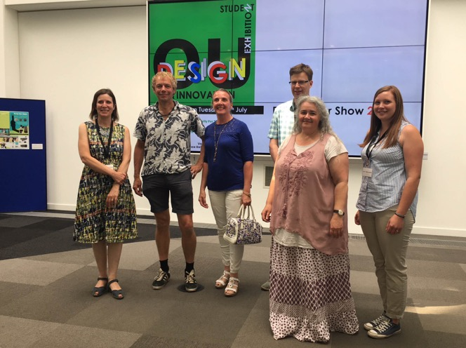
Exhibition of student work
Annual show
45 submissions, 35 chosen
Students, regional, central and emeritus staff rate, discuss and choose submissions to be shown
4 student exhibition designers
1 professional exhibition designer
Grand opening 30 attended
Prizes for winner and runners up
Online exhibition in parallel seen by over 1500
Video promoting Qualification from exhibition
This year, runs over weekend with a student and family open day

Slide 15
Testimonial
Dear Nicole,
I am not sure if it will help with your research I know it is about building communities and engagement but the event and the opportunity to come to the OU and get involved and chat to everyone on the Q61 team boosted my confidence no end; having the chance to chat to you all at the OU, working with the other students face to face, working with you to create the poster and working out how to use gimp properly in the process as well as spending the time being interviewed by the media team.
From that I was recently asked to take on the PR role in my local military wives choir as they saw the post about the exhibition on Twitter and asked if I’d like to get involved - while not a huge role it means I’ll be making posters, giving interviews and trying to find ways to keep members of the choir engaged, and advertising to new audiences and potential members.
On top of that I was also asked recently to apply for a Future Leaders Programme with British Canoeing which has Sport England funding.
I’m an avid supporter and participant of paddle sports and was asked to apply for the role after speaking to the sports development manager at an event. They were really interested in my degree and the experience I had at the OU in the summer. The programme involves designing a project for a particular area of the sport that needs development and pitching it to the heads of the sport and then implementing the idea with an overall view of being appointed to sit on one of the sport volunteer committees, designing further projects for them, within the next few years and also mentoring others through the same programme. I feel the project in the summer was invaluable work experience and gave me the confidence to speak up about my experiences.
It took me from not being particularly confident in how I would take my degree into the world of work, to realising that the degree and the exhibition has given me a huge amount of applied experience that I can apply to almost everything I do.
I wouldn’t ever have applied had I not been asked to and that was all down to having something to talk about, the exhibition being that something! So thank you for your hard work in putting it all together as none of what I have going on now would have happened without it!
I’ve recommended to other students to get involved with anything that comes up in the future as from chats/their posts online on social media they seem to want to gain work experience in design roles to aid finding employment but aren’t entirely sure how to go about it. There is also a lot of chat via social media about applying for design roles - what experiences to talk about and which category of design the degree falls into - something we talked about at the exhibition set up and one of the chats with Theo, Derek and Dawn on the day was about exactly that too, so from a student perspective there is definitely a need for more of this type of event to enable other students practical experiences and informal chats with tutors and writers of the modules! I look forward to hearing about the next one!
All the best Claire

Slide 16
Discussion
Question for us and questions to you

Slide 17
Over to you!
10 min discussion on each Question with 1-2 min presentation of each group
What are the opportunities in moving from module-thinking to qualification-thinking?
What face-to-face or blended formats could work for you to engage students across a qualification? How can we better integrate face-to-face and online engagement?
How can we generate relevant content for students to engage with at qualification level, or what content can students self-generate to engage the rest of the qualification?
Use the set of cards provided to design an engagement event for your area.
In groups, use Flip charts and Padlet to record discussion
We have designed a set of Cards to facilitate parts of the discussion

Slide 18
THANK YOU
&
Q&A

