Slide 1
Everyone welcome!
Developing a sense of community through cross‐level engagement between staff and students in creative industries subjects
Nicole Lotz, Georgy Holden
School of Engineering and Innovation, STEM, OU, UK
20th November 2019

Slide 2
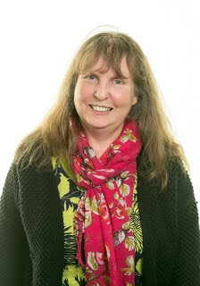
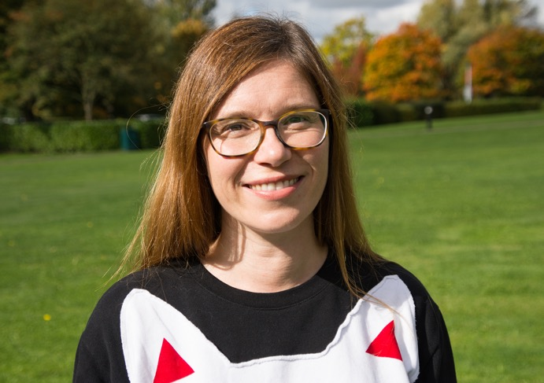
That’s us
Senior Lecturer in Design and Innovation
Qualification lead
30+ years at OU
Also AL
2 grown up children I elderly mother
Senior Lecturer in Design
Module Chair for U101 Design Thinking
12 years at OU
Athena SWAN Chair
2 young children

Slide 3
Motivation
Listening to tutors and students

Slide 4
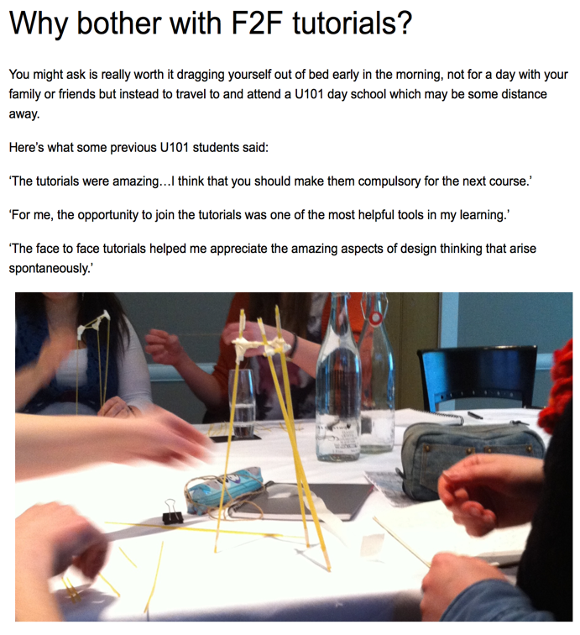
Beyond Face-to-Face tutorials
Show of hands: Do you attend face-to face tutorials regularly?
How do you develop an understanding about what is ‘important’ in your subject area?
In design, it has always been the studio in which you meet and discuss with peers, tutors and experts from the field
Design students also often visit museums and galleries together
Develop a sense of what it means to be / become a designer
Difficult to create in Distance learning
Research has shown that developing a Sense of Community increases retention and progression
Or in other words
When students meet others across their qualification they develop a sense of where they are heading

Slide 5
Trying something different
With support from School of Engineering and Innovation, eSTEeM and More Students Qualifying

Slide 6
Our model for creating and running sessions
Consult tutors and students > Run pilot events > Re-run successful events > consult tutors and students > Pilot other events

Slide 7
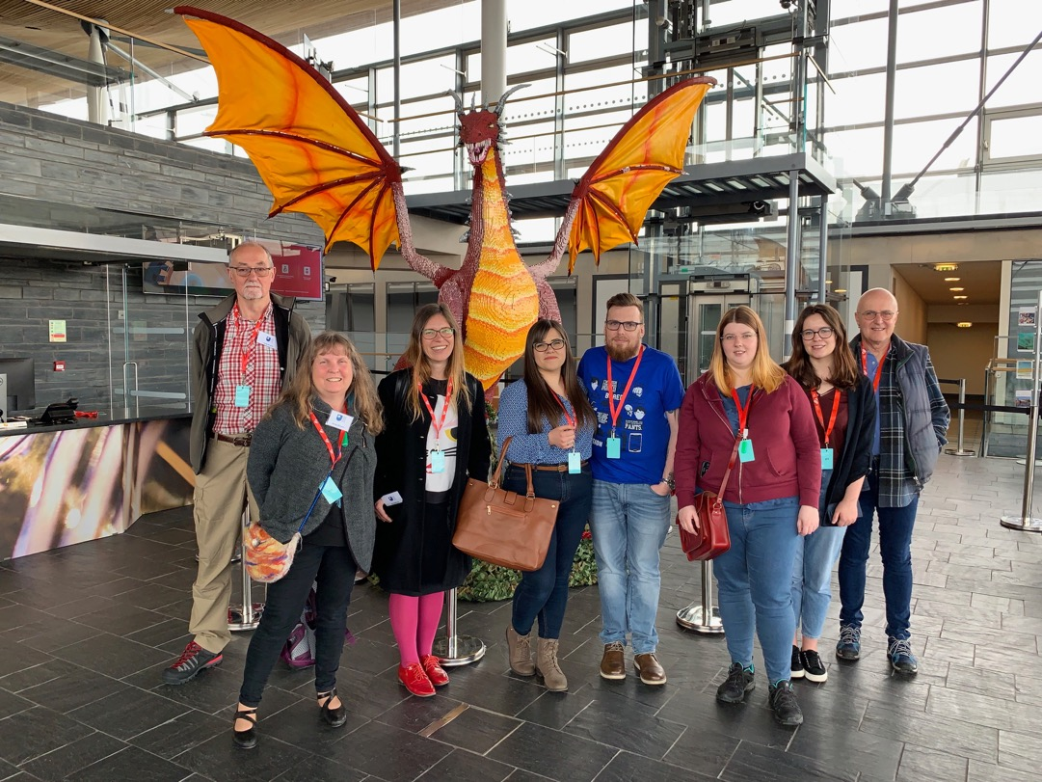
Who’s involved
Module team members - Associate Lecturers – Students - Staff Tutors

Slide 8
2017-2018
What we’ve run
Pilot 1: Design Fair at OU campus.
Pilot 2: Field Trip to Design Museum in London
Pilot 3: Design workshop at Imperial War Museum, Manchester
Pilot 4: Designers Talking on the Study website
Pilot 5: Exhibition of student work across all levels
Re-run: Field Trip to Design Museum in London + Facebook Live
Pilot 1: Belfast Design week + Facebook Live
Pilot 2: V&A Dundee and Riverside Glasgow + Facebook Live
Pilot 3: Senedd Cardiff + Facebook Live
Re-run: Exhibition of student work across all levels (+ family workshop) + Facebook Live
2018-2019
Pilot 1: Engineering Designs Show + Facebook Live (student initiated)
Pilot 2: Museum of Brands + Facebook Live (of a talk on food canning)
Pilot 3: Makerversity + Facebook Live
Re-run: Field Trip to Design Museum in London (+ family workshop) + Facebook Live
Re-run: Exhibition of student work across all levels (+ family workshop) + Facebook Live
2019-2020

Slide 9
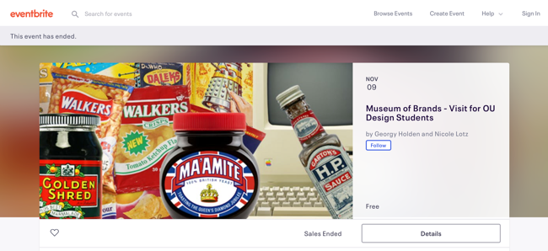
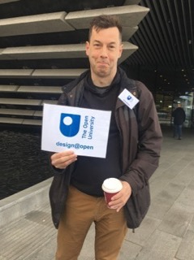
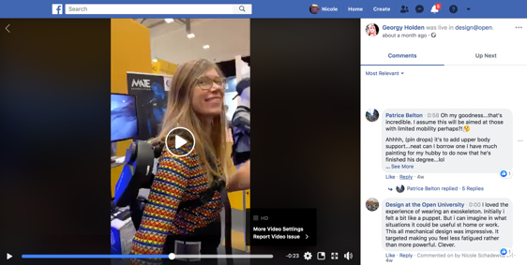
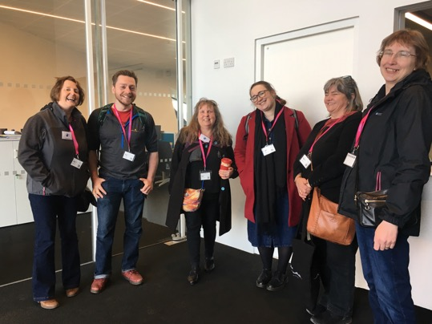
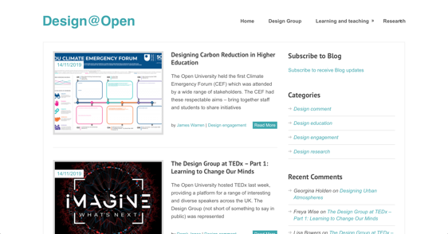
What it’s like
Suggest location (tutor, staff or student)

Slide 10
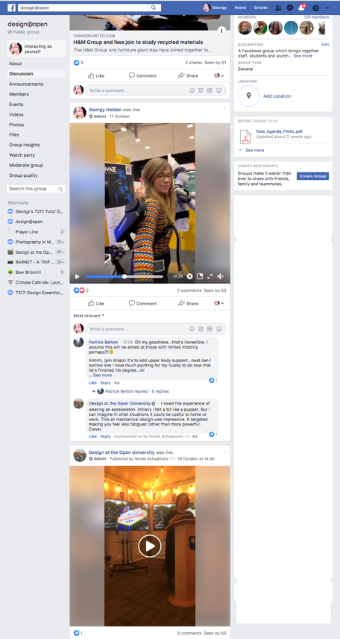
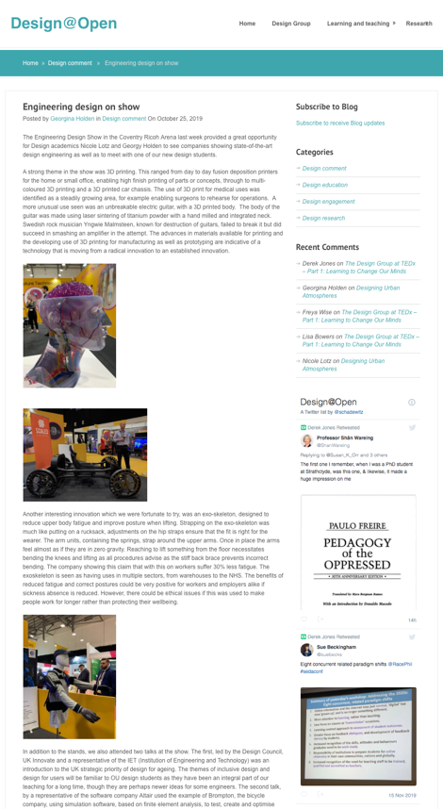
Virtual attendance (where possible)

Slide 11
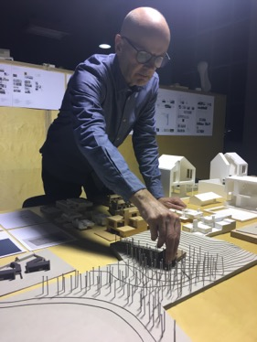

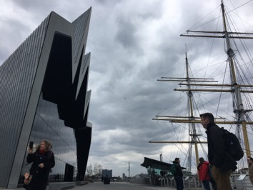
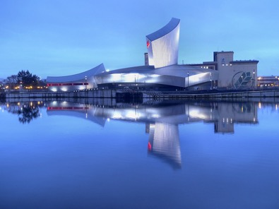
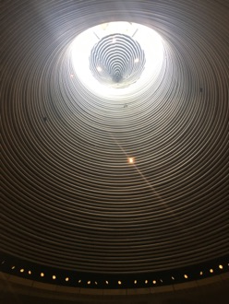
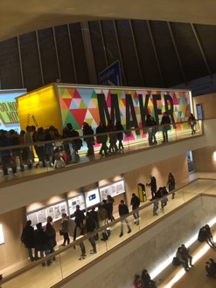
Where we have been

Slide 12
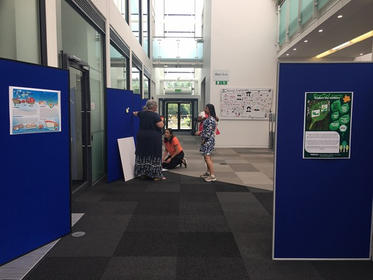
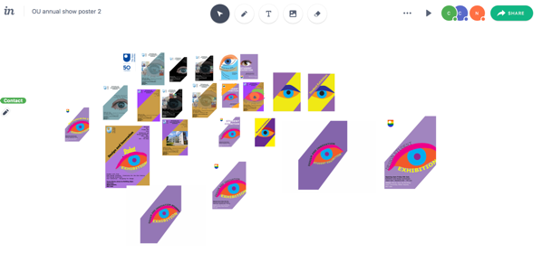

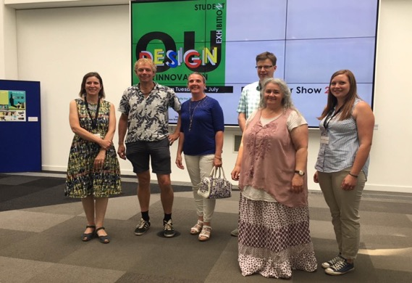
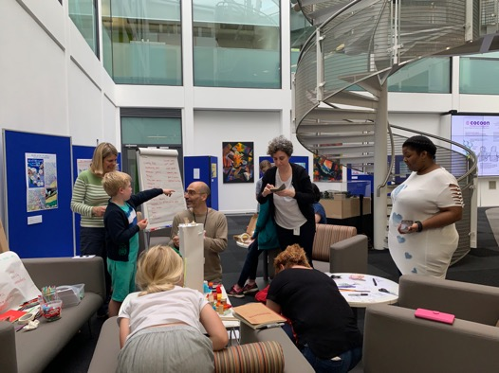
Exhibition of student work

Slide 13
Feedback
Numbers and impressions

Slide 14
Quantitative feedback
1 strongly disagree --- 5 strongly agree
Question | DM1 | DM2 | MK | MCR | BF | DU | GL | AV
I understood the purpose of the event. | 4.8 | 4.9 | 4 | 5 | 4 | 5 | 5.0 | 4.7
I was appropriately challenged by the event. | 4.8 | 4.4 | 4 | 5 | 4 | 4.5 | 3.7 | 4.3
I was inspired by the event activities and discussions. | 4.7 | 5.0 | 4.8 | 5 | 4.5 | 5 | 5.0 | 4.9
I will be able to apply what I learned. | 4.5 | 4.7 | 4.6 | 5 | 5 | 4.5 | 4.3 | 4.7
My learning was enhanced by the knowledge of the facilitator(s). | 4.4 | 4.7 | 4.75 | 5 | 5 | 5 | 4.7 | 4.8
I found the facilitator(s) approachable and welcoming. | 4.8 | 5.0 | 4.8 | 5 | 5 | 5 | 5.0 | 4.9
It was easy for me to get actively involved during the session | 4.7 | 4.9 | 4.8 | 5 | 4.5 | 5 | 5.0 | 4.8
I was comfortable with the duration of the session | 4.7 | 5.0 | 4.75 | 5 | 4.5 | 3.5 | 5.0 | 4.6
I was well engaged during the event. | 4.7 | 4.9 | 4.8 | 5 | 4.5 | 4.5 | 5.0 | 4.8
I was given ample opportunity to get answers to my questions. | 4.9 | 5.0 | 4.2 | 5 | 5 | 3.5 | 5.0 | 4.7
I was given ample opportunity to network with others. | 4.8 | 5.0 | 4.6 | 4.75 | 4.5 | 4.5 | 5.0 | 4.7
I was given ample opportunity to demonstrate my skills. | 4.0 | 4.3 | 4.2 | 4.75 | 3.5 | 4 | 5.0 | 4.2
I was pleased with the venue. | 5.0 | 5.0 | 4.6 | 5 | 4.5 | 4.5 | 5.0 | 4.8

Slide 15
What participants said:
Confidence
Without the event to encourage me, I doubt I would have come to visit the museum, and that would have been such a shame. Thank you for organising!
Motivation
Thank you and everyone that made it happen. Getting to meet you all and getting to share a bit of the OU experience with my peers was wonderful and highly motivating.
Meeting the module/design innovation team 'for real' was marvellous. Talking with other OU students inspired me. I feel motivated after this group event. Will attend in future. Thank you too.
Informality and networking
Interesting event, but I found the talk a little long. It was interesting, but I found it a pity that I didn’t get to see more of the museum.
Annotated form: 'Massively agree' to 'opportunity to network with others’
Beyond students
I found event on Eventbrite. Hope the plastic fantastic will be a driving force for OU, and gain traction with students, and public (eventually)

Slide 16
THANK YOU
&
Q&A

