Slide 1
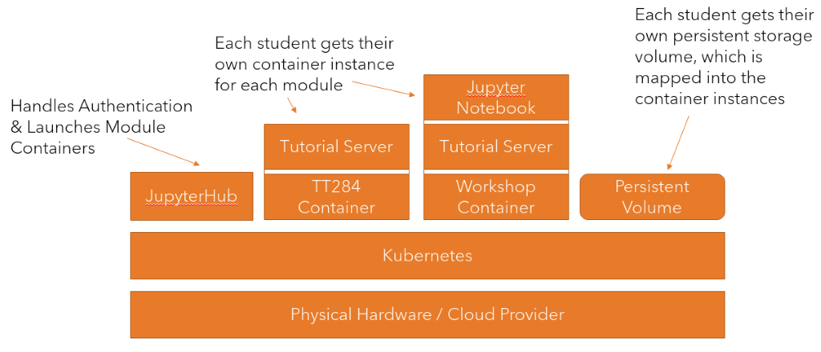
Modern Container-based Learning Interface and Delivery Infrastructure (MCLIDI) Mark Hall, Soraya Kouadri Mostéfaoui Project Aims - Deploy and evaluate a modern container-based learning interface and delivery infrastructure, focussing on supporting: * Neurodiverse students * Students with disabilities (vision and motor-skill impairments) * Dyslexic students.
Objectives - Understand technologies and requirements for students with disabilities and neurodiversities
- Develop the new learning interface and delivery infrastructure for TT284-21J - Gather feedback from students and ALs, as well as automatic monitoring of their interactions with the system - Analyse the students’ and ALs’ feedback together with the collected analytics data
Outputs - Improved student learning experience - Better student satisfaction, and improved retention, - An understanding of the cost impacts of this approach.

