Slide 1
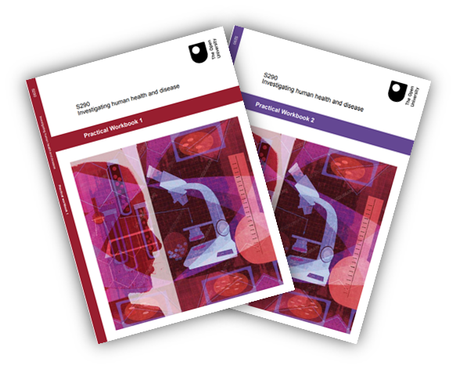
Student progression through linked ISEs: building confidence and competence. Mark Hirst, Christopher Heath and Hilary MacQueen.(LHCS)
Context: Active learning and ISE useability
Project: Perception of useability and skills development
ISE- based active learning:
Commonly used in Science teaching to develop skills:
Data selection and KU contextualisation
Use of experimental variables and controls
Application of numeracy, record keeping
Data recording, graphing and interpretation
S290 (health sciences degree and diploma n= 610)
Topics 1-3: Microscopy (cell biology) and cancer prognosis data
Topics 4-6: Analytical- diagnostic laboratory tests
Accessible ISEs development built across module
Printed tutorial workbook for each activity
Application – contextualised problem solving
ISE useability and engagement:
Aspects that influence effectiveness of onscreen activities include their usability and ease-of-use (TAM; technology access model) and aspects of ‘gamification’ (enjoyment, playfulness and reward). These need balancing with scientific LOs.
Research questions- what we hope to uncover
What are the students perceptions of the ISEs in terms of their ease of use and do reward and enjoyment influence overall engagement?
Do access routes or conditions (e.g. device, connectivity, time) affect this ?
Do workbook-based activities support learning and increase useability?
Do students feel more confident in working in ISEs as they progress through the module?
What is the student perception of the role of ISEs in developing core KU, the development of scientific skills and in their confidence for solving analytical tasks.
ISE design and deployment
All new OU ISEs must be WCAG2.1 compliant (perceivable, operable, understandable & robust). Most ISEs are integrated into module materials or as part of OpenSTEM laboratory areas and are deployed sequentially in a KU relevant context that promotes enhancement of LOs.
Methodology- how we’ll do it
Module-wide surveys x 3 (T1-3, T4&5) and post-EMA
Small focus groups- sub-groups/themes from survey findings

