Slide 1
Intro Slide Title 3
From eSTEeM to the Open Computing Lab
Pivoting an eSTEeM project
Mark M Hall & Soraya Kouadri
Computing & Communications
21.06.2023

Slide 2
The Original Problem
Web Development Students undertaking practical work need to interact with three elements:
The instruction text
The editor for writing code
The browser for viewing their work
Switching between these adds significant cognitive load
As a result students are often observed skipping parts of the instruction text

Slide 3
The Original eSTEeM Project
2-year project
Develop an improved interface for students
Put in place the infrastructure for deploying this to the students
Run a pilot study with ~50 students

Slide 4
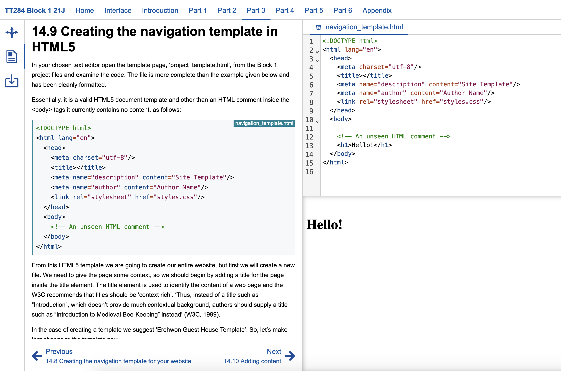
The eSTEeM Project Solution I
Provide an integrated interface that shows all three elements at once
Based on previous work by Mark Hall at Edge Hill University

Slide 5
The eSTEeM Project Solution II
Use standard cloud-deployment technologies
Docker containers for the software setup
Kubernetes for the cloud orchestration
JupyterHub for the authentication and container launching

Slide 6
eSTEeM Project Progress
Interface development completed after 2 months
Deployment infrastructure in place after 3 months
What do we do now???

Slide 7
The Pivot
Contacted by the Module Teams for TM129 and S397
“We’ve heard you have some cloud infrastructure. Would you have space for us to?”
“Sure, as long as you bring the money to pay for renting the cloud hardware.”

Slide 8
Scaling Up
Original plan:
Pilot with ~50 students in 21J
New plan:
Pilot with ~60 students from TM129 in 21B
Live with up to 1500 students from TM129 and S397 in 21J
Focus on simplifying authentication and authorization
Focus on supporting Module Teams in developing their Virtual Computing Environments (VCEs)

Slide 9
The Open Computing Lab
Project was a success
Part of the software developed was re-used by STEM Technical
Approximately 2k students used the systems in 21J
Approximately 1.4% of students experienced an issue and 0.1% experienced an issue with the core delivery infrastructure
Result: The Open Computing Lab

Slide 10
What does it provide?
Support for delivering Virtual Computing Environments (VCEs) to students (and tutors [and staff])
VCE development infrastructure
VCE configuration support for Module Teams
Content distribution to students
User authentication and authorization
Users can only see VCEs for the modules they have access to
VCE deployment infrastructure
Persistent storage for students’ work

Slide 11
What can it support?
Jupyter notebooks in either the classic Jupyter notebook interface or the new JupyterLab interface
R-Studio or R-Shiny apps
Visual Studio Code
Any kind of custom web application

Slide 12
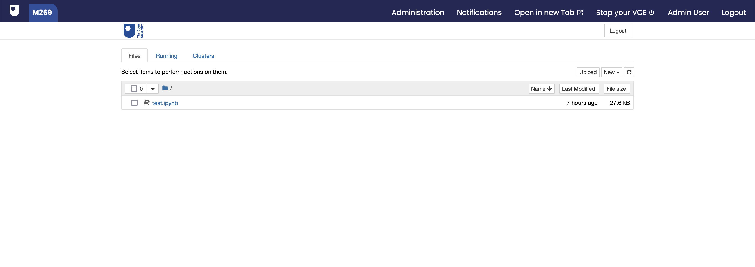
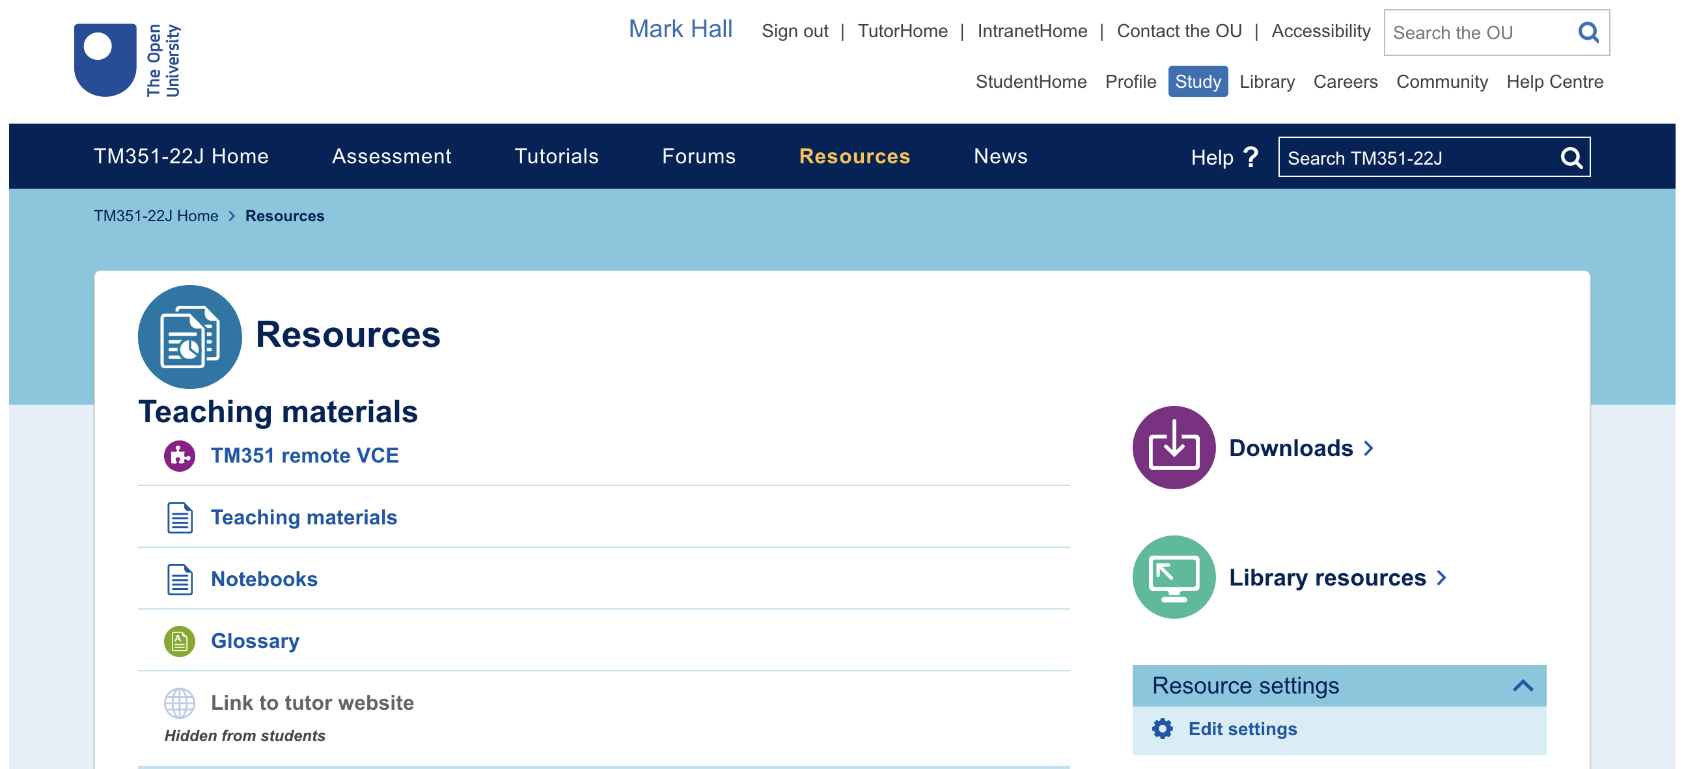
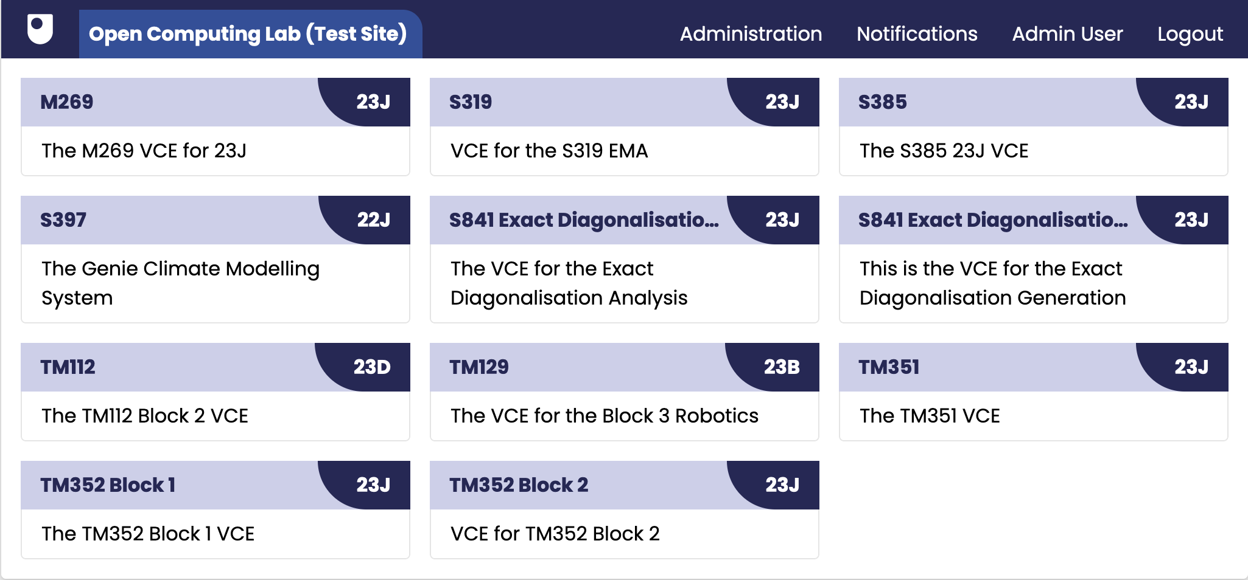
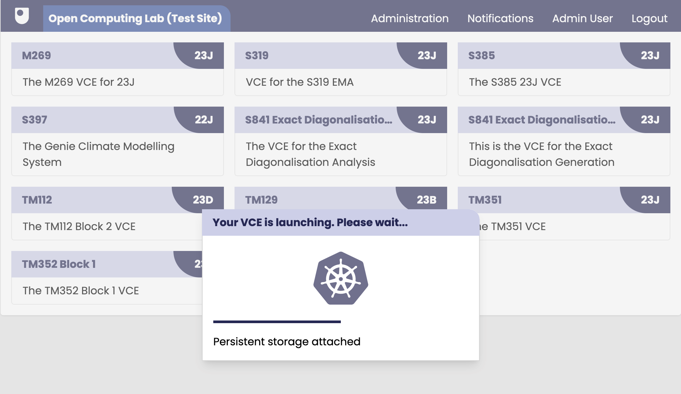
What does it look like?

Slide 13
Slide Title 30
Thank you. Questions.
opencomputinglab@open.ac.uk

Slide 14
Slide Title 31

