Slide 1
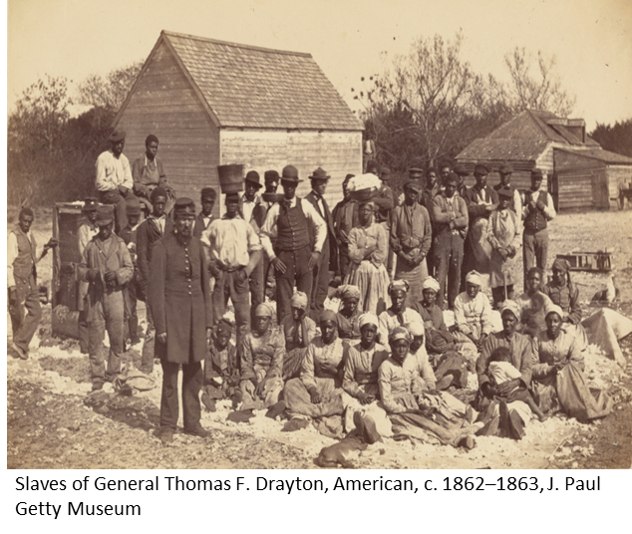
Decolonising Computing: Resources for Educators Mustafa Ali with Ray Corrigan, Clem Herman, Magnus Ramage, Zoe Tompkins, & Steve Walker What we intend to do
This project complements the OU’s Decolonising the Curriculum initiative with a roadmap for what computing could – and arguably should – mean for computing educators. Critical race theory and decolonial thought are used to interrogate our curriculum’s content and pedagogy with a view to re-orienting our teaching. How we are doing it We are developing criteria and methods for this work, which we are refining through consultation with module chairs, ALs, external experts and students. We have conducted a student survey to gather views on colonialism and computing. We will share our criteria and methods in the School to explore implications for our curriculum. Project outcomes are being disseminated internally and externally through reports, seminars and conference presentations.
What we expect to find/achieve/develop We are documenting our substantive findings about what decolonisation means in the computing curriculum and possible implications for curriculum and teaching methods, to inform next steps in decolonising both our own curriculum and the computing curriculum more widely.
Twitter: @OU_CritInfo

