Slide 1
BLENDED TUTORIALS IN MATHEMATICS: SIMULTANEOUS F2F & ONLINE EVENTS
ANDREW POTTER AND COLIN BLUNDELL
eSTEeM Conference, online
12:25, Wednesday 29th March 2020

Slide 2
What is a “blended tutorial”?
The connection to the literature

Slide 3
What is a “blended tutorial”?
The connection to the literature
The term “blended” is so over-used in the literature that it might as well mean anything! (Hrastinski, 2019)
Our definition of “blended” is referred to as “blended synchronous learning” (also “hybrid synchronous learning”, “Here or There (HOT) instruction” or “synchromodal learning”).
Bower et al. (2015) consider a single case (amongst six case studies) of a statistics class, but generally there is a lack of consideration in the literature for the unique challenges in a mathematical environment!
Rendering symbols using technology is difficult!

Slide 4
What did we do?
Our setup

Slide 5
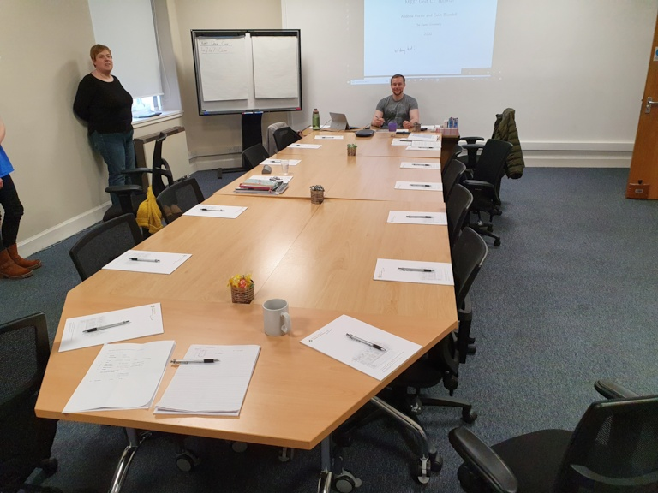
What did we do?
Our setup – F2F
Microsoft Surface connected to projector
Pre-prepared slides with blank space for handwritten annotations
Jabra conferencing mic/speaker (kindly loaned by OUiS)

Slide 6
What did we do?
Our setup – online
Microsoft Surface logged into Adobe Connect
Screen-sharing to PDF annotation program
Second tutor joined remotely
Second laptop set up to monitor chat (2nd tutorial)

Slide 7
What did we do?
Our setup – pedagogy
Worked through problems sent out in advance with input from students
Second tutor monitored chat and kept online students engaged
Second tutor gave audio contributions

Slide 8
Why did we do this?
Context of M337 Complex Analysis

Slide 9
Why did we do this?
Context of M337 Complex Analysis
Falling student numbers
Increased standard group size 17J: 15 students 18J: 17 students 19J: 20 students
Redundancies and resignations left patchy F2F tutorial coverage
Numbers in Scotland remain resilient, but no AL there!

Slide 10
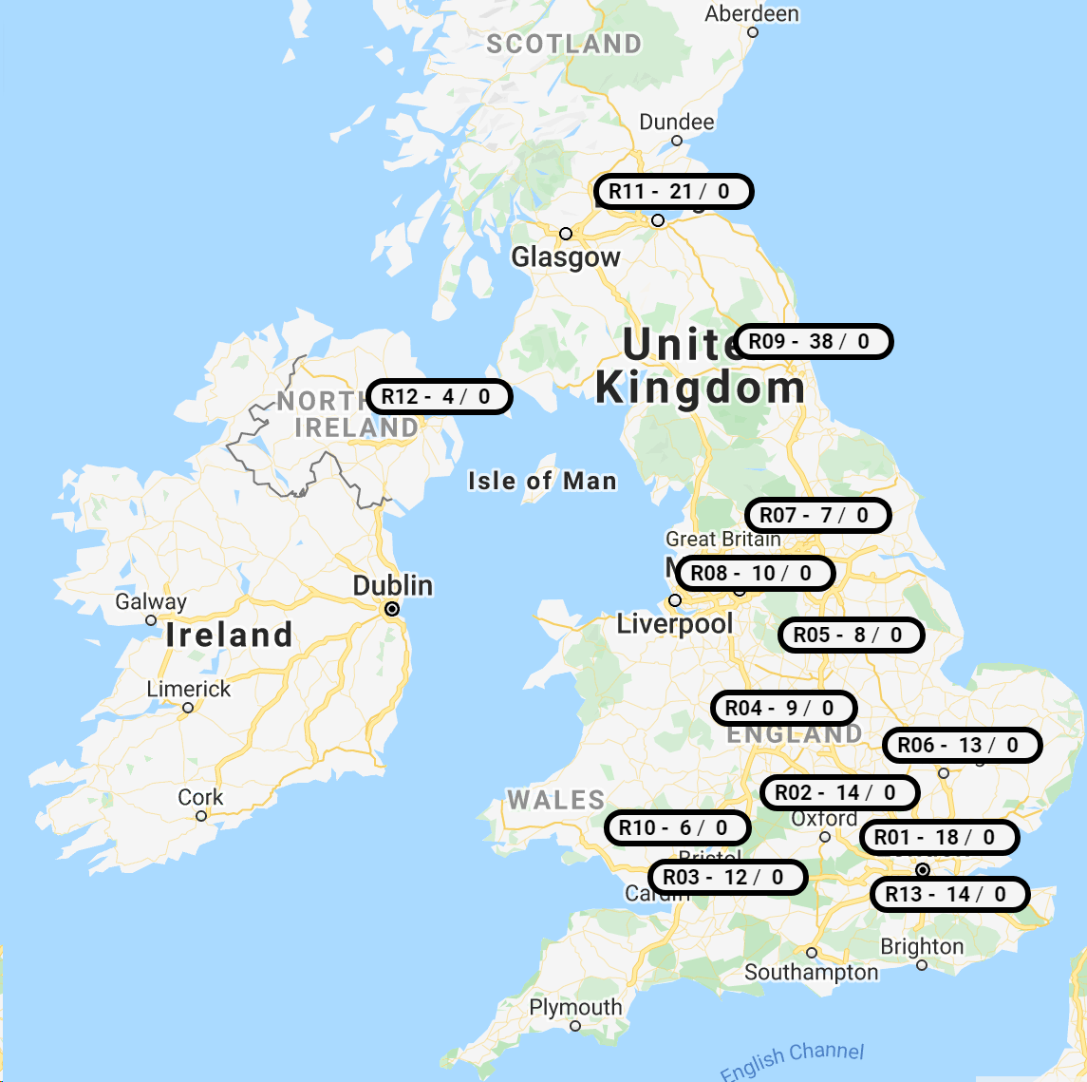
Why did we do this?
The current state on M337-19J
11 tutors; one group each
F2F tutorials in Edinburgh/Glasgow, Leeds, Birmingham, Cambridge, Reading, London, Brighton
3 tutors in London
2 tutors in R06
2 tutors who live in Oxford
31 international students (R09)

Slide 11
How are we evaluating this?
Reflections, observations, student interviews

Slide 12
How are we evaluating this?
Reflection – the AL perspective
Is it practical?
“As an AL, I would use a whiteboard and move around…”
Is it just a lecture?
“I would usually make students do some work in a F2F tutorial…”
What are the technology risks?
“Why did the tech fail both times?” “What are my strategies for dealing with tech failure?”
Are there pedagogical advantages for online students?
“Does it feel better for online students to watch students in the room and ‘feel like they are there’?”

Slide 13
How are we evaluating this?
Reflection – the Staff Tutor perspective
Is it cost-effective? “Could one tutor manage on their own?”
What training is needed?
“Do ALs need specialist tech equipment?”
What venues would be suitable for a blended approach?
“Reliable wi-fi is a must.” “How should the room be set up?” “Need a data projector and to be able to hook up own machine.”

Slide 14
How are we evaluating this?
Observation – the expert perspective
The three spheres Face-to-face: rich discussion happened “here”. Online: contribution and participation happened “there”. Blended: was there any interaction at the nexus between the two?
Managing the blend Andrew would ask a question to the room then immediately look at a screen! Andrew looked exhausted by the end! Would you cover more, less or the same amount of material in a purely F2F tutorial? In a purely online tutorial?

Slide 15
How are we evaluating this?
Interviews – the student perspective (initial findings – ongoing)
Accessibility issues Audio issues – hearing other students; tutor’s head direction; two or more people talking simultaneously Ensuring access to questions in advance of the tutorial
Pacing of the tutorial Slower than a “normal” F2F tutorial; about the same for an online
Online experience One student wasn’t aware there were F2F attendees! Webcam: nice to see your face, but didn’t really add much; delay
Recording Makes me feel a little self-conscious listening to the recording

Slide 16
THANK YOU Questions? Comments? Future directions?

