Slide 1
Generating graphical content for teaching: a simple and cheap way to produce diagrams/symbol rich content for forum postings and for live streaming in Adobe Connect
Nick Chatterton, Eleanor Crabb and Kate Bradshaw
Please complete the following poll – Your current technology and practice

Slide 2
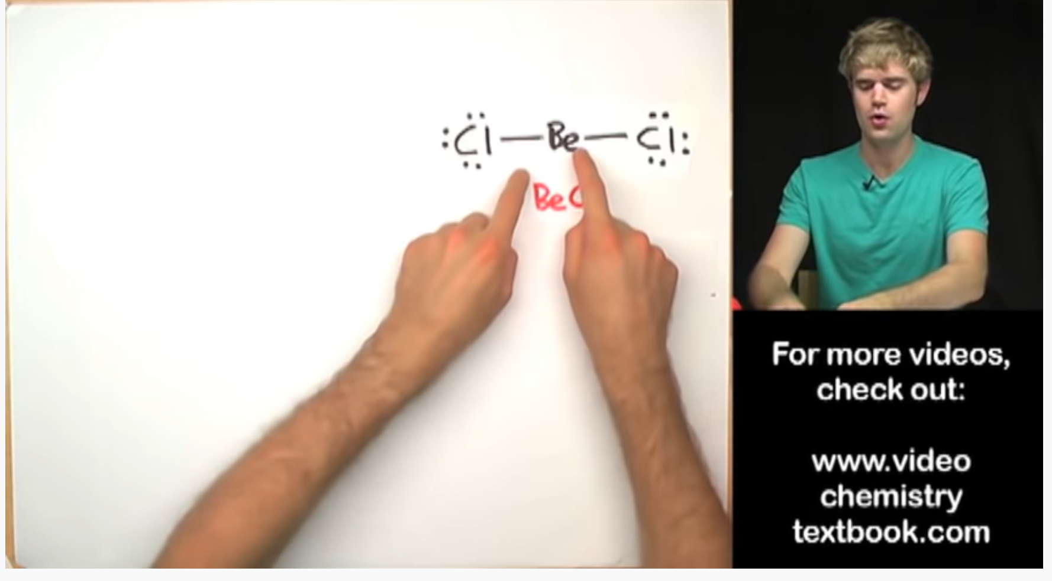
Online chalk and talk in chemistry teaching
2016-2017 eSTEeM Chemistry Clinics project
Utilised well known YouTube content
730,000 subscribers 5.9 million subscribes

Slide 3
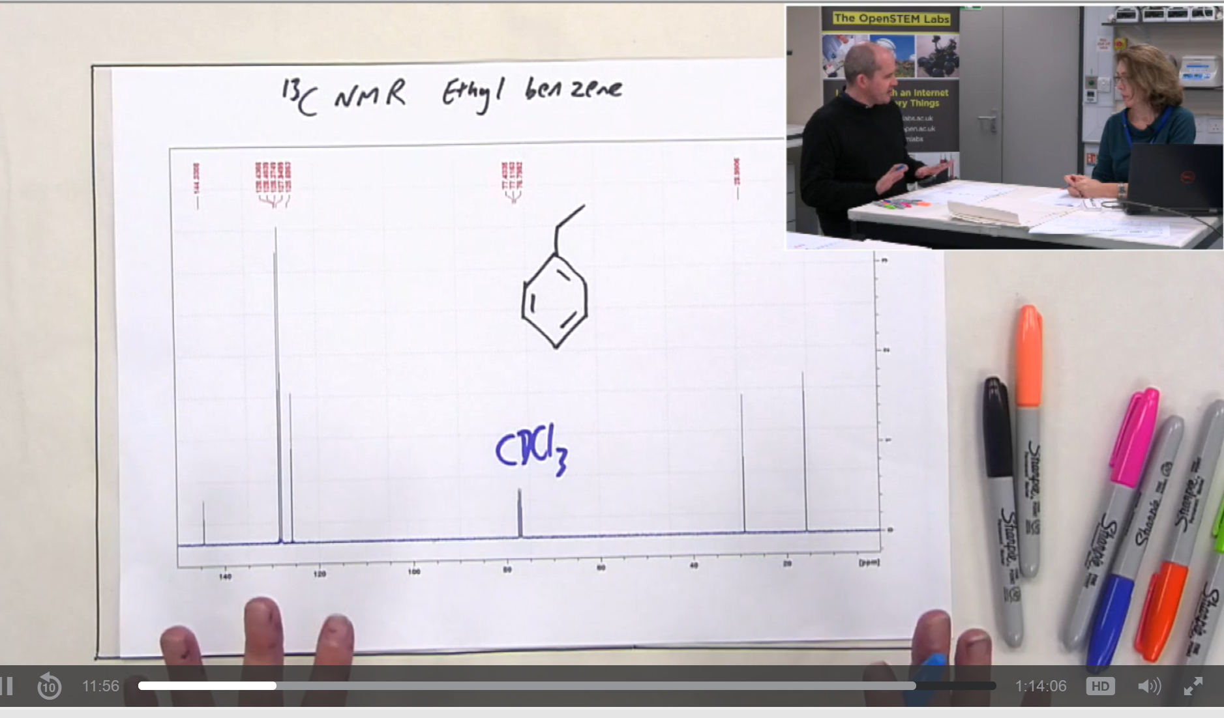
Using chalk and talk in Labcasts since 16J (S315)

Slide 4
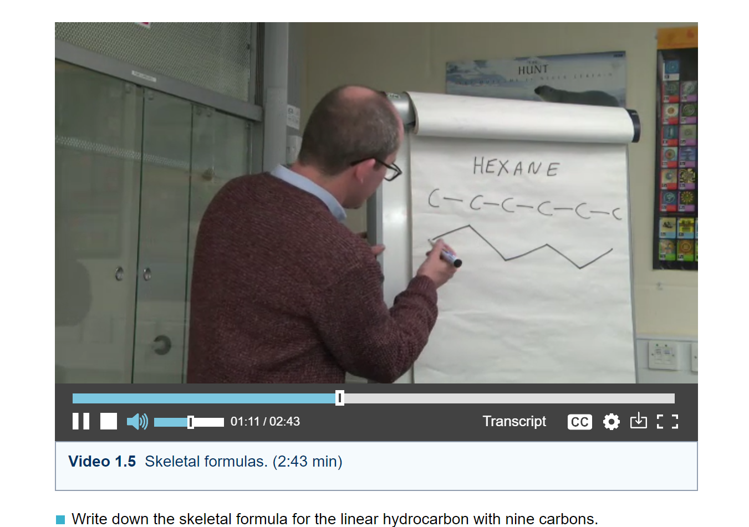
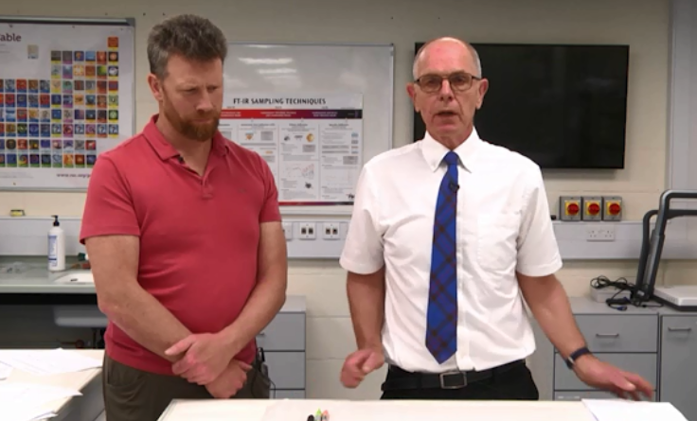
In assets produced for modules

Slide 5
In assets produced for modules
Calculations in S112

Slide 6
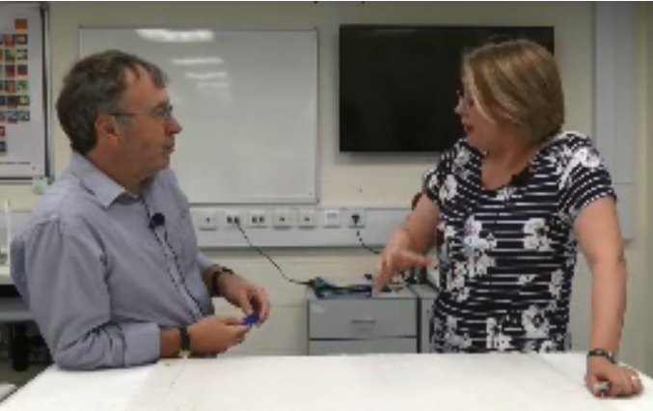
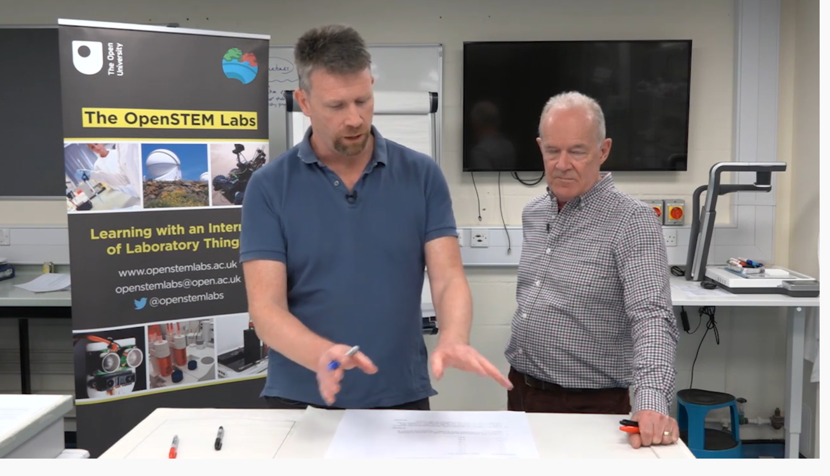
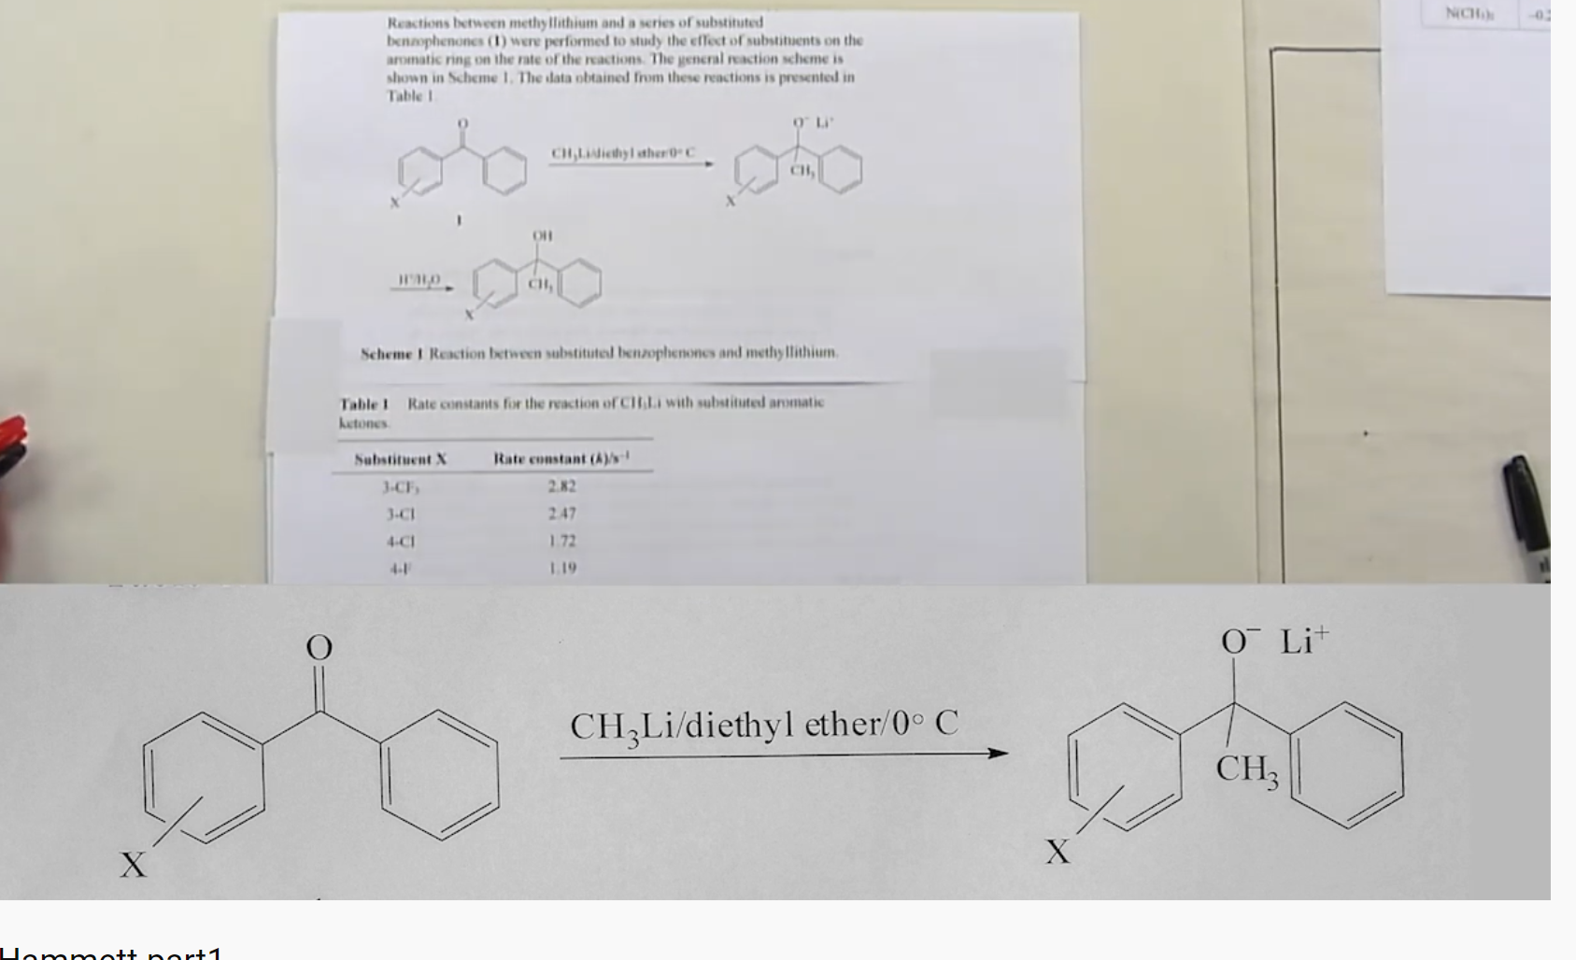
AL involvement in production of assets
Tricky topics in S215
Additional exam support in S315

Slide 7
Perceived advantages of talk and chalk
In drawing molecules or anything pictorial – where “how” you draw something matters and has meaning and is assessed
Pacing of calculations
Seeing an experts “approach”
Tricks/short-cuts that students can use in assessment
You are doing what you are asking them to do

Slide 8
Aims of eSTEeM project
To develop responsive “chalk and talk” teaching resources for S315 i.e. in response to specific forum queries.
To produce recorded “chalk and talk” sessions on topics that are known to be problematic for students
Scope affordable hard and software solutions that allow for the production of these resources that might of use to the university more widely
To compare effectiveness of different approaches
Initial focus on production of video assets for forum posts

Slide 9
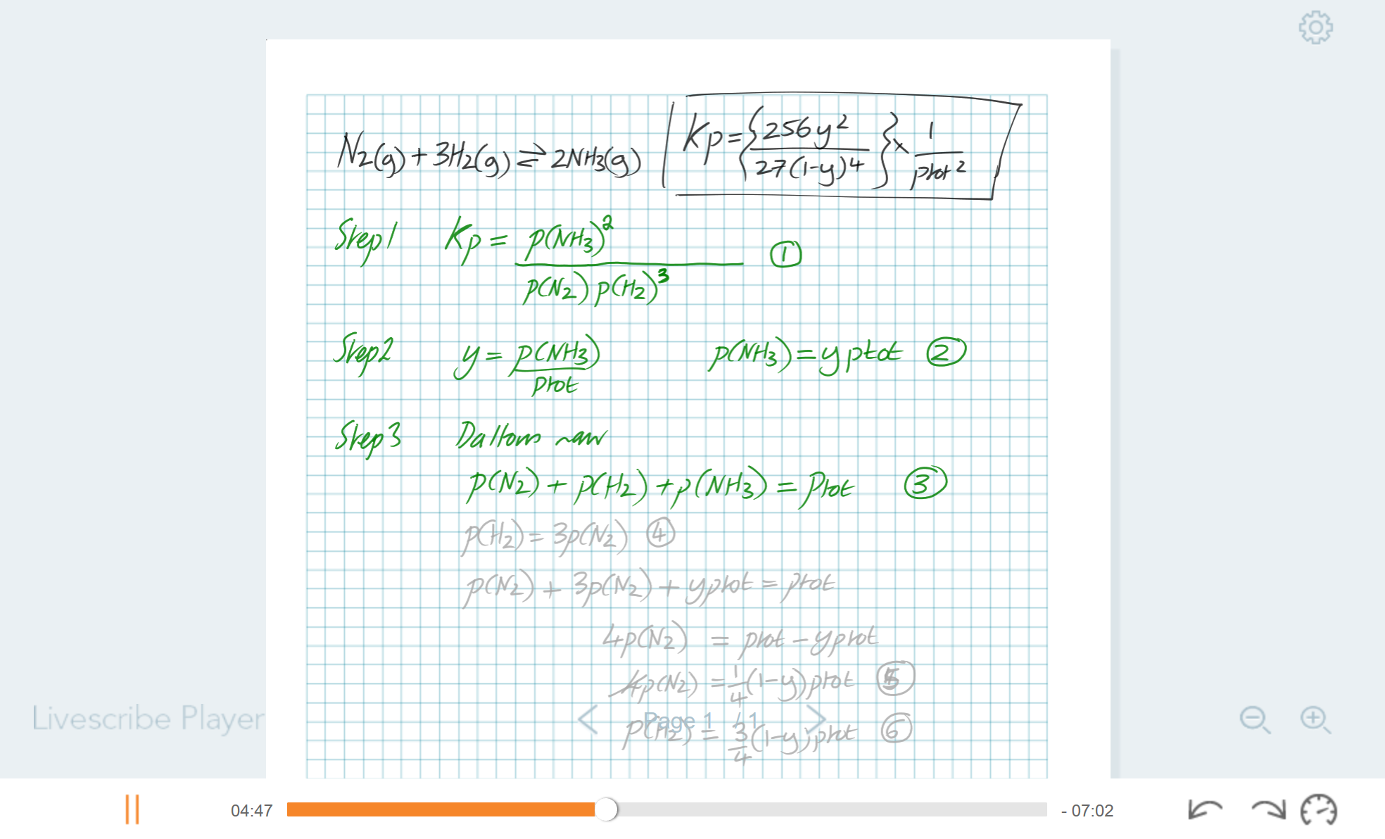
Considered different technologies
Pencasts using Livescribe
Students save to desktop and drag to Livescribe Player
that pdf tool worked and was really helpful. Words said sometimes make that bit more sense than written - brilliant learning tool.
so much better for me to listen as well as seeing the working through

Slide 10
Considered different technologies
Tried Surface pro and pen – not ideal especially for equations
V4K USB camera – best for chalk and talk

Slide 11
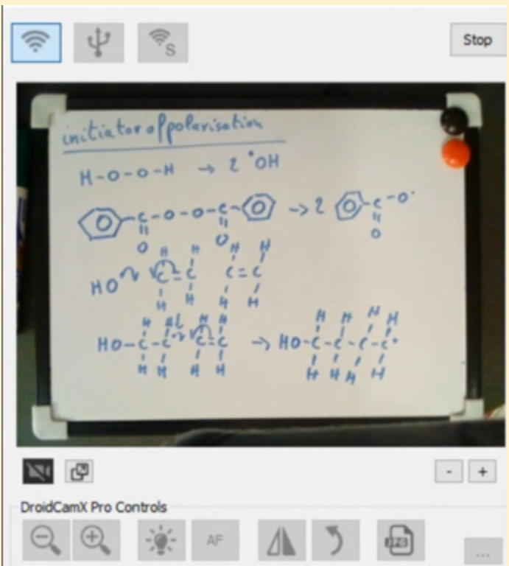
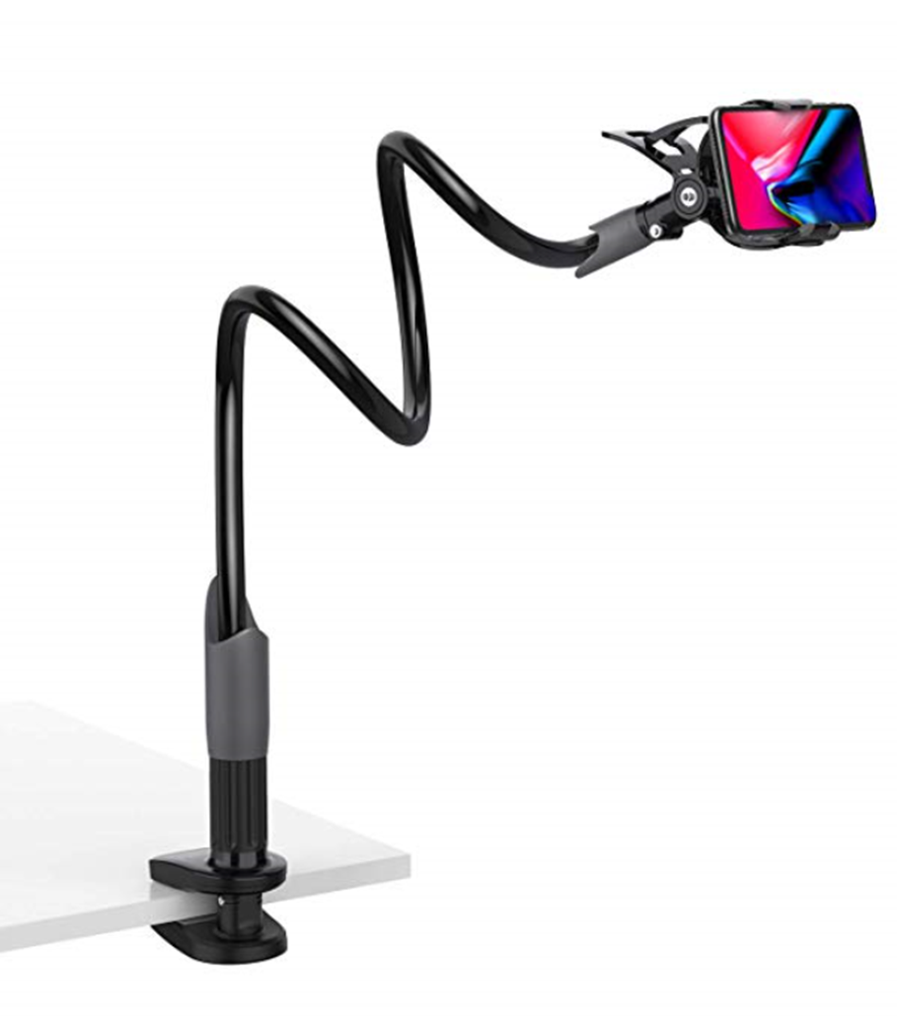
Smart phone/inbuilt cameras
DroidCam (Android) or EpocCam (Apple)

Slide 12
Use in forum
In response to specific student queries
Uploaded to YouTube then posted in forum posts
Automatic captioning available

Slide 13
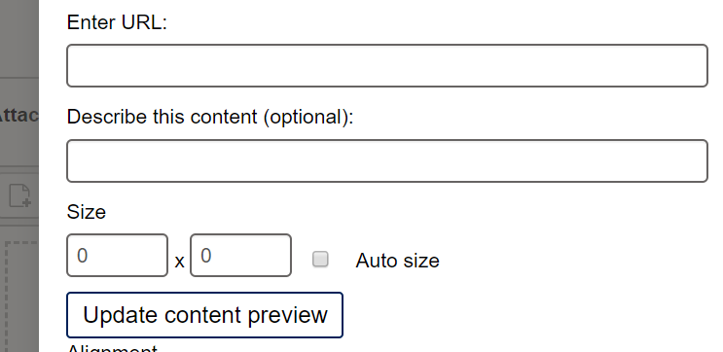
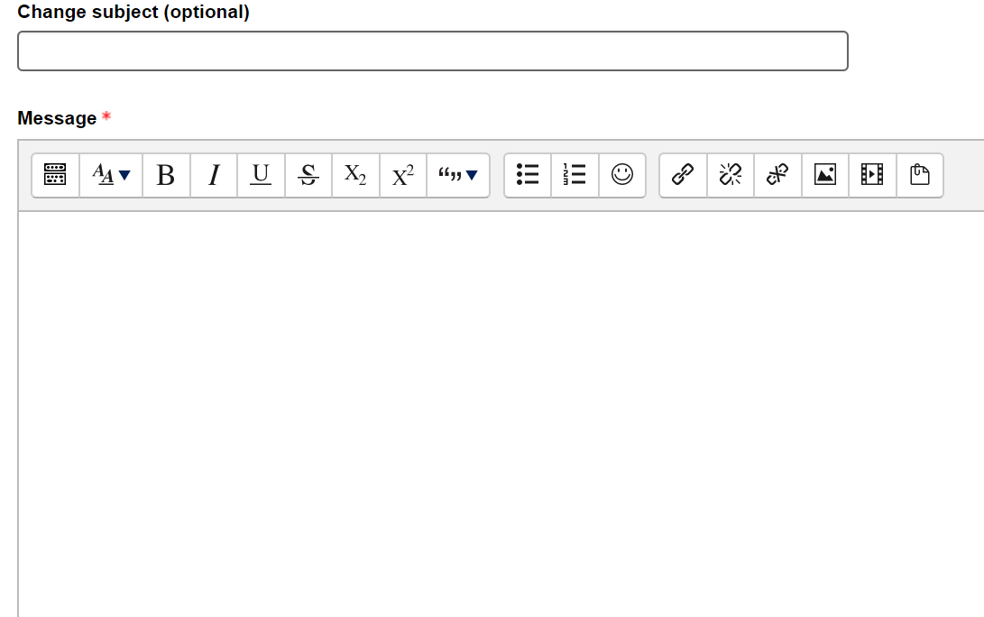
Advantages of these video assets
Can be re-used over multiple presentations
Placed at appropriate place in text of forum to emphasise key points

Slide 14
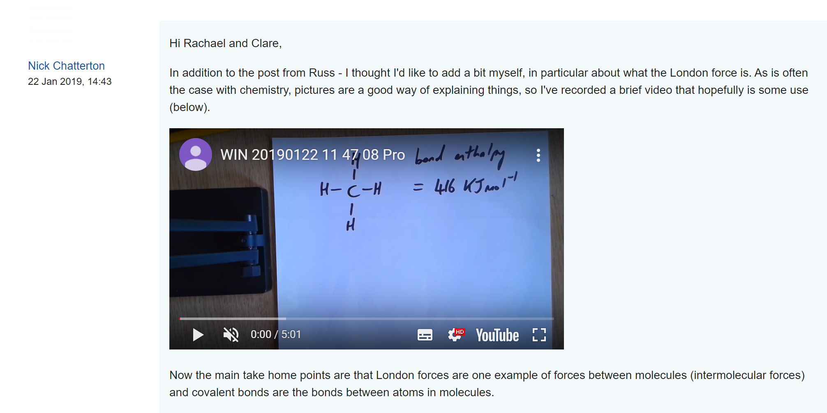
Use in module team forum in S112
Clarification of module materials
https://www.youtube.com/watch?v=vWLkcy1y8yY&feature=emb_logo

Slide 15
Some student feedback: S112
“As one who is an 'onlooker' in this discussion, I have found this to be a great 'innovation' in OU instruction and much more accessible than the normal 1 hr tutorial (which are great if I'm up to speed with the subject matter) hut where I am often behind or more rarely ahead of where the tutorial is pitched.
A five minute explanation is very digestible!”
“Just found this and it's made the topic much clearer - thanks so much for this clip.”
“It would be great to have a 'library' of 'tricky bits' to access in this format. Straight to the point and informative with minimal time - something I think most of us are short of!!!”

Slide 16
Some feedback: S315
That's amazing, thank you! It's the factorisation step I was missing, I hadn't considered to do that. I feel relieved now I can see how to get there.
Thanks again for posting the videos, they are excellent resources.

Slide 17
Demonstration of forum posts

Slide 18
Poll 1
Poll results

Slide 19
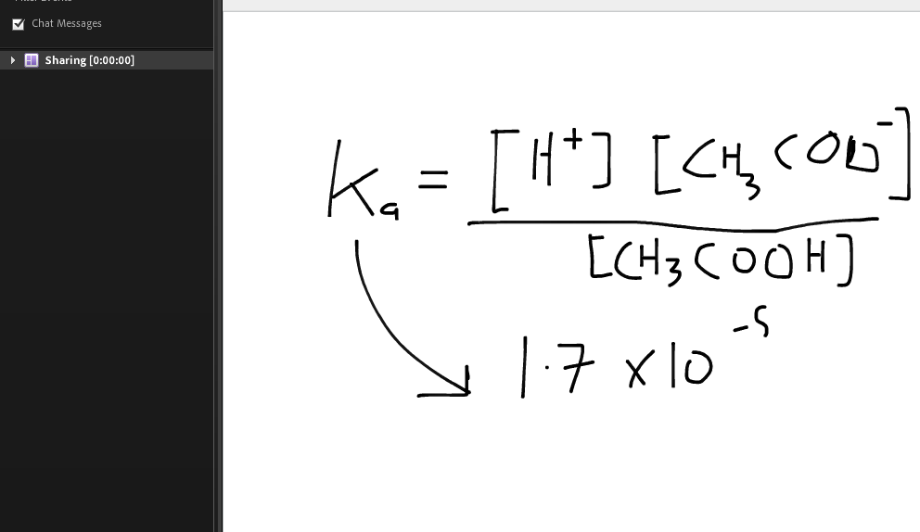
Chalk and talk in AC tutorials
Either using drawing tool via mouse
or with Wacom Bamboo type tablets
Problematic to work with
Slow writing speed
“But I think Adobe Connect is not the best system for science needs (e.g. drawing chemical structures on it is, at best, quite challenging).”

Slide 20
Use of camera in AC tutorials
“How” to draw things
Additional explanation

Slide 21
Demonstration in AdobeConnect

Slide 22
AL usage
All S315 tutors were given a camera to use either in tutorials or in forum posts
Some feedback:
“I like to think that it was helpful for them to see me draw out the possible structures, mistakes and all.
I've also used it in some tutor group tutorials for some organic chemistry and inorganic (I think I drew some orbitals). I think it is the most useful for drawing molecules.
I know the first time I turned it on in my first tutor group tutorial the students were very excited and had a lot more questions.”

Slide 23
Break out rooms (10 min)
Please discuss the following in your group and capture your thoughts in the chat or on a word file.
Is this technology something that would be useful to you in your discipline? If yes, how might you see this being used?
What are the pitfalls that you might envisage could arise and how might you mitigate these?
What advantages do you foresee that might arise in terms of student experience?
C&C and KMi Room
E&I Breakout Room
EEES Breakout Room
LHCS Breakout Room
M&S Breakout Room
SPS Breakout Room

Slide 24
Summary
USB cameras acting provide a convenient and reasonably economic way of enhancing student engagement in both forums and online tutorials
Mobile phones are also an option
Particularly beneficial if you need to demonstrate “how” to draw something, annotate diagrams or go through steps of calculation
Easy to use in tutorials and no problems to date with bandwidth etc

Slide 25
Interested in getting involved
If you are interested in getting involved with this project please enter your details via the following link – Further details

