Slide 1
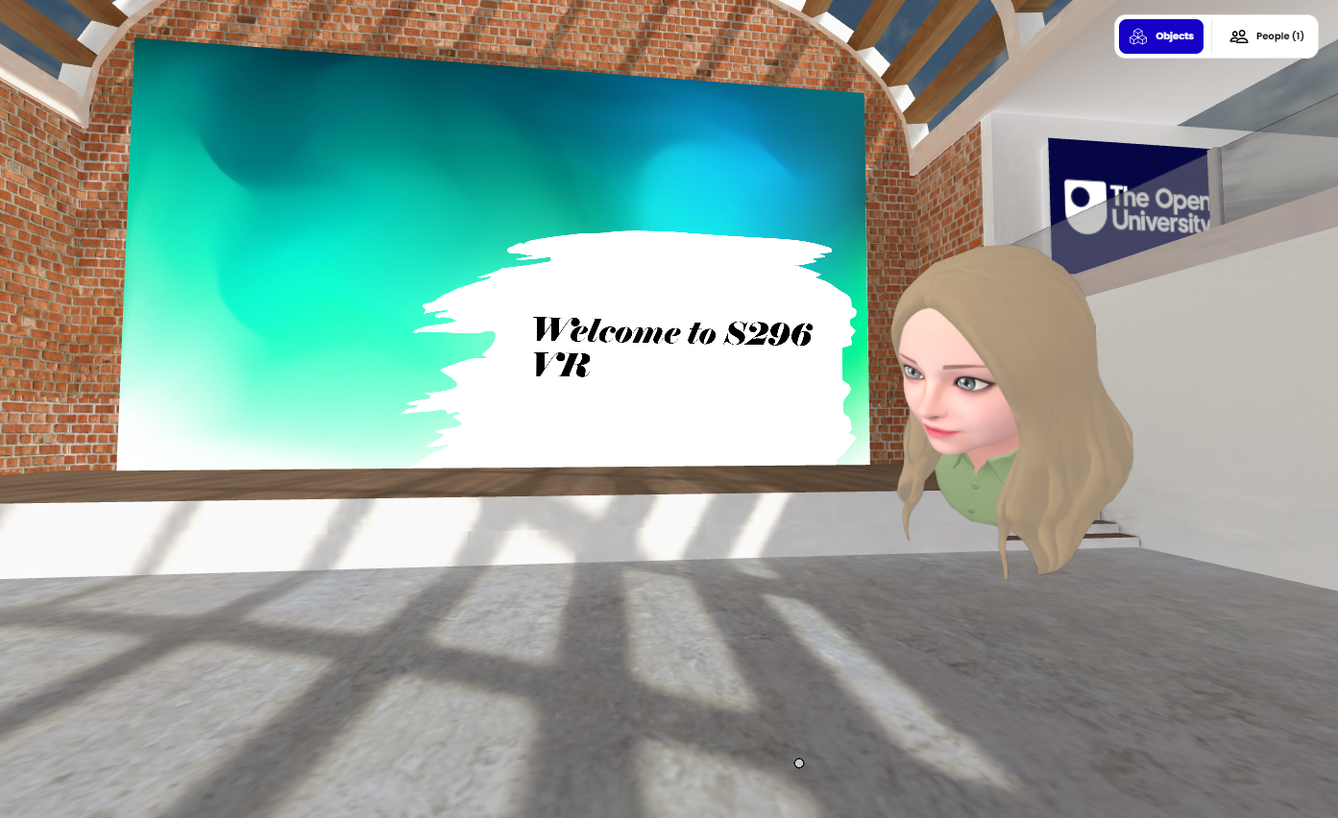
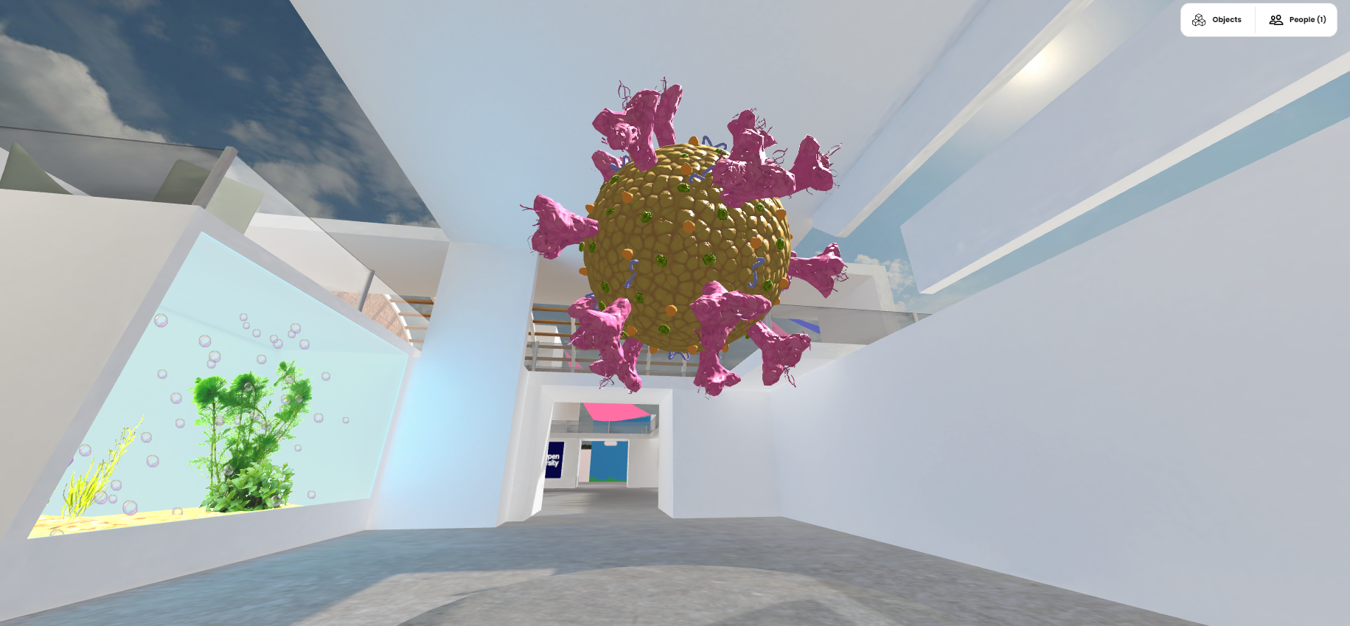
Exploring virtual reality tutorials on S296, Cell and molecular biology Sarah Daniell, Katja Rietdorf, Lorraine Waters
Pilot 30 min VR tutorials on S296 23J after Christmas, plus a pre-Christmas party/orientation session.
Recruit up to 100 volunteer students to participate in four parallel sessions.
Sessions will run on Mozilla Hubs platform. Highly accessible via web link and doesn’t require software development.
With AL help, tutorials will be planned to complement ongoing tuition in Adobe Connect.
Focus on what’s harder to achieve in AC – communication and collaboration.
Evaluate the sessions by observing student behaviour, post-session poll, questionnaire & focus group to compare to equivalent in AC.
Aim to understand whether introducing an element of VR tuition would be popular with our biology students, potentially complementing AC, increasing attendance and motivation, providing an environment conducive to interaction.

