Slide 1
The Awarding Gap for Students with a Mental Health Declaration
A practical response
Mychelle Pride 29 April 2021
Notes:
OU internal – mental health difficulty
OfS – mental health condition
Mental ill health, mental health concerns, mental health issues – all language you will hear
Students in the OU declare a mental health difficulty which gives them a disability marker
You can have a disability marker without providing evidence, but you cannot access support or finance without evidence.
It is important to note that students can and do manage their mental health conditions well. Will have varying impact on their student experience.
Wellbeing – we all have, on a spectrum from excellent wellbeing to very poor.
As a student then
- diagnosed mental health condition (managed or not managed) (declared or not declared)
- mental health difficulty that you declare
- regarding wellbeing, might be poor, in distress
That brings us to the awarding gap
The awarding gap in the Access and Participation Plan compares students who have a mental health declaration to students with no known disability. This is the gap we are going to talk about in the next section.
In the second and third sections, we will talk about students who are in distress, whether or not they have declared a mental health difficulty or condition and practical suggestions for supporting students in distress.

Slide 2
Welcome
Poll: Are you a: Student, Associate Lecturer, Staff Tutor, Central Academic, Module Team member, Other?
Poll: What is your confidence level in taking action to address this awarding gap?

Slide 3
Setting the scene
Notes:
OU internal – mental health difficulty
OfS – mental health condition
Mental ill health, mental health concerns, mental health issues – all language you will hear
It is important to note that students can and do manage their mental health conditions well.
Wellbeing – we all have, on a spectrum from excellent wellbeing to very poor.
Students in the OU declare a mental health difficulty which gives them a disability marker
You can have a disability marker without providing evidence, but you cannot access support or finance without evidence.
The awarding gap in the Access and Participation Plan compares students who have declared a mental health declaration to students with no known disability. This is the gap we are going to talk about in the next section.
In the second and third sections, we will talk about students who are in distress, whether or not they have declared a mental health difficulty or condition and practical suggestions for these supporting students.

Slide 4
True or False? At University level, in 2019/20
9.6% of students declared a mental health difficulty
The gap at TMA 1 was 4.8 percentage points
If the completion gap did not exist, 1895 more students with a mental health declaration would have completed their module
The completion to pass conversion rate for students with a mental health declaration was 97%
The module good pass gap was 2.8 percentage points
Students with a mental health declaration are more likely to return to study than a student with no declared disability
Notes:
OU level
APS Dashboard
Four nations
Levels 1 – 3
Across all modules at the OU
Next set of slides are specifically for students who declare mental health difficulties as reported in the data dashboard. Granularity, as in what type of condition, is not available in this dataset. Students who have not declared mental health difficulties or poor wellbeing are not included in this dataset.

Slide 5
Student with Mental Health Declaration by Faculty 2019/2020
Data from APS dashboard. UK only. Levels 1 – 3. PVC-Students not included which is why faculty numbers do not = 15153
 | FLP1# | % declared
Institution | 15153 | 9.60%
FASS | 5771 | 12.90%
FBL | 1617 | 7.00%
STEM | 4924 | 8.80%
WELS | 2826 | 8.20%
Notes:
Data from APS dash board, levels 1 – 3. Does not include PVC-students separately
Research indicates that at least half of the students with a mental health condition or poor wellbeing, don’t declare it.
At least double the figure is more likely.
There are inconsistencies across different data sources at the OU. There are differences in data definitions. Student with multiple disabilities including mental health, may not show up as they may show as multiple disabilities.
Not all students declare a mental health condition, but may live with a mental health condition.

Slide 6
Notes:
As in previous slides, data has been taken from the APS dashboard – available through PowerBI

Slide 7
Personal reflection
Is your own experience reflected in the data?
Has anything in this section surprised you?

Slide 8
The Student Experience

Slide 9
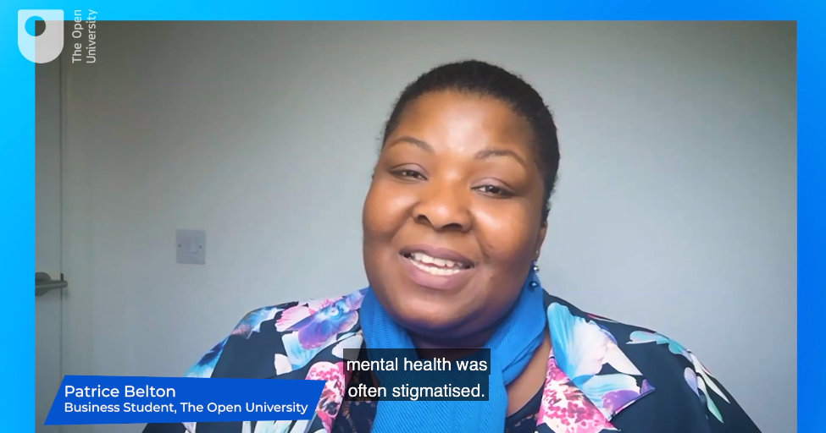
Studying with a mental health condition

Slide 10
Scholarship and initiatives
Wellbeing scholarship
Tutorial review from mental health perspective
Video project – by students for students
Student mental health and wellbeing induction block

Slide 11
Personal reflection
What is your own experience of working with students with mental health conditions or supporting staff who are working with students with mental health conditions?

Slide 12
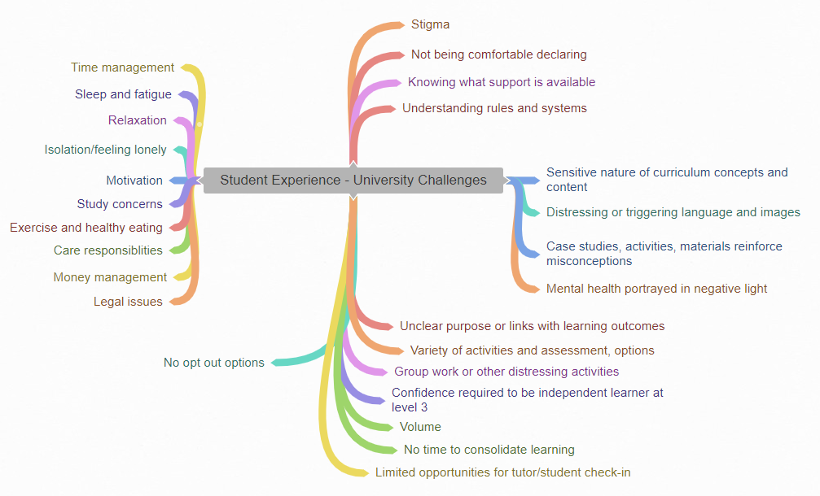
Notes:
Thematic analysis of four projects: full spectrum of themes in order to inform the student experience team, module teams and the Faculty. No weightings used.
Course study can contribute to poor mental health and poor wellbeing

Slide 13
Shared reflection
Do the challenges identified in the previous slide reflect the challenges your students have experienced?
In what ways yes?
In what ways no?
Type your thoughts into the chat box

Slide 14
Coping when you are struggling

Slide 15
Practical response
Five actions you can take (times 5)

Slide 16
Curriculum, tuition and assessment
Co-create with students and consult student mental health experts
Provide consistent clarity on learning objectives
Provide clarity on how learning objectives link to assessment
Consider differing student learning styles, build in optionality
Know your module flow data
See Kate Lister’s work vignettes of mental health in distance learning
Notes:
Course study can contribute to poor mental health and poor wellbeing

Slide 17
Provide the following
Macro- and micro- sensitive content indication
Clear indication of modality
Academic rigour
Detailed analysis
Collaborative working
Debate
Clear pathways through tutorial and assessment resources
Comprehensive tutorial guides for ALs
Practical student mental health and wellbeing training to all Faculty staff and student representatives

Slide 18
Module teams
Review module materials from mental health and wellbeing perspective
Review use of images and languages that could be distressing
Ensure tutorial materials include references to student wellbeing
Ensure materials include culturally appropriate and accurate themes relating to mental health and wellbeing
Annually review any curriculum, tuition or assessment changes
Provide a wide range of learning resources that are multimodal, context specific and easily accessible
Provide options for tutorial and assessment
Consider volume on modules
Notes:
Student centric not content centric
Built in optionality is critical for success

Slide 19
Staff Tutors
As module team members, focus on the student experience
Use student groups to review materials
If using ALs for content, provide student mental health and inclusivity training
If relevant, provide pre-enrolment content and modality guidance
Ensure your ALs know how and where to signpost
Provide training for delivering sensitive topics
Take student complaints seriously
Notes:
Course study can contribute to poor mental health and poor wellbeing
Sarah Mander in WELS is providing practical notes for tutors to better support students: stress management, time to relax, sleep hygiene, five ways of wellbeing

Slide 20
Associate Lecturers
Increase your own awareness of appropriate and available support
Provide clear signposts where and how students can access additional help
Be student aware
Keep students connected – check in
Share examples of good practice on tutor forums
Notes:
Course study can contribute to poor mental health and poor wellbeing
Support often goes beyond the pre-prepared materials

Slide 21
Personal and shared reflection
What is the one piece of information from today that resonates with you most? Why?
As a result of what you have heard today, what one action are you going to take away? Type in the chat box

Slide 22
Takeaway messages
We are all responsible for making changes to improve outcomes for our students with mental health conditions and poor wellbeing
Signpost early and often
Many students don’t declare. Know your students.
Keep in contact with students – retention is key
Take care of your own wellbeing
Notes:
We are all responsible for making changes to improve outcomes for our students with mental health declarations and poor wellbeing

Slide 23
Personal reflection
Poll: What is your confidence level in taking action to address this awarding gap?

Slide 24
Thank you Questions

Slide 25
References
Hubble, S., & Bolton, P. (2020). Support for students with mental health issues in higher education in England. UK Parliament Briefing Paper. Available online https://commonslibrary.parliament.uk/research-briefings/cbp-8593/ [Accessed 27 February, 2021]
Jones, E. J., Pride, M., Edwards, C., & Tumilty, R. (2020). Challenges and opportunities in co-creating a wellbeing toolkit in a distance learning environment: a case study. The Journal of Educational Innovation, Partnership and Change, 6(1). Available online https://www.journals.studentengagement.org.uk/index.php/studentchangeagents/article/view/1007 [Accessed 25 March 2020]
Office for Students (2019) Mental health: Are all students being properly supported? Insight 5 Available online https://www.officeforstudents.org.uk/media/b3e6669e-5337-4caa-9553-049b3e8e7803/insight-brief-mental-health-are-all-students-being-properly-supported.pdf [Accessed 27 February, 2021]
Pereira, S., Reay K., Bottell, J., Walker, L., Dzikiti, C (2019) University Student Mental Health Survey 2018: A large scale study into the prevalence of student mental illness within UK universities. The Insight Network Available online https://www.theinsightnetwork.co.uk/uncategorized/university-student-mental-health-survey-2018/ [Accessed 25 March, 2020]

Slide 26
Resources
Five ways to wellbeing
OU Help Centre: Mental health, wellbeing and welfare
OU Students Association Support
Student Minds
TogetherAll
Wellbeing in the curriculum
Your wellbeing – Law School page
Chris Hadfield’s life advice

Slide 27
Bonus slides
A bit of extra information you might find helpful

Slide 28
Student with Mental Health Declaration Module Flow
Data from APS dashboard. UK only. Levels 1 – 3. PVC-Students not included
 | Student MH declaration count | TMA1 % | gap | Complete % | gap | First time pass % | gap | Good pass % | gap
OU | 15153 | 82.20% | 4.8 | 62.90% | 12.5 | 61.20% | 12.5 | 62.60% | 2.8
FBL | 1617 | 81.30% | 5.9 | 64.30% | 10.2 | 61.50% | 10.7 | 62.70% | 5.8
FASS | 5771 | 88.80% | 3.4 | 65.60% | 10.1 | 64.10% | 10.5 | 66.30% | 3.7
STEM | 4924 | 79.60% | 7.9 | 58.40% | 15.2 | 56.40% | 15.3 | 61.50% | 2.4
WELS | 2826 | 72.70% | 6.9 | 63.00% | 14.5 | 61.60% | 14.2 | 55.10% | 4.3

Slide 29
Scholarship
Practical co-creation

Slide 30
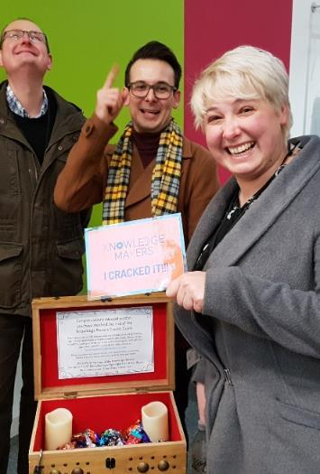
Co-creation
Determine what co-creation means for the project
Determine at what stages you will co-create
Incorporate students as early as possible – give students agency
Induct/onboard students
Induct/onboard staff
Notes:
Students as (co) designers
Students as (co) producers
Students as (co) researchers
Students as (co) authors
Students as (co) creators
Students as mentors

Slide 31
Scholarship with mental health in mind
Create a safe research/scholarship place
Provide independent space for reflection
Collectively agree the research project principles
Articulate mutual benefit
Address the power dynamic
Facilitate different levels of comfort and confidence
Facilitate different levels of commitment
Nurture creativity and embrace difference

Slide 32
‘Your Wellbeing’
Snapshot of Tina Forbe’s Wellbeing page that has launched across the OU
On qualification sites, click ‘succeed’ at the top and select ‘your wellbeing’

Slide 33
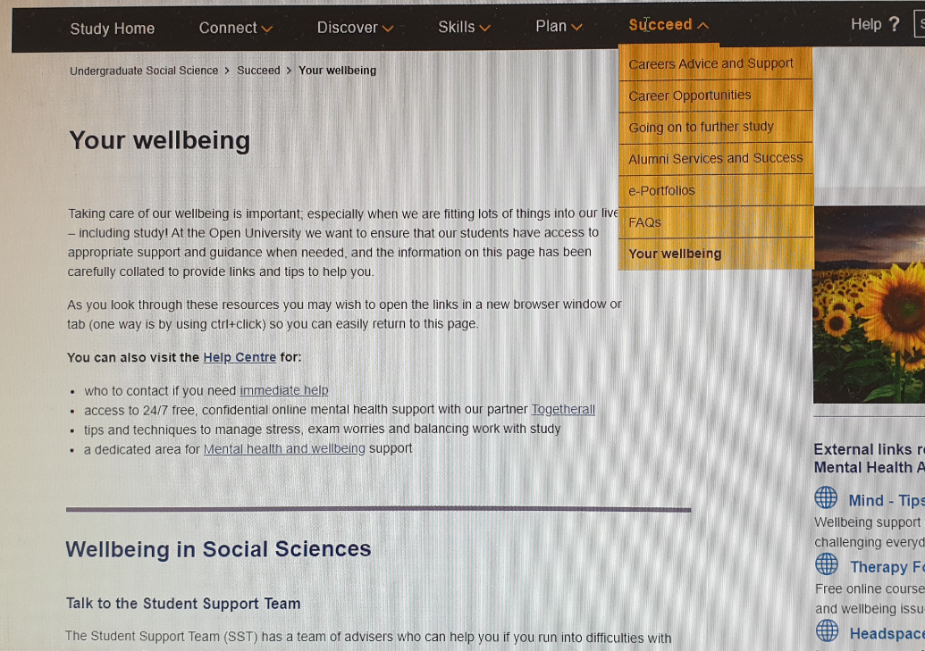

Slide 34
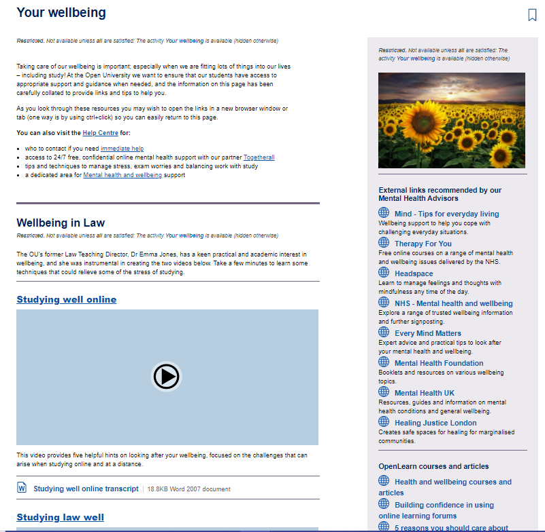
‘Your wellbeing’ Law School page

