Slide 1
Intro Slide Title 1
Conference Proceedings Briefing
Sue Pawley and Daphne Chang
eSTEeM
May 2024

Slide 2
Session Outline
Aims of the Journal
Why are we producing the Conference Proceedings
Objectives
How will the authors benefit from writing a paper
Format of Paper
Short discussion on sections of the paper, as discussed in Guidelines
Paper Review
A brief review of two papers to highlight format

Slide 3
Aims of Conference proceedings
Publication of OU scholarship and innovation.
Short papers (mindful of workload).
Publish in Friendly environment.
Gives experience to staff new to scholarship.
Gives experience to new authors.
Gives experience to those new to reviewing.
Can run as a partner to new style project report.

Slide 4
Objectives
Reflection
Opportunity to publish paper
Opportunity to review papers
Continuous professional development
Dissemination platform
Can help with thoughts for Applaud submission/ promotion case
Fits well with new style project report format

Slide 5
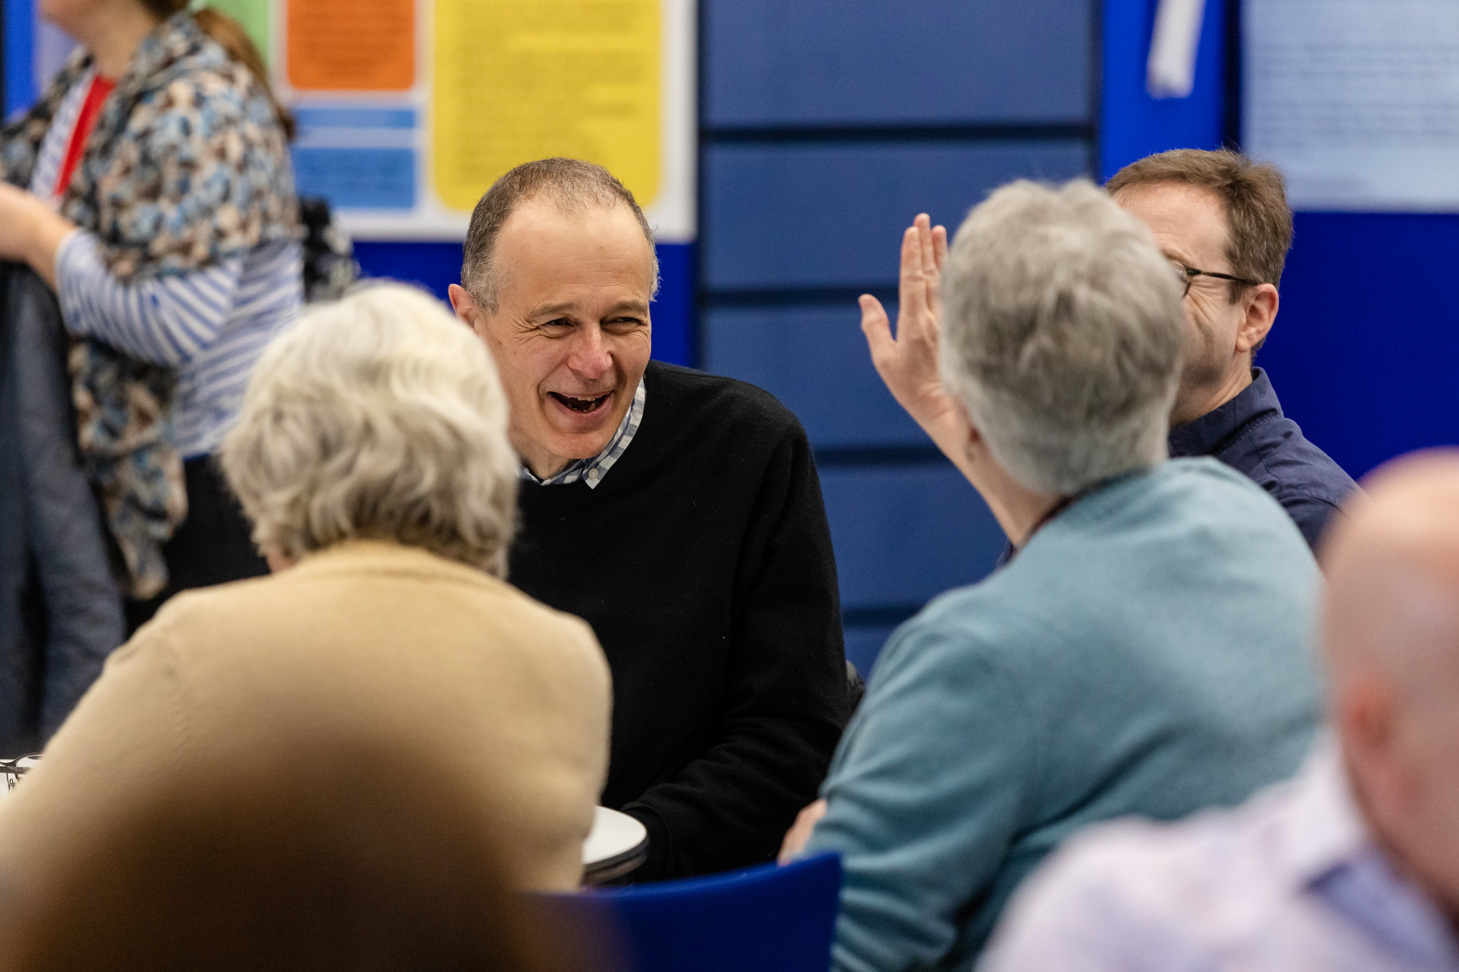
Paper Format
Don’t forget to refer to proceeding guidelines
Beginning
Set the scene (OU context)
Look at prior works/Lit review
Say what you were trying to solve or examine
Give brief outline of paper
Middle
What you did (eg intervention/activity)
How you collected data (include if required HREC ref. obtained)
Analysis/What you found out.
End
What conclusions do you want to draw from your findings?
Were there any limitations
Where does this lead next
Notes:
Daphne to take over

Slide 6
Review Papers (Task)
In groups, have a look at the three papers, linked below. They are from a set of conference proceedings and so will be similar in purpose to our journal (but different in length).
Identify the three sections, beginning, middle and end. See how the papers differ in structure, see the similarities.
Paper one
Paper two
Paper Three
Notes:
Innovating Higher education Conference (15 mins)

Slide 7
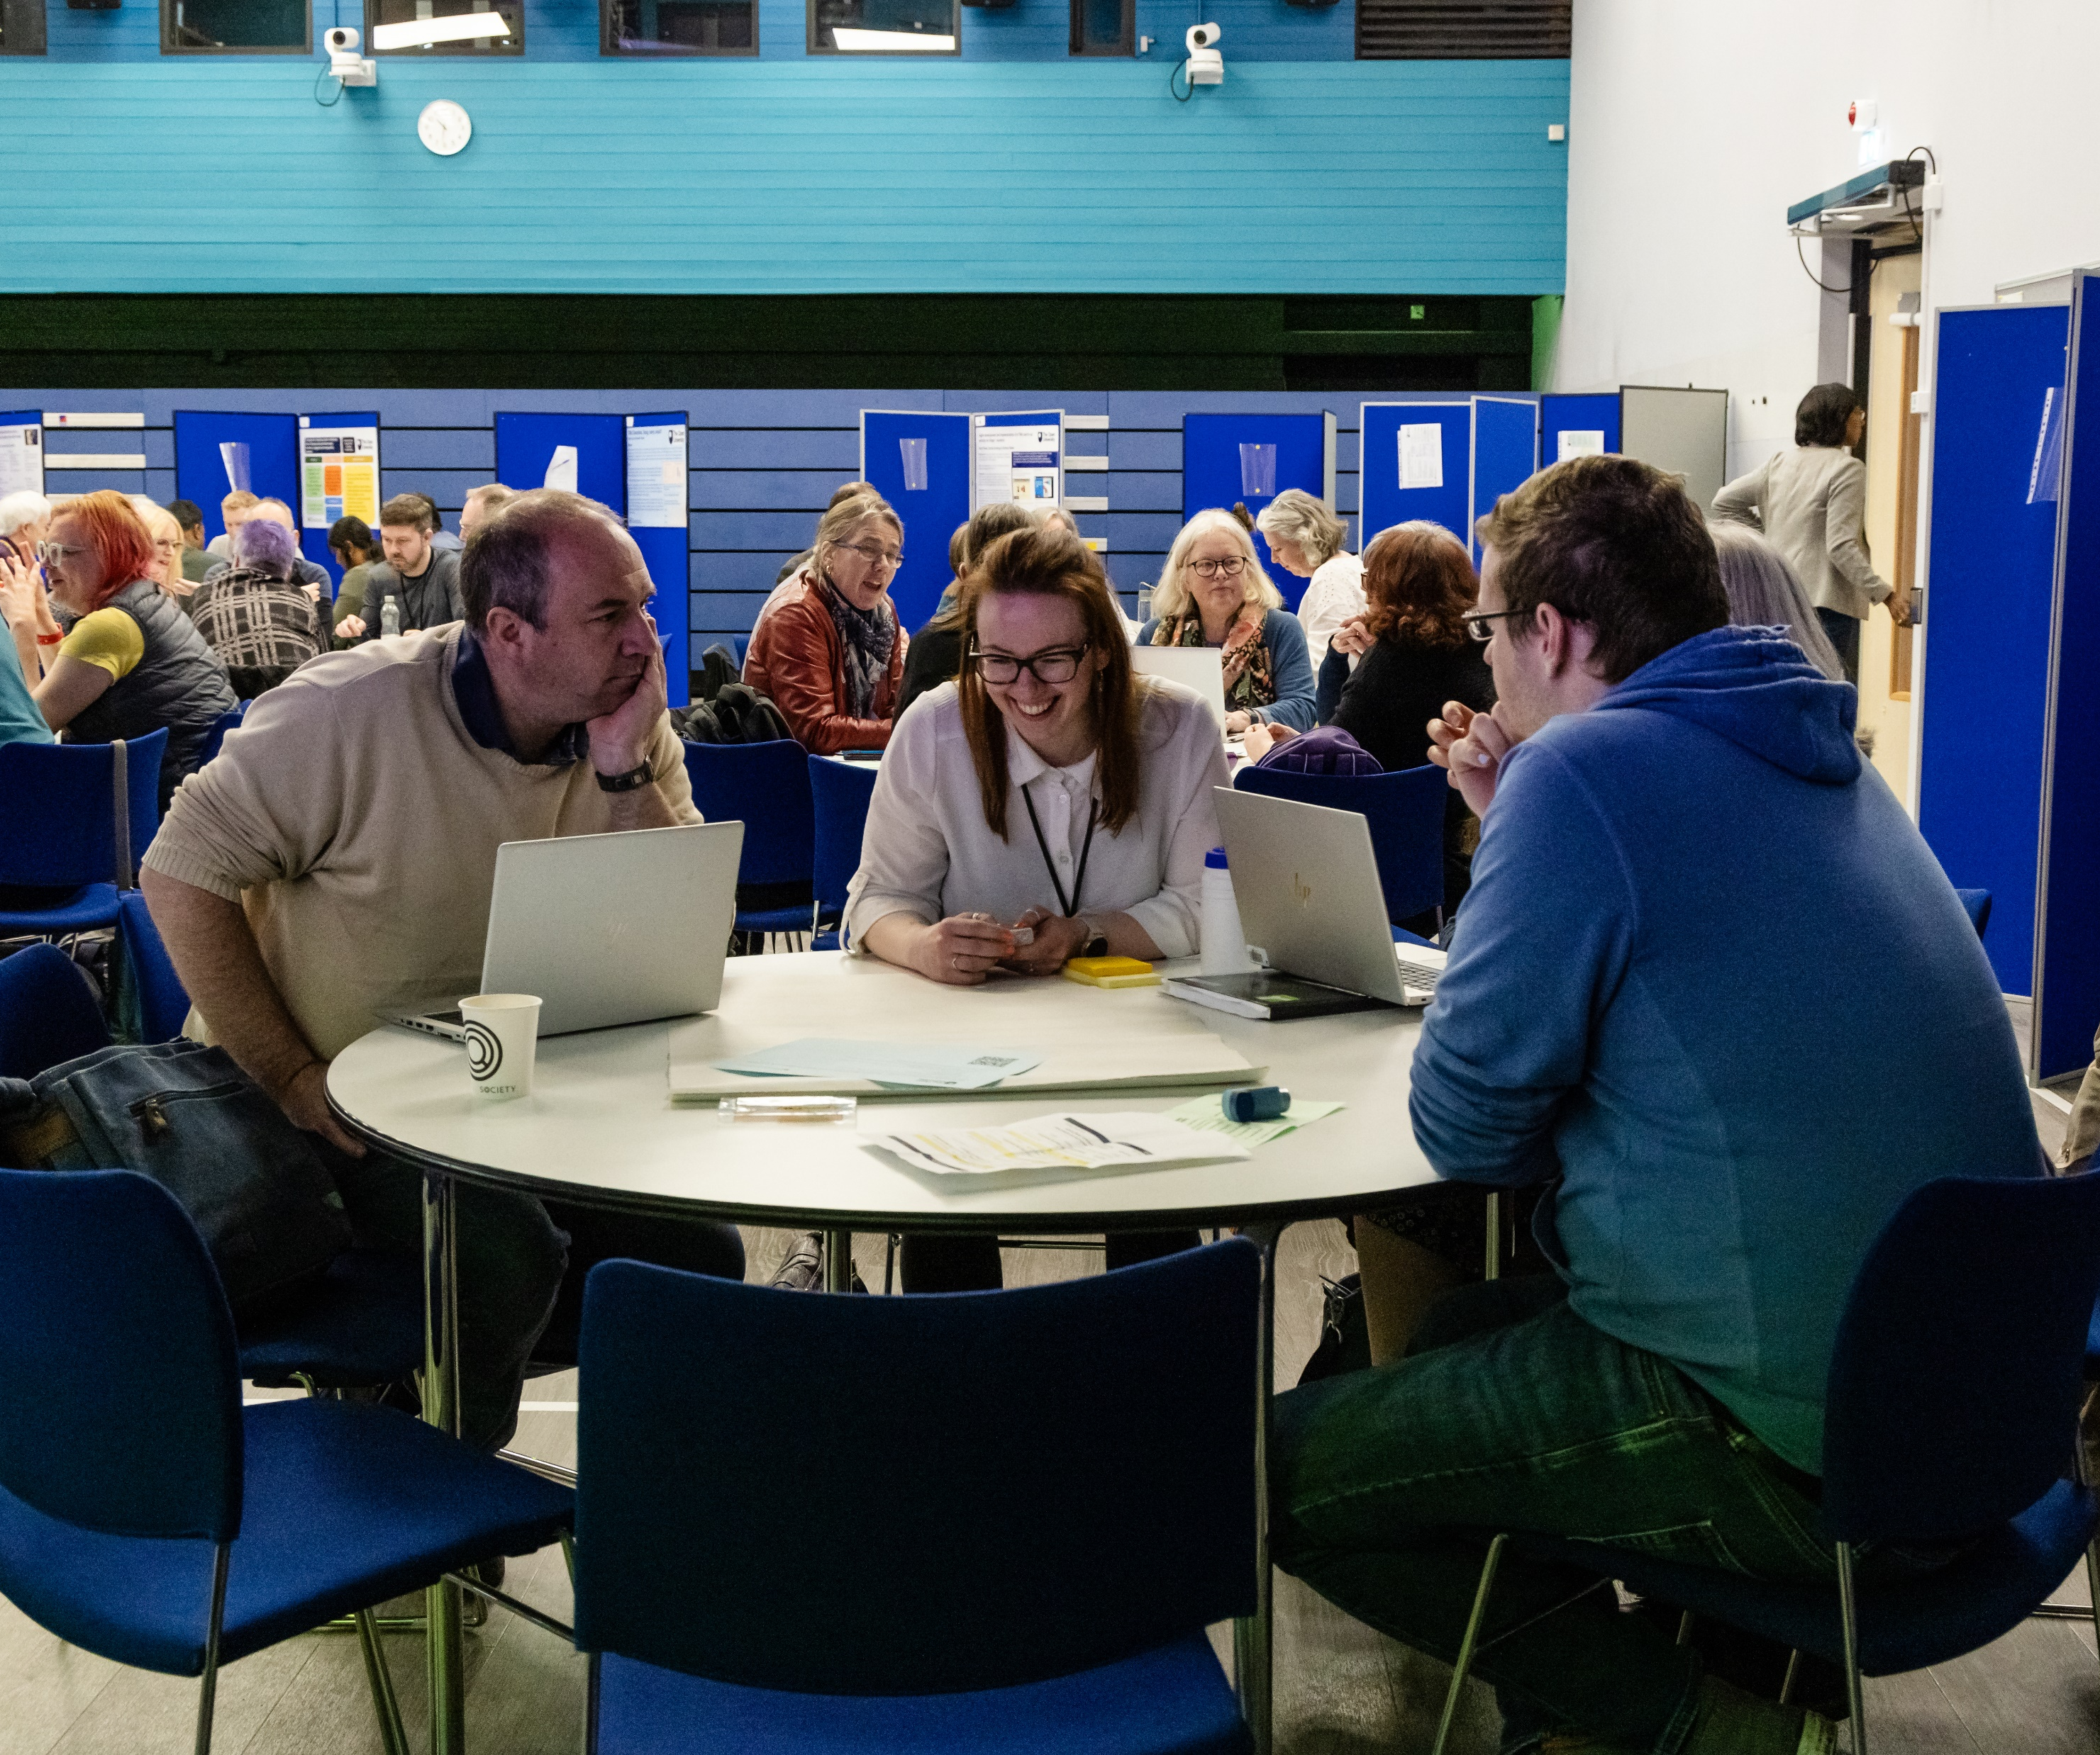
Your paper
Think about what you want to say
How will it fit into the three sections of a paper?
Does it have a good narrative?
Are there take home points for each reader?
Does it open up a discussion for further work?
Any Questions ?

Slide 8
Slide Title 31

