Slide 1
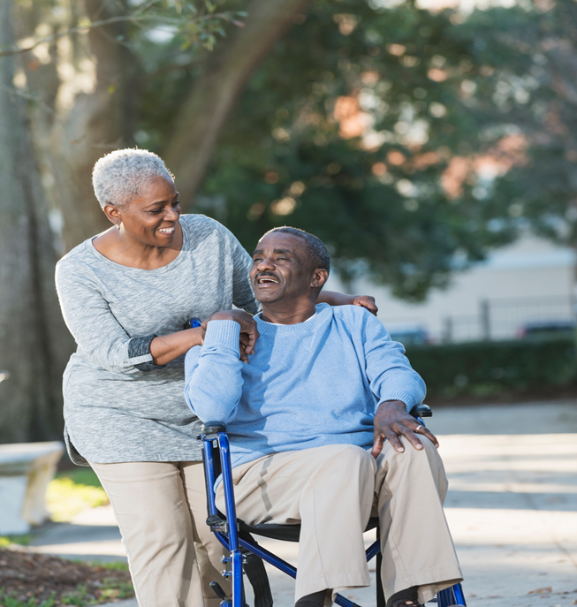
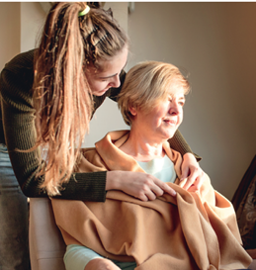
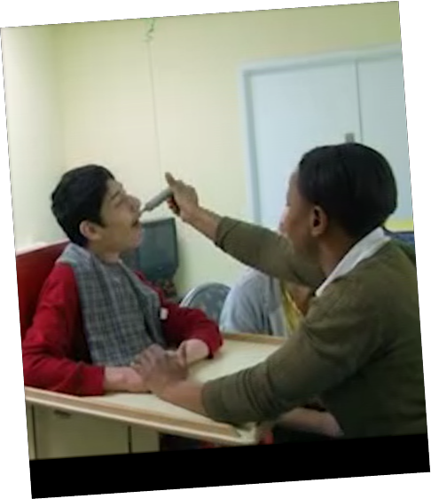
DEVELOPING ‘GOOD’ SUPPORT FOR STUDENT CARERS
Professor Mary Larkin
mary.larkin@open.ac.uk

Slide 2
DEFINING CARERS
A carer is anyone who cares, unpaid, for a friend or family member who due to illness, disability, a mental health problem or an addiction cannot cope without their support
(Carers Trust, 2017)

Slide 3
THE EVER-INCREASING DEMAND FOR CARERS

Slide 4
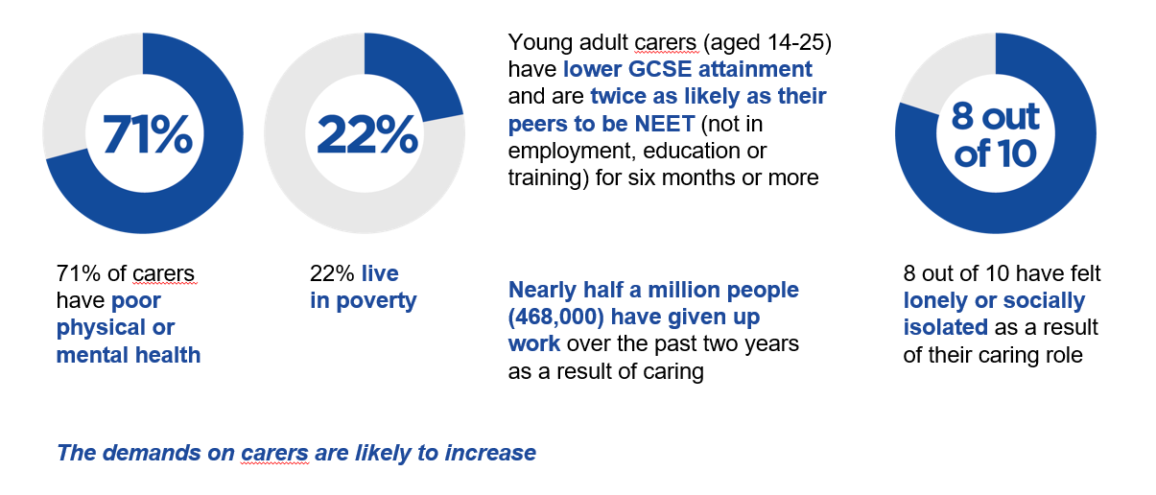
CARERS ARE OFTEN DISADVANTAGED BY CARING

Slide 5
PROJECT RATIONALE
the OU is ideally placed to meet student carers’ needs
currently 6,000 OU students have declared caring status and the number of students with caring responsibilities will increase
carers are now one of the priority groups within Higher Education
there have been a number of significant developments in carer support at OU
little research about supporting student carers (generally and within the OU) and strategies to address their needs remain underdeveloped
members of the OU’s Carer research group have carried out a two-phase project in order to better understand and support the growing numbers of OU students who are carers
comprised 2 studies: (1) involved student carers based in the School of Health, Wellbeing and Social care (HWSC) only (2) included students from across the university in order to further develop understanding of how caring responsibilities affect student study, persistence and retention

Slide 6
METHODOLOGY
the project comprised 2 studies
both studies were a qualitative and adopted the same methods
the first study ran from January - September 2019, 20 telephone interviews with HWSC students carers across modules, levels and programmes, conducted by a PhD student, interviews were professionally transcribed and thematically analysed
second study ran from October 2020 – end of June 2021, 40 telephone interviews students with caring responsibilities from all the OU’s Faculties, conducted by an external consultant, interviews were professionally transcribed and thematically analysed
the gender imbalance across the 2 studies was comparable and reflected the fact that caring is predominantly a female activity - 16 (80%) females and 4 (20%) males for the first study and 33 (82.5%) females and only 7 males (17.5%) for the second study

Slide 7
THEMES
Studying and caring: motivations and meanings
Studying with OU
Caring and studying
Managing studying and caring
OU carer support
Suggestions for improving OU carer support

Slide 8

THEME 1: STUDYING AND CARING: MOTIVATIONS AND MEANINGS
Interest and enjoyment
Developing ‘my other side’
Fulfilling an ambition
Employment-related motivations

Slide 9
Interest and enjoyment
several participants were studying in order to pursue a personal passion or interest
very much enjoying the creative, intellectual, problem -solving and unpredictable dimensions of academic study.
as studying was an inherently enjoyable activity meant that for some it offered an opportunity to transcend their circumstances:
It gives me something to focus on
studying was also intertwined with life enhancing social engagement
wanted good marks and tried to do their best:
I’m concentrating on getting the best possible marks I can with my degree and then take it from there really

Slide 10
Developing ‘my other side’
some, saw it as a kind of personal experiment - as a way of ‘proving’ to themselves that there ‘capable of doing it’
others saw it as a vehicle for self-development:
  more aware of my capabilities where I’ve kind of gone through life thinking I was a bit mediocre. Not saying that study makes you a better person by any means, but it’s just given me like an inner strength
several participants had a vocational educational background and wanted to develop their academic side

Slide 11
Fulfilling an ambition
a long-standing ambition to study that could not be pursued because of their caring responsibilities
to restore a plan that had been paused:
  I already had a plan for the future in place obviously that had been disrupted, I wanted to do something different and it just wasn’t feasible for me to go into a brick uni on a day to day basis. So the plan for the course was what can I do and what can I do around my family and what can I do around my current situation with my son
  ‘to do something for me’
turned the restrictions of caring into an opportunity to pursue a neglected ambition study e.g. a woman who had swapped a demanding role running her own business for part time work……
up until 2010 I had my own business. Then sold that because of my caring responsibilities, and so my aim was to do something that I should have done when I was at school and didn’t pursue which was science.

Slide 12
Employment-related motivations
preparing to move into paid work: most wanted to a role that was different from their previous work and several were intending to build on or draw from their caring experience
‘My daughter, who’s now 14, had been diagnosed with anxiety and depression, so I just wanted to help children if I can, so I thought maybe being a counsellor could maybe help not only my daughter and other children like her, but maybe going further into other people as well, so I’m looking to maybe go into counselling at the end of it eventually’
improving current work practice or employability: several were developing skills for their current job. Some were strengthening their employability and hoping to stave off redundancy in recognition of the instability of the economy during a pandemic
changing jobs or career: in some cases, the shift in career was out of dissatisfaction with their current employment circumstances. Others, prompted by semi-retirement or redundancy, were thinking in more transformative terms

Slide 13

THEME 2: STUDYING WITH OU
the OU had been recommended to the vast majority by friends, colleagues and current/ex OU students
the OU had been unanimously chosen in preference to other universities because it (a) affords the flexibility that student carers require in order to balance care and study (b) its reputation for helping carers access and succeed in education (c) its open access policy
saw the OU as pivotal in meeting their personal expectations for growth and development
where students were more negative it was about the loneliness of OU study, learning materials that failed to feed into their preferred learning preferences, and the timing of assignments (e.g.in school holidays)

Slide 14
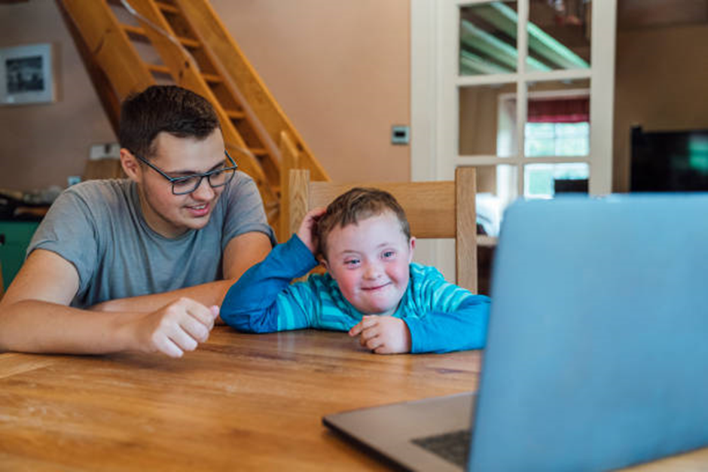
THEME 3: CARING AND STUDYING
many positive aspects of caring: acquisition of specific skills and qualities, some of which were useful in their workplace roles; rewarding and emotionally satisfying to make the person for whom they care ‘happy and contented’; becoming focused, organized
pressures of caring and the stress that causes them (particularly during lockdown): intense and challenging levels of caring; unpredictable nature of care; time consuming; financial pressures; everyday life often described as ‘juggling’. ‘a balancing act’
primacy of caring in their lives
hard to plan/find uninterrupted time to study

Slide 15

THEME 4: MANAGING STUDYING AND CARING
learning to ‘go with the flow’ and replanning when study time dissipates
working around their caring responsibilities
careful time management
making use of short period of time available
being ‘a bit ahead of the game’
strategically planning and taking time off work to manage their study
setting clear boundaries wherever possible and managing other people’s (mostly those who were being cared for) expectations
- immediate and wider family, friends and community support
However, participants still experienced guilt when taking time away from caring and a number of participants voiced concern about their ability to deliver against module deadlines.

Slide 16
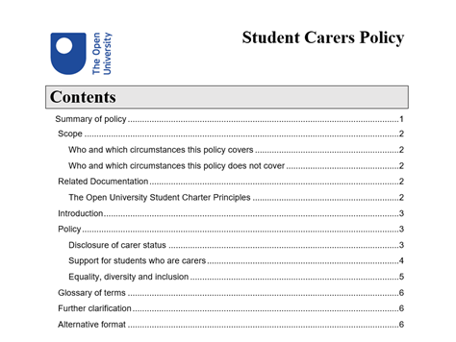
THEME 5: OU CARER SUPPORT
the support for learning provided by SSTs and ALs was excellent and always there if needed - ‘very supported and very privileged’ and ‘I’ve yet to meet a tutor that hasn’t been nice to me.
not all students had disclosed their caring responsibilities, mainly because they had not seen themselves as carers
importance of the AL role: the best tutors had been proactive in their contact with students, clarifying their role and accessibility and establishing clear expectations for students, telling them about support for carers, answering emails promptly, responded appropriately and supported them when they experienced challenges

Slide 17

THEME 6: SUGGESTIONS FOR IMPROVING OU CARER SUPPORT
better signposting of any carer-related information and support
a dedicated support phone line for student carers that they could use to contact a named member of staff (preferable someone with experience of caring) who would have an understanding of their role as a student and as a carer
Carer peer support groups
Carers’ Website: which would signpost them to support services both inside and outside the university – local support groups, agencies and broader information for carers
an official OU Facebook page and/ WhatsApp group
return to some elements of face-to-face tuition to increase the visibility of their peer community
financial support
no submission dates in school holidays

Slide 18
CONTINUING TO SUPPORT STUDENT CARERS
Going forward:
1. Build on our reputation in order to be able to help more carers to fulfil their ambitions
2. Use the findings to further improve on the support we do provide
align support and advice we give carers to ‘where they are at’
increase student carers’ awareness of the support available
encourage more carers to declare their caring status
explore and discuss suggestions they make for improving that support e.g. dedicated helpline, more financial support
The findings showed:
the importance of the OU support students had received in helping them to successfully cope with studying
how well the OU suits carers’ learning needs and that we do support carers well
OU’s reputation as the university of choice for carers

