Slide 1
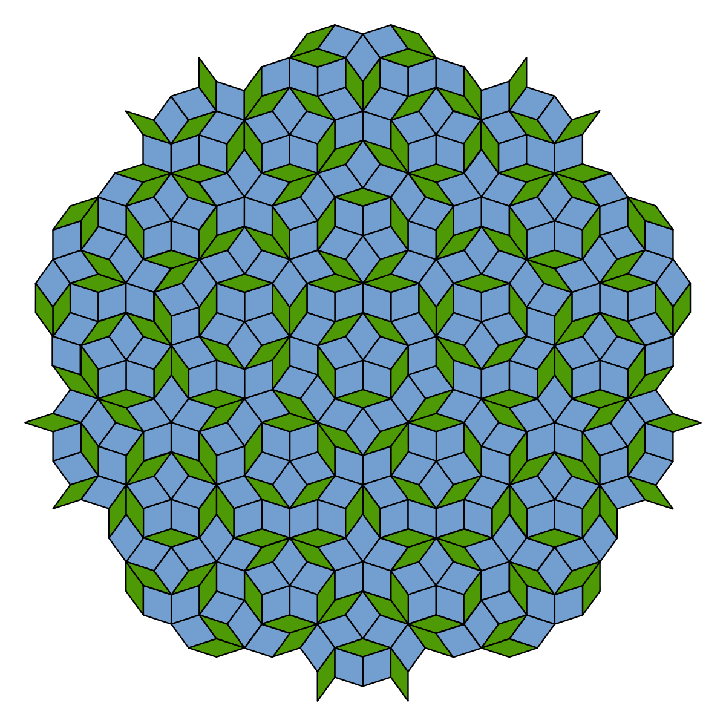
Aperiodic tilings exhibition
Penpuzzle challenge

Slide 2
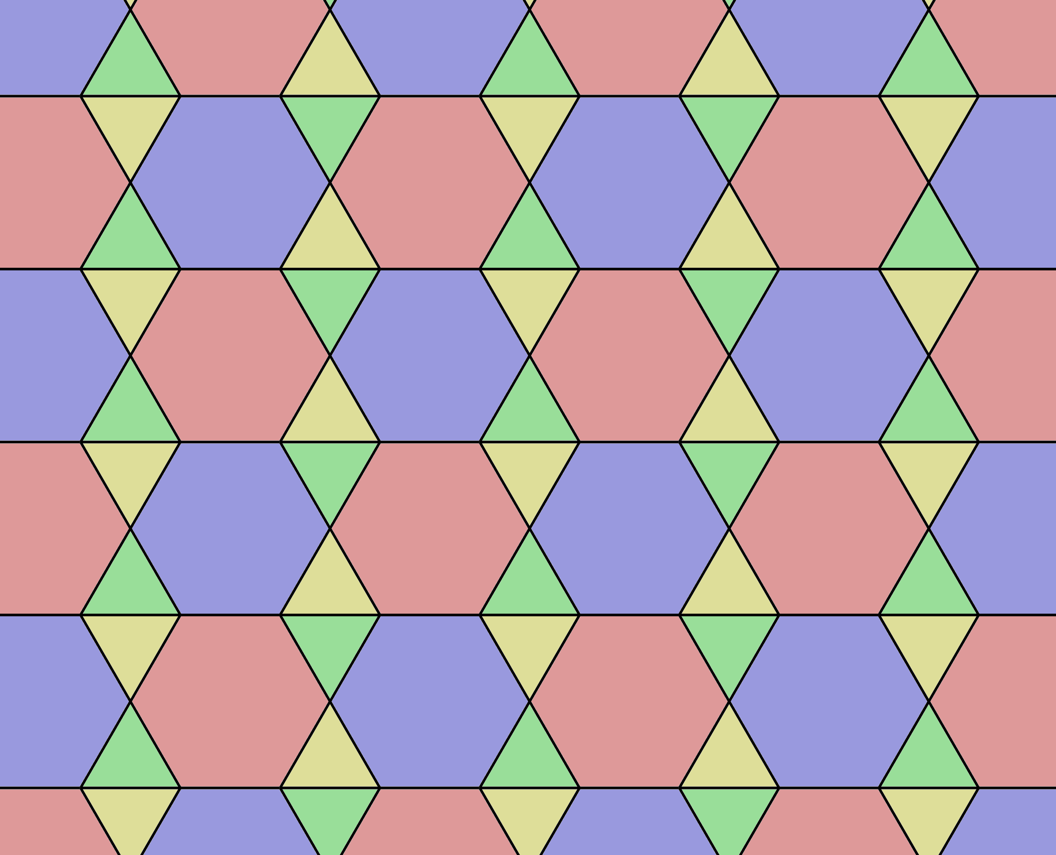
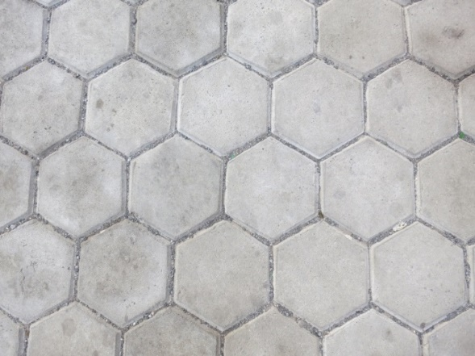
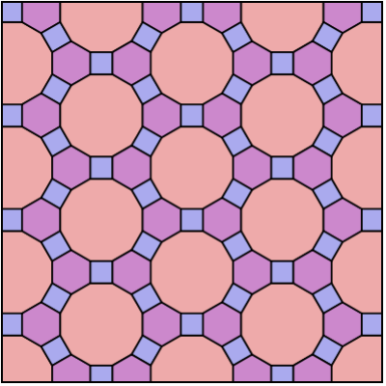
Periodic tilings
Semi-regular tessellations
Demi-regular tessellations
Regular tessellations

Slide 3
Penrose tiling

Slide 4
Penrose tiling

Slide 5
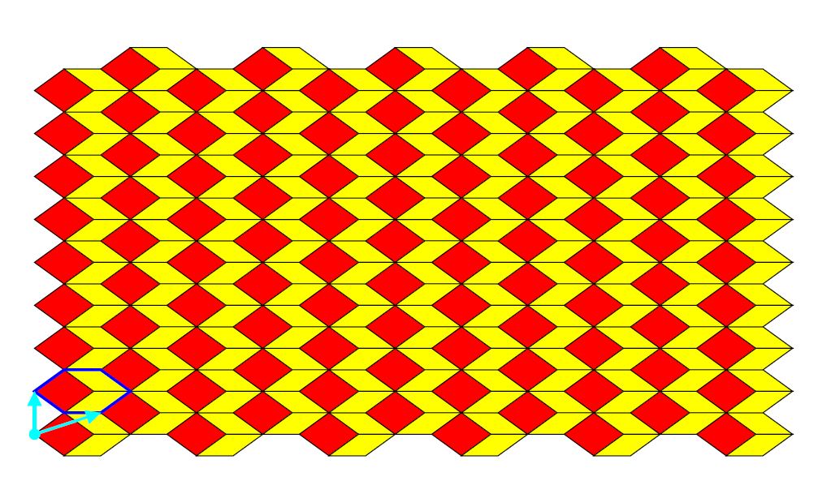
Penrose tiling

Slide 6
Penrose Tiling

Slide 7
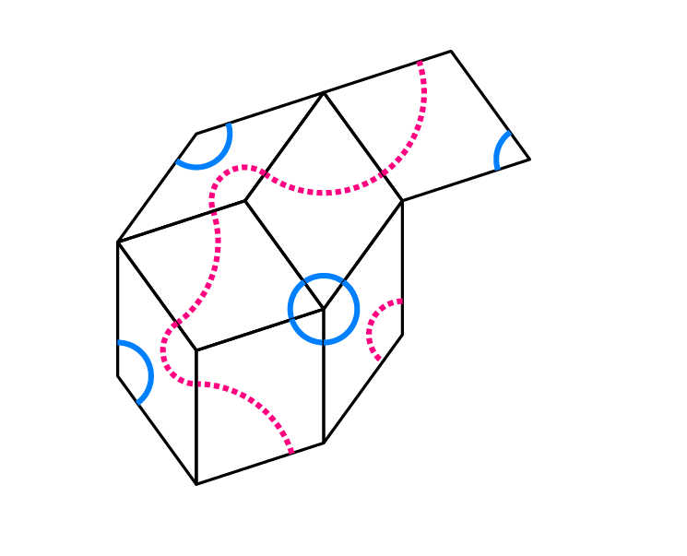
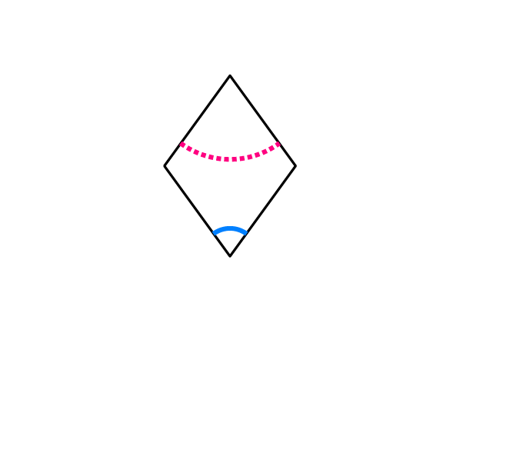
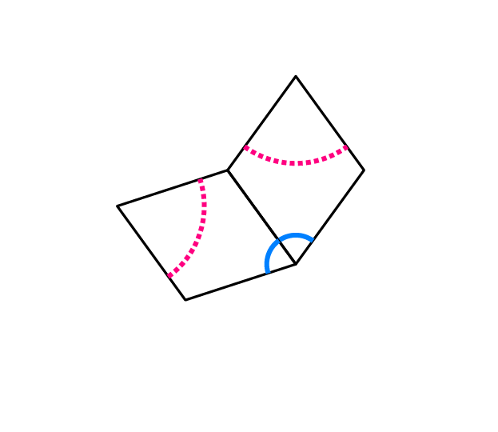
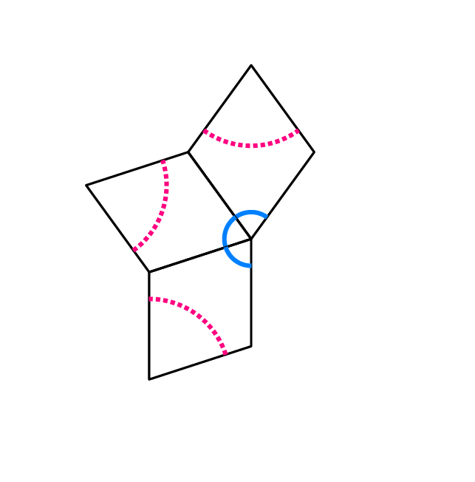
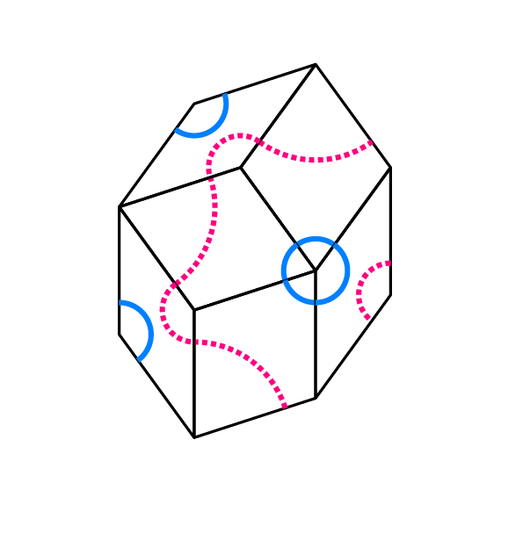
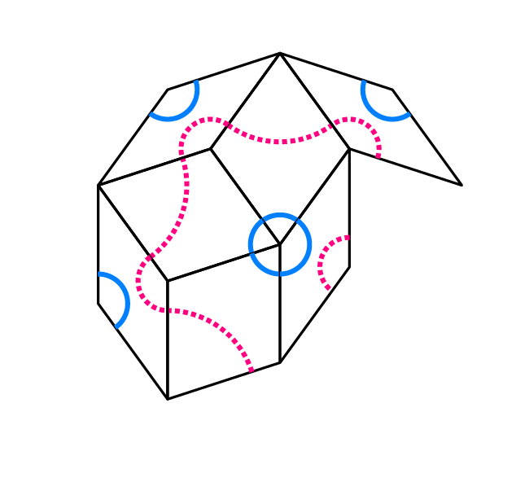
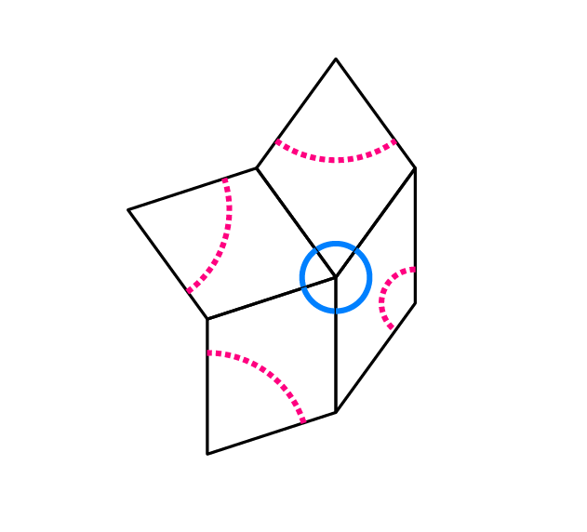
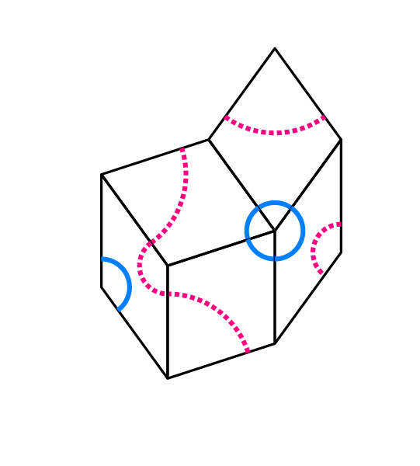
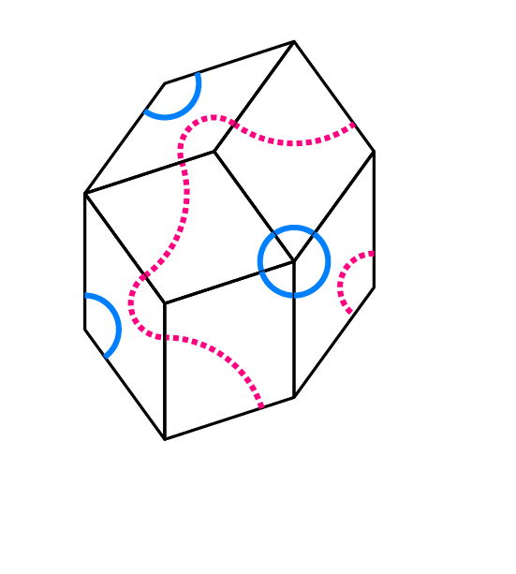

Slide 10
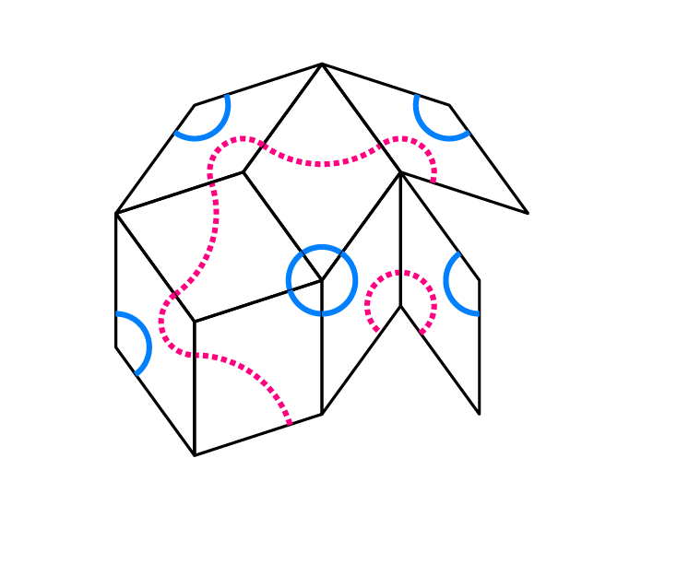

Slide 11
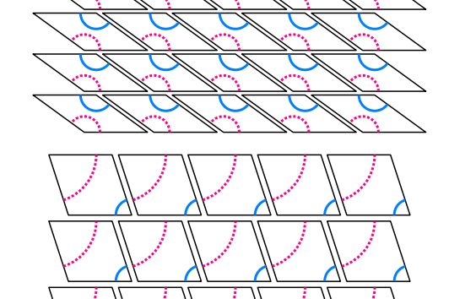
Activity – Penpuzzle
In pairs or threes, work together to solve the Penpuzzle.
First cut out all the smaller and larger rhombuses
Option 1:
Create your own tiling using the tiles
following the line matching rules
leaving no gaps and no overlapping
Question:
Is there more than one solution?

Slide 12
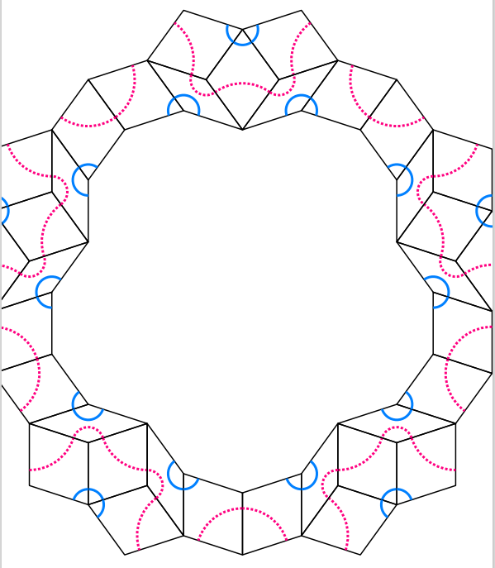
Activity – Penpuzzle
Option 2
Fit the puzzle pieces into the template
following the line matching rules
leaving no gaps and no overlapping

Slide 13
Activity – Penpuzzle
STOP!
Solutions on the next slides.

Slide 14
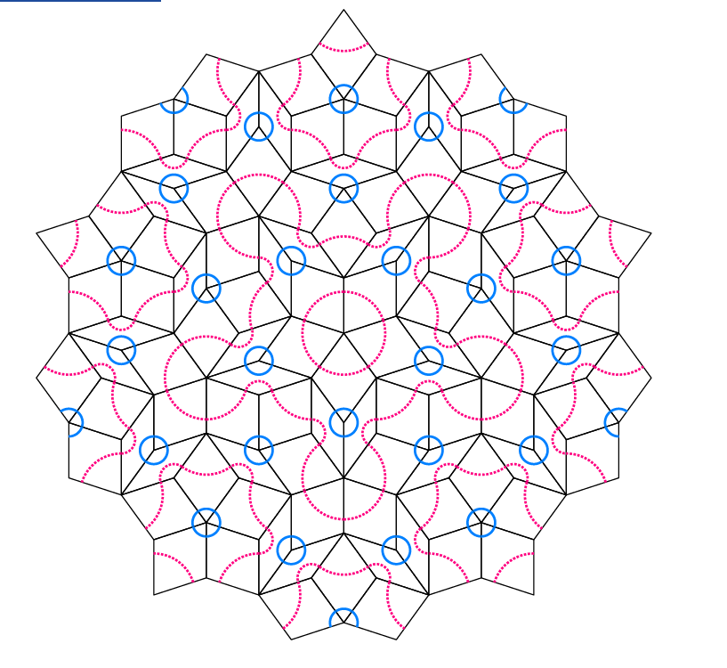
Penpuzzle – a solution

Slide 15
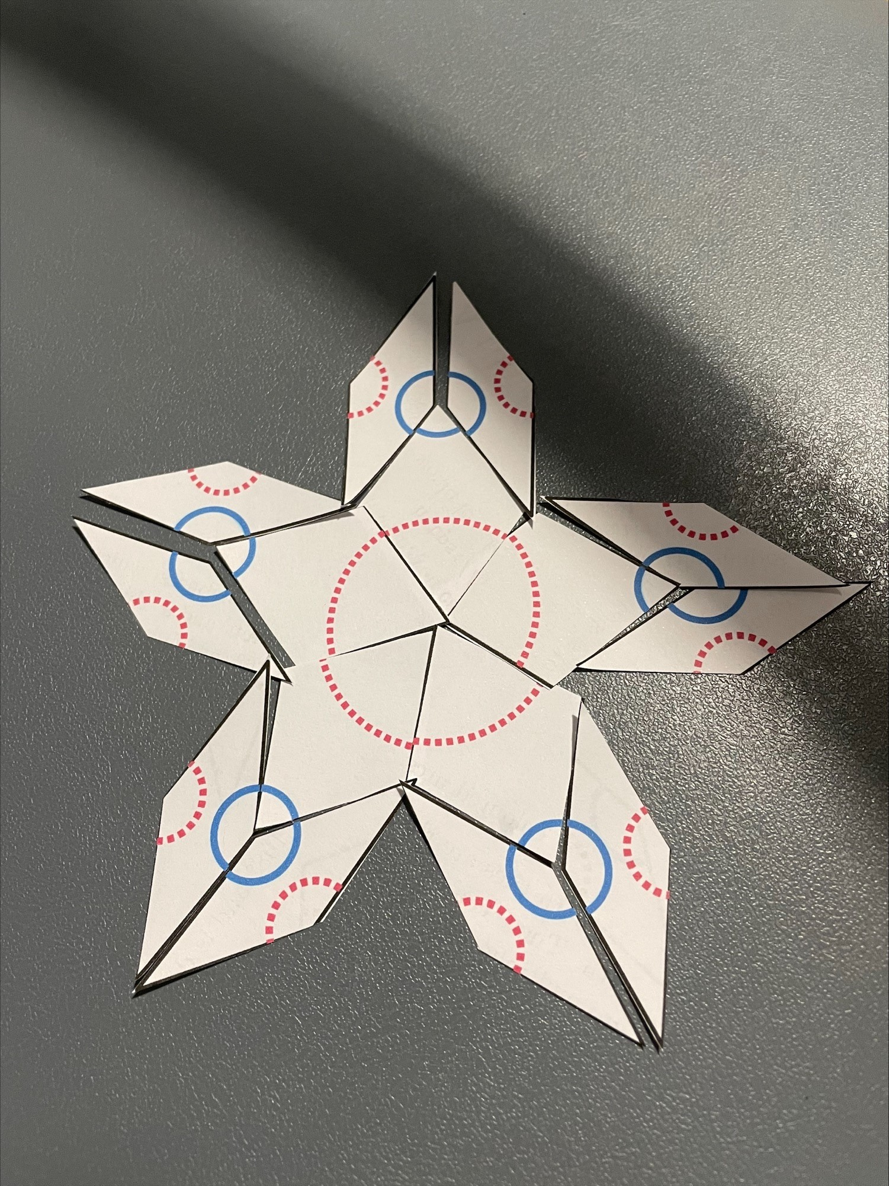
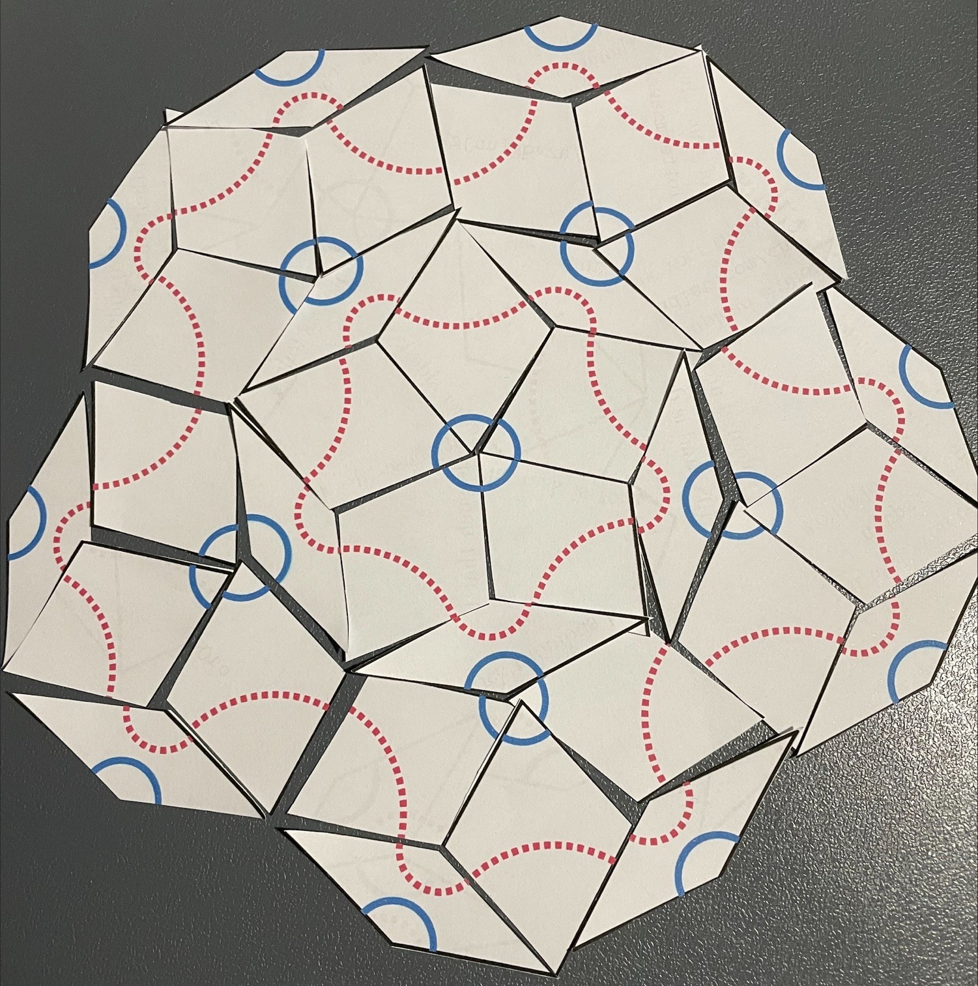
Penpuzzle – student work

Slide 16
Now watch part 2:
Aperiodic tiling exhibition
Collaborative art activity

