Slide 1
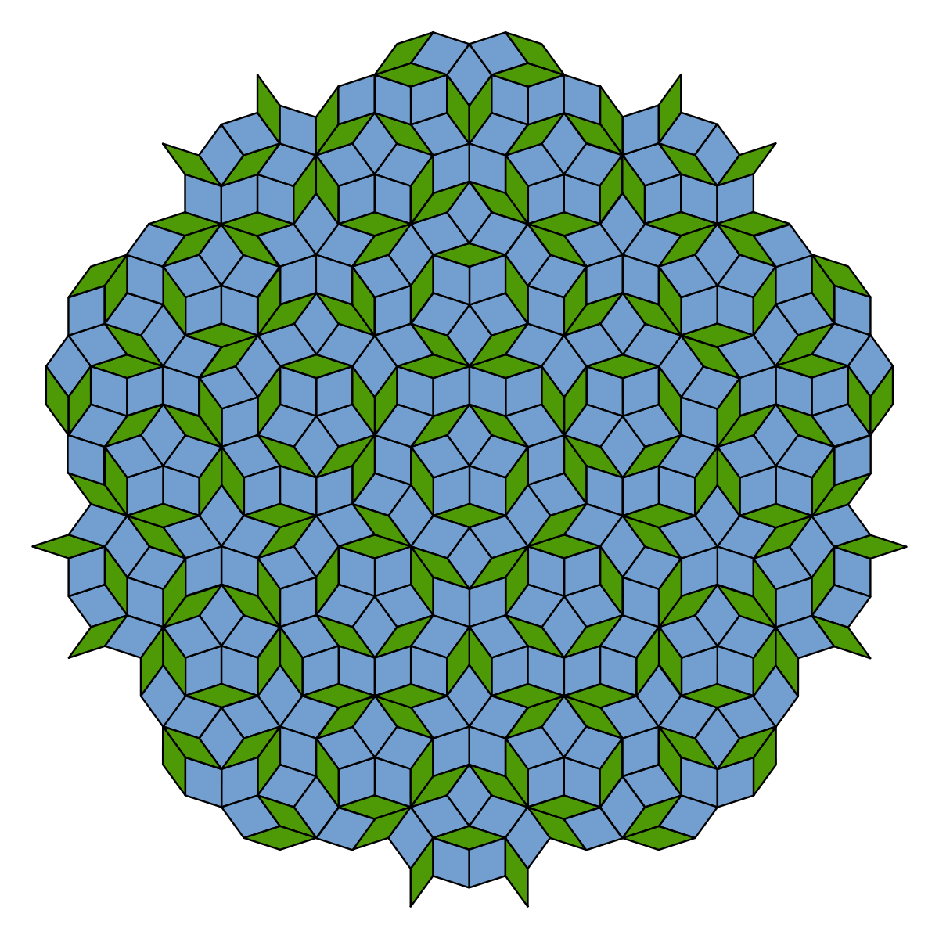
Aperiodic tilings exhibition
Collaborative art
activity

Slide 2
Penrose tiling

Slide 3
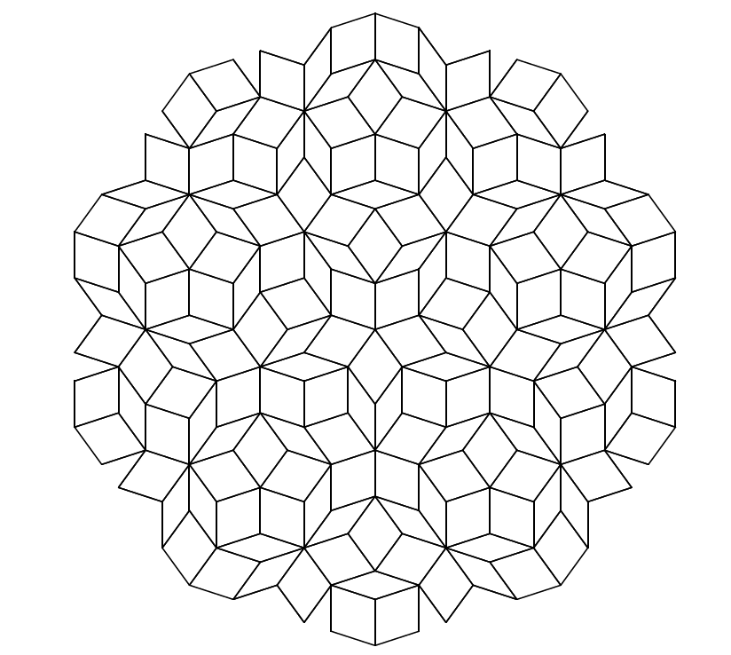
Penrose tiling

Slide 4
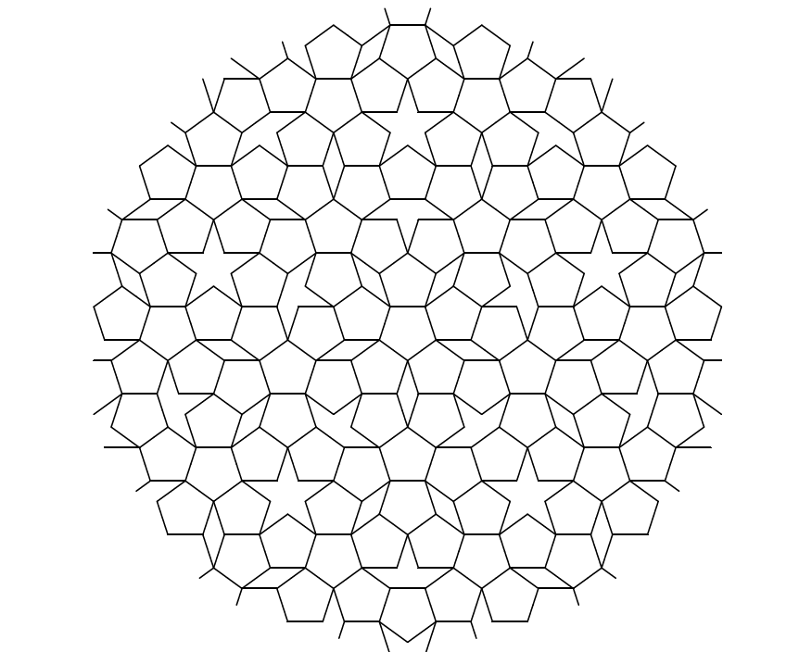
Penrose tiling

Slide 5
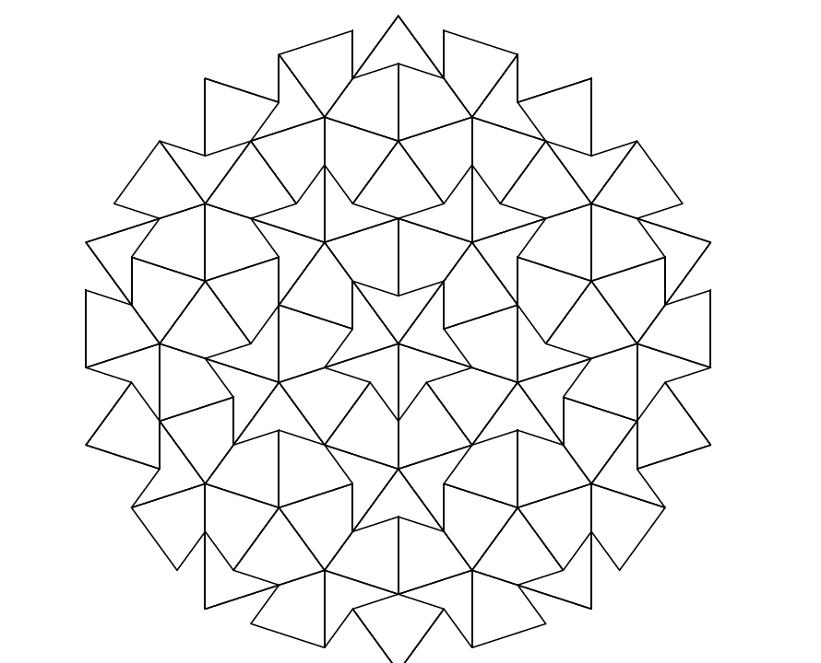
Penrose tiling

Slide 6
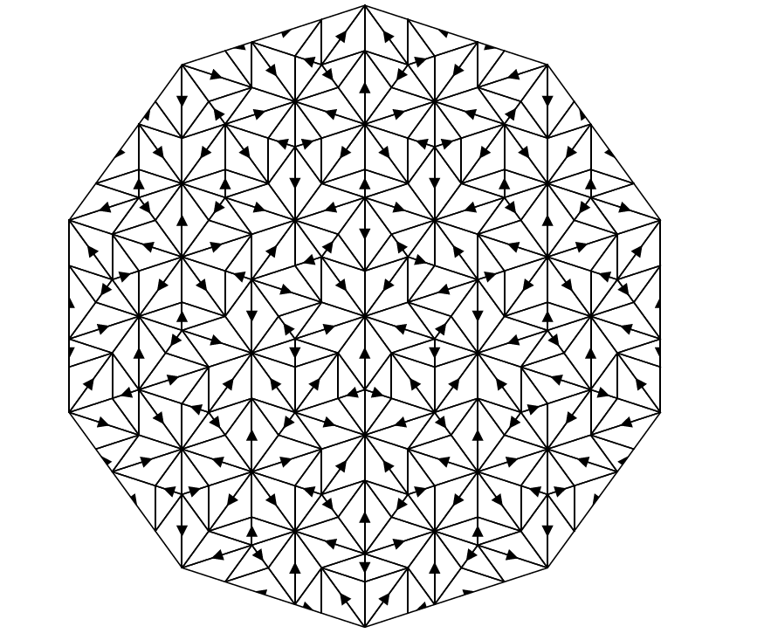
Penrose tiling

Slide 7
Col
Activity – Collaborative art
In pairs or threes, work together to create your own Penrose tiling
Option 1:
- First cut out the printed (black and white) tiles)
- Decide how you will arrange your tiles and decorate them
(you can decorate the tiles first, then tile them, or tile them and then decorate them – each will have very different results!)
- Glue your tiling onto coloured sugar paper (make sure you do this before you pack away so you don’t lose your tiling!)
Remember to:
follow the line matching rules
leave no gaps and no tiles overlapping

Slide 8
Col
Activity – Collaborative art
Option 2:
Decorate the completed Penrose tiling
Think carefully about your colour choices as this will change which parts of the tiling are highlighted.
*There are some examples on the next few slides.

Slide 9
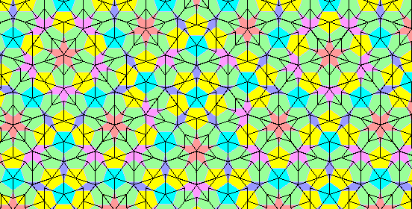
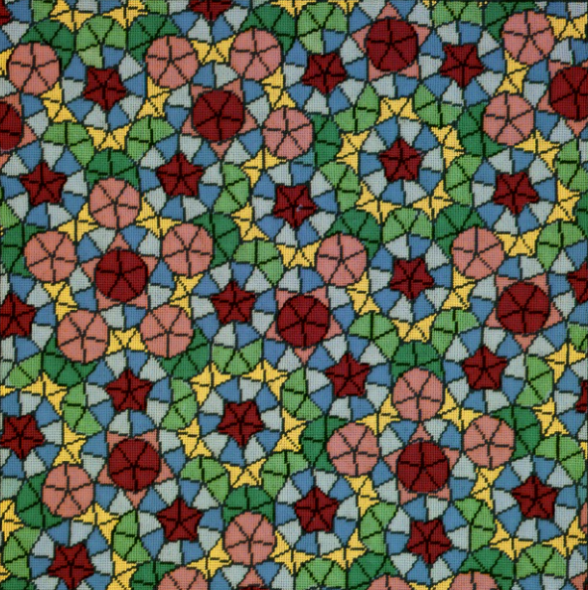
Penrose art activity – colouring examples

Slide 10
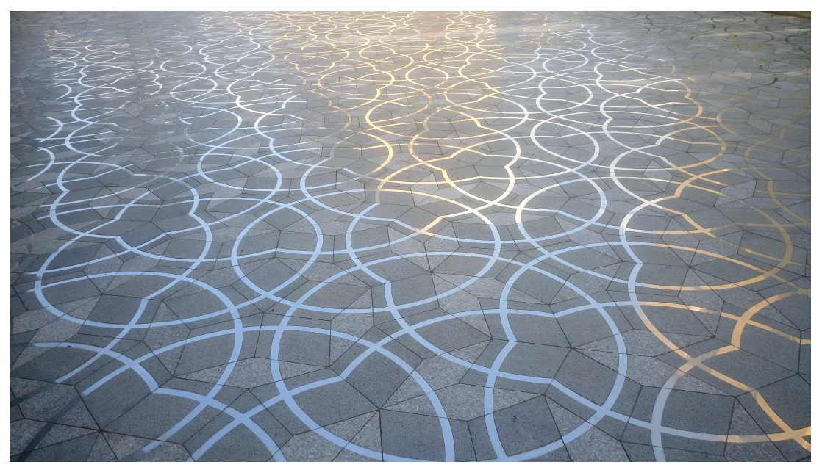
Penrose tiling, Art and Architecture
Oxford Mathematics Institute

Slide 11
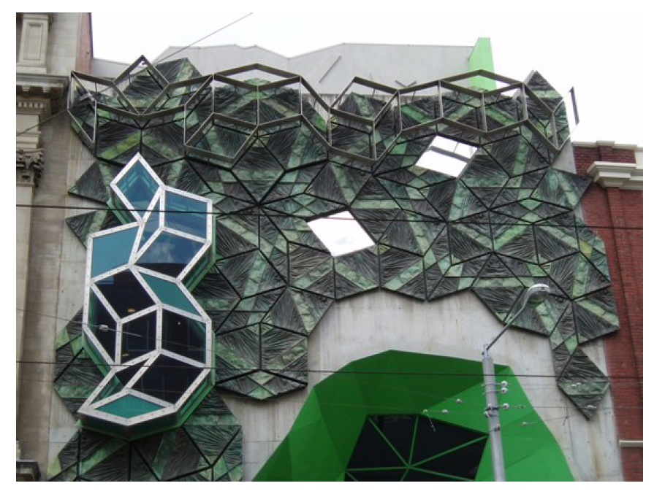
Penrose tiling, Art and Architecture
Melbourne

Slide 12
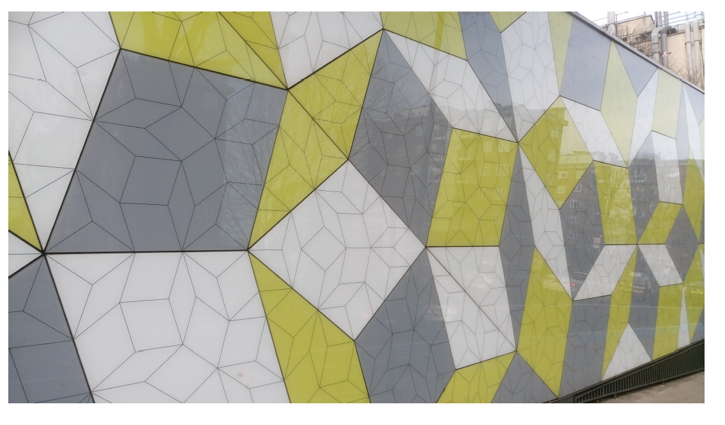
Penrose tiling, Art and Architecture
Queen Mary University

Slide 13
Penrose tiling, Art and Architecture
Penrose tiling, Art and Architecture
Designed by Professor Uwe Grimm

Slide 14
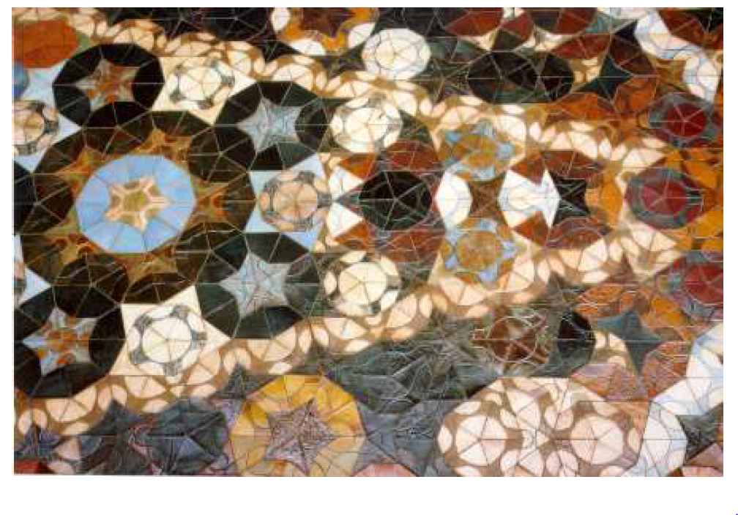
Penrose tiling, Art and Architecture
Museum in Mexico

